Slide 1
Ancient Tragedy, Greece & Rome
Andrew Scholtz, Instructor
LT 507 ascholtz@Binghamton.edu

Slide 2
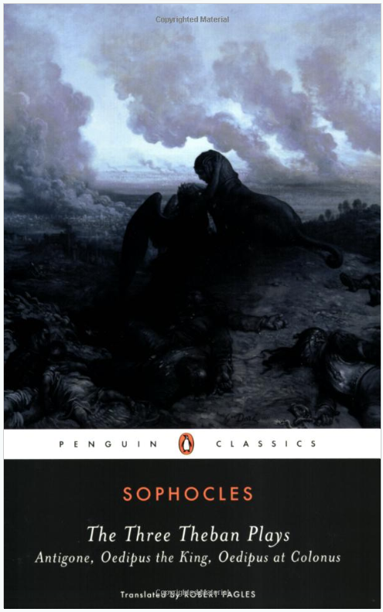
For Thursday, 18-Jan: Read Sophocles Antigone pt 1 (Penguin pp. 59-107). This time no journal entry

Slide 3
Why?
Iphigenia at Aulis

Slide 4
“If asked why, why do you want to kill her, / what, pray, will your answer be?”
(Clytemnestra to Agamemnon)
https://youtu.be/5jD-IuhwLmk?si=A0AnAS4zvBeOdMqF&t=4895
Notes:
This is Michael Cacoyannis’ film version of Euripides’ ancient Athenian play, Iphigenia at Aulis. The Greek army is waiting to set sail for Troy to conquer it, but they’ve been told the gods won’t let them depart until their leader, Agamemnon, king of Argos, sacrifices his daughter. The girl’s mother and baby brother look on as the girl pleads with her father.
(after showing) What I want you to do is to jot down a few notes as to why. why does the girl have to die? then we’ll discuss.
what does her dying have to do with us?

Slide 5
Another Question
What is Tragedy?

Slide 6
Tragedy is (Oxford English Dictionary)
“A play or other literary work of a serious or sorrowful character, with a fatal or disastrous conclusion”
“An event, series of events, or situation causing great suffering, destruction, or distress, and typically involving death”
Notes:
Now, when we call an event a “tragedy,” we inevitably mean something like “disastrous,” “very sad or unfortunate” or the like. But the truth is that the term does not very often, at least where it specifically has to do with events, address the matter of human agency. so, for instance, Hurricanes Sandy or Katrina, while clearly tragedies, can’t easily be understood as directly caused by human failures, by sin, or the like.
Yet curiously, a lot of literary and other, entertainment-related tragedy – tragedy as a genre, and I’m thinking not just of ancient Greek or Roman tragedy, but later manifestations, too – does very often have to do with the bad karma, I’ll call it, of individuals, families, nations.
Put differently, if this were Athens in the 400s bce, then a play about a Hurricane-Sandy-like event would seek to find meaning in the misfortune.
But do real-life misfortunes have meaning the way they presumably do in drama and literature? Do literature and life really link up in that way?
And if they don’t, what’s the point? Do we enjoy tragic drama to have a good cry? Because we enjoy watching people suffer?

Slide 7
What do you think Tragedy is?
Breakout groups of 4/5
Choose scribe
Discuss five minutes
Scribes report back
Put questions to other groups

Slide 8
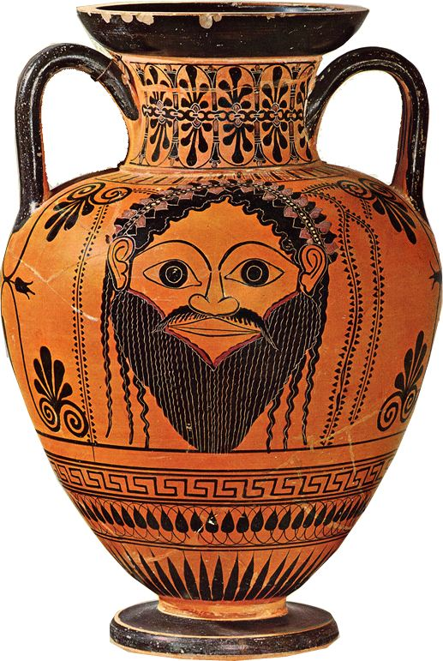
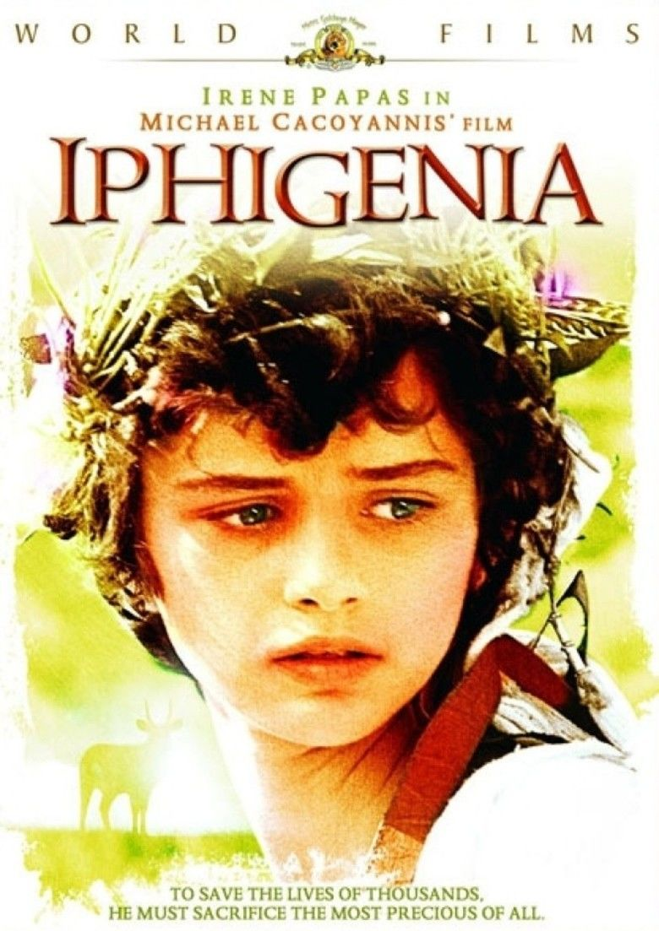
Dionysian Masks
Notes:
ultimately, we are exploring literature as itself a kind of performance, a kind of MASK
so i don’t think we’re going to be trying to “unmask” drama as much as explore its power to reveal, to clarify, and to distort.

Slide 9
Project: Theories of Tragedy
Yours, others’
Gender
Performance
Notes:
course project: theories of tragedy
What is tragedy? Is there a connection between tragic drama and the tragedies of life? Is tragedy always sad?
Our exploration will at times be broad and open ended. But we'll also be focusing on two, very specific issues, both with relevance to today's world:
Other people's thoughts — Honig's, Williams', etc. Do they connect with us?
Gender — how it is dramatized in the plays we'll read and how that might connect with us
Performance — what we can learn about the plays by thinking of ways to make them more alive for today's audiences. (This is not a theater class, nor will I assign performances of scenes. What we'll do instead is form discussion groups on the day of class to share thoughts about performance and to demonstrate with reading of lines)
We'll work on the above in our journal entries and in our in-class discussion. It will figure into essay questions on exams.

Slide 10
Time and Place
The Ancient Mediterranean Context

Slide 11
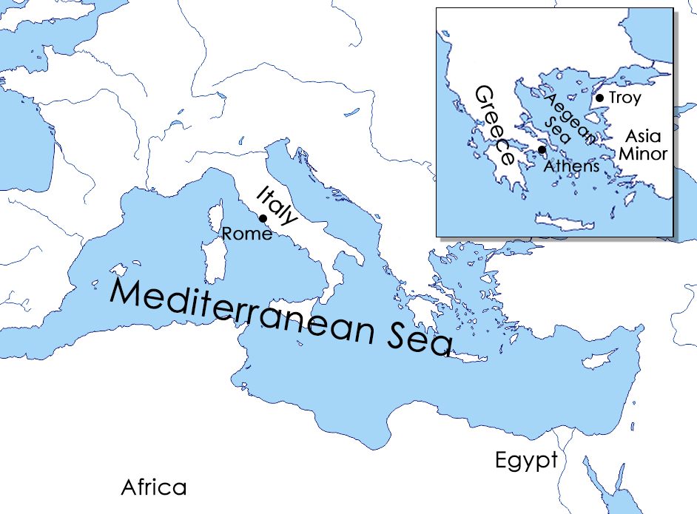
Notes:
Where? (Greek & Roman Worlds)

Slide 12
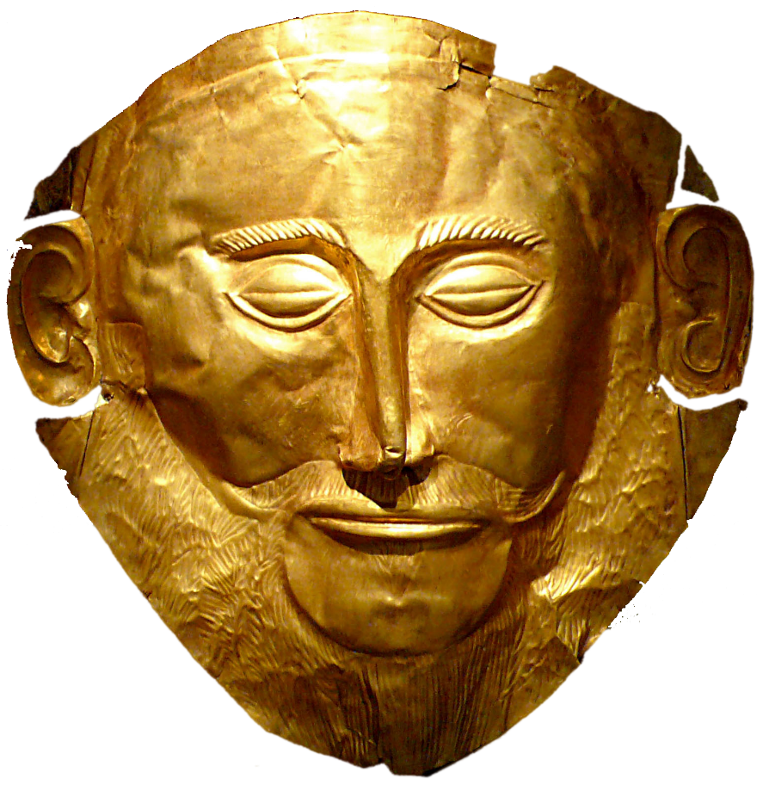
When
Greek Bronze/“Heroic” Age
  pre-1000 BCE
Greek Classical period
  471-323 BCE
Roman Principate (earlier empire)
  Nero & Seneca, 50s-60s CE

Slide 13
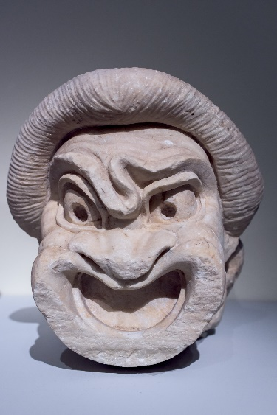
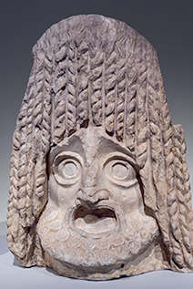
Who, What
Ancient Tragedy
  Aeschylus
    525-455 BCE
  Sophocles
    ca. 496-ca. 406
  Euripides
    484?-406 BCE
  Seneca
    ca. 4 BCE-65 CE
Ancient Comedy
  Aristophanes
    448?–385?
Modern drama
  Anouilh
    1910-1987 CE

