Slide 1
The Good, the Bad, and the — What?
Sophocles’ Antigone 1
Ancient Tragedy, Greece and Rome
Randy Scholtz ascholtz@Binghamton.edu

Slide 2
Agenda
Preliminary Considerations…
  Why?
Antigone: Play Intro
Play facts, Play Themes
Polla ta deina Chorus (pp. 76–77)
  “Numberless wonders, terrible wonders”

Slide 3
Preliminary Considerations…
Why?
Notes:
why, in soph’s ant, does the title character have to die? yes, because of creon’s decree. but is that avoidable?
fate? a family’s bad karma?
... once
the gods have rocked a house to its foundations
the ruin will never cease, cresting on and on
from one generation on throughout the race—
like a great mounting tide
driven on by savage northern gales.... (2nd stasimon p. 91)
does creon suffer from bad judgment? (haemon) antigone, from obstinate pride? (Ismene)
is compromise possible, antigone-creon?
what went wrong?

Slide 4
Antigone: Play Intro
Play facts, Play Themes
Notes:
More on that soon. Right now,

Slide 5
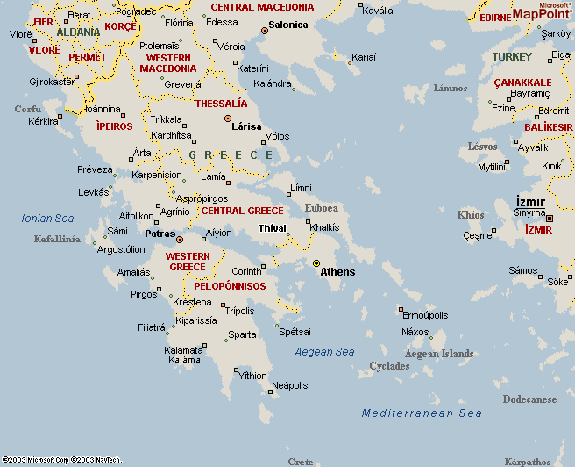
Play Facts
Sophocles
“Theban Cycle”
ca. 496 – ca. 406 BCE
First victory 468
Compositional order
  Antigone (ca. 441)
  Oedipus the King (ca. 429)
  Oedipus at Colonus (ca. 406)
Story order
  Oedipus the King
  Oedipus at Colonus
  Antigone
Thebes
Notes:
Sophocles
ca. 496-ca. 406 BCE
first victory 468
“Theban Plays”
Dates
Antigone
ca. 441
Oedipus the King
ca. 429
Oedipus at Colonus
ca. 406
(“Theban Plays,” cont.)
Story order
Oedipus the King
Oedipus at Colonus
Antigone

Slide 6
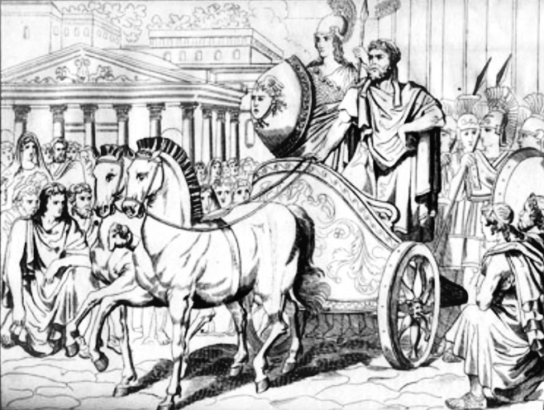
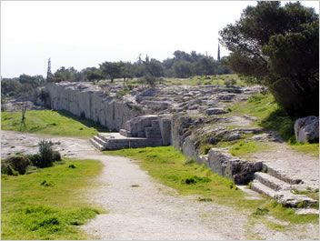
Political Context
Athens, 560–510 BCE
  Tyranny (Peisistratus & sons)
Athens, 441 BCE
  Democracy
    Democracy = “people power”
    Oligarchy = rule by the few
Peisistratus
Ancient Athenian Assembly

Slide 7
Myth Background: House of Thebes
Labdacus
Menoeceus
Laius
Jocasta
Creon
Eurydice
Oedipus
Jocasta
Polynices
Eteocles
Antigone
Ismene
Haemon
Megareus
SEVEN AGAINST THEBES
“… you throw him back — / the enemy out of Argos,” Antigone parodos
Notes:
something a bit off here? (oed-Jocasta-laius)
further family issues? (polynices v Eteocles)
DISTURBED GENEALOGY, HOUSE OUT OF BALANCE
7 Against Thebes (ANT PARODOS – “Glory – great beam of the sun, brightest of all / that ever rose on the seven gates of Thebes, … you throw him back - / the enemy out of argos.” victory song.)
deposed king Polynices + 6 allies versus …
brother Eteocles
important point - polynices treachery truly awful: risked terrible destruction for his city had he won, terrible losses for it even if he hadn’t
his victory probably would have involved serious bloodletting once the victorious army entered the gates
a combination on violent conquest and civil strife, the two worst nightmares for an ancient greek city
so we can sympathize with creon’s measures: to punish the wicked and make an object lesson of them, to stabilize the state. yet to leave the body unburied represents not just an extreme and unusual punishment for a traitor; it subjects the land to ritual pollution
but we can also sympathize with Antigone: the duties of family to the dead, the impiety of leaving the dead unburied, unable, therefore, to complete the passage to the other world

Slide 8
Play Analysis
Prologue (59 ff.)
  Antigone, Ismene (burial)
Parodos (choral entry ode, 65 f.)
  Victory song
1st episode
  Creon, Sentry (Polynices’ burial)
1st stasimon (choral ode, 76 f.)
  “Numberless wonders, terrible wonders”
2nd episode
  Sentry, Creon; Creon, Antigone, Ismene (Creon-Antigone agōn)
2nd stasimon (91 f.)
  “Blest they who escape misfortune”
3rd episode (92 ff.)
  Creon, Haemon (agōn)
3rd stasimon (101)
  madness of erōs
4th episode (101 ff.)
  Choral dialogue (kommos) w/ Antigone (bride of death); Antigone, Creon
4th stasimon (108 f.)
  myth parallels to Antigone
5th episode (110 ff.)
  Tiresias, Creon (prophecy, warning, agōn)
Hyporchema (choral ode, 118 f.)
  Dionysus save the day!
Exodos (119 ff.)
  Messenger, Eurydice; Choral dialogue (kommos) w/ Creon
numbers refer to Penguin pages
Notes:
parodos
stasimon
koruphaios

Slide 9
Cultural/Thematic Oppositions
Antigone
female
private
inside
(family, household)
lamentation
divine law
Creon
male
public
outside
(politics, city)
retribution
human law

Slide 10
Cultural/Thematic Oppositions
Antigone
“Nor did I think your edict had such force / that you, a mere mortal, could override the gods.... These laws—I was not about to break them, / not out of fear of some man’s wounded pride....”
Creon
“And whoever places a friend / above the good of his own country, he is nothing.... Whoever prizes his loyalty to the state — / I’ll prize that man in death as well as in life."

Slide 11
Cultural/Thematic Oppositions
Antigone
female
private
inside
(family, household)
lamentation
divine law
Creon
male
public
outside
(politics, city)
retribution
human law
CREON
“I am not the man, not now: she is the man / if this victory goes to her and she goes free” (p. 83)
Notes:
think about it, what is at stake for each of these antagonists?
for antigone, fivine law and loyalty to family:
Give me glory! What greater glory could I win
than to give my own brother decent burial?
These citizens here would all agree, (84)
for creon, his manhood = power. maybe even patriarchy itself
CREON: [To the guards] Stop wasting time. Take them in.
From now on they’ll act like women.
creon: “Wasn’t Eteocles a brother too—cut down, facing him? (p. 84)
is there a way out? can “tragedy” be avoided?

Slide 12
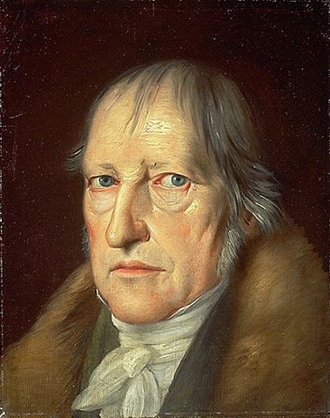
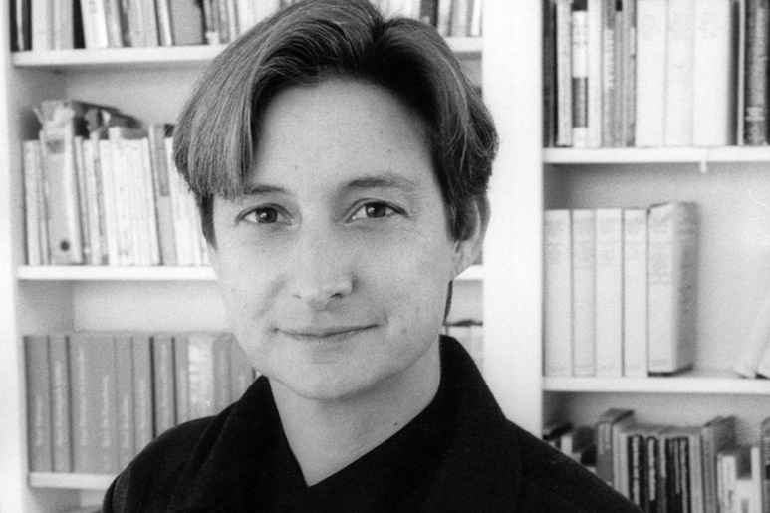
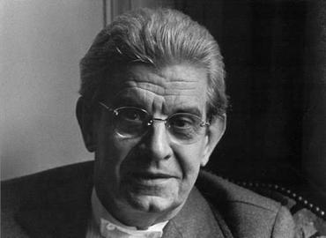
Modern Interpretations
G.W.F. Hegel (1770–1831),
thesis, antithesis, synthesis
Judith Butler (b. 1956),
acceptance of the unconventional
Jacques Lacan (1901–1981),
Creon as “the word of the father”
Notes:
Butler’s Antigone's Claim seeks to do two things:
To interrogate past interpretations of Sophocles' Antigone — to ask whether, in trying to theorize the defiance Antigone shows in the play, certain thinkers, Hegel (late 18th-early 19th cent.) and Lacan (20th cent.) in particular, do not end up validating the "take" of Creon and the power structures he stands for.
In the case of Hegel, the position of Creon as exponent of public, political law against the private, divine law impelling Antigone to defy Creon
In the case of Lacan, the position of Creon as exponent of the "symbolic order," the "word of the father," that which orders human life as if from the outside, though it is very much internal to human and social existence
and,
To see if Antigone's defiance and "crime," not to mention the incest that runs through it all, can't be understood in more positive terms, which is to say, as pointing toward acceptance, even embrace, of the unconventional.

Slide 13
Project: Theories of Tragedy
Yours, others’
Gender dimension
Performance as lens...
Notes:
course project: theories of tragedy
What is tragedy? Is there a connection between tragic drama and the tragedies of life? Is tragedy always sad?
Our exploration will at times be broad and open ended. But we'll also be focusing on two, very specific issues, both with relevance to today's world:
Other people's thoughts — Honig's, Williams', etc. Do they connect with us?
Gender — how it is dramatized in the plays we'll read and how that might connect with us
Performance — what we can learn about the plays by thinking of ways to make them more alive for today's audiences. (This is not a theater class, nor will I assign performances of scenes. What we'll do instead is form discussion groups on the day of class to share thoughts about performance and to demonstrate with reading of lines)
We'll work on the above in our journal entries and in our in-class discussion. It will figure into essay questions on exams.

Slide 14
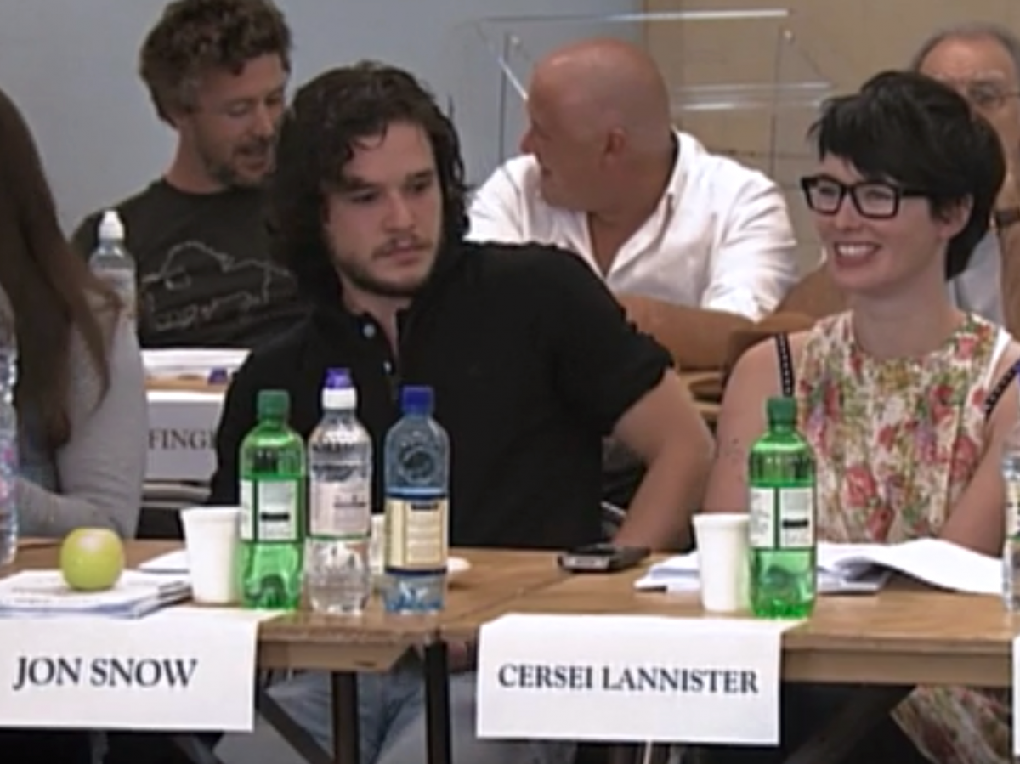
Performance as Lens
Journal posts, performance ideas
Group work, table reads
Textual meaning, dramatic meaning
Notes:
Journal posts, performance ideas
Group work, table reads
Impromptu performance as a window into meaning beyond the text

Slide 15
Polla ta deina Chorus (pp. 76–77)
“Numberless wonders, terrible wonders”
Notes:
ancient Athenian tragedy is noteworthy for, among other things, the prominence of the chorus.
in some surviving tragedies, the chorus plays a key role in the drama; it’s an actor, in effect.
in others, it’s role, dramatically at least, seems to be to comment on the action. in yet other plays, the choruses appear almost parachuted in. is this chorus dispensable? and if not, what does it add dramatically? that’s the topic for the journal entries for next class.
here, i wanted just to introduce you to it, to digure out what the chorus is singing about.....

Slide 16
Play Analysis
Prologue (59 ff.)
  Antigone, Ismene (burial)
Parodos (choral entry ode, 65 f.)
  Victory song
1st episode
  Creon, Sentry (Polynices’ burial)
1st stasimon (choral ode, 76 f.)
  “Numberless wonders, terrible wonders”
2nd episode
  Sentry, Creon; Creon, Antigone, Ismene (Creon-Antigone agōn)
2nd stasimon (91 f.)
  “Blest they who escape misfortune”
3rd episode (92 ff.)
  Creon, Haemon (agōn)
3rd stasimon (101)
  madness of erōs
4th episode (101 ff.)
  Choral dialogue (kommos) w/ Antigone (bride of death); Antigone, Creon
4th stasimon (108 f.)
  myth parallels to Antigone
5th episode (110 ff.)
  Tiresias, Creon (prophecy, warning, agōn)
5th stasimon (choral ode, 118 f.)
  Dionysus save the day!
Exodos (119 ff.)
  Messenger, Eurydice; Choral dialogue (kommos) w/ Creon
numbers refer to Penguin pages

Slide 17
Polla ta deina chorus, pp. 76–77 (slide 1)
Numberless wonders
terrible wonders walk the world but none the match for man—
that great wonder crossing the heaving gray sea,
driven on by the blasts of winter
on through breakers crashing left and right,
holds his steady course
and the oldest of the gods he wears away—

Slide 18
Polla ta deina (slide 2)
the Earth, the immortal, the inexhaustible—
as his plows go back and forth, year in, year out
with the breed of stallions turning up the furrows.
And the blithe, lightheaded race of birds he snares,
the tribes of savage beasts, the life that swarms the depths—

Slide 19
Polla ta deina (slide 3)
with one fling of his nets
woven and coiled tight, he takes them all,
man the skilled, the brilliant!
He conquers all, taming with his techniques
the prey that roams the cliffs and wild lairs,
training the stallion, clamping the yoke across
his shaggy neck, and the tireless mountain bull.

Slide 20
Polla ta deina (slide 4)
And speech and thought, quick as the wind
and the mood and mind for law that rules the city—
all these he has taught himself
and shelter from the arrows of the frost
when there’s rough lodging under the cold clear sky
and the shafts of lashing rain—
ready, resourceful man!

Slide 21
Polla ta deina (slide 5)
Never without resources
never an impasse as he marches on the future—
only Death, from Death alone he will find no rescue
but from desperate plagues he has plotted his escapes.
Man the master, ingenious past all measure
past all dreams, the skills within his grasp—

Slide 22
Polla ta deina (slide 6)
he forges on, now to destruction
now again to greatness. When he weaves in
the laws of the land, and the justice of the god
that binds his oaths together
he and his city rise high—

Slide 23
Polla ta deina (slide 7)
but the city casts out
that man who weds himself to inhumanity
thanks to reckless daring. Never share my hearth
never think my thoughts, whoever does such things.

Slide 24
deina means...
“Terrible things”
“Terrific things”
“Awful things”
“Awesome things”
Humanity as...
  Terrible?
  Terrific?
  ?

