Slide 1
The Masks of Dionysus
Euripides Bacchae 1

Slide 2
Question
Do these two understand each other, and if not, fix it? How?
https://youtu.be/kn4lhHpHWyo?si=pyLCL_0DQkbrxNaa
Notes:
should that be fixed?

Slide 3
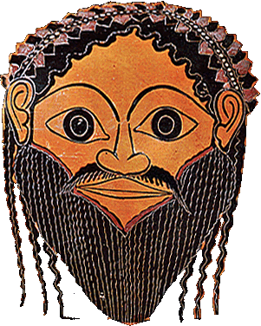
“For whoso leads the revel / He is always Dionysus”
(Euripides’ Bacchae, Chorus, p. 400)
Notes:
“For whoso leads the revel / He is always Dionysus” – what does that mean?
in the play, is Dionysus leading a dangerous cult? or is he the real deal and we just don’t understand? will we at least understand better if we join in? but at what cost to our sense of self do we join in?

Slide 4
Agenda
Recap and Update
  Aristotle Poetics — and Bacchae
Euripides Bacchae
  Play Facts, Backstory
Dionysus
  Attributes, Mysteries, Euripides’ Bacchae

Slide 5
Recap and Update
Aristotle Poetics — and Bacchae
Notes:
ASK YOURSELF: WILL THIS TREATISE HELP YOU IN APPRECIATING/CRITIQUING POETRY? (probably yes.) IN CREATING POETRY? (far more incomplete on that score. differs thus from ari's Rhetoric.) some of it really specifically concerned with critical questions, e.g., which better, epic or tragedy.
AND IF WE CAN VIEW ARISTOTLE’S as a critical-theoretical approach, does ari tell us anything useful about tragedy? what?
ari thus does not impart to readers tekhne (technical skill) as much as try to train them to recognize it, especially in areas that, for aristotle, count.

Slide 6
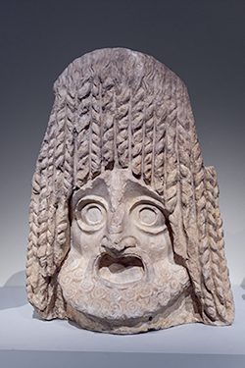
Aristotle on Parts of Tragedy (part xii)
prologue
parodos
stasimon (plural, stasima)
kommos (plural, kommoi)
exodos

Slide 7
Analysis, 1st Half
prologue (starts p. 395)
  Dionysus
parodos (398): “Asian” (modern Turkey) Bacchants. Cult hymn
1st episode (402)
  Tiresias, Cadmus, Pentheus
1st stasimon (412)
  Pentheus’ impiety
2nd episode (414)
  Servant, Pentheus, Dionysus (in disguise)
2nd stasimon (417)
  Thebes’ rejection of Dionysus
Choral dialogue with D (419)
  Earthquake, destruction of house
Trochaic dialogue, D & Leader (421)
  “messenger” scene
3rd episode (422)
  Short dialogue, D&P
  Messenger scene: hubris in the hills
Notes:
prologue (starts p. 395)
Dionysus. I am changed, a god made man, d’s boundary-crossing aspect. cf. dress-up, geographical-cultural boundary-crossing, etc. he is a foreign god (“I come from Lydia” etc.) coming to conquer Greece. yet he is a native greek. (barbarian-greek divide.)
parodos (398): “Asian” (Anatolian) Bacchants. Cult hymn. celebrates the double birth of god: at thebes, on crete (p. 400, “p chamber of curetes”)
1st episode (402)
Tiresias, Cadmus, Pentheus. note the comedy of c and t, old geezers, done up in Dionysian garb.
tir: humanity has 2 blessings: demeter (earth, food), d (wine). encomium of wine: anodyne, soporific. the wine is d and vice versa. when we drink we are possessed.
286. t defends myth of 2ble birth. a mystic interpretation hinging on pun: meros/homeros. z, harboring d on olympus and thus angering hera, gives to h a piece of sky (aither) as "hostage." but the crowd understands that as meros, "thigh." the myth associates dionysus with the heavenly element, i.e., with zeus. aither is used to make the facsimile of helen, too. note that this interpretation is important: d is the god of facsimile, of the simulacrum. there is, in a sense, no real god there, only air. the process of imitation manifests the god.
1st stasimon (412)
Pentheus’ impiety
2nd episode (414)
Servant, Pentheus, Dionysus (in disguise)
soldier describes the miraculous escape of the Bacchae. note the quasi-sexual appreciation of d’s implicitly effeminate beauty. yet d is the bull god, the roarer, the quintessentially phallic deity. d plays at being an emissary of himself. he is playing someone other than himself, yet in so doing at a deeper level is very much himself. (p casannot see the god though he is looking at him – d is “where I am.) you are d if you are not yourself. this is the essence of Athenian drama.
2nd stasimon (417)
Thebes’ rejection of Dionysus
Choral dialogue (418): Chorus & D
Earthquake. self-freed’s power. adoration of him by bacchants.
Trochaic dialogue, D & Leader (420)
“messenger” scene. d describes his destruction of the palace of pentheus. note that the women, the bacchants of Anatolia, think d is a human worshipper of god. god’s playacting.
3rd episode (422)
Short dialogue, D&P
Messenger scene: hubris in the hills. the foreign women of the chorus are in town. the women of the town have burst free and, led by the royal sisters, wreak hubristic havoc in the countryside. here the fennel rods-thursoi-prove truly hubristic.

Slide 8
Aristotle on Plot
Less Good
Better
Episodic
Simple, lacking…
  Reversal (peripeteia) and/or
  Recognition (anagnorisis)
Diffuse
  “Epic” time-span
  Multiple story lines
Logical, plausible
Complex, possessing…
  Reversal (peripeteia) and/or
  Recognition (anagnorisis)
Unified
  24-hour time-span
  Single story line
Notes:
WHAT’S THE VALUE-ADDED OF ARI’S POETICS? WHAT’S THE TAKE-AWAY?
basically, a theory of tragedy that begins help us understand it in relation to its ancient historical development and ancient ways of experiencing it.
but also a theory of it that combines notions of its utility with pleasure3 derived therefrom – indeed, a way of theorizing pleasure as, potentially, at least, pleasurable.
87. how best to go about conceiving a plot.
90. complication, unraveling. complication = plot up to reversal. then unraveling.
reversal should concern "the character between these two extremes [the very noble and the very wicked] - that of a man who is not eminently good and just, yet whose misfortune is brought about not by vice pr depravity, but by some error or frailty [hamartia]." but aristotle means mistake. (76)
79-80. we're seeing recognition not simply of another's identity, but with that, of the moral implications, previously unknown, of a given action as connected to identity. so for instance there is no recognition in antigone, strictly speaking. but there is a point in the play when the delusion falls away from creon and he realizes just what he has been doing: he has been destroying himself, and it is his self-wrought reversal he notices. this dimension of learning in characters and in spectators only lightly touched on in ari, but a central theme of the tragedies themselves. see p. 85.
84. on recognition. relatively unimaginative-artistic: from tokens. (atekhnoterai.) this is about either recognition of, or employment of, tekhne, technical skill.
85. even less artistic, blatant "i am." (i.e., artificial.) ari likes recognition by inference. note that recognition can be of fate etc., not just ID.
86. best: from plot action - e.g., soph's OK.

Slide 9
Euripides Bacchae
Play Facts, Backstory

Slide 10
Euripides
484?-406 BC
1st competes, 455
1st victory, 441
Innovator, “disrupter”
  Solo arias (“monodies”)
  Ordinary characters
  Topical references
Notes:
484?-406 BCE, Athenian. Spends most of his career in Athens, but from 408 until his death, stays at the court of King Archelaus of Macedon.
1st competes in the Greater Dionysia in 455. 4 times victor in the Greater Dionysia during his lifetime. 1st victory, 441.
In 405, his son, also Euripides, stages his father's plays to win, again, at the Greater Dionysia:

Slide 11
Bacchae: Topical Reference
Sophists
Demagogues
Messenger, p. 425, location 8413
“Then a fellow who was fond of gadding up to town, / very glib of speech, / held forth to all of us and said: / ‘Hey, you people here / who live upon these holy mountain terraces, / what d’you say we go and hunt Agave out, / Pentheus’ mother, / and chase her from her mad ecstatic rapture, / so do a service to the king?’”

Slide 12
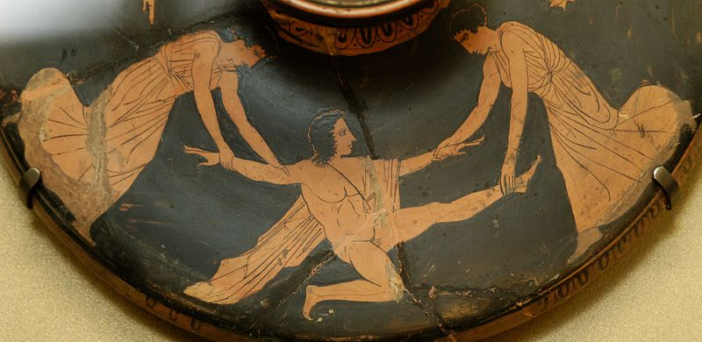
Play Facts, Textual Issues
Production Date
  ca. 405 BCE
Tetralogy
  Iphigenia at Aulis
  Alcmeon
  Bacchae
  Satyr play (lost)
Text (issues)
Death of Pentheus, ca. 450-425 BC
Notes:
In 405, his son, also Euripides, stages his father's plays to win, again, at the Greater Dionysia:
Iphigenia at Aulis
Bacchae
Alcmaeon in Corinth
[a satyr play??]
Set in Thebes, early on in the "heroic" age of myth. More below on background, characters, etc.
Production: Dionysia of 405 (postumous).
Text
interpolation
corruption

Slide 13
Characters, Backstory
Notes:
Backstory
Cadmus founds Thebes
Semele scorned
Daughter of Cadmus and Harmonia, spouse of Echion, mother of Pentheus. Her sisters were Autonoë, Ino and Semele
(Αὐτονόη; Autonóē). Daughter of Cadmus and Harmonia, sister of Semele, Agave and Ino ( Leucothea), wife of Aristaeus, mother of Actaeon (Hes. Theog. 977; Apollod. 3,26; 30; Hyg. Fab. 184). In Euripides' Bacchae she leads a thiasos of Theban Maenads (230; 680; Ov. Met. 3,720). Following the death of her son, she goes to Megara; her tomb is mentioned by Pausanias (1,44,5).
(Ἰνώ; Inṓ). Daughter of Cadmus [1] and Harmonia, generally taken to be the second (first: schol. Hom. Il. 7,86 Bekker according to Philostephanus and Eust. ad locum; schol. Lycoph. 22) wife of Athamas in Thebes [2] (the first being Nephele [1]). She is the mother of Learchus and Melicertes. Envy of her stepchildren Phrixus and Helle prompted her to develop a cunning plan. She talked the women of the country into roasting the seed grains, thus causing a severe famine. She bribed the envoys sent by Athamas to Delphi to tell the king that the infertility of the land could only be reversed by offering Phrixus as a sacrifice. After Phrixus and his sister had been carried away by the ram sent by Nephele, Athamas succumbed to madness and, in the mistaken belief that he was out hunting, he killed his eldest son Learchus with arrows. I. fled and flung herself from a cliff into the sea together with her younger son Melicertes. From then on, she was cultically venerated as Leucothea
Pentheus king
Dionysus returns

Slide 14
Dionysus
Attributes, Mysteries, Euripides’ Bacchae

Slide 15
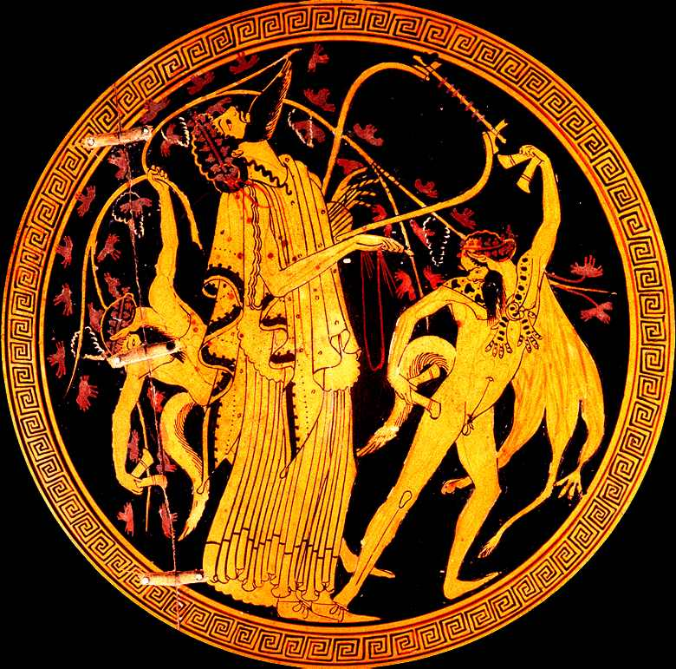
Dionysus with Satyrs,
Athenian cup (“Brygos painter”)
circa 510 BCE
Notes:
discussions of athenian tragedy need to begin with dionysus. though greek drama doesn’t seem to have arisen exclusively in connection with dionysus (so, for instance, your readings show proto-drama connected with Artemis at the greek city of sparta), at athens and elsewhere, the dionysian connections are extremely strong.
so who – or what – was dionysus?
wine
release
sociality, boundary-crossing

Slide 16
Dionysus, Wine (Tiresias, first episode)
[Humankind] has two blessings:
the goddess Demeter is the one—
Earth, that is, call her what you will—
who keeps us alive with solid food;
the other is Semele’s son,
who came afterwards and matched her food with wine.

Slide 17
Dionysus, Wine (Tiresias, cont’d)
So when we pour libations out
it is the god himself we pour out to the gods,
and by this bring blessings on mankind.

Slide 18
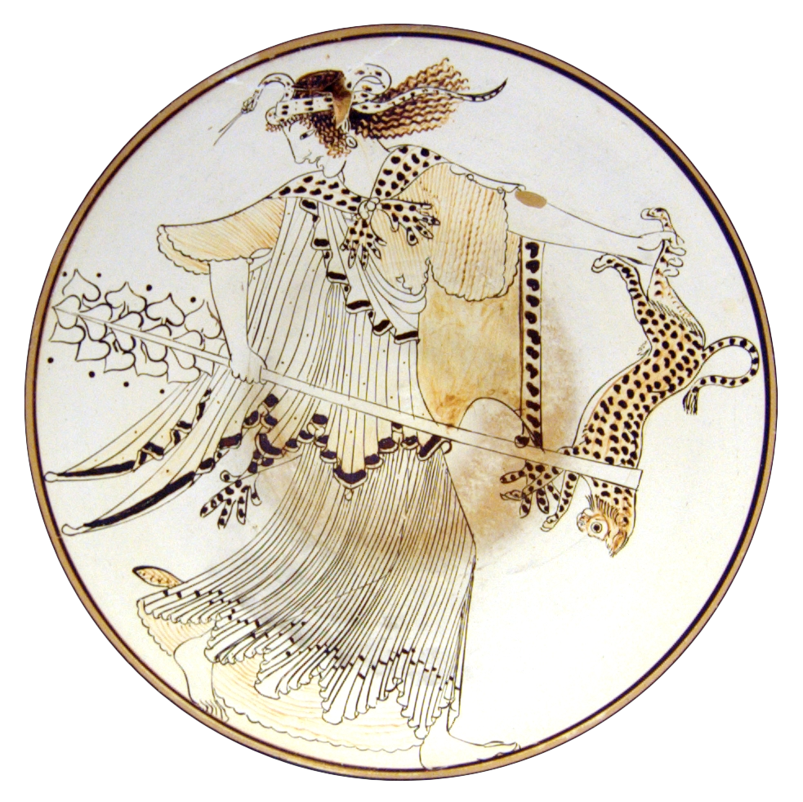
Maenads, bakkhoi/bakkhai
Rapture
  Ekstasis
  Enthousiasmos
Thyrsus
Sparagmos, omophagia
  Did this really happen?
Oresibasia
Maenad with thyrsus and leopard. 490-480 BCE
Notes:
maenads, thyrsi, etc.
“. . . and with the fennel, join reverence to riot” (p. 400)
lit. “Sanctify the hubristic (hubristas) fennel rods all around!”
marked oxymoron
holy / hubristic
“weaponized” thyrsi in play
ritual violence both given release and yet needs to be contained
and that foreshadows “terrorist action” of p. 103: “They tore like an invading army into the villages of Hysiae and Erythrae, … and turned them upside down, they snatched up babies out of homes …”
cf. women’s festival of hubristika, at argos: women exercising for a time strange powers and freedoms
HUBRIS AS GOOD!!!
god of paradox and reversal. in the midst of the most dead time of year, celebration of life-renewing license

Slide 19
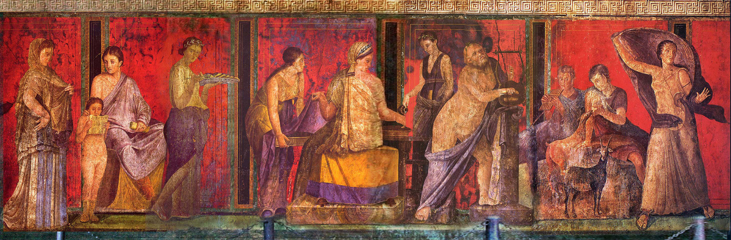
Dionysian Initiation
Cross-dressing
Mystic knowing
Ritual rebirth
Dionysian initiation, Villa of the Mysteries, Pompeii
Notes:
Mystery cults …
of Demeter
e.g., at Eleusis
of Dionysus
… involve
initiatory rite of passage
thematic foci
community
fertility
enlightenment
conquest of death
Bacchae, Initiation (cont.)
Cross-dressing
ritual transvestism as element of mystic, transformative rite of passage
the fluid, redefinition of self
ritual feminization preceding ritual death
p dressed in linen: 821, D to P “then you must put on a linen shift”
linen = bacchic-orphic burial garb
Mystic knowing
Ritual dying, rebirth
LIFE-DEATH-LIFE

Slide 20
iō Bakkhe, euoi

Slide 21
Discussion: Tragedy in Performance
Rock the Palace!
(Dionysus-Stranger, 1st Voice, 2nd Voice, Chorus)
(pp. 418 ff., CHORAL DIALOGUE @ location 8307)

