Slide 1
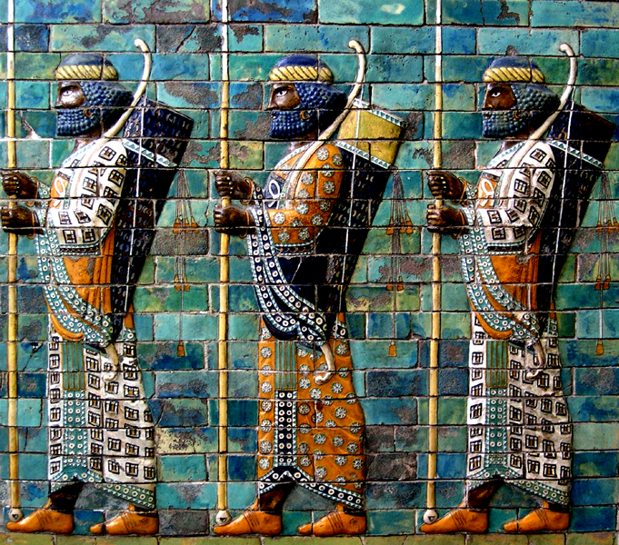
Aeschylus’ Persians
“The Ancient Law of hubris and atē”

Slide 2
Aeschylus Persians. Parodos. Opening
Τάδε μὲν Περσῶν τῶν οἰχομένων
Ἑλλάδ᾽ ἐς αἶαν πιστὰ καλεῖται,
καὶ τῶν ἀφνεῶν καὶ πολυχρύσων
ἑδράνων φύλακες, κατὰ πρεσβείαν
οὓς αὐτὸς ἄναξ Ξέρξης βασιλεὺς
Δᾱρειογενὴς
εἵλετο χώρας ἐφορεύειν. (1–7)
Tade men | Persōn | tōn oi|khomenōn
Hellad’ es | aian | pista ka|leitai,
kai tōn | aphneōn | kai polu|khrūsōn
hedranōn | phulakes, | kata pres|beian
hous au|tos anax | Xerxēs | basileus
Dārei|ogenēs
heileto | khōrās | ephoreuein.
͡
Notes:
Τάδε μὲν | Περσῶν | τῶν οἰχ | ομένων
Ἑλλάδ᾽ ἐς | αἶαν | πιστὰ κα | λεῖται,
καὶ τῶν | ἀφνεῶν | καὶ πολυ | χρύσων
ἑδράνων | φύλακες, | κατὰ πρεσ | βείαν
οὓς αὐ | τὸς ἄναξ | Ξέρξης | βασιλεὺς
Δᾱρει | ογενὴς
εἵλετο | χώρας | ἐφορεύειν.

Slide 3
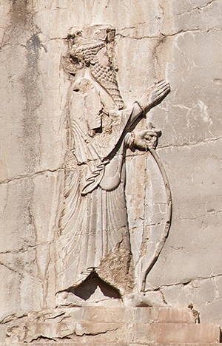
Agenda
Discussion, Aeschylus’s Persians
  Tragedy As Local? As Universal?
Recap & Update
  A Step Backwards. . .
Play and Background
  Persia, Persian War, Persians
Tragic Patterns in Aeschylus
  Hubris, atē, the Great Reveal
Xerxes I, Naqsh-e Rustam

Slide 4
Discussion, Aeschylus’s Persians
Tragedy As Local? Universal?
Notes:
how can what’s universal about Persians be grief that’s be appropriated and manipulated to serve local, political purposes? but how can it be tragic if it isn’t universal?

Slide 5
Persians, Orientalism
“. . . Said sees a play like Aeschylus’ Persians as an example of the Orient being transformed from a very ‘distant and often threatening Otherness into figures that are relatively familiar (in Aeschylus’ case grieving Asiatic women). The dramatic immediacy of representation in the Persians obscures the fact that the audience is watching a highly artificial enactment of what a non-Oriental has made the symbol for the whole Orient.’ ”
(Rebecca Kennedy, Classics at the Intersections, quoting Saïd Orientalism)
Notes:
Quoting from Mark Munn’s The Mother of the Gods, Athens, and the Tyranny of Asia,
Aeschylus’ Persians is recognized as a landmark in the articulation of Western perceptions of a fundamental distinction between the world inhabited by the majority of Greeks on the one hand and barbarian Asia on the other. Edward Said, for example, has identified Aeschylus’ Persians as the earliest example of “a highly artificial enactment of what a non-oriental has made into a symbol for the whole orient.” (p. 233)
Now, if that’s at all right, it raises serious problems. If at some level with our ongoing attempt to define tragedy aligns with Aristotle’s understanding of it as a kind of vicarious sharing in the suffering of others, as a fundamentally social experience, if forces us to ask just how much the play’s original audience could possibly have actually felt a connection with the play’s characters, foreigners all of them. For if the point of the play is to dramatize a collective other to define us as “US” in capital letters, then doesn’t the suffering of a Xerxes, the “Great King” of the Persians, and of his subjects, tend to alienate the “us” the is the audience and readership from the “them” that is the cast of characters?
put differently, can this simultaneously be a tragedy with universal validity, yet function, as it so clearly did, as a kind of political or pep rally, at the same time?
Maybe so. So I’d like today to use Aeschylus’ Persians, the earliest of the Greek tragedies that survives entire, as a laboratory into the basic features of what Greek tragedy is all about, to use it to explore a feature of archaic Greek thought that has been termed “the Ancient Law of hubris and ate” by the great C. J. Herington. I’m wondering, in other words, of the whole foreignness of this cast of characters – their separation from the putative everyday experience of “us” on a whole number of levels – doesn’t also play as role in that psychic-artistic dynamic we call “the tragic.”
Put differently, what is it for actors to be playing, and therefore appropriating, their Other — men playing women, Greeks playing Persians, Us playing Them — in this and other ancient Athenian plays? And what about this play's celebration of defeating that Otherness: how does one do justice to the power, even the beauty, of the play's rhetoric without enabling a kind of malevolent gloating, without succumbing to the worse angels of our nature?

Slide 6
Recap & Update
A Step Backwards. . .

Slide 7
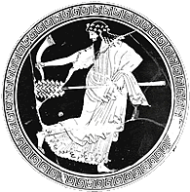
Where We’ve Got To. . .
Intro Class – issues
  Theory of tragedy
  Performative, gender-based approach
Antigone, Honig, Aristotle
  Tragedy “perfected”
  Tragedy’s aims
  Tragedy’s relevance
Seaford, Dionysus, Bacchae
  Tragic origins
  Imitation, impersonation
Notes:
but what does this explain?

Slide 8
Where We’re Headed (today)
“… the Greek poet consistently strove to set the transient doings of mortals against a permanent universe, a universe of ever-present death and ever-living gods. Unless so measured, the particular human act … will scarcely be worth narrating, or even intelligible. Only the permanent will make sense of the ephemeral.” (Herington, p. 5, Persians)
Notes:
“… perhaps the most important single characteristic of the Greek poetic tradition within which Aeschylus worked … is this: the Greek poet consistently strove to set the transient doings of mortals against a permanent universe, a universe of ever-present death and ever-living gods. Unless so measured, the particular human act … will scarcely be worth narrating, or even intelligible. Only the permanent will make sense of the ephemeral.”
for Herington, this is specific to Aeschylus and to early Greek poetry generally. For us, this can be a starting point – yes, one of several so far – in our tragic Odyssey. That is, it bears asking whether something like this describes the mass of Greek tragedies – whether, in other words, the “ancient law of hubris and atē” is a constant or a point of departure.
note that this is traged as
universal – we are talking about the relationaship of the human to the cosmic, are we not?
local – as h points out, this is a distinctively archaic greek (and greek is the right word here, not Athenian) world view, one that forces us to confront the issue of US and OTHER in the play as a problem, specifically, where does US stop and OTHER beging?

Slide 9
Play and Background
Persia, Persian War, Persians

Slide 10
Persians: Play Facts
Production
Play
472 BCE
Aeschylus (ca. 525-455 BCE)
Choregus: Pericles
Tetralogy
  Phineus
  Persians
  Glaucus of Pontiae
  Prometheus
Setting: Susa
Characters
  Chorus of Persian Elders
  Atossa-“Queen”
  Messenger
  Darius’ ghost
  Xerxes

Slide 11
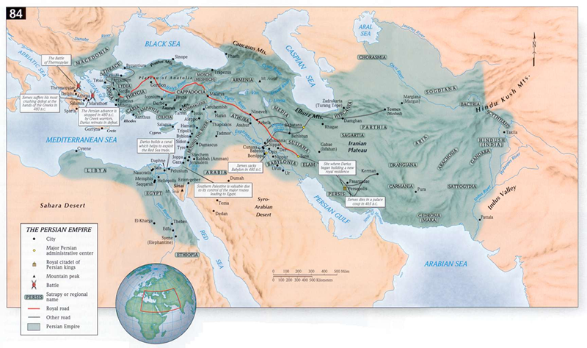
Persian Empire
Cyrus I (“the Great”) r. 550–530
Cambyses II r. 530–522
Darius I (“The Great”) r. 522-486
Xerxes r. 486–465
Notes:
Cyrus I (“the Great”) r. 550–530
Cambyses II r. 530–522
Darius I (“The Great”) r. 522-486
Xerxes r. 486–465
Xerxes, Achaemenid great king (486-465 BC), son of Darius I and Atossa. built persepolis. put down rebellions and consolidated father’s conquests. but in the western tradition, became synonymous with foreign despotism – a symbol, as said would put it. in 480-479 bce, undertook a campaign in greece, as planned by father – though in aesch’s play, that campaign is presented as errant hubris frowned upon by dad.

Slide 12
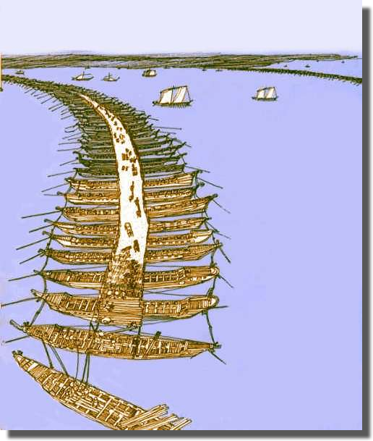
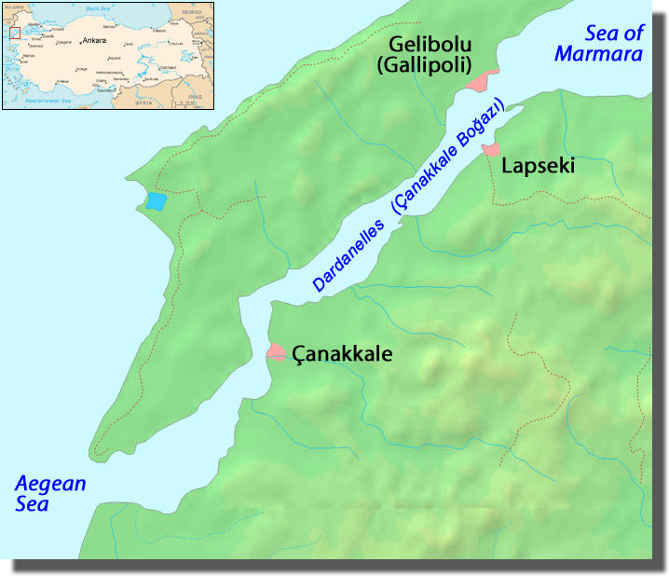
Xerxes’ Bridge
Hellespont / Dardanelles
Notes:
for horseback troops / and troops on foot / all, all of them / have left home … and have crossed the sea-dividing span that juts from two shores yoking two lands.

Slide 13
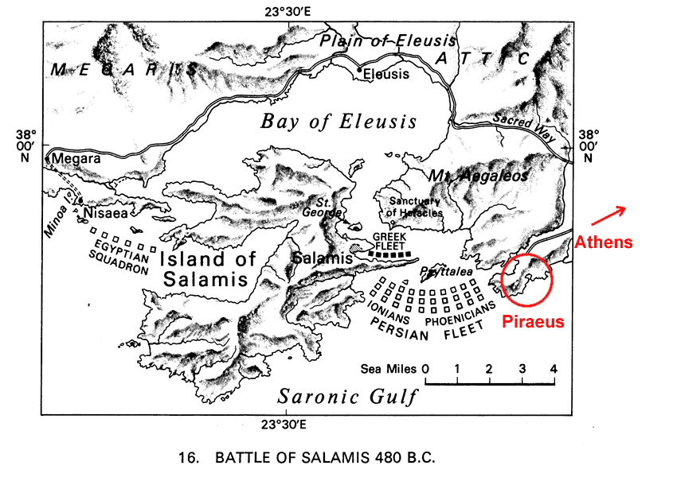
Xerxes somewhere here
Notes:
Autumn, 480 BCE
Abandonment, destruction of Athens
Forces
ca. 385 Greek ships
ca. 400 Persian ships
Plan
feign Greek disunity
draw Persians into straits
Losses
Greeks: ca. 40 ships
Persians: ca. 200 ships

Slide 14
Tragic Patterns in Aeschylus
Hubris, atē, the Great Reveal

Slide 15
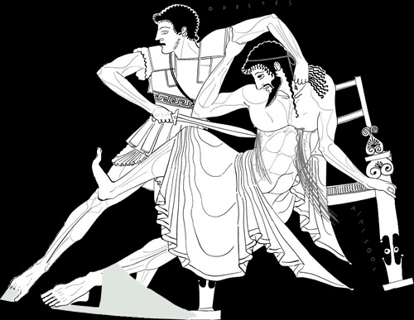
Ancient Law of hubris and atē
koros (excess, extravagance)
hubris (arrogance, violation)
atē (delusion, ruin)
dikē (justice)
Notes:
from Herington’s intro to the play:
“And perhaps the most important single characteristic of the Greek poetic tradition within which Aeschylus worked . . . is this: the Greek poet consistently strove to set the transient doings of mortals against a permanent universe, a universe of ever-present death and ever-living gods. . . . Only the permanent will make sense of the ephemeral” (5).
against that background, Herington’s “Ancient Law of hubris and ate”:
“In its least refined form the law simply entails the visitation of God's ferocious punishment on anything that is unduly great, whether physical or mental” (9).
Working from Solon and other poets of archaic (i.e., early ancient) Greece, Herington in effect frames Aristotle’s notion of tragic reversal within this “ancient law.” Hence the formula: koros, hubris, ate, dike.
FORMULA
koros (excess, extravagance)
Atossa: “Surely our wealth is beyond reproach!” (46)
hubris (arrogance, violation)
Atossa’s dream, Xerxes’ “team”
ate (delusion, ruin)
Chorus: “for with gestures of kindness as bait, / Blind Folly (ate) fawns a man into her net” (43)
dikē (justice)
Darius: “. . . the height of evil waits . . . to pay them back for pride and godlessness” (80)
foretelling defeat at Plataea

Slide 16
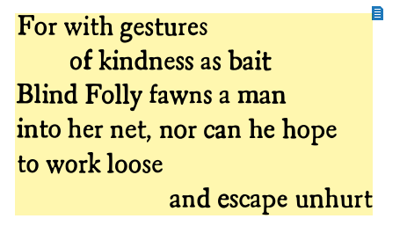
Chorus on atē. Aeschylus Persians p. 43

Slide 17
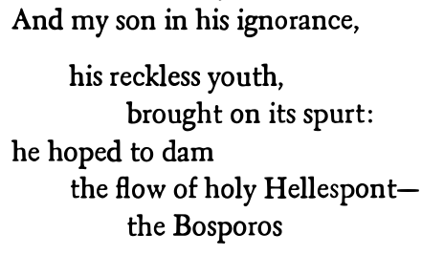
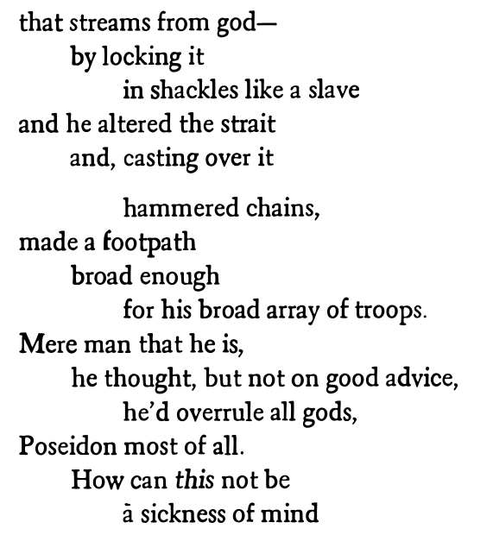
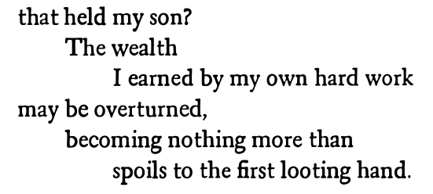
Darius. Aeschylus Persians pp. 76–77

Slide 18
Aeschylean Progression
(C.J. Herington Aeschylus)
verbal
ambiguous
human
visual
explicit
divine
to
Notes:
Herington sees a pattern in surviving Aeschylean tragedy, a movement towards what I’ll call epiphany, that indescribable sense of revelation that we sometimes experience.
how, for Herington, is that epiphany manifested?
in movement from talking to action
in the consummation of a foreshadowed doom or redemption
in the oresteia, …
in the move from “acts” 1 and 2 to the third, where Athena herself takes to the stage to resolve the action
or in the schema drawn up by Herington:
verbal to visual
ambiguity to clarity
human to divine

Slide 19
Persians: Analysis
PARODOS, Persian Elders (pp. 39 ff.)
  Rhythmic chanting
  Sung narrative, lament
EPISODE 1 (44 ff.)
  Atossa’s dream
  Messenger speech (Salamis)
STASIMON 1 (65 ff.)
  Rhythmic chanting
    Xerxes’ recklessness
  Lyric singing
    Grief at the loss
EPISODE 2 (68-69)
  Atossa to summon Darius’ ghost
STASIMON 2 (69 ff.)
  Conjuration: Chorus, Atossa raise dead
EPISODE 3 + lyric dialogue (72 ff.)
  Darius gets bad news
    Darius, Atossa speak
    Chorus alternates: speech, song
STASIMON 3 (82 ff.)
  Darius’ reign
EXODOS (94 ff.)
  Xerxes enters, chanting
  Lyric dialogue: kommos (lament)
Notes:
PARODOS. note during the anapestic entrance chant, the catalogue of persian commanders and contingents – a resonant echo of of homer’s iliad book 2, an almost cinematic attempt to impress on audiences the sheer size of xerxes’ army, plus the vastness of the persian empire. at the same time, the playwright’s use of apostrophe – they call on each of the absent commanders by name – humanizes both the chorus and the absent contingents, and arounses our sympathy – our pity and fear…
EPISODE 1. atossa recounts her dream, quizzes chorus on athens. having the audience view athens through persian eyes has to flatter them. “who herds the manflock? who lords the army?” “they’re not anyone’s slaves or subjects.”
MESSENGER SPEECH. designed to elecit pride or pity? at any rate, an immediate fulfillment of atossa’s doom-laden dream. 54 ff., the catalogue of the dead stands in stark contrast to the chorus’ catalogue earlier. (note the allusion to them’s trick, p. 57.)
note how xerxes becomes a kind a creon figure, a tyrant defeated and bewailing his loss – but already near the beginning of the play.
atossa’s “you” targets a vaguely defined superhuman power, a hateful daimon, that in effect induced atē. atossa assigns to chorus task of making sure x won’t harm himself.
STASIMON 1. now chorus blames x. over-determined disaster. this is in effect a kommos, literally, a beating of breast. (cf. d later: “but when a man speeds toward his own ruin, a god gives him help,” 76.)
EPISODE 2. will naturally remind of scenes in libation bearers. only here, we really do get to the see the ghost on stage. BUT WHY SUMMON D’S GHOST? is this merely a coup de theatre. or is there a dramatic point? and what does the chorus want with d anyways? (d’s to help them, the same way ag is to in lb, or any god in any number of summoning hymns in tragedy. clearly, their longing for d is for a better status quo ante, the king who “never once” killed “Folly’s blind and life-devouring haste.” oddly, this isn’t so different from the whole dramatic point of frogs or of eupolis’ demes.)
EPISODE 3. the true reason perhaps emerges here. it is to add insult to injury by informing the dead of the woes of the living. (d is a power beneath 4the earth, as ag and oed will be.)
note the stichomythia. pp. 75 f. 76 ff. d recounts x’s multiple instances of (mostly geological) hubris. atossa on x’s envy of d’s victories.
79. chorus seeks d to teach them the lesson. “don’t fight greeks.”
81. d on zeus as princple of justice: “zeus, the pruning sheer of arrogance, 828–9: Ζεύς τοι κολαστὴς τῶν ὑπερκόμπων ἄγαν φρονημάτων ἔπεστιν, εὔθυνος βαρύς.
EXODOS-KOMMOS. again, a catalogue.

Slide 20
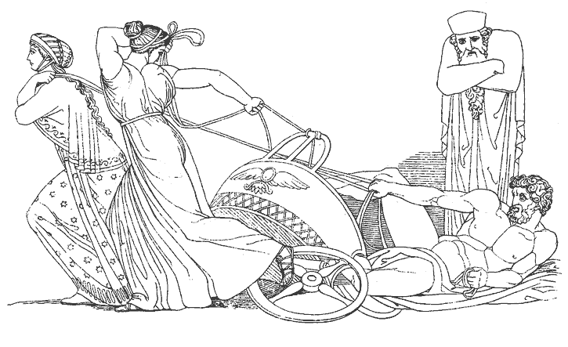
Atossa’s Dream
koros (excess, extravagance)
hubris (arrogance, violation)
atē (delusion, ruin)
dikē (justice)
hamartia (error, crime)
peripeteia (reversal)
anagnorisis (recognition)
Notes:
this is atossa’s terrifying dream, one loaded with significance. this foreshadows the disasters soon to be reported. compare the portent of the eagle (persian kingship) and hawk (greece). the eagle, bird of zeus, cowers before the hawk’s violent attacks.
later commentary elucidates the connection with “The Ancient Law of hubris and atē”:
DARIUS Stubborn child! Did he go by land or sea?
ATOSSA Both. With a double front of two contingents.
DARIUS But how could footsoldiers cross the sea?
ATOSSA He made a path by yoking the Hellespont.
DARIUS What? He closed mighty Bosporos?
ATOSSA Yes. I think Something divine gave him help.
DARIUS Something so monstrous it twisted his good sense!
x’s ate, nationalist pride:
and as you behold them, remember Athens and remember Greece lest someone scorning the immediate blessings Heaven grants, lusting for others, pour away his worldly goods and happiness. Zeus the Pruning Shear of arrogance run wild is set over you, a grim accountant.
peripeteia, anagnorisis are plot points and dramatic effects not themes. the others are themes and effects.

Slide 21
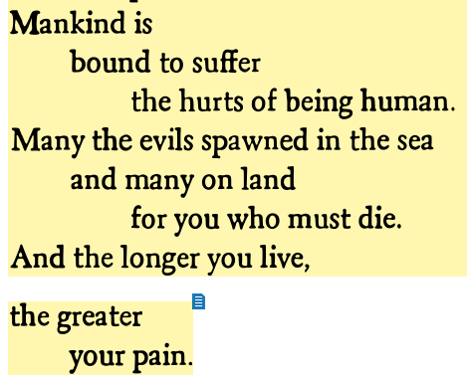
Darius on the tragic condition. Aeschylus Persians p. 71

