Slide 1
Aeschylus’ Agamemnon, Part 1

Slide 2

Opening Discussion
Two Videos: What Does the Fire Do?
Notes:
write down thoughts. cold-calling, be ready.

Slide 3
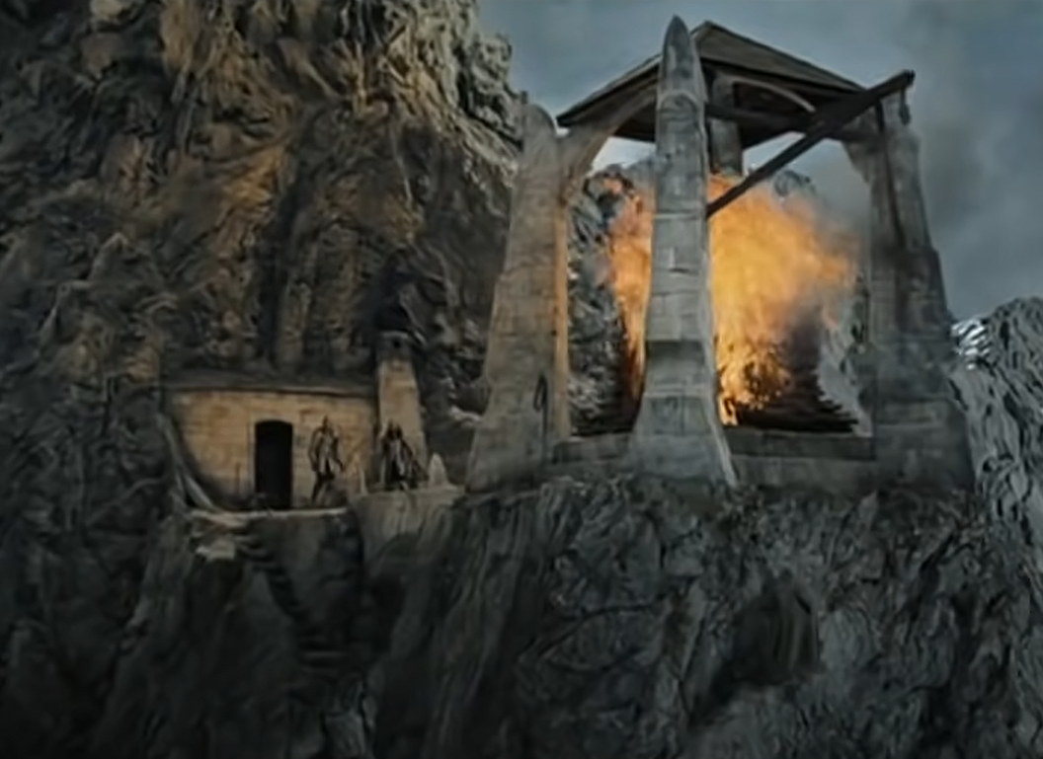
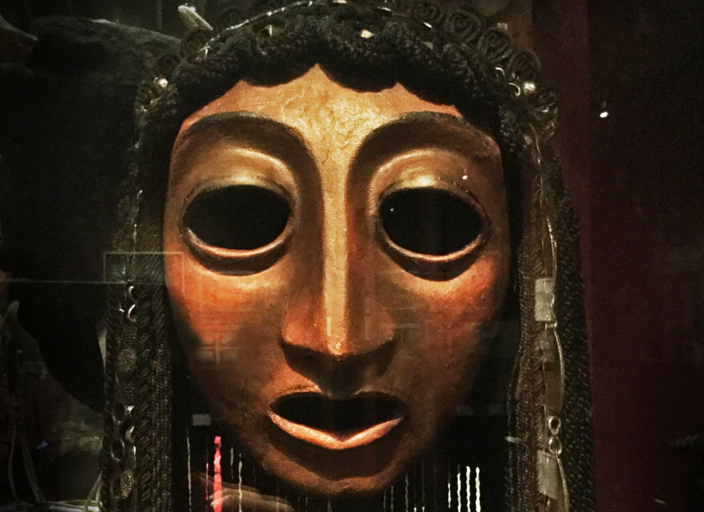
Two Videos
www.youtube.com/watch?v=jm0wz0ZlYqc&t=33s
youtu.be/mdv3vkECqXA?si=8ZenGfPkyIGHHH0W&t=1171
Notes:
Return of the King, Peter Jackson, 2003
Aeschylus Agamemnon. Peter Hall, 1983. Clytemnestra, Pip Donaghy.
what, in aeschylus’ play, does the fire do?
burns.
fire-signals, relay news of the sack of troy.
more than just a signal relay...
fire: red. blood: red. communicates the bloodflow, troy to argos.
seeks to validate the queen, to quell the chorus’ doubts of a woman’s word.
Clytemnestra’s brainchild, it demonstrates her authority.
in the mind of the chorus, masculinizes Clyemnestra. in so foing, reinforces their sense of the disturbed state of affairs in argos: queen as king, the king’s bed occupied by another

Slide 4
Agenda
Opening Discussion
  Two Videos: What Does the Fire Do?
Aeschylus’ Oresteia
  What? Where? When?
Aeschylus’ Agamermnon
  Thematic-Dramatic-Poetic Patterns

Slide 5
Aeschylus’ Oresteia
What? Where? When?

Slide 6
Oresteia: Play Facts
Playwright
  Aeschylus 525-456
Plays (458 bce)
  Agamemnon
  Libation Bearers
  Eumenides
  Proteus (lost)

Slide 7
Historical Context: Athens
508 Athenian democracy
479 Persia defeated
461 Constitutional crisis
  Areopagus veto-power rescinded
  Full democracy achieved
Athenian Acropolis
Notes:
we see political themes with a democratic slant poaking their way into the drama at certain points
The people’s voice is heavy with hatred,
now the curses of the people must be paid [the people, understood here as enraged by the deaths of greeks at troy, like a fury. note the greek – emphasizes not just anger but power of the demos, the people]
βαρεῖα δ᾽ ἀστῶν φάτις ξὺν κότῳ·
δημοκράτου δ᾽ ἀρᾶς τίνει χρέος. (456-457)
clyt to ag (later in play):
our child is gone, not standing by our side,
the bond of our dearest pledges, mine and yours;
by all rights our child should be here . . .
Orestes. You seem startled.
You needn’t be. Our loyal brother-in-arms
will take good care of him, Strophios the Phocian.
He warned from the start we court two griefs in one.
You risk all on the wars - and what if the people
rise up howling for the king, and anarchy
should dash our plans?
ag (later): “Victory, you have sped my way before, / now speed me to the last.” (p. 134). the context is ag’s fear of subversion at home, of false friends and of elements that need to be rooted out. a king like him cannot rest of his laurels; he must always be winning. put differently, kingship is necessarily unstable

Slide 8
Agamemnon: Analysis
Prologue (pp. Penguin 103 f.)
  Watchman
Parodos (105 ff.)
  Entry march (recited). misgivings: expedition
  Lyric (sung, danced). portent of eagles and hare
1st episode (112 ff.)
  Leader, Clyt. Fire signals
1st stasimon (117 ff.)
  Paris’ crime
2nd episode (121 ff.)
  Herald, Leader, Clyt. Victory. Menelaus lost?
2nd stasimon (129 ff.)
  Helen’s blood wedding
3rd episode (132 ff.)
  Chorus (reciting). Ag., Clyt. Red-carpet welcome
3rd stasimon (141 ff.)
  Foreboding
4th episode (143 ff.)
  Clyt., Leader. Cassandra to enter palace
  Cass., Leader, whole Chorus. Cass.’s visions (spoken, sung)
Choral recitation (158)
  Perils of power
Choral scene (159)
  Leader, whole Chorus, Ag. (offstage)
Exodos (160 ff.)
  Clyt., Leader. Ekkuklēma with corpses
  Clyt., Chorus (lyric dialogue). Recriminations
  Clyt., Aegisthus, Leader (dialogue). Gloating in victory, more recriminations
Notes:
key here is the extremely important role of the chorus in narrative exposition
of backstory
of themes and issues
108. artemis as pitying troy. detaining fleet at aulis with contrary winds. "the architect of vengeance" - clyt. the connection: iphi. clyt as "memory womb of child-avenging Fury." then back to eagles. calchas' prophecy of blessings and doom.

Slide 9
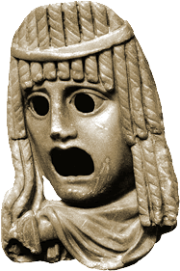
Myth Backstory. . .
Feast of Thyestes (genealogy)
Abduction of Helen (map)
  Sacrifice of Iphigenia
  Sack of Troy
Notes:
a massive pileup of what Aristotle calls hamartia, sin or error, what archaic greek poetics calls hubris and ate, a whole host of crimes narrated as prequel and enacted as plot
Feast of Thyestes
Abduction of Helen
Sacrifice of Iphigenia
Sack of Troy
clyt’s fateful, prophetic words:
And even if the men come back with no offence
to the gods, the avenging dead may never rest -
Oh let no new disaster strike! And here
you have it, what a woman has to say.
oh but they will….

Slide 10
Genealogy

Slide 11
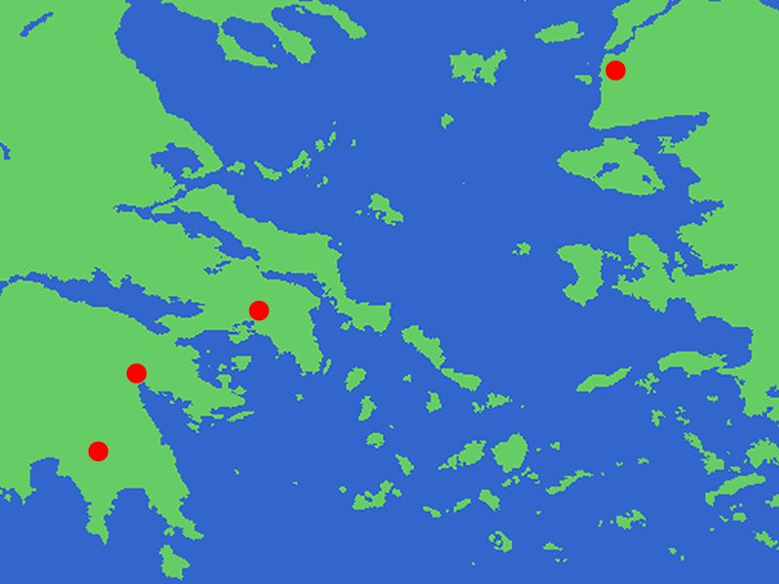
Troy
Greece
Turkey
(Asia Minor)
Delphi
Aulis
Athens
Argos
Sparta

Slide 12
Aeschylus’ Agamermnon
Thematic-Dramatic-Poetic Patterns

Slide 13
Oresteia: Thematic Conflicts
man | v. | woman
civic harmony | v. | civic chaos
(democracy | v. | tyranny)
persuasion | v. | violence
JUSTICE | v. | JUSTICE
Do the binaries hold up?
Notes:
the plays speak the language of ideological affirmation:
of gender ideologies, political ideologies, and so on.
but the conflicts dramatized in plays necessarily put a whole range of cherished truths on trial:
that the patriarchal suppression of women (par for the course in the world known to our playwright and his audience) is just.
that men’s lust for glory constructive.
that the conflicts that inevitably arise in the social-political order can be neatly resolved through existing institutions, that justice without compromise jives with social or political order, with human happiness. for in a world where crime punishes crime, could justice itself be the problem?

Slide 14
Oresteia: Aeschylean Patterns
Aeschylean Progression
“Tragic Formula”
verbal
ambiguity
human
visual
clarity
divine
koros (excess, extravagance)
hubris (arrogance, violation)
ate (delusion, ruin)
dike (justice)
to
In the Agamemnon?
Notes:
Patterns, recap. . .
EPIPHANY
How manifested?
in the movement from talking to action
yes, the signals “signal” ag’s immanent return, but the talk isn’t fully believed until he shows up in person
in the consummation of a foreshadowed doom or redemption
in ag’s immanent murder as punishment for iph’s death
in the oresteia more generally, …
in the move from “acts” 1 and 2 to the third to Zeus the Savior
“FORMULA”:
COMMENT: when i say “formula,” i’m misrepresenting a bit. as herington divined, this is a formula operating according to an archaic “logic,” one that is in essence circular. each step is implied in the next, the strict sequentality of it all is no more a reality than is any too neat articulation of the “formula” in any source – indeed, to illustrate it in the agamemnon, where it is prominently on display, one cannot but jump around.
anyway, just to recapitulate, the formula can best be articulated as an archaic, pre-aristotelian version of reversal as in the Poetics, only here imagined as a cosmic principle, a violent rebalancing of a world out of joint

Slide 15
CHORUS: “Sprung from the great good fortune in the race / comes bloom on bloom of pain” (p. 131)
CHORUS: “But ancient Violence longs to breed, / new Violence comes when its fatal hour comes” (p. 131)
CLYTEMNESTRA: “Just let no lust, no mad desire seize the armies / to ravish what they must not touch — / overwhelmed by all they’ve won!” (p. 116)
Notes:
EXEMPLIFIED IN AGAMEMNON:
koros (excess)
CHORUS: “Sprung from the great good fortune in the race | comes bloom on bloom of pain” (p. 131)
hubris (violation), which may precipitate ate or may operate in tandem with it
CHORUS: “But ancient Violence (hubris) longs to breed, | new Violence (hubris) comes when its fatal hour comes” (p. 131)
the sacrifice-murder of iph as crime paying for the destruction of troy
cl’s warning:
Just let no lust, no mad desire seize the armies
to ravish what they must not touch -
overwhelmed by all they’ve won!

Slide 16
CHORUS: “… neither young nor strong could leap the giant dredge-net of slavery, all-embracing ruin” (p. 117)
CHORUS: “Justice turns the balance scales, / sees that we suffer / and we suffer and we learn” (p. 111)
Notes:
EXEMPLIFIED IN AGAMEMNON:
ate (ruin)
CHORUS: “… neither young nor strong could leap the giant dredge-net of slavery, all-embracing ruin (ate)” (p. 117)
the frenzy that besets ag
dike (justice)
“Justice turns the balance scales, / sees that we suffer / and we suffer and we learn” (p. 111)

Slide 17
Associative Poetics
Lyric exposition: parodos
Linked imagery: fire, blood
Portent: eagles, hare.
Artemis’ anger.
Sacrifice of Iphigenia.
Burning of Troy.
Fire signals.
Notes:
the associative poetics of aesch’s lyric exposition, especially during choruses, are like Cassandra’s powerful yet incoherent prophecies. they stack horror on horror so that sequentially distinct stages in the story collapse onto each other like the floors of a collapsed building. we, like Cassandra, feel crushed, but also see all too clearly how all the horrors connect. endowed now with our own visionary powers, we break free from the logic of ordinary causation. instead, we see how the terror rages “back and back in the future / . . .
Memory womb of Fury child-avenging fury!”
associative poetics: conceptual association by way of a shared feature, motif, image. in these plays, weavings, colors, poured drink offerings, blood – a host of motifs binding the whole oresteia together as a group of plays. chief among these motifs: the color red. as the color of blood and of fire, it is serves as emblematic of the organic connection between tragic events like the feast of thyestes, sack of troy, and murder in agamemnon’s palace. so, too, red, as the color of fire, convey with the fire signals in the opening of agamemnon not just news of troy’s destruction; they emblematically convey curse from troy to argos.
[the red carpet completes the connection; cassandra’s vision of the bloody, gory feast of thyestes atop the roof of the palace, like a gory, bloody version of panckakes and syrup, allows doom to saturate how we imagine the house of agamemnon. it allows us, the audience, a single stroke to envision doom upon doom crashing down upon the accursed house of agamemnon. but we shall also see this unifying motif of the color red return repurposed yet constant in its resonance in the Eumenides, the final act of this three-tragedy drama.]
in a choral passage like the parodos, the imagery suggests a chaotic, almost hallucinogenic series of connections, all suggesting that the synaptic firing of the chorus’s imagination has plunged into a mad spiral. we see more of the same in the likewise lyric ravings of cassandra later.

Slide 18
Tragic Cycle
Crime begets crime
Blood guilt
Tragic knowing
  Pathei mathos
  (“from suffering, knowledge”)
Notes:
CHORUS: “… men’s prosperity never will die childless, once full-grown it breeds. Sprung from the great good fortune in the race comes bloom on bloom of pain”
CHORUS: “A curse burns bright on crime –
full-blown, the father’s crimes will blossom,
burst into the son’s.” (Chorus, lines 378 ff.)
“Ancient violence (hubris) longs to breed, new Violence comes when its fatal hour comes, the demon comes to take her toll–no war, no force, no prayer can hinder the midnight fury stamped with parent fury moving through the house” (755–60)
Blood guilt: “womb of guilt, kinsmen / torturing kinsmen, . . . severed heads” (“Feast of Thyestes,” p. 145)
109-. hymn to zeus. "he who was once mighty" etc. = ouranos, kronos. zeus thus = "zeus the victor." but note that it is a victory of son defeating father.
"zeus has led us on to know, the helmsman lays it down as law that we must suffer, suffer into truth.“
“Zeus has led us on to know, . . . that we must suffer, suffer into truth,” (Chorus, p. 109
punishment comes from the gods, and in the form of inexorable, fated woe.
tragedy action also self-justifies: through suffering we gain a higher awareness. the questions is, do tragic characters learn in time to benefit from their misfortune?

