Slide 1
Aeschylus’ Agamemnon, Part 2

Slide 2
A meme...
https://youtu.be/P5TX6quFBEs?si=YE0idZ7BOM4Pj-iG&t=12

Slide 3
Who “sees” dead people?
(In Agamemnon)
Notes:
whose power of vision sees, plain as day, the presence of figures no one else can see? can see those dead people in the here-and-now, whatever the time, place, or manner of their deaths? can see and say how past deaths link up with present and future deaths, though people has trouble understanding, much less believing her?

Slide 4
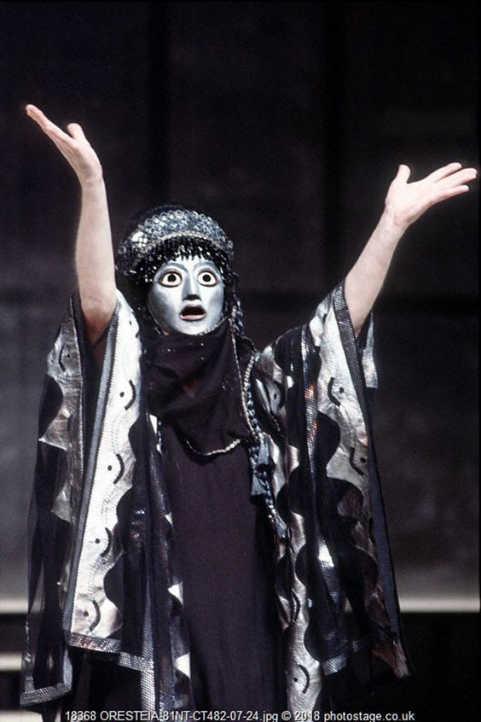
Cassandra!
Notes:
Would anyone care to share the myth of Cassandra?
the beautiful princess, daughter of priam, caught the eye of Apollo, god of prophecy
she agrees to become Apollo’s lover in return for the gift of prophecy

Slide 5
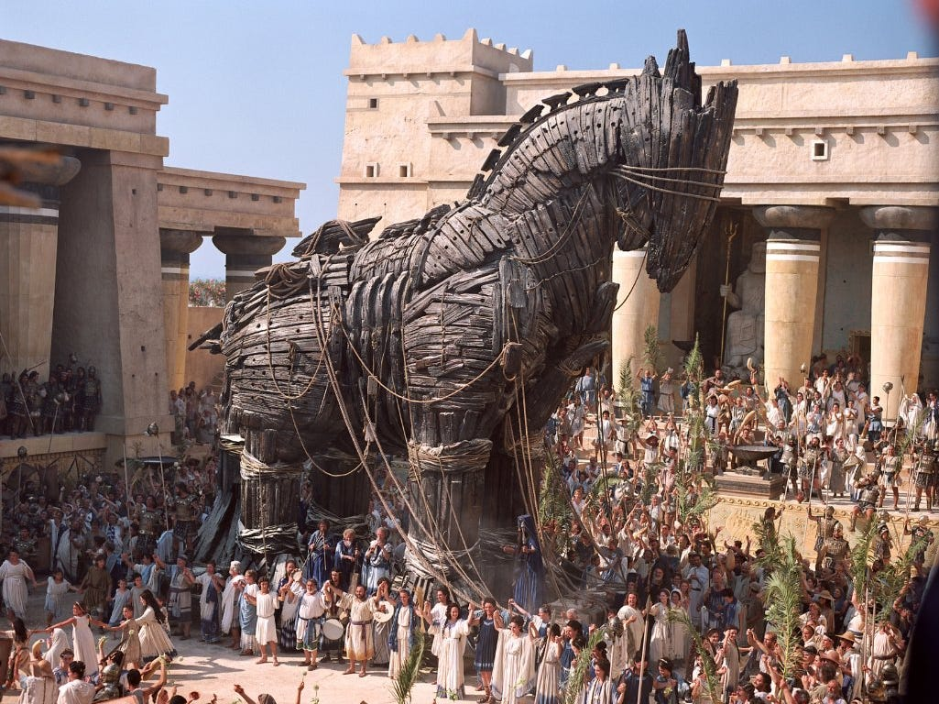
Trojan Horse
Notes:
at the last instant during love-making, she refuses to satisfy the god’s lust
she retains the gift of prophecy, but loses the capacity to be believed
that proves fatal for troy when she warns Trojans not to accept the gift of the horse from the greeks, who wish not to make peace but to infiltrate the city’s walls
as we shall see, her visions, and the manner of her communicating them, match the associative and imagistic poetics of the chorus as they reflect on past, present, and future at argos (the play’s setting) and at troy (cass’s home and the scene of recent atrocity committed by greeks)

Slide 6

Oresteia: desis (“complication”)
JUSTICE (dikē) |  | JUSTICE (dikē)
lex talionis | versus | What?
(= vendetta justice)
Notes:
thus Cassandra reaffirms the complication, the desis, as aristotle would put it, that runs through the whole of the surviving three plays of the Oresteia:
blood begets blood, thus,
past (feast of thyeastes, sacrifice of Iphigenia, impious destruction at troy), present (murder of agamemnon and cass), and future (Orestes’ revenge) collapse upon one another into a single vision of doom
a vision of vengeance-driven violence that will repeat itself generation after generation
or will it?

Slide 7
Agenda
Cold Open
  Oresteia: the desis (“complication”)
Discussion
  What Does Clytemnestra’s Red Carpet Do?
Recap & Update
  Plot and Poetics in Aeschylus’ Agamemnon
Notes:
and that pretty much summarizes both the style of exposition in the agamemnon and the chief complication, what aristotle calls desis, that the action of the play confronts, namely, the problem of how to escape the cycle of violence when justice is defined by the lexs talionis, that of an eye for an eye.
over the course of this and the next three class meetings, we’ll be exploring how aeschylus explores that question.

Slide 8
Discussion
What Does Clytemnestra’s Red Carpet Do?

Slide 9
“What does this red carpet do? Why does it matter so much? To Clytemnestra? To Agamemnon? (To us??)”
(Study Guide)
https://www.youtube.com/watch?v=ldIJVtDG5TM&t=61s

Slide 10

CLYTAEMNESTRA: But the great victor - it becomes him to give way.
AGAMEMNON: Victory in this . . . war of ours, it means so much to you?
CLYTAEMNESTRA: O give way! The power is yours if you surrender,
all of your own free will, to me! (pp. 138-139)
Notes:
those words on the screen are pregnant with active potential. they, working in concert with the material object, the carpet, overdetermine agamemnon’s ruin, lock it in
welcomes agamemnon
celebrates, elevates agamemnon
his wealth (Tyrian purple and similar colors obtained from the dye-producing glands of certain snails, labor-intensive production, costly and thus a status symbol)
lure agamemnon into committing a kind of hubris
treats the precious cloth with contempt
the contemptuous treatment of the cloth implies overweening arrogance
that arrogance arouses the resentment of the gods, jealous of their superior status, they are unwilling to share that status with beings as inferior as us
direct contact with the koros, the outsized wealth, of the house invites god-sent atē, “ruin"
the sensuous, tactile pleasure of treading upon the precious cloth tempts and entraps agamemnon, much as the prospect of spying on the maenads tempts and traps Pentheus in Euripides’ bacchae
the luxury weakens agamemnon
assimilates him to a woman, to a barbarian like priam
leaves him vulnerable
the cloth becomes a kind of net, leading agamemnon to, and entrapping him in, his fated end
connects the blood-flow at troy with destruction of argos
thus serves as a kind of poetic justice, agagmemnon brought fwon by his own victory
agameņon’s victory thus becomes a defeat, a reversal
of his gender
of his ethnicity
of his power
on a sociological plane, illustrates greek ideologies of gender and ethnicity, without which the reversal wrought by this carpet would be impossible

Slide 11
Recap & Update
Plot and Poetics in Aeschylus’ Agamemnon

Slide 12
Agamemnon: Analysis
Prologue (pp. Penguin 103 f.)
  Watchman
Parodos (105 ff.)
  Entry march (recited). misgivings: expedition
  Lyric (sung, danced). portent of eagles and hare
1st episode (112 ff.)
  Leader, Clyt. Fire signals
1st stasimon (117 ff.)
  Paris’ crime
2nd episode (121 ff.)
  Herald, Leader, Clyt. Victory. Menelaus lost?
2nd stasimon (129 ff.)
  Helen’s blood wedding
3rd episode (132 ff.)
  Chorus (reciting). Ag., Clyt. Red-carpet welcome
3rd stasimon (141 ff.)
  Foreboding
4th episode (143 ff.)
  Clyt., Leader. Cassandra to enter palace
  Cass., Leader, whole Chorus. Cass.’s visions (spoken, sung)
Choral recitation (158)
  Perils of power
Choral scene (159)
  Leader, whole Chorus, Ag. (offstage)
Exodos (160 ff.)
  Clyt., Leader. Ekkuklēma with corpses
  Clyt., Chorus (lyric dialogue). Recriminations
  Clyt., Aegisthus, Leader (dialogue). Gloating in victory, more recriminations
Notes:
part 2, choral exposition yields to on- and off-stage action
killing of ag
faceoff betweenaegisthus and chorus
clyt sheds her dissimulation
full measure of her and her lover’s conspiracy revealed
Clytemnestra’s apparent, and agamemnon’s evident, fear of the people
CLYTAEMNESTRA: “And you fear the reproach of common men? AGAMEMNON: The voice of the people - aye, they have enormous power.” (p. 138)
more broadly for the Oresteia, tyranny as inherently unstable

Slide 13
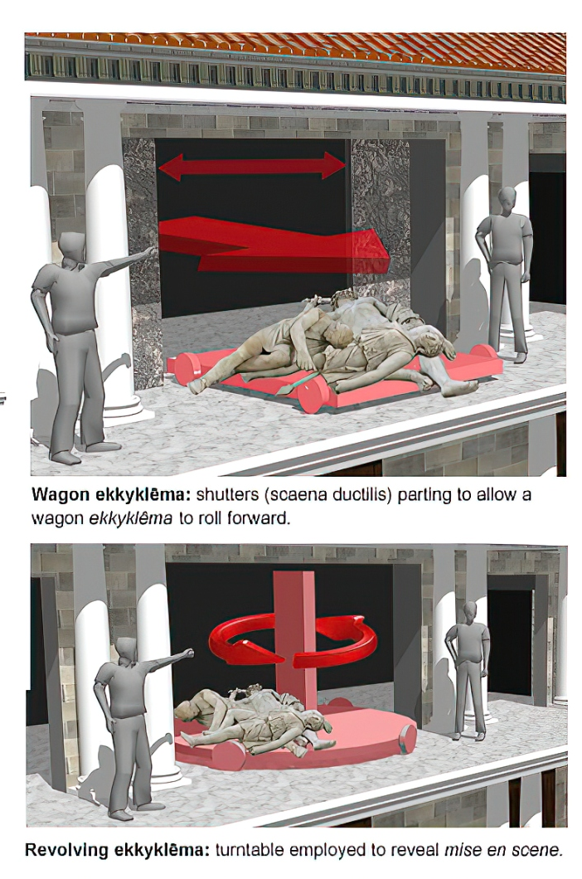
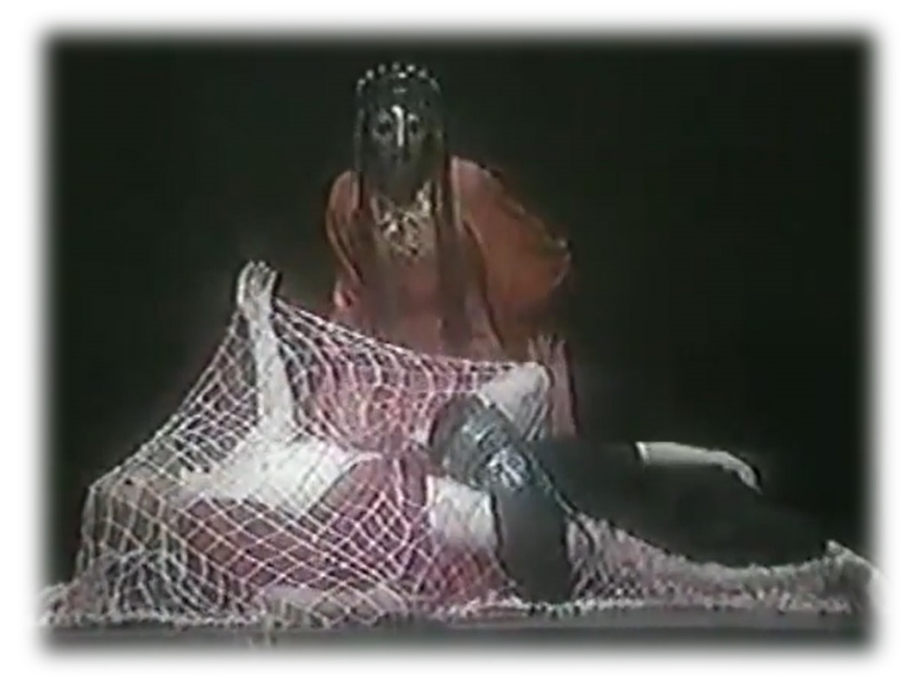
The Big Reveal
Aeschylus Agamemnon part 2. Peter Hall, 1983
Notes:
CLYTAEMNESTRA: “Words, endless words I’ve said to serve the moment -
now it makes me proud to tell the truth.”
so says Clytaemnestra, and with the deed she has just done, she fulfills all our worst fears.
so, what is that thing we see rolled out with the bodies of Agamemnon and Cassandra stacked on it?
ekkuklēma
but what about the chorus just prior to the murder? they talk about doing something, but do they in fact do something?
who does do something? who, to use the Greek, drāi? Whom commits a drama, an action?
it is, of course, clyt. and the moment of the palace doors opening, and of the ekkuklēma being wheeled out, with its horrific cargo – that is exactly the moment the audience has so eagerly been waiting for. it is the big reveal. Aristotle very clearly deems staging of secondary importance to words as the machinery of imitation. but in Aeschylean drama, the culmination of the verbal in the visual is what it is all about. and here we have it: clyt’s complete triumph over her child-murdering husband but also over the doubts of the chorus. she stands before us in all her magnificent yet terrible glory. and we can only wonder, where will this all lead to?

Slide 14
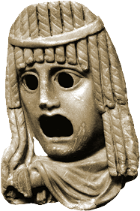
Aristotelian Elements
Reversal(s)?
  peripeteia
Recognition(s)?
  anagnorisis
Error, sin?
  hamartia
Pity? Fear? Catharsis?
Notes:
as questions for students
does ari help?

Slide 15
Associative Poetics
Lyric exposition: parodos
Linked imagery: fire, blood
Portent: eagles, hare.
Artemis’ anger.
Hymn to Zeus.
Sacrifice of Iphigenia.
Burning of Troy.
Fire signals.
Red carpet.
Murder in the palace.
Notes:
associative poetics: conceptual association by way of a shared feature, a shared motif, a shared image. in these plays, weavings, colors, poured drink offerings, blood, wrestling moves – a whole host of motifs binding the whole oresteia together as a group of plays. chief among these motifs: the color red. as the color of blood and of fire, as the color of violence, it is serves as emblematic of the organic connection between tragic events like the feast of thyestes, sack of troy, and murder in agamemnon’s palace. so, too, red, as the color of fire, convey with the fire signals in the opening of agamemnon not just news of troy’s destruction; they emblematically convey curse from troy to argos. the red carpet completes the connection and cassandra’s visions complete the picture even before the action itself does.

Slide 16
Cassandra Scene: Analysis
Part 1 (pp. 143–149)
Part 2 (pp. 149–158)
Greek incomprehension
  Clytemnestra, Leader, Cassandra
Lyric transport
  Visions, prophecy
  Cassandra, Leader
Speech 1
  Visionary credentials
Speech 2
  Grief & fury
Speech 3
  Humiliation, later calamity
Notes:
Part 1 (pp. 143–149)
Greek incomprehension
Clytemnestra, Leader, Cassandra
Lyric transport
Cassandra, Leader
feast of Thyestes
Aegisthus’ complicity in Agamemnon’s murder
Paris, abduction of Helen
house as place of death, net of death, etc. (net of death = cly herself)
Part 2 (pp. 149–158)
Speech 1
Visionary credentials. (prōtarkhos atē, Thyestes’ adultery with Atreus’ wife, Aerope)
story of the source of her doomed prophecy
Speech 2
Visionary reveal, grief & fury. “Agamemnon, you will see him dead” (p.
Speech 3
Humiliation, coming calamity
cass‘s near-rape by apollo

Slide 17
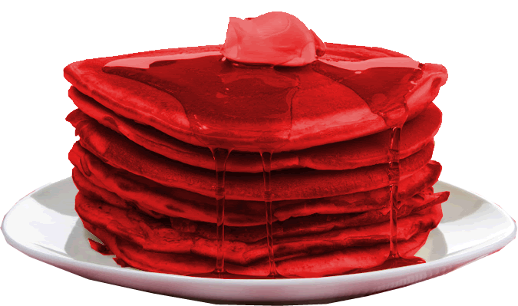
Cassandra Scene: Stack O’ Woe
Feast of Thyestes
Trojan War
Murder of Agamemnon &
Cassandra
Murder of Clytemnestra
Notes:
in choral passages from the first half, the imagery creates a chaotic, almost hallucinogenic series of connections, plunging the the storytelling into a mad spiral.
we see more of the same in Cassandra’s likewise lyric ravings.
her powerful yet incoherent prophecies stack horror on horror so that sequentially distinct stages in the story (past, present, and future) collapse onto each other like the platforms of a failed scaffolding. we, like Cassandra, feel crushed, but also see all too clearly how all the horrors connect. endowed now with our own visionary powers, we break free from the logic of ordinary causation. instead, we see how the terror rages “back and back in the future / . . .
so, too, within the poetic texture of the play as whole, themes, images, and plot-action reverberates backwards and forwards, creating poetic worm-holes allowing instant shifts across time and place. the horror drips through the whole like a bloody stack of pancakes.

