Slide 1
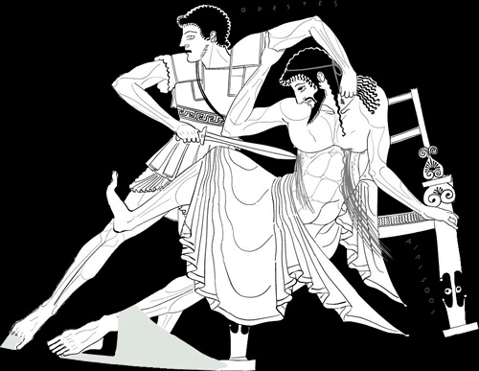
Aeschylus’ Libation Bearers
The Downward Spiral
Orestes
Aegisthus
Notes:
QUESTION

Slide 2
Question...

Slide 3
Is dikē hubris?
(Does it have to be hubris?)

Slide 4
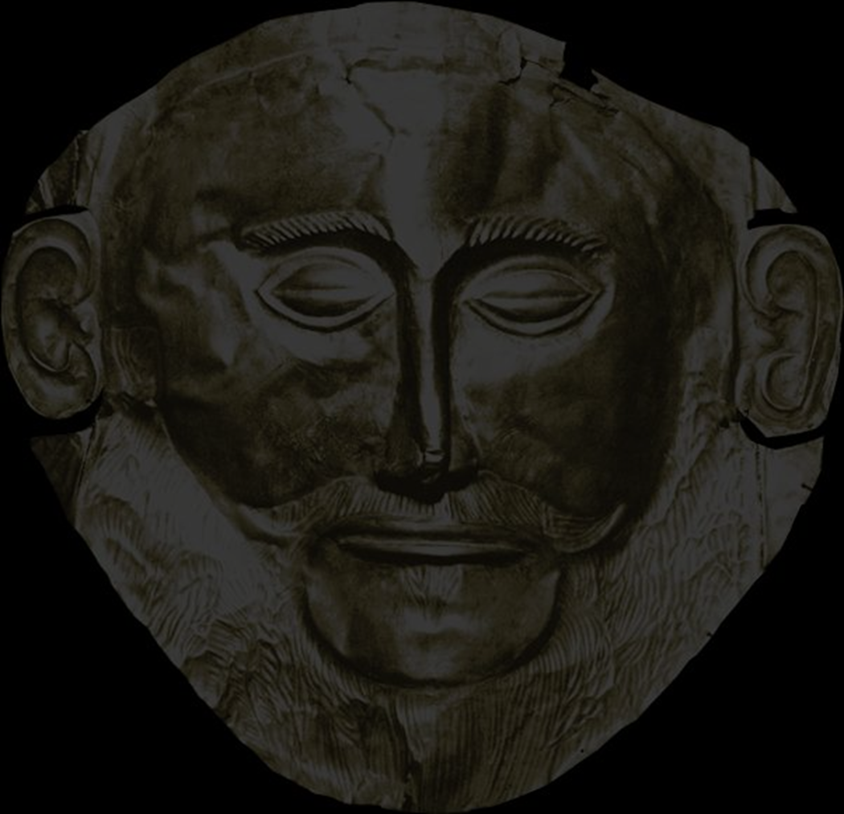
Is dikē hubris?
ELECTRA:
  … teach me what to say
CHORUS LEADER:
  Let some god or man come down upon them.
ELECTRA:
  Judge or avenger, which?
LEADER:
  Just say “the one who murders in return.”
ELECTRA:
  How can I ask the gods for that and keep my conscience clear?
LEADER:
  How not, and pay the enemy back in kind?
Notes:
IS A NON-HUBRISTIC DIKE POSSIBLE? CAN JUSTICE CONSENT TO A BRIGHTER FUTURE FOR THE HOUSE OF ATREUS? FOR ANYONE?
if so, what are the criteria of a “just” justice?
where is a privileged justice? if the lex talionis cannot bring closure, what can?
is the principle of “help friends, harm enemies” in 1st episode electra + chorus ultimately just?
pp. 181-2. chor: “say a blessing as you pour, for those who love you … [friends =] all who hate Aegisthus.” cly and aeg = those upon whom chor wishes “let some god or man come down upon them.”
[other quotes
CHORUS (p. 180): “to cleanse a man’s red hands swells the bloody tide”
182-3: leader: just say (i.e., pray for) the one who murders in return! el: how can i ask the gods for that and keep my conscience clear? leader: how not, and pay the enemy back in kind?
ap to or: “gore them like a bull … or pay their debt with your own life…. – such oracles are presuasicve, don’t you think? … and even if i’m not convinced, so many of yearnings meet and urge me on” 191-2

Slide 5
Is dikē hubris?
ORESTES (to Clytemnestra):
  You killed and it was outrage — suffer outrage now (p. 219)
Notes:
ch: “let the grey retainer, murder, breed no more”
Orestes to Clytaemnestra: “You killed and it was outrage—suffer outrage now” (p. 219 l. 917: Ορ. ἔκανες ὃν οὐ χρῆν, καὶ τὸ μὴ χρεὼν πάθε.)

Slide 6
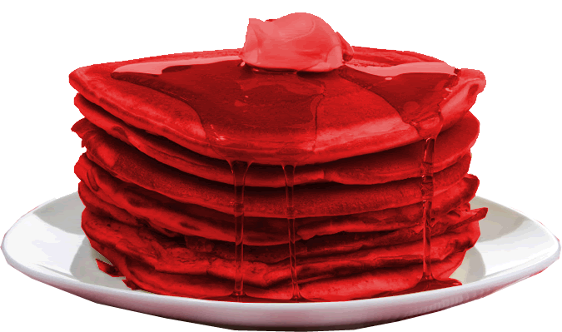
“Where will it end?”
(Chorus, p. 226)
Feast of Thyestes
Killing of Iphigenia
Trojan War
Murder of Agamemnon &
Cassandra
Murder of Clytemnestra
Notes:
where will it end? will it end with, ...
the murder of cly?
or must the cycle go on and on, each new, libation of blood, each new drink offering poured onto the earth, demanding yet another and another?
how to break the cycle of violence?

Slide 7
Agenda
Cold Open
  Is dikē hubris? Where will it end?
Recap and Update
  Here We Go Again. . .
Performance Project
  Clytemnestra-Orestes Showdown (agōn, pp. 215 ff.)

Slide 8
Recap and Update
Here We Go Again. . .

Slide 9
Oresteia: Ideological Conflicts
man | v. | woman
civic harmony | v. | civic chaos
(democracy | v. | tyranny)
persuasion | v. | violence
new | v. | old
JUSTICE | v. | JUSTICE
Notes:
the plays speak the language of ideological affirmation:
of gender ideologies, political ideologies, and so on.
Tragedy a vehicle for putting the city and society on trial, whether for the purpose of validation, critique, or both.
the conflicts dramatized in the three oresteia plays necessarily put a whole range of cherished truths on trial:
that the patriarchal suppression of women (par for the course in the world known to our playwright and his audience) is just.
that make ambition is beneficial and socially desirable.
that the conflicts that inevitably arise in the social-political order can be neatly resolved through existing institutions
but in a world where crime punishes crime, could justice itself be the problem?
thus the desis, the complication or problem, now becomes JUSTICE V JUSTICE:
the presumptively just dictates of apollo’s oracle, which demands the killing of agamemnon be avenged.
the presumptively just dictates of the furies, earth-born goddesses of retribution, who seek to hound orestes, the mother-killer, into madness?

Slide 10
Historical Context: Athens
508 Athenian democracy
479 Persia defeated
461 Constitutional crisis
  Areopagus veto-power rescinded
  Full democracy achieved
Athenian Acropolis
Libation Bearers Study Guide, Historical Background
Notes:
we see political themes with a democratic slant poaking their way into the drama at certain points
Agamemnon:
The people’s voice is heavy with hatred,
now the curses of the people must be paid [the people, understood here as enraged by the deaths of greeks at troy, like a fury. note the greek – emphasizes not just anger but power of the demos, the people]
βαρεῖα δ᾽ ἀστῶν φάτις ξὺν κότῳ·
δημοκράτου δ᾽ ἀρᾶς τίνει χρέος. (456-457)
clyt to ag (later in play):
our child is gone, not standing by our side,
the bond of our dearest pledges, mine and yours;
by all rights our child should be here . . .
Orestes. You seem startled.
You needn’t be. Our loyal brother-in-arms
will take good care of him, Strophios the Phocian.
He warned from the start we court two griefs in one.
You risk all on the wars - and what if the people
rise up howling for the king, and anarchy
should dash our plans?
ag (later): “Victory, you have sped my way before, / now speed me to the last.” (p. 134). the context is ag’s fear of subversion at home, of false friends and of elements that need to be rooted out. a king like him cannot rest of his laurels; he must always be winning. put differently, kingship is necessarily unstable

Slide 11
Libation Bearers: Analysis
Prologue 177 f. Orestes
  Offering of hair
Parodos 178 ff.
  Mourning, libations, Clytemnestra’s dream, general foreboding
1st episode (beginning) 180 ff.
  Electra, Leader, Orestes, whole Chorus
  recognition, reunion
Kommos (lyric interlude) 192 ff.
  Electra, Orestes, Chorus
  Mourning, invocation
1st episode (end) 198 ff. Electra, Leader, Orestes
  More invocation, Clytemnestra’s dream, plan
2nd stasimon. 204 ff. (“... the Earth breeds many marvels)
2nd episode 206 ff. Orestes, Porter, Clyt, Leader, Nurse
  Deception. Chorus: “... can the vigour of our voices serve Orestes?”)
3rd stasimon 212 f. Prayers for justice
3rd episode 213 ff.
  Killing, agōn, killings
4th stasimon 219 f.
  Victory song
Exodos 221 ff.
  Orestes, Chorus, Leader. Victory, madness, Furies
Notes:
this play is in several ways a doublet for the the ag: is central event is the act of revenge around which the rest of the action revolves. (hence my subtitle for today’s lecture, “here we go again.”
1st episode. contains quasi-reprise of the Persians conjuration scene. only here, the spirit of ag is invoked not to make a special appearance all on his own, but to empower and guide the avengers.
1st stasimon 204 f.
p. 204 – anticipation of the 1st stasimon of Antigone. “marvels, the earth breeds many marvels, … oh but a man’s high daring spirit, who can account for that?”
Clyt’s crime, nature/myth parallels. catalogue of women’s hubris, precursor-parallel to the “many are the wonders” chorus from antigone.
the earth’s wonders
althaia, mother of meleager
scylla, megarian princess and in love with minos, kills father nisus (beseiging enemy of minos) by cutting his lock of immortal hair
“woman’s brazen cunning” – misogynistic?
lemnian women (husbands take thracian mistresses, kill all men, marry argonauts, surviving men on lemnos carry off athenian women, men kill wives and children fearing the athenian loyalties of the athenian brides)
2nd episode 206 ff.
Orestes, Porter (doorman), Clyt, Leader, nurse
deceptive messenger speech in brief:
leader: “oh dear friends who serve the house, when can we speak out, when can the vigor of our voices serve orestes?” – the power of the chorus is in their words
p. 210. nurse, bewailing the supposed death of or, recalls, among other things, taking him out to relieve himself as an infant. “oh I tried and I missed” – rare comic relief in aeschylus
p. 211, chorus let’s nurse in on secret of or’s return (cf. od), instructs not to convey cl’s bodyguard instruction to aeg
exodos with ekkuklema scene explicitly reprising parallel scene from agamemnon:
the twin bodies wheeled out on trolley, clyt wrapped in the weavings, metonymically linked to the red carpet, with which she ensnared aga in his bath before stabbing him.
but new development, too: the Furies, or Erinues, goddesses of retribution, seeking the blood of orestes, a mother-killer implicated in blood-guilt.

Slide 12
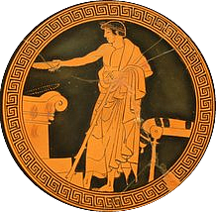
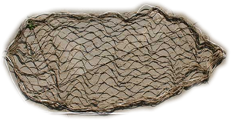
Associative Poetics
libations
nets
snakes
Notes:
imagery in oresteia
metonymically unifies, provides a kind of carrier wave upon which dramatic transformations - reversals etc. - play out
pay especially close attention to red robes in eum
but imagery obviously does not stop there …
Libation
drink offering for gods or deceased
vengeance as “blood offering”
vengeance as a “toast”
Zeus the Savior: the third toast-libation
Orestes, of Aegisthus: “Our Fury never wants for blood. His (Aegisthus’ blood) she drinks unmixed (i.e., like wine straight up), our third libation to saving Zeus” (lines 564–5)
Nets
vengeance as hunting and capture
p. 221, or displays the bodies of cly and aeg wrapped in the garments that ensnared ag – a double death matching that of ag and cass
Snakes
death, underworld
health (Asclepius)
clyt herself (ag died “in … the viper’s dark embrace,” or 190)
Clytaemnestra’s dream
pp. 200-1. that she had borne a snake. swaddled it like a baby. bit her breast to draw milk curdled by blood. “No idle dream. The vision of a man.” (ch, p. 201) or: I am the serpent. the blood imagery also recalls libations. the shedding of blood in vengeance is a drink offering to the dead in the earth.
Furies:
Orestes: “No, no! Women–look–like Gorgons, shrouded in black, their heads wreathed, swarming serpents!” (1048–50)
phallic symbols??

Slide 13
Tragic Patterns
Aristotelian Analysis
“Ancient Law of hubris and atē”
  Complex plot
    Anagnorisis (recognition)?
    Peripeteia (reversal)?
  Desis (complication)?
  Lusis (resolution)?
  Pity, fear, catharsis?
  koros (excess, extravagance)
  hubris (arrogance, violation)
  atē (delusion, ruin)
  dikē (justice)
Also: Blood guilt, cycle of violence

Slide 14
Tragic Patterns: Aeschylean Progression
verbal
ambiguous
human
visual
clear
divine
to
Notes:
how realized in LB?
as in the ag, so too in the lb, the finale exhibits the visible outcome of vengeance: bloody bodies wheeled out on the ekkuklema. the riddle of clyt’s dream is resolved, its prophecy fulfilled. but we have yet to bring gods clearly into the picture

Slide 15
ELECTRA: Orestes -
can I call you? — are you really-
ORESTES: I am!
Open your eyes. (p. 188)
ORESTES: He (Agamemnon) died in the coils, the viper’s dark embrace. (p. 190)
CHORUS: It is the law: when the blood of slaughter
wets the ground it wants more blood.
Slaughter cries for the Fury
of those long dead to bring destruction
on destruction churning in its wake! (p. 195)

Slide 16
“And the ancient pride (sebas) no war, / . . . could tame. . . . Success (to eutukhein), / they bow to Success, more god than god himself. / But Justice (Dikē) waits and turns the scales. . . . And the blood that mother earth consumes . . . breeds revenge / and frenzy (Atē) goes through the guilty, / seething like infection, swarming through the brain” (Chorus, parodos, p. 179)

Slide 17
CHORUS: Oh but a man’s high daring spirit,
who can account for that? Or woman’s
desperate passion daring past all bounds?
She couples with every form of ruin known to mortals.
Woman, frenzied, driven wild with lust,
twists the dark, warm harness
of wedded love - tortures man and beast! (p. 204)

Slide 18
CLYTEMNESTRA: Ai- you are the snake I bore — I gave you life! (p. 219)

Slide 19
Performance Project
Clytemnestra-Orestes Showdown (agōn, pp. 215 ff.)

Slide 20
Procedure
Read-through of scene.
Discussion: issues/themes in the scene, challenges in performance.
Discussion: performance solutions, suggestions.

