Slide 1
Sophocles’ Oedipus the King
“Know Thyself!” — If you Dare!

Slide 2
Eumenides appeal hearing, conclusion:
The judges’ decision
Judges, front and center

Slide 3
A scene from Oedipus’ backstory. We see Oedipus kill, we don’t know whom. What do we learn?
https://www.youtube.com/watch?v=K62P7A7ELJE
Notes:
When we read or teach the play Oedipus the King, we often treat it as a sort of nightmare version of public television’s, Finding Your Roots.
A horrifying origin story, an unfolding drama of recognition and reversal. An emotional roller-coaster: hopes raised, lowered, buoyed up again, then dashed to bits.
A story of a man who cannot escape his fate, an exemplar of the tragic condition of humankind.
For there’s Oedipus himself, quite apart from his history and fate. What does Oedipus himself — his nature, his character — What do we learn about the scene enacted here, one narrated in the play by Jocasta and then by Oedipus himself?
How does Oedipus’ anger matter to the play?

Slide 4
reader 1
O the generations of men
the dying generations — adding the total
of all your lives I find they come to nothing ...
does there exist, is there a man on earth
who seizes more joy than just a dream, a vision?
And the vision no sooner dawns than dies
blazing into oblivion.
You are my great example, you, your life
your destiny, Oedipus, man of misery —
I count no man blest.
(Chorus Oedipus the King, p. 233)
reader 2
“You are my
great example”
Notes:
O the generations of men
the dying generations—adding the total
of all your lives I find they come to nothing ...
does there exist, is there a man on earth
who seizes more joy than just a dream, a vision?
And the vision no sooner dawns than dies
blazing into oblivion.
You are my great example, you, your life
your destiny, Oedipus, man of misery—
I count no man blest.
You outranged all men!
Bending your bow to the breaking-point
you captured priceless glory, O dear god,
and the Sphinx came crashing down,
the virgin, claws hooked
like a bird of omen singing, shrieking death—
like a fortress reared in the face of death
you rose and saved our land. From that day on we called you king
we crowned you with honors, Oedipus, towering over all—
mighty king of the seven gates of Thebes. But now to hear your story — is there a
man more agonized?
More wed to pain and frenzy? Not a man on earth,
the joy of your life ground down to nothing
O Oedipus, name for the ages....
In the third stasimon of soph’s Oedipus the King, on p. 233 of the Penguin edition, the chorus sings: “… is there a man on earth who seizes more joy than just a dream, a vision? … you are my great example, you, your life your destiny oedipus, man of misery – I count no man blest.”
“I count no man blest,” says the chorus, and they cite Oedipus as proof.
so what does that mean? how does Oedipus prove that human existence is tragic?
because most of us, I suspect, would think that oed’s situation – killed his father, slept with his mother – differs from common experience. though most of us might agree that oed’s situation is really, really, tragic, most would think that’s because it’s really, really sad – kind of creepy, really.
hence a question: how is this play, how is this character tragic? because it’s uncommonly sad? or for some other reason, for instance, because it’s expressive of the human condition, as the play itself would seem to suggest? and if the latter, how does that work?
all of which is meant to advance the project we started with a little further. what is tragic? is there something universal about tragedy? is tragedy particular to individual contexts? so, not just what is tragedy, but what is greek tragedy?

Slide 5
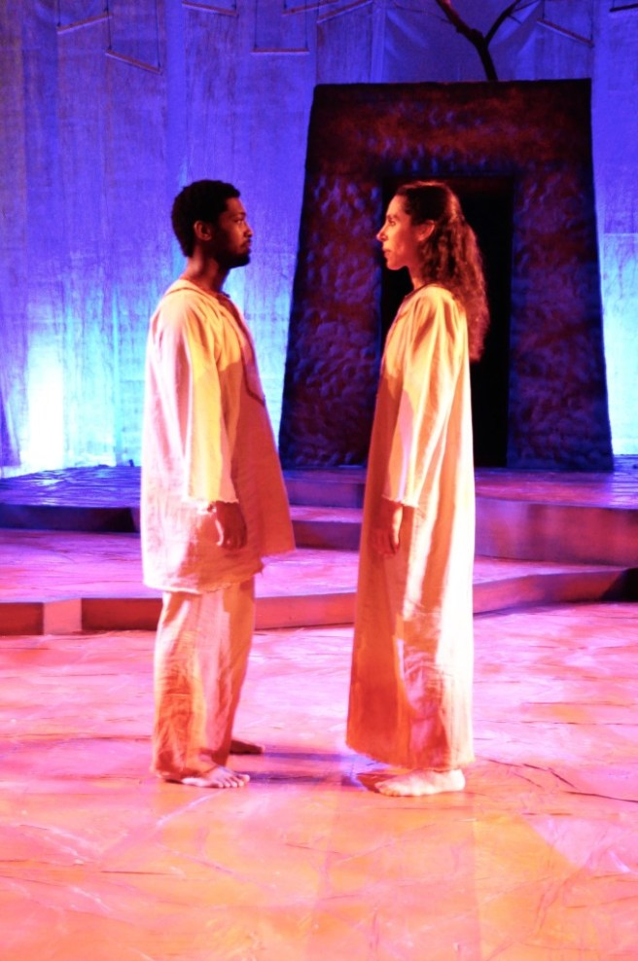
“My Example”: Why not Jocasta?
MESSENGER: The queen is dead.
LEADER: Poor lady—how?
MESSENGER: By her own hand. ... (p. 235)
“You are my great example,
Oedipus”
Oedipus & Jocasta, Pittsburg production, 2017
Notes:
how is Oedipus’, not Jocasta’s, suffering “my great example”?
Does Oedipus’ suffering matter more?

Slide 6
Agenda
Cold Open
  Appeals hearing: conclusion
  Oedipal anger
  “My Great Example”
Sophocles’ Oedipus the King
  An Introduction
Tragic Transformations
  Oedipus’ Rite of Passage

Slide 7
Sophocles’ Oedipus the King
An Introduction

Slide 8
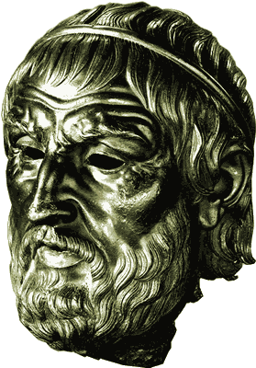
Sophocles, “Theban Plays”
Playwright
  ca. 496-ca. 406 BCE
  first victory 468
Plays
  Antigone, ca. 441
  Oedipus the King, between Antigone and OC
  Oedipus at Colonus, ca. 406
Sophocles

Slide 9
Oedipus’ Family, Backstory
Cadmus
Polydorus
Labdacus
Menoeceus
Laius
Jocasta
Creon
Eurydice
Oedipus
Jocasta
Polynices
Eteocles
Antigone
Ismene
Haemon
Megareus

Slide 10
Oedipus the King, Analysis
Prologue 15 ff.
  Oedipus, priest, Creon. Plague, oracle
Parodos 168 ff.
  Divine invocation. War on plague
1st episode 171 ff.
  Oedipus, Tiresias. agōn 1
1st stasimon 186 f.
  Who is the killer?
2nd episode 188 ff.
  Creon, Oedipus. agōn 2
  1st kommos (197 ff.)
    Chorus, J, Oedipus
  Comparison of oracles
2nd stasimon 209 f.
  Pride breeds the tyrant
3rd episode 211 ff.
  Jocasta, Corinthian messenger, Oedipus. Polybus dead. Oedipus “child of fortune”
3rd stasimon 224
  desperate optimism
4th episode 225 ff.
  Oedipus, Shepherd, J. recognition
4th stasimon 233 f.
  Oedipus man of sorrows
Exodos
  Messenger, Oedipus. J’s suicide
  2nd kommos (240 ff.)
    Chorus, Oedipus., Oed’s grief
  Oedipus, Creon. final arrangements
Notes:
PROLOGUE
blood-guilt, plague
CORRUPTION: oracle to creon: drive the corruption from the land” (164)
again: blood-guilt/pollution/purification theme – here, conflation of pollution with guilt
oracle “Drive the corruption from the land, / don’t harbor it any longer, past all cure, / don’t nurse it in your soil – root it out!” (164)
cr understands that as "pay the killers [of laius] back“ (164)
we find in beginning of play there’s a plague at thebes. disease has settled over the city, it’s crops, animals, and people. a healing is sought – sort of like a purification. but we also meet oedipus, “you all know me, the world knows my fame.” displays a hubristic attitude. question: where will that attitude end up? displays as well possibly patronizing attitude. “I would be blind to misery not to pity my people kneeling at my feet.”
priest to Oedipus, possibly foreshadowing? “you cannot equal the gods, / your children [paides but = subjects] know that. but we do rate you first of men….” hero-oed. they supplicate Oedipus almost as if he were a god.
with creon’s arrival we learn from creon (back from delph) the cause of the plague. murder. so tragic patterns. problem? thebes in effect punished for not punishing malefactor. the sphinx a distraction. the killer is the “heart of our corruption” (miasma – technical term for ritual pollution, what catharsis is to wash away.) Oedipus asks how to cleanse selves. (99 Oedipus Ποίῳ καθαρμῷ;) either by killing or by banishing killer.
chorus: invocational hymn. zeus. athena. artemis. apollo. dionysus (alludes to d’s connection to thebes). describing the dead: they go “like seabirds winging west outracing the day’s fire.”
EPISODE 1. Oedipus: “you pray to the gods? let me grant your prayers.” oed’s proclamation. the killer is to reveal self and go into exile. why? at ahtens, that was often presented as a de facto option to accused killers. would distance killer from family of deceased, plus remove from athens source of pollution. even if doesn’t reveal self, still to be driven out. dramatic irony of calling curse on self if Oedipus harbors killer.
leader-oed dialogue. hints at “rumors” etc. furious foreshadowing.
tir-oed. in effect, AN AGON. for tir, the horror of truth. p. 178. oed’s unseemly wrath. cf. creon in ant. Oedipus revealed by tir as murderer and incestuous husband. so the suspense will Oedipus, will we ever believe tir? is so how? Oedipus blames cr. p. 185. “blind who now has eyes, beggar who now is rich” – oed’s reversal foreshadowed.
STAS 1 chorus baffled.
EPI 2. oed-creon. AGON. then, oed-j dialogue. j reveals the laius oracle. resonates with o’s memory of fork in road. Oedipus now fearful. remembers drunken man’s words. recounts his and laius’ road-rage. each exhibits hubris to the other.
2ND STAS. “pride breeds the tyrant violent pride, gorging, crammed to bursting / with all that is overripe and rich with ruin.” (872–877 Υβρις φυτεύει τύραννον· ὕβρις, εἰ / πολλῶν ὑπερπλησθῇ μάταν / ἃ μὴ ᾽πίκαιρα μηδὲ συμφέροντα, / ἀκρότατα γεῖσ᾽ ἀναβᾶσ᾽ / <ἄφαρ> ἀπότομον ὤρουσεν εἰς ἀνάγκαν). the tyrant, then, as a quintessential tragic figure – in sense of awaiting doom correcting excesses.
3RD EPI j in response to corinthian news declares world ruled not by decree of gods or fate but by chance. after all the news and revelation from corinthian messenger, Oedipus must have truth. j freaks. oed’s determination to know truth of himself just as unrelenting as the tenor of previous messages regarding the matter. is this need to know hubristic? j had been speaking oof chance. he now adopts chance as his parent. “I count myself the son of Chance, / the great goddess, giver of all good things” (p. 224).
4TH STAS. soph’s notorious pessimism. Oedipus as exemplary of all humanity’s tragic fate. we are all Oedipus – how?
p. 233 of the Penguin edition, the chorus sings: “… is there a man on earth who seizes more joy than just a dream, a vision? … you are my great example, you, your life your destiny oedipus, man of misery – I count no man blest.”
EXODOS. no waters can in fact purify house of thebes acc to 2nd messenger reporting on oed’s self-blinding, j’s suicide. “he was raging, one of the dark powers pointing the way” – that would be atē.

Slide 11
Tragic Transformations
Rite of Passage

Slide 12
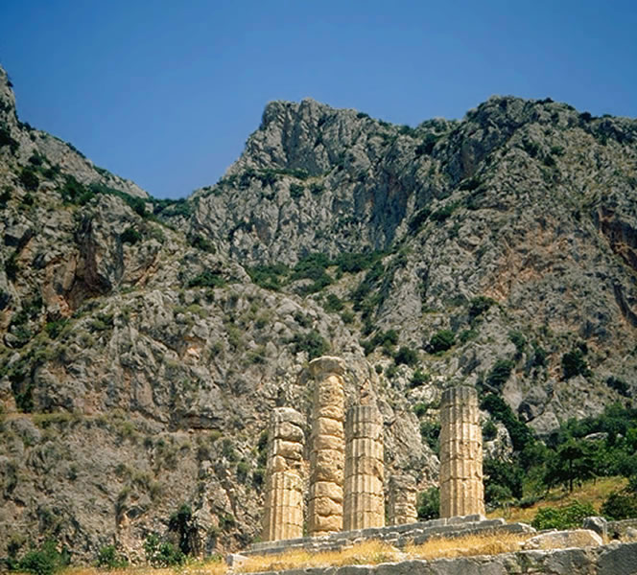
gnōthi sauton
“Know thyself!”
Temple of Apollo, Delphi
Notes:
pathei mathos, from suffering, knowledge (agamemnon)
explain the delphi quote, how it frames
if oed is the paradigmatic tragic character, and if his knowledge of self is the ultimate tragic sort knowledge, what is the value-added in tragic knowledge, even for those who are audience and supposedly insulated from the suffering on stage? is aristotle right, that the vicarious experience of another’s suffering is a healthful purifying for us?

Slide 13
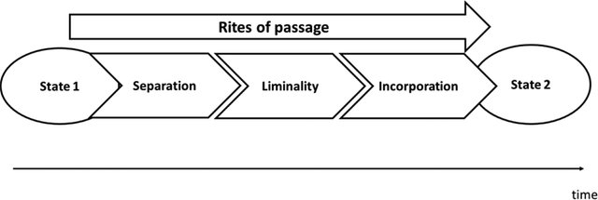
aka transition
Arnold van Gennep, Les rites de passage (Paris, 1909)
Notes:
“rite of passage”
ceremony to accompany a life-crisis, like coming of age

Slide 14

Oedipus’ Rite of Passage
“I count myself the son of Chance,”
(Oedipus, p. 224)
sight
ignorance
incorporation
blindness
knowledge
separation
transition
Oedipus
Notes:
anagnorisis, peripeteia, lusis all rolled into one
note the transitional stage, dramatized in oed’s case as child-of-chance stage
J (p. 215): What should a man fear? It’s all chance,
chance rules our lives. Not a man on earth
can see a day ahead, groping through the dark.
Better to live at random, best we can
Oedipus p. 224: I count myself the son of Chance,
the great goddess, giver of all good things —
I’ll never see myself disgraced. She is my mother!
And the moons have marked me out, my blood-brothers,
one moon on the wane, the next moon great with power.
That is my blood, my nature—I will never betray it,
never fail to search and learn my birth!
no one's son (son of chance, a personified abstraction)
EVERYONE'S son (son of chance i.e., potentially any number of possible mothers)
the universal Oedipus, the exemplar of everyone’s voyage of self-discovery, becomes the radically accursed Oedipus, universally abhored
p. 241. “apollo, friends, Apollo – he ordained my agonies – these my pains on pains! but the hand that struck my eyes was mine.” Oedipus declares his agency in his own punishment – a kind of reversal for the fates!

