Slide 1
Sophocles’ Oedipus the King 1
“Know Thyself!” — If You Dare!

Slide 2
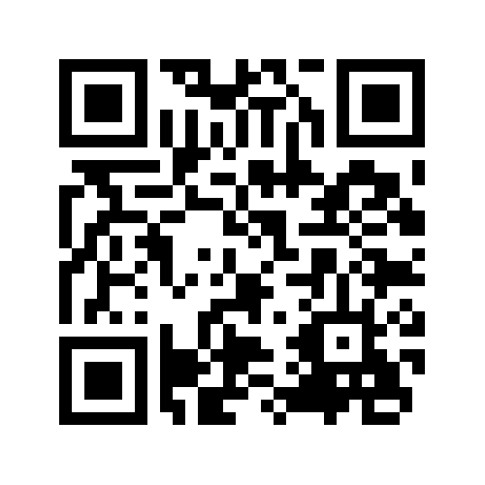

Nominate Your Career Champ
Nominate by Friday, Dec. 4, for a chance to win a $25 gift card!
Notes:
Who has helped you find your way?
A professor who helped you gain new skills? A staff member who connected you with professionals in your field? A mentor who encouraged you to dream bigger? Take a moment to recognize someone who has impacted your personal and professional journey!
NOMINATE YOUR CAREER CHAMPION
A Career Champion is a Binghamton University staff or faculty member who has helped you:
Explore career options
Connect with employers for jobs or internships
Apply for graduate school
Gain skills or experience

Slide 3
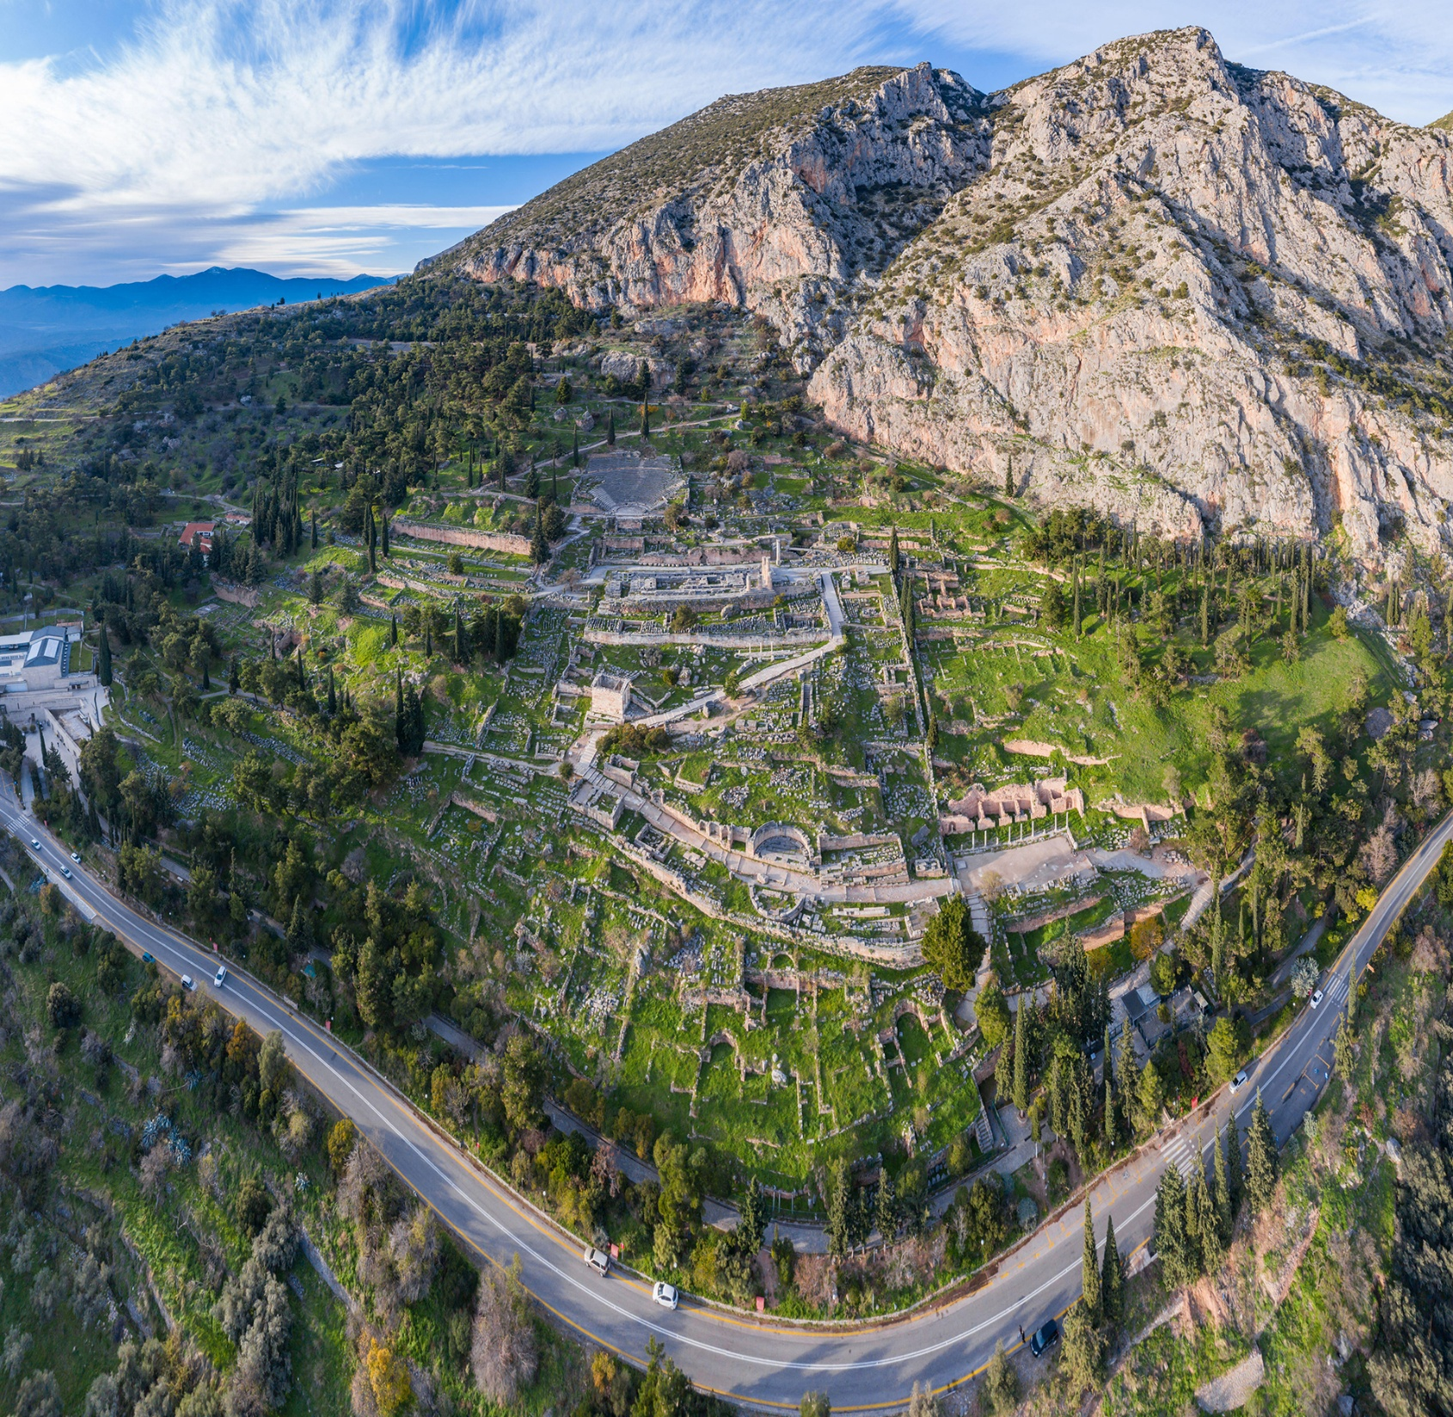
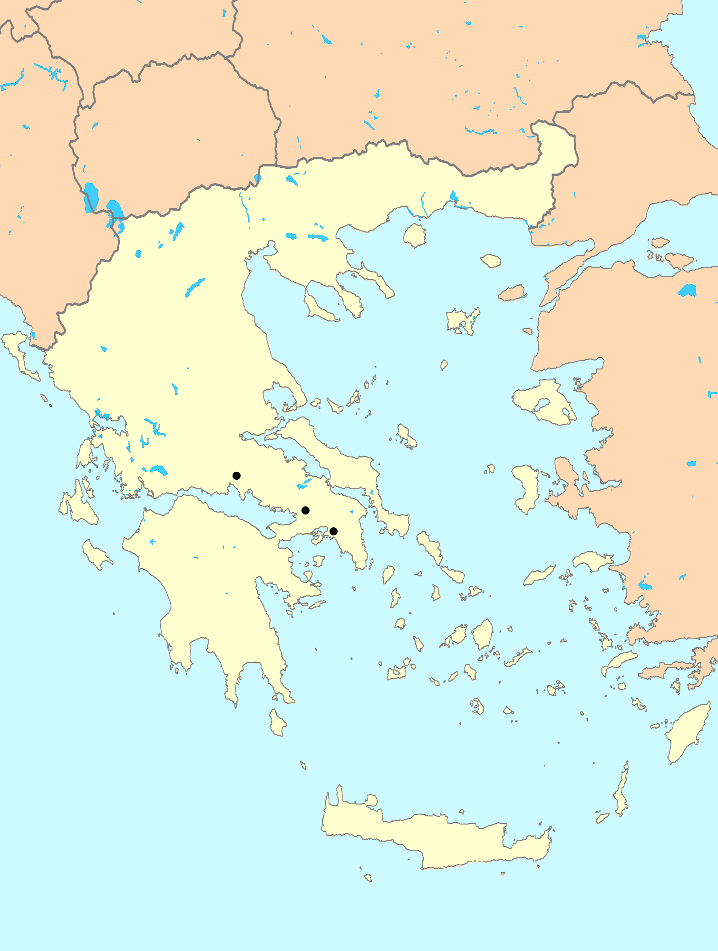
Delphi. Aerial Photo
Temple of Apollo, Delphi
Delphi
Thebes
Athens
Notes:
Delphi, from the late 800s BCE until the last recorded consultation of its oracle in 363 CE (by the emperor Julian), played host to what was, probably, the single most important oracular site center in the ancient Greek-speaking, indeed, in the Mediterranean world. Oracles were centers of prophecy, always dedicated to a particular god; in the case of Delphi, to Apollo. Suppliants would come to Delphi at certain times of year with their questions; the god would answer. The priestess, the Pythia, served as Apollo’s mouthpiece.

Slide 4
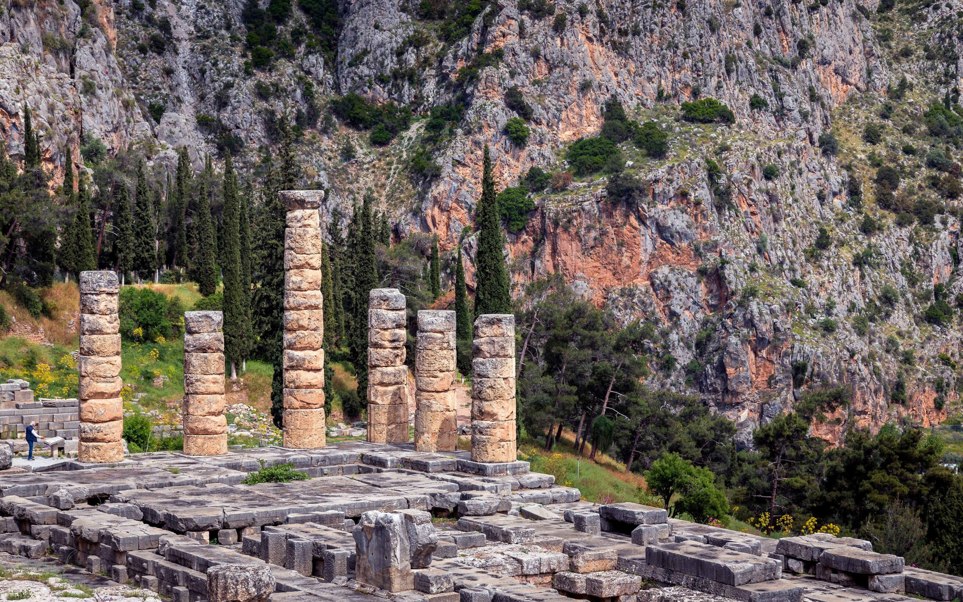
gnōthi sauton (Latin, temet nosce)
“Know thyself!”
Notes:
The temple was entered from the east through an entry porch, the remains of which you see here, to the left. On its walls were written a number of proverbs, the most famous of which was, gnōthi sauton (Latin, temet nosce), “Know thyself!”
In Sophocles’ Oedipus plays, we learn that the oracle predicted to Oedipus’ parents that their child, once grown, would kill his father and marry his mother.
Why does the Delphic oracle tell you to “know thyself?” Isn’t it enough that the god knows everything and can tell you what you want to know? Let’s watch a clip and then return to the question.

Slide 5
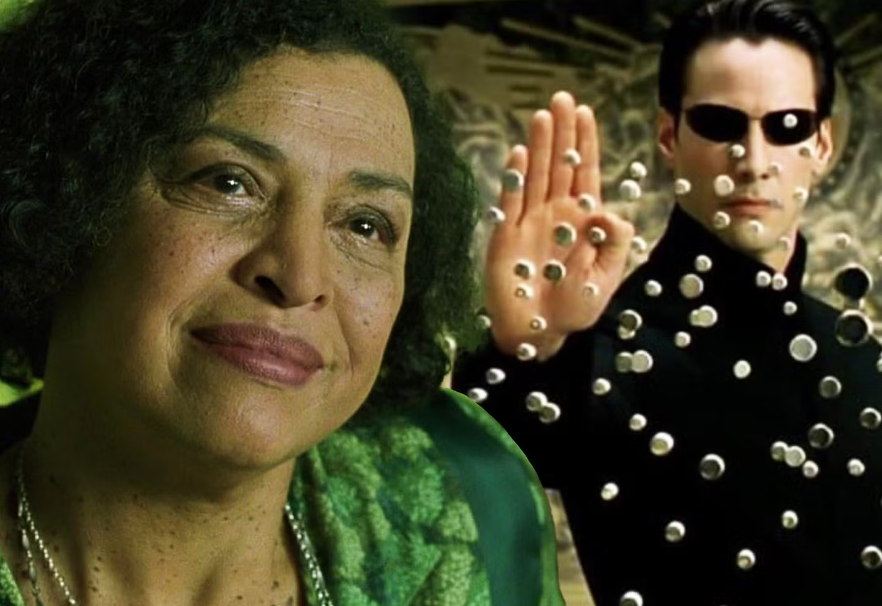
Oracle Scene, Matrix 1
Notes:
So, why does it matter?
[in asking if he is “the one,” neo is, in effect, asking who he is. until neo figures that out for himself, whatever she says is less than useless to him. because knowing the future and causing the future are two, very different things.]

Slide 6
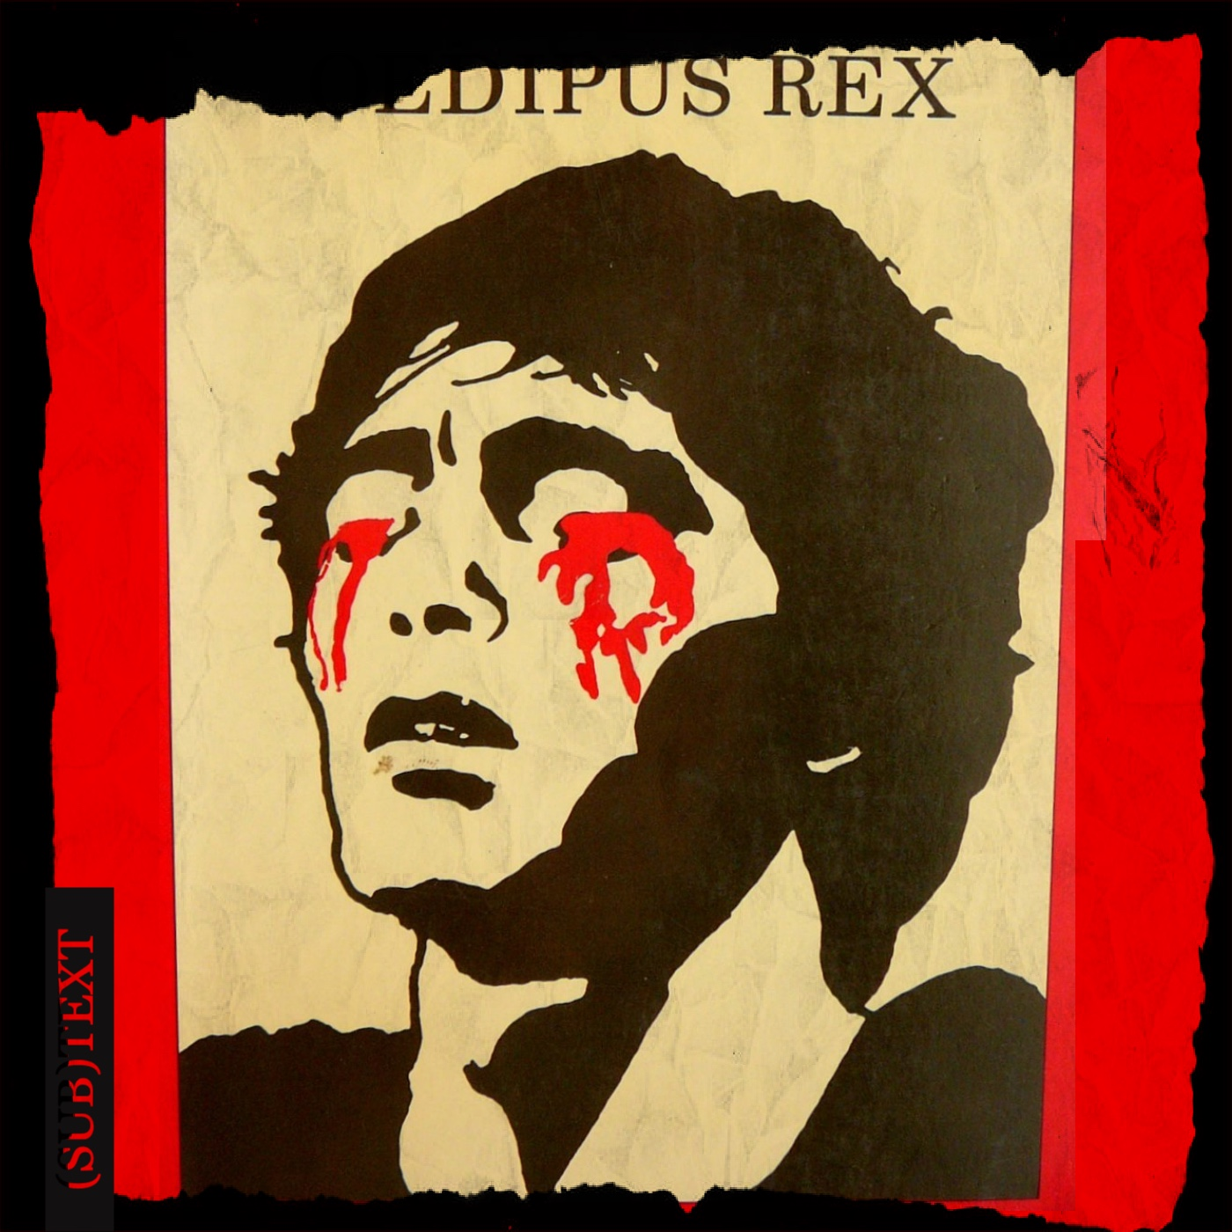
Oedipus, fate, self-knowledge
Notes:
But we’re not interested in Neo; we’re interested in Oedipus.
When Oedipus himself had reached manhood, he heard from a drunken guest at his foster parents palace (Oedipus grew up in Corinth, not Thebes, where he was born) that his parents weren’t who he thought they were.
So Oedipus goes to Delphi to ask the god who his parents really were. But Oedipus gets the same answer, that he would kill his father and marry his mother.

Slide 7
Agenda
Discussion
  Critchley, Oedipus: Are We Prisoners of Fate?
Oedipus the King
  An Introduction

Slide 8
Discussion
Critchley, Oedipus: Are We Prisoners of Fate?

Slide 9
Guiding Questions
Are we prisoners of fate? And even if we are (to one degree or another), does that release us from responsibility for our acts?
Notes:
Think back to the Critchley reading and claims made there about how
"we collude, seemingly unknowingly, with the calamity that befalls us"
the Oedipus the King (OTK), as the (supposed) template for all tragedy (literary, experiential), "In its movement from a delusional self-knowledge and the fantasy of an unencumbered freedom to an experience of an insight into truth that costs us our eyes, ... gives voice to an experience of agency that is partial and very often painful"
"In tragedy, time is out of joint, and the linear conception of time as a teleological flow from the past to the future is thrown into reverse"
"Tragedy has a kind of boomerang structure where the action that we throw out into the world returns to us with a potentially fatal velocity"
"[W]e are tyrants, too"

Slide 10
Breaking It Down
Does OTK support SC? Explain
Fate — respond to Soph, SC
Does support (moral agency)
  Both J and O try to avoid prophecy, happens
  Oed didn’t not kill
  Oed ignores inconvenient prophecy
Narcissism-tyranny
Narcissism-tyranny, maybe in O’s case. We can sympathize with O’s incredulity
Element of victim-blaming
  Maybe we need to nuance what SC says
  Stories a little fake, circular reasoning
Self-fulfilling prophecy
Limited/narrow-minded perspective
But did O actually deserve it?

Slide 11
Critchley Quotations 1
“What … Greek tragedies enact over and over again is not a misfortune that is outside our control. Rather, they show the way in which we collude, seemingly unknowingly, with the calamity that befalls us.”
Notes:
Critchley ch3. “What the thirty-one extant Greek tragedies enact over and over again is not a misfortune that is outside our control. Rather, they show the way in which we collude, seemingly unknowingly, with the calamity that befalls us.”

Slide 12
Critchley Quotations 2
“One lesson of tragedy, then, is that we conspire with our fate. That is, fate requires our freedom in order to bring our destiny down upon us.”

Slide 13
Critchley Quotations 3
“The core contradiction of tragedy is that we both know and we don’t know at one and the same time and are destroyed in the process.”

Slide 14
Critchley Quotations 4
“The tyrant doesn’t hear what is said to him and doesn’t see what is in front of his eyes.
“But we are tyrants too.”

Slide 15
Oedipus the King, Introduction
An Introduction

Slide 16
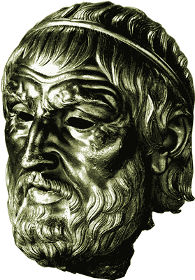
Sophocles, “Theban Plays”
Playwright
  ca. 496-ca. 406 BCE
  first victory 468
Plays
  Antigone, ca. 441
  Oedipus the King, ca. 429?
  Oedipus at Colonus, ca. 406
Sophocles

Slide 17
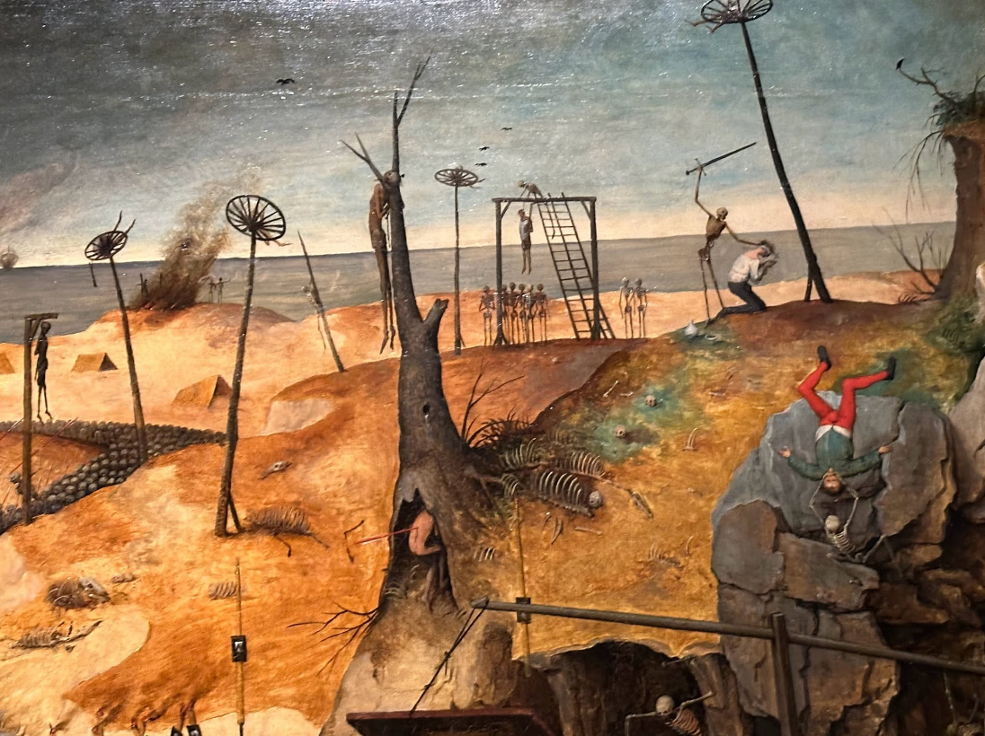
Historical Context: Athens
Peloponnesian War
  431–404 BCE
Great Plague of Athens
  430–426
“Drive him back!—the fever, the god of death / that raging god of war” (Chorus, p. 170)
Breughel, Triumph of Death

Slide 18
Oedipus’ Family, Backstory
Cadmus
Polydorus
Labdacus
Menoeceus
Laius
Jocasta
Creon
Eurydice
Oedipus
Jocasta
Polynices
Eteocles
Antigone
Ismene
Haemon
Megareus
Notes:
[summarize backstory.]

Slide 19
Oedipus the King, Analysis 1
Prologue 15 ff.
  Oedipus, priest, Creon. Plague, oracle
Parodos 168 ff.
  Divine invocation. War on plague
1st episode 171 ff.
  Oedipus, Tiresias. agōn 1
1st stasimon 186 f.
  Who is the killer?
2nd episode 188 ff.
  Creon, Oedipus. agōn 2
  1st kommos (197 ff.)
    Chorus, Jocasta, Oedipus
  Comparison of oracles
Notes:
PROLOGUE
blood-guilt, plague
CORRUPTION: oracle to creon: drive the corruption from the land” (164)
again: blood-guilt/pollution/purification theme – here, conflation of pollution with guilt
oracle “Drive the corruption from the land, / don’t harbor it any longer, past all cure, / don’t nurse it in your soil – root it out!” (164)
cr understands that as "pay the killers [of laius] back“ (164)
we find in beginning of play there’s a plague at thebes. disease has settled over the city, it’s crops, animals, and people. a healing is sought – sort of like a purification. but we also meet oedipus, “you all know me, the world knows my fame.” displays a hubristic attitude. question: where will that attitude end up? displays as well possibly patronizing attitude. “I would be blind to misery not to pity my people kneeling at my feet.”
priest to Oedipus, possibly foreshadowing? “you cannot equal the gods, / your children [paides but = subjects] know that. but we do rate you first of men….” hero-oed. they supplicate Oedipus almost as if he were a god.
with creon’s arrival we learn from creon (back from delph) the cause of the plague. murder. so tragic patterns. problem? thebes in effect punished for not punishing malefactor. the sphinx a distraction. the killer is the “heart of our corruption” (miasma – technical term for ritual pollution, what catharsis is to wash away.) Oedipus asks how to cleanse selves. (99 Oedipus Ποίῳ καθαρμῷ;) either by killing or by banishing killer.
chorus: invocational hymn. zeus. athena. artemis. apollo. dionysus (alludes to d’s connection to thebes). describing the dead: they go “like seabirds winging west outracing the day’s fire.”
EPISODE 1. Oedipus: “you pray to the gods? let me grant your prayers.” oed’s proclamation. the killer is to reveal self and go into exile. why? at ahtens, that was often presented as a de facto option to accused killers. would distance killer from family of deceased, plus remove from athens source of pollution. even if doesn’t reveal self, still to be driven out. dramatic irony of calling curse on self if Oedipus harbors killer.
leader-oed dialogue. hints at “rumors” etc. furious foreshadowing.
tir-oed. in effect, AN AGON. for tir, the horror of truth. p. 178. oed’s unseemly wrath. cf. creon in ant. Oedipus revealed by tir as murderer and incestuous husband. so the suspense will Oedipus, will we ever believe tir? is so how? Oedipus blames cr. p. 185. “blind who now has eyes, beggar who now is rich” – oed’s reversal foreshadowed.
STAS 1 chorus baffled.
EPI 2. oed-creon. AGON. then, oed-j dialogue. j reveals the laius oracle. resonates with o’s memory of fork in road. Oedipus now fearful. remembers drunken man’s words. recounts his and laius’ road-rage. each exhibits hubris to the other.

Slide 20
Oedipus Quotations
“You pray to the gods? Let me grant your prayers.” (To Chorus, p. 171)
“… I came by, Oedipus the ignorant, / I stopped the Sphinx! With no help from the birds, / the flight of my own intelligence hit the mark.” (to Tiresias, p. 182)

Slide 21
Tiresias Quotations
“I say you are the murderer you hunt.”
“You cannot imagine ... I tell you, / you and your loved ones live together in infamy, / you cannot see how far you’ve gone in guilt.” (p. 180)

Slide 22
Oedipus nd Creon agōn
Oedipus
Creon
“You, plotting to kill me, kill the king — / I see it all, the marauding thief himself / scheming to steal my crown and power!” (p. 189)
“How could kingship / please me more than influence, power / without a qualm?” (p. 193)

