Slide 1
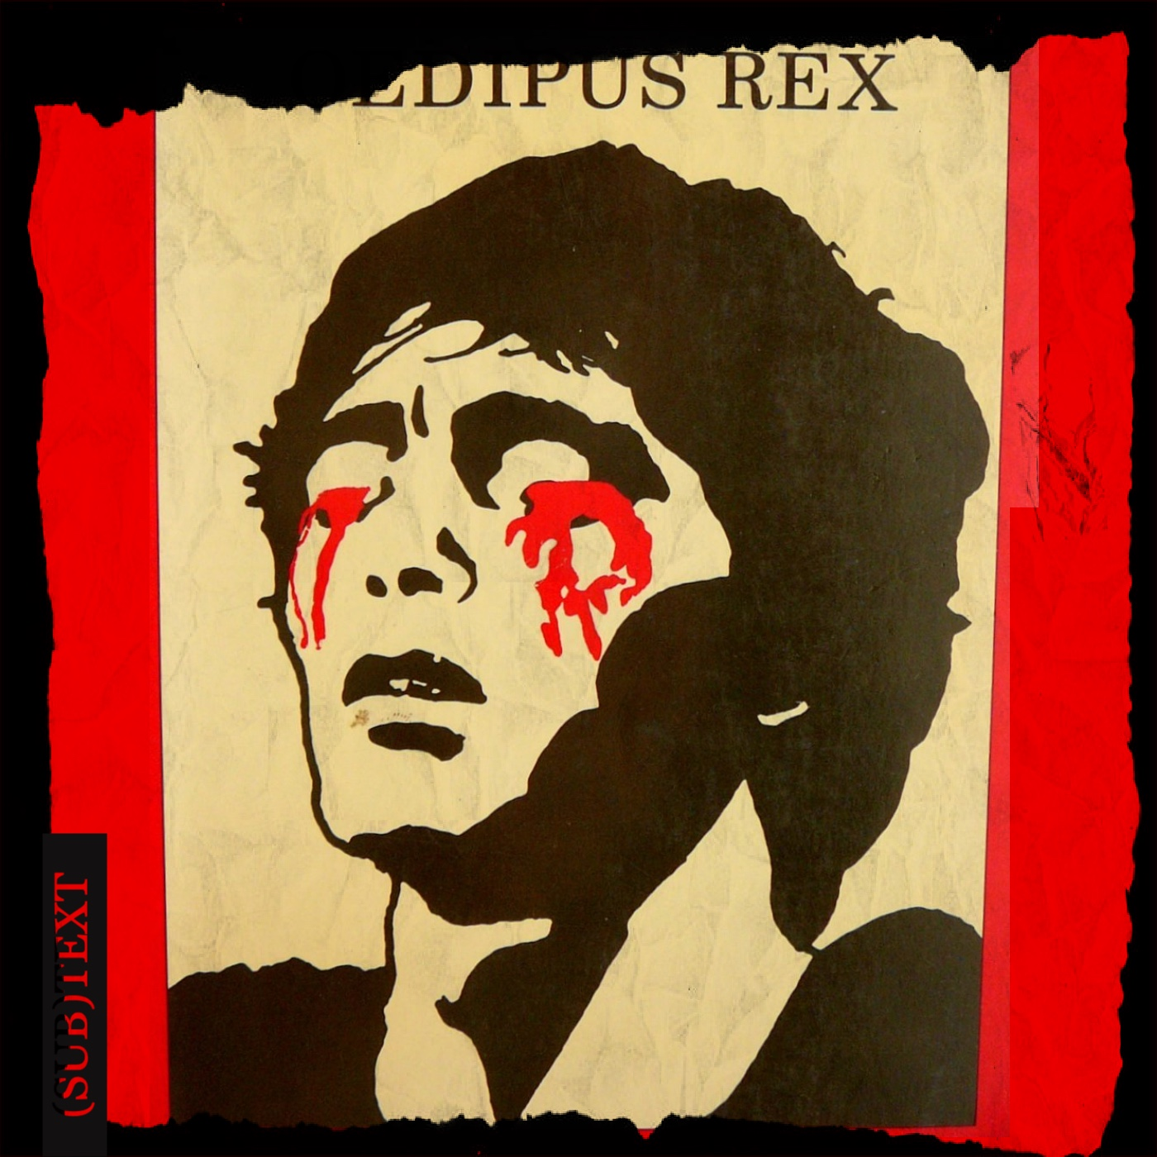
Sophocles’ Oedipus the King 2
“Know Thyself!” — If You Dare!

Slide 2
OTK 4th Stasimon, Reader 1
Oh, the generations of men
the dying generations — adding the total
of all your lives I find they come to nothing ...
does there exist, is there a man on earth
who seizes more joy than just a dream, a vision?

Slide 3
OTK 4th Stasimon, Reader 2
And the vision no sooner dawns than dies
blazing into oblivion.
You are my great example, you, your life
your destiny, Oedipus, man of misery —
I count no man blest.
(Chorus, Oedipus the King p. 233)
Notes:
O the generations of men
the dying generations—adding the total
of all your lives I find they come to nothing ...
does there exist, is there a man on earth
who seizes more joy than just a dream, a vision?
And the vision no sooner dawns than dies
blazing into oblivion.
You are my great example, you, your life
your destiny, Oedipus, man of misery—
I count no man blest.
You outranged all men!
Bending your bow to the breaking-point
you captured priceless glory, O dear god,
and the Sphinx came crashing down,
the virgin, claws hooked
like a bird of omen singing, shrieking death—
like a fortress reared in the face of death
you rose and saved our land. From that day on we called you king
we crowned you with honors, Oedipus, towering over all—
mighty king of the seven gates of Thebes. But now to hear your story — is there a
man more agonized?
More wed to pain and frenzy? Not a man on earth,
the joy of your life ground down to nothing
O Oedipus, name for the ages....
In the third stasimon of soph’s Oedipus the King, on p. 233 of the Penguin edition, the chorus sings: “… is there a man on earth who seizes more joy than just a dream, a vision? … you are my great example, you, your life your destiny oedipus, man of misery – I count no man blest.”
“I count no man blest,” says the chorus, and they cite Oedipus as proof.
so what does that mean? how does Oedipus prove that human existence, all of it, is tragic? Critchley would tell us that we’re all Oedipus because we’re all “tyrants”: all of us let the fatal signs, the fate that we’re complicit in, go overlooked. Sophocles’ chorus tells us that it’s hubris that breeds the tyrant, maybe it’s hubris, a carelessly destructive arrogance, that makes us what we are. and what we are is tragic. but I have a question for you….

Slide 4
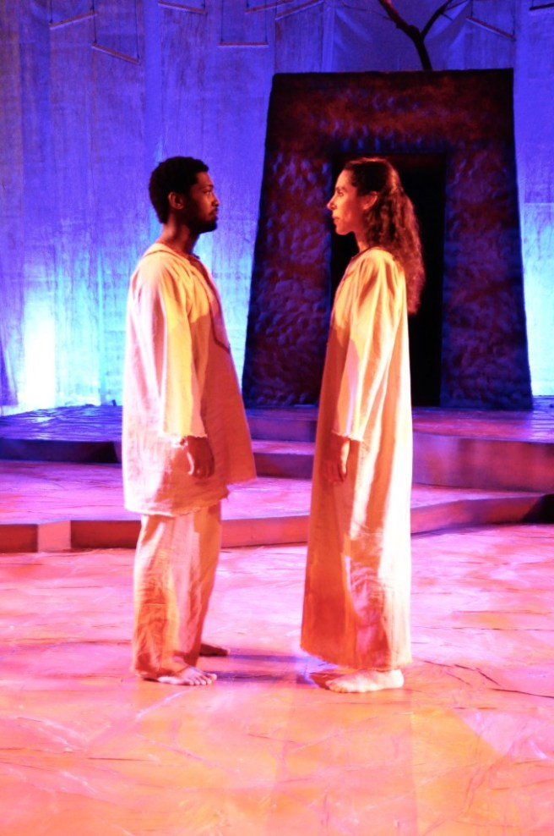
“My Example”: Why not Jocasta?
MESSENGER: The queen is dead.
LEADER: Poor lady—how?
MESSENGER: By her own hand. ... (p. 235)
“You are my great example, Oedipus”
Oedipus & Jocasta, Pittsburg production, 2017
Notes:
why Oedipus? why not Jocasta? whose tragedy is greater, Oedipus’ or Jocasta’s — Jocasta, who, terrified by a terrible prophecy, tried to head it off by killing her baby. Jocasta, whose, fate simply boomeragned right back on her. Jocasta, for whom the horror was so great that death, not blindness, was the only relief.
how is Oedipus’, not Jocasta’s, suffering “my great example”? Does Oedipus’ suffering matter more?

Slide 5
Agenda
Discussion
  Critchley, Oedipus: Are We Prisoners of Fate?
Recap and Update
  Oedipus the King: The Perfect Tragedy?

Slide 6
Discussion
Critchley, Oedipus: Are We Prisoners of Fate?

Slide 7
Guiding Questions
Are we prisoners of fate? And even if we are (to one degree or another), does that release us from responsibility for our acts?
Notes:
Think back to the Critchley reading and claims made there about how
"we collude, seemingly unknowingly, with the calamity that befalls us"
the Oedipus the King (OTK), as the (supposed) template for all tragedy (literary, experiential), "In its movement from a delusional self-knowledge and the fantasy of an unencumbered freedom to an experience of an insight into truth that costs us our eyes, ... gives voice to an experience of agency that is partial and very often painful"
"In tragedy, time is out of joint, and the linear conception of time as a teleological flow from the past to the future is thrown into reverse"
"Tragedy has a kind of boomerang structure where the action that we throw out into the world returns to us with a potentially fatal velocity"
"[W]e are tyrants, too“

Slide 8
Breaking It Down
Does OTK support SC? Explain
Fate — respond to Soph, SC
Does support (moral agency)
  Both J and O try to avoid prophecy, happens
  Oed didn’t not kill
  Oed ignores inconvenient prophecy
Narcissism-tyranny
Narcissism-tyranny, maybe in O’s case. We can sympathize with O’s incredulity
Element of victim-blaming
  Maybe we need to nuance what SC says
  Stories a little fake, circular reasoning
Self-fulfilling prophecy
Limited/narrow-minded perspective
But did O actually deserve it?
Notes:
Critchley ch3. “What the thirty-one extant Greek tragedies enact over and over again is not a misfortune that is outside our control. Rather, they show the way in which we collude, seemingly unknowingly, with the calamity that befalls us.”
“One lesson of tragedy, then, is that we conspire with our fate. That is, fate requires our freedom in order to bring our destiny down upon us.”
“The core contradiction of tragedy is that we both know and we don’t know at one and the same time and are destroyed in the process.”
“The tyrant doesn’t hear what is said to him and doesn’t see what is in front of his eyes.
“But we are tyrants too.”

Slide 9
“Pride breeds the Tyrant”
“Pride (hubris) breeds the tyrant
violent pride, gorging, crammed to bursting
with all that is overripe and rich with ruin—
clawing up to the heights, headlong pride
crashes down the abyss—sheer” (Chorus, Oedipus the King p. 209)
Notes:
common ground: Herington, Critchley

Slide 10
Guiding Questions (discuss)
Are we prisoners of fate? And even if we are (to one degree or another), does that release us from responsibility for our acts?

Slide 11
Recap and Update
Oedipus the King: The Perfect Tragedy?

Slide 12
Oedipus the King, Analysis 1
Prologue 15 ff.
  Oedipus, priest, Creon. Plague, oracle
Parodos 168 ff.
  Divine invocation. War on plague
1st episode 171 ff.
  Oedipus, Tiresias. agōn 1
1st stasimon 186 f.
  Who is the killer?
2nd episode 188 ff.
  Creon, Oedipus. agōn 2
  1st kommos (197 ff.)
    Chorus, Jocasta, Oedipus
  Comparison of oracles
Notes:
PROLOGUE
blood-guilt, plague
CORRUPTION: oracle to creon: drive the corruption from the land” (164)
again: blood-guilt/pollution/purification theme – here, conflation of pollution with guilt
oracle “Drive the corruption from the land, / don’t harbor it any longer, past all cure, / don’t nurse it in your soil – root it out!” (164)
cr understands that as "pay the killers [of laius] back“ (164)
we find in beginning of play there’s a plague at thebes. disease has settled over the city, it’s crops, animals, and people. a healing is sought – sort of like a purification. but we also meet oedipus, “you all know me, the world knows my fame.” displays a hubristic attitude. question: where will that attitude end up? displays as well possibly patronizing attitude. “I would be blind to misery not to pity my people kneeling at my feet.”
priest to Oedipus, possibly foreshadowing? “you cannot equal the gods, / your children [paides but = subjects] know that. but we do rate you first of men….” hero-oed. they supplicate Oedipus almost as if he were a god.
with creon’s arrival we learn from creon (back from delph) the cause of the plague. murder. so tragic patterns. problem? thebes in effect punished for not punishing malefactor. the sphinx a distraction. the killer is the “heart of our corruption” (miasma – technical term for ritual pollution, what catharsis is to wash away.) Oedipus asks how to cleanse selves. (99 Oedipus Ποίῳ καθαρμῷ;) either by killing or by banishing killer.
chorus: invocational hymn. zeus. athena. artemis. apollo. dionysus (alludes to d’s connection to thebes). describing the dead: they go “like seabirds winging west outracing the day’s fire.”
EPISODE 1. Oedipus: “you pray to the gods? let me grant your prayers.” oed’s proclamation. the killer is to reveal self and go into exile. why? at ahtens, that was often presented as a de facto option to accused killers. would distance killer from family of deceased, plus remove from athens source of pollution. even if doesn’t reveal self, still to be driven out. dramatic irony of calling curse on self if Oedipus harbors killer.
leader-oed dialogue. hints at “rumors” etc. furious foreshadowing.
tir-oed. in effect, AN AGON. for tir, the horror of truth. p. 178. oed’s unseemly wrath. cf. creon in ant. Oedipus revealed by tir as murderer and incestuous husband. so the suspense will Oedipus, will we ever believe tir? is so how? Oedipus blames cr. p. 185. “blind who now has eyes, beggar who now is rich” – oed’s reversal foreshadowed.
STAS 1 chorus baffled.
EPI 2. oed-creon. AGON. then, oed-j dialogue. j reveals the laius oracle. resonates with o’s memory of fork in road. Oedipus now fearful. remembers drunken man’s words. recounts his and laius’ road-rage. each exhibits hubris to the other.

Slide 13
Oedipus the King, Analysis 2
2nd stasimon 209 f.
  Pride breeds the tyrant
3rd episode 211 ff.
  Jocasta, Corinthian messenger, Oedipus. Polybus dead. Oedipus “child of fortune”
3rd stasimon 224
  desperate optimism
4th episode 225 ff.
  Oedipus, Shepherd, Jocasta. Recognition
4th stasimon 233 f.
  Oedipus man of sorrows
Exodos
  Messenger, Oedipus. J’s suicide
  2nd kommos (238 ff.)
    Chorus, Oedipus., Oed’s grief
  Oedipus, Creon. final arrangements
Notes:
2ND STAS. “pride breeds the tyrant violent pride, gorging, crammed to bursting / with all that is overripe and rich with ruin.” (872–877 Υβρις φυτεύει τύραννον· ὕβρις, εἰ / πολλῶν ὑπερπλησθῇ μάταν / ἃ μὴ ᾽πίκαιρα μηδὲ συμφέροντα, / ἀκρότατα γεῖσ᾽ ἀναβᾶσ᾽ / <ἄφαρ> ἀπότομον ὤρουσεν εἰς ἀνάγκαν). the tyrant, then, as a quintessential tragic figure – in sense of awaiting doom correcting excesses.
3RD EPI j in response to corinthian news declares world ruled not by decree of gods or fate but by chance. after all the news and revelation from corinthian messenger, Oedipus must have truth. j freaks. oed’s determination to know truth of himself just as unrelenting as the tenor of previous messages regarding the matter. is this need to know hubristic? j had been speaking oof chance. he now adopts chance as his parent. “I count myself the son of Chance, / the great goddess, giver of all good things” (p. 224).
4TH STAS. soph’s notorious pessimism. Oedipus as exemplary of all humanity’s tragic fate. we are all Oedipus – how?
p. 233 of the Penguin edition, the chorus sings: “… is there a man on earth who seizes more joy than just a dream, a vision? … you are my great example, you, your life your destiny oedipus, man of misery – I count no man blest.”
EXODOS. no waters can in fact purify house of thebes acc to 2nd messenger reporting on oed’s self-blinding, j’s suicide. “he was raging, one of the dark powers pointing the way” – that would be atē.

Slide 14
Aristotle Poetics on OTK
“The best form of recognition is coincident with a Reversal of the Situation, as in the Oedipus.”
“For the plot ought to be so constructed that, even without the aid of the eye, he who hears the tale told will thrill with horror and melt to pity at what takes place. This is the impression we should receive from hearing the story of the Oedipus.”

Slide 15
Simon Critchley on OTK
“As a first step, we might consider the [Greek tragedy] that has been … held up as the highest exemplar of tragedy: Oedipus the King.”
“Greek tragedy provides lessons in shame. When we learn that lesson and finally achieve some insight, as Oedipus does, then it might cost us our sight and we might pluck out our eyes — for shame.”
Notes:
“As a first step, we might consider the most famous of the Athenian tragedies, the one that has been, since the time of Aristotle’s Poetics, held up as the highest exemplar of tragedy: Oedipus the King.”

Slide 16
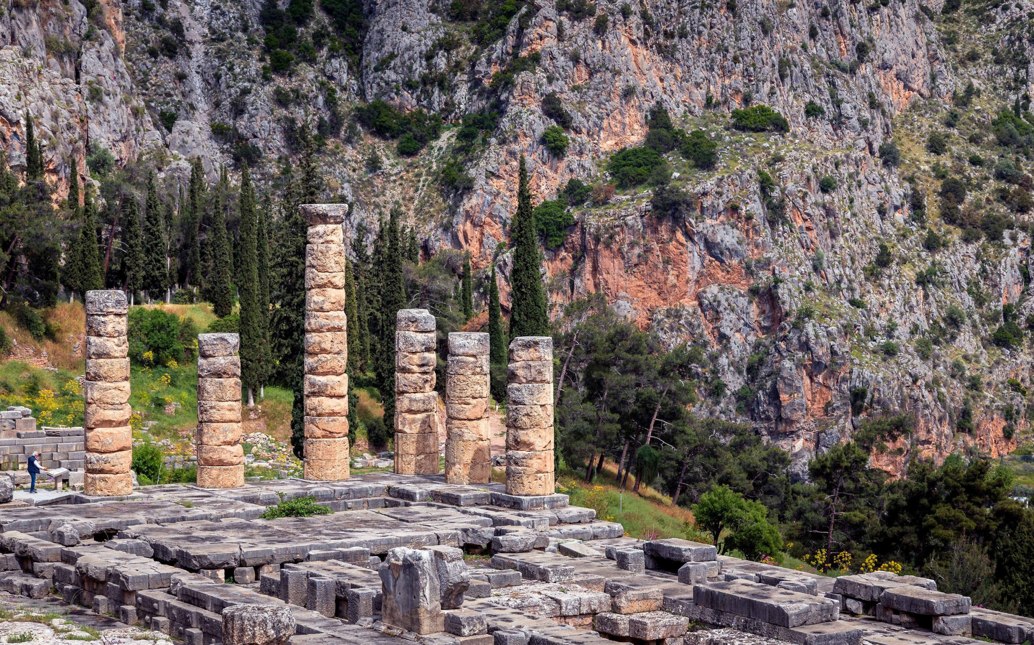
gnōthi sauton (Latin, temet nosce)
“Know thyself!”

Slide 17
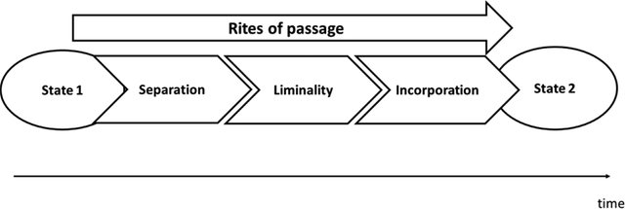
Rites of Passage
Arnold van Gennep, Les rites de passage (Paris, 1909)
Notes:
https://www.researchgate.net/profile/Jonas_Soederlund/publication/321103675/figure/fig1/AS:632629175021568@1527841957248/Stages-in-the-rites-of-passage_W640.jpg
“rite of passage”
ceremony to accompany a life-crisis, like coming of age

Slide 18

Recognition, Reversal, Rites of Passage
“I count myself the son of Chance,”
(Oedipus, p. 224)
sight
ignorance
incorporation
blindness
knowledge
separation
transition
Oedipus
Notes:
anagnorisis, peripeteia, lusis all rolled into one
note the transitional stage, dramatized in oed’s case as child-of-chance stage
J (p. 215): What should a man fear? It’s all chance,
chance rules our lives. Not a man on earth
can see a day ahead, groping through the dark.
Better to live at random, best we can
Oedipus p. 224: I count myself the son of Chance,
the great goddess, giver of all good things —
I’ll never see myself disgraced. She is my mother!
And the moons have marked me out, my blood-brothers,
one moon on the wane, the next moon great with power.
That is my blood, my nature—I will never betray it,
never fail to search and learn my birth!
no one's son (son of chance, a personified abstraction)
EVERYONE'S son (son of chance i.e., potentially any number of possible mothers)
the universal Oedipus, the exemplar of everyone’s voyage of self-discovery, becomes the radically accursed Oedipus, universally abhored
p. 241. “apollo, friends, Apollo – he ordained my agonies – these my pains on pains! but the hand that struck my eyes was mine.” Oedipus declares his agency in his own punishment – a kind of reversal for the fates!

