Slide 1
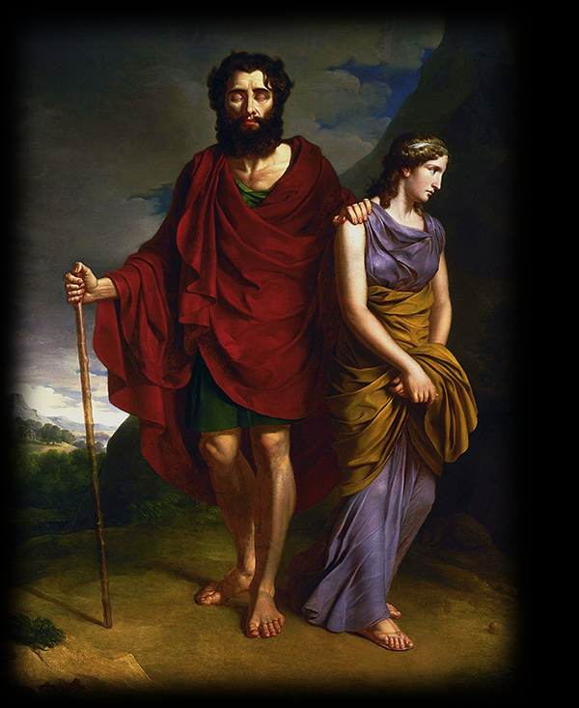
Pity the Man?
Sophocles’ Oedipus at Colonus
Notes:
“Oedipus and Antigon” by Antoni Brodowski (1828)

Slide 2
Midterm Questions?
(that can’t be answered with the study guide)

Slide 3
Appeals Hearing, Eumenides
Would Aeschylus’ original audience have found the mothers-aren’t-blood-parents argument convincing?
  How might that change the reception of the play?
The “Apollo made me do it” argument —
  The Furies are gods, too. Do Apollo’s prerogatives trump theirs?

Slide 4
Appeals Hearing, Eumenides (cont’d)
Is it ever valid to wish, or even to take steps to make sure that, the socially-politically expedient verdict is achieved?
  Are the repercussions of a verdict/judgment ever a valid consideration?
Should either side be arguing for, basically, vendetta justice?
  Isn’t trial by jury, maybe, a better idea?

Slide 5
Appeals Hearing, Eumenides (cont’d)
Is it possible, in the end, to achieve justice and buy-in and closure?
  Can we always have our cake and eat it, too?

Slide 6
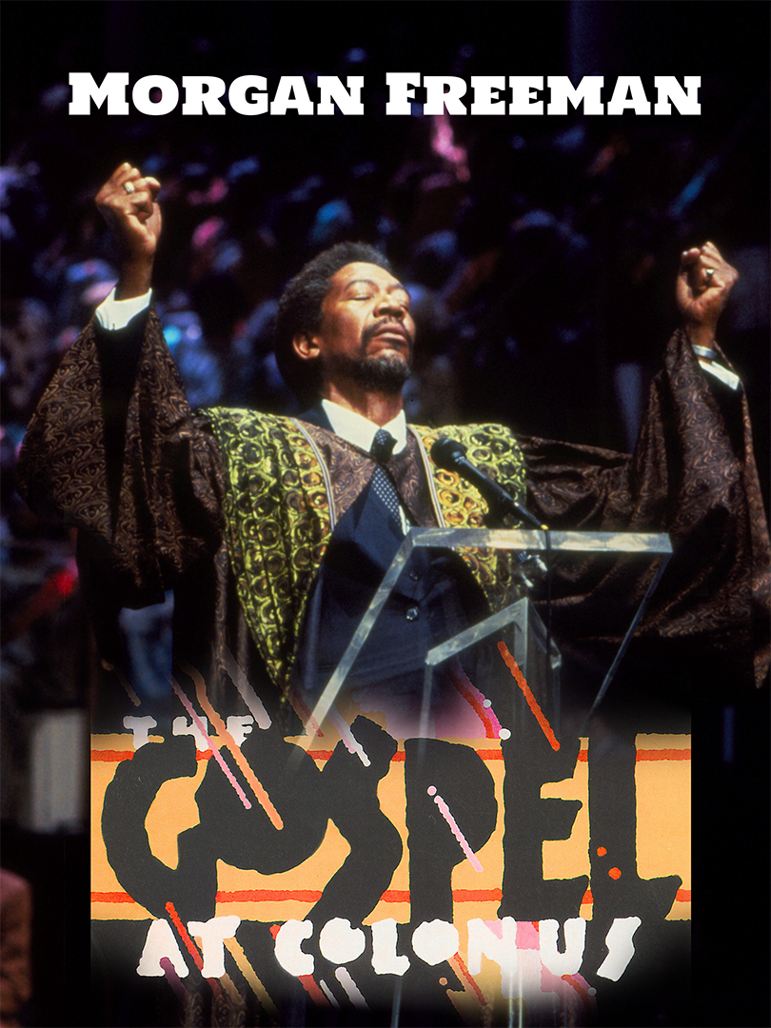
Sophocles’ OAC, third stasimon, adapted for
The Gospel at Colonus
(produced Broadway, 1988)
YouTube clip (57 mins 45 secs)
Notes:
The Gospel at Colonus opened on Broadway at the Lunt-Fontanne Theatre on March 11, 1988, in previews, officially on March 14, 1988, and closed on May 15, 1988, after 61 performances and 15 previews. Directed by Lee Breuer, the cast featured Morgan Freeman (Messenger), Sam Butler, Jr. (The Singer), Clarence Fountain and the Five Blind Boys of Alabama (Oedipus) and the Institutional Radio Choir of Brooklyn. Breuer was nominated for the 1988 Tony Award for his book. (Wikipedia)

Slide 7
Not to Be Born Is Best?!
“Not to be born is best
when all is reckoned in, but once a man has seen the light
the next best thing, by far, is to go back
back where he came from, quickly as he can.”
(Chorus, Sophocles Oedipus at Colonus, p. 358)

Slide 8
Agenda
Cold Open
  Midterm, Justice in Eumenides, Not to Be Born Is Best?!
Sophocles’ Oedipus at Colonus
  Introduction to Play
Ideological Orientations
  Space, Cult, Politics
Lenses
  What Light Do they Shed?

Slide 9
Sophocles’ Oedipus at Colonus
Introduction to Play

Slide 10
Sophocles, “Theban Plays”
Playwright
  ca. 496-ca. 406 BCE
  first victory 468
Plays – production dates
  Antigone, ca. 441
  Oedipus the King, after 429
  Oedipus at Colonus, ca. 406
Plays – story order
  Oedipus the King
  Oedipus at Colonus
  Antigone

Slide 11
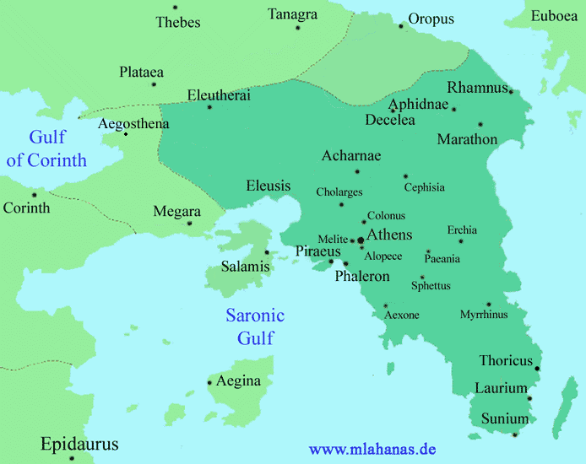
Thebes
33 miles
Colonus
Central Athens

Slide 12
Production, Historical Context
War with Sparta (and Thebes): 431–404 BCE
Great Plague of Athens: 430–426
Oligarchic revolution: 411/10
Colonus cavalry skirmish, 410 (407?)
Compositional Order
Antigone (ca. 442)
Oedipus the King (ca. 430?)
Oedipus at Colonus (ca. 406)
Notes:
series of military, political, even health crises/disasters for athens. possible reflection in plays
edmunds p. 96: scholiast aristid. on 4 172; cf. ds 13.72.3-73. spartan king agis led cavalry attack on athens; theban cavalry included. oedipus appeared at colonus; ralied athenian cavary. cf. also x hell. 1.1.33.

Slide 13
Analysis, pt 1
Prologue (pp. 284 ff.)
  Oedipus, Antigone, Citizen
  Identity, positioning
Parodos (291)
  Amoibaion (chorus-character dialogue)
  Chorus, Oedipus, Antigone
  Supplication
1st episode A (298)
  Leader, Oedipus, Ismene, Antigone
Amoibaion (314)
  Chorus, Oedipus
  Oed’s crimes (?)
1st episode B (318)
  Leader, Theseus, Oedipus
  Supplication, negotiation
1st stasimon (326)
  Praise (Colonus, Athens)
2nd episode (328)
  Antigone, Oedipus, Leader, Creon, Theseus
  tussle over Oedipus
Notes:
PROLOGUE. like Eumenides, this is explicitly a play seeking closure, reconciliation, atonement. Oedipus and Antigone arrive at grove of “terrible goddesses,” explicitly ID’d as eums and semnai (p. 289) – i.e., the furies – in colonus just outside ath.
the symbolism should not be lost on us. Oedipus, now at the end of his life, is going to negotiate atonement with the goddesses who, in effect, have hounded since even before his birth.
but he can’t simply achieve reconciliation with his fated sins with a snap of the fingers. that will involved his transforming into a kind of fury himself. he has to pass final ordeals first.
note deities associated with the spot they’ve arrived at: furies, poseidon, prometheus, and we’ll find out athena. we’ll find those deities hold political significance. statue of colonus, whose statue we can reasonably speculate is on stage.
but note, too, the question to “citizen”: “do you have a king or a common public voice?” answered “a king in the city governs these parts” – here theseus isn’t a proto-democrat but fully-fledged benevolent despot.
PARODOS. note that the parodos is unusual: an amoibaion. dramatizes the chorus entry as an encounter with an Oedipus who’s on stage the whole time. UNDERSCORES PLAY AS DRAMA OF PLACE.
among other things, like aesch eum, the story is brought to athens (or a suburb). that is brought to the fore in the undisguisedly patriotic 1st stasimon, which starts with praise of colonus, but finishes with praise of athens – clearly propagandistic during difficult period of pw. (celebration of dem and kore, goddesses of earth, of pos’s horses and athena’s olive.)
the drama here is whether the suppliant will be rejected or accepted. later it will be whether he’ll be hauled off to thebes or stay here. so this is a tragedy above all of place.
but it’s also a symbolic drama of place: how do we receive into our midst, not simply our city if we’re the chorus of the play, but into our audience psyches, the tragic horror of an oedipus? how is this somehow all a boon for us? note the dramatized pity-and-fear-but-also revulsion reaction of the chorus behaving like a stage audience.
but is this grove sacred to these goddesses of vengeance – is a foul, malodorous place??
(it is in fact a place so pure that the cold never touches it, even in winter, and flowers bloom the year round.)
1ST EPISODE
we learn from ismene about eteo’s and poly’s battle for the kingship. eteo (younger bro) seizes throne, poly seeks aid from argos. but ismene also informs Oedipus of oracles proclaiming his body a sacred object after death, powerful to ward off enemies. thebans seek to have oed’s body buried within theban control, though not within thebes itself (b/c of parricide).
I’ve mentioned oed’s rage – we see that, and grk anti-barbarian bias – in oed’s speech associating oed’s sons with effeminate egyptians (304).
p. 309 we see oed’s anger resurfacing – preview of later transformatiuon into alastor, male spirit of vengeance.
1st stasimon. praise of colonus and of athens
celebrates both places as quasi miraculous. evokes Poseidon and his gift to athens, the horse, initially. then goes on to evoke Athena’s olive and Poseidon’s ships – more blessings evocative of athens’ greatness.

Slide 14
Analysis, pt 2
2nd stasimon (348)
  Victory song
3rd episode (350)
  Leader, Oedipus, Antigone, Thes
  Leave-taking begins
3rd stasimon (358)
  The human condition
4th episode A (359)
  Antigone, Oedipus, Poly
  A father’s curse
Amoebic kommos, dialogue (371)
  Chorus, Oedipus, Antigone
  Portents
4th episode B (373)
  Theseus, Oedipus
4th stasimon (377)
  prayers for Oedipus
Exodos (378)
  Spoken dialogue, lyric kommos
  Messenger, leader, Antigone, Ismene, Theseus
  Oedipus’ demise. Lament, consolation
Notes:
2nd half of play shows us yet again an angry oedipus: angry at Polynices and eteocles, angry at creon. the ferocity of his anger and is shocking:
OEDIPUS: My son, king—that son I hate! His words alone
would cause me the greatest pain of any words,
any man alive. (p. 355)
anger of the gods and fate:
Such was the pleasure of the gods, raging,
perhaps, against our race from ages past. (Oedipus, p. 344)
that same quote, from near the middle of the play, suggests a connection between oed’s supposed guilt and the human condition. the gods have raged against us from the start; Oedipus can make no better sense of his destiny than as some generalized divine animosity. which considered along with the “count no man blest” quote suggests that in pitying Oedipus and his tragic – IF we pity Oedipus and his tragic fate – we are pitying ourselves. at the same time, if oed’s suffering is at some deeper level OUR suffering, does he in showing us that he has beaten the rap, show us how WE have beat the rap? but if so, where is human responsibility and therefore human dignity?
at the same time, 4th episode A shows us another tragic dynamic, a sense of tragic inevitability born of honor. poly’as sense of honor prevents him from renouncing his war against his brother and his city. (“exile is humiliating” etc., p. 367), his determination not to be victimized by hubris leads him to a terrible hubris. poly, almost self-pityingly, paints himself the victim of forces beyond his control, but isn’t he hear the author of his own fate?

Slide 15
Destiny, Human Agency
Oedipus the King
Oedipus at Colonus
Apollo to Creon
  “Pay the killers back, whoever is responsible” (164)
Oedipus
  “Apollo, friends, Apollo — he ordained my agonies” (241)
Oedipus
  “Thebes bound me fast to a bride who was my ruin (atē)” (315)
Polynices
  “I must travel down that road, doomed by fate and the curses of my father” (368)
Notes:
why does Oedipus now plead innocence?
Oedipus’ bafflement in face of the law drasanta pathein
his refusal to “face” guilt leads to blindness
but does he still refuse to face guilt??
Oedipus to Creon:
“… if, by an oracle of the gods …”
“… I made her my bride against my will”
“No, I’ll not be branded guilty …” (pp. 344–5)
Polynices – is he unfairly chewed out by his father??:
“So late, to my everlasting shame I learn all this so late”
“… this, I’m certain, must be the work of a Fury, your Fury”
“Exile is humiliating”
“I must travel down that road, doomed by fate”
(pp. 360 ff.)
evocation of
cycle of violence as inexorable force
of Oedipus as alastor, personified retribution, a male fury
does then fate let Oedipus off the hook? if so, why not poly (and eteo)?

Slide 16
Ideological Orientations
Space, Cult, Politics

Slide 17
OEDIPUS: Do you have a king or a common public voice?
CITIZEN: A king in the city governs all these parts. (p. 287)
....
CREON: I bear the mandate of my entire people (p. 329)
Notes:
2ND EPISODE.
with entry of creon, politics of people. creon comes with “mandate of my entire people” – democracy!
thus a conservative athens and radical thebes. creon, the quintessential democratic sophist, his “wicked way with words” (332) – but he’s actually a tyrant!
so creon now embodies 2 political stereotypes: tyrant and demagogue. creon isn’t tragic here; he’s fully a villain.

Slide 18

Stage Set, “Colonus Hippius”
South
East
West
skene (stage building)
Equestrian statue
Olive grove
To Underworld
to Thebes
Altar of Athena Hippia,
Poseidon Hippios
to Athens
Source: Wiles Tragedy in Athens
Notes:
political space.

Slide 19
CHORUS p. 348:
“… chariots racing down the wind — the enemy will be crushed!
…
They honor Athena, reigning queen of horsemen — honor the Sea-lord, guardian of our earth…”
Notes:
in this stasimon, the chorus imagines Theseus’ cavalry charge upon the Theban soldiers seeking to bring the captive girls back to Thebes
but what’s wrong with this picture?
Athena, goddess of horses?
chariots racing down the wind?
Clearly, in the attempt to honor both Athens aristocratic-“horsey” heritage, and its naval-democratic heritage, the poet finds himself using his metaphors and other associations rather promiscuously
as if, in the attempt to underscore the unity of the state in his rhetoric, his discloses its divisions

Slide 20

Lenses
What Light Do they Shed?

Slide 21
Lenses (interpretive frameworks)
Origins of tragedy, cult, performance practices.
  Seaford reading, various lecture items
“Ancient Law of ....”
  koros, hubris, atē, dikē
Aeschylean progression.
  verbal ⇨ visual
  ambiguous ⇨ clear
  human ⇨ divine
Cycle of violence.
Knowledge through suffering.
Aristotelian patterns.
  Character-based motivation
  Hamartia
  Complex plot: Recognition, reversal
  Pity? Fear? Catharsis
Honig reading.
Notes:
everybody wruite down the number that best fits and the number that least fits. we’ll talk...
Knowledge too late
polynices: 1428 learns of oed's bad way too late (1264 Ἁγὼ πανώλης ὄψ᾽ ἄγαν ἐκμανθάνω, "So late late, / to my everlasting shame I learn this so late"). poly's (supposed) regret over Oedipus. seeks father's mercy. but poly seems not to think too late... poly painfully aware of the tragic destiny that seems to be catching up with him. yet poly feels helpless before the dicates of honor – can longer back down.

