Slide 1
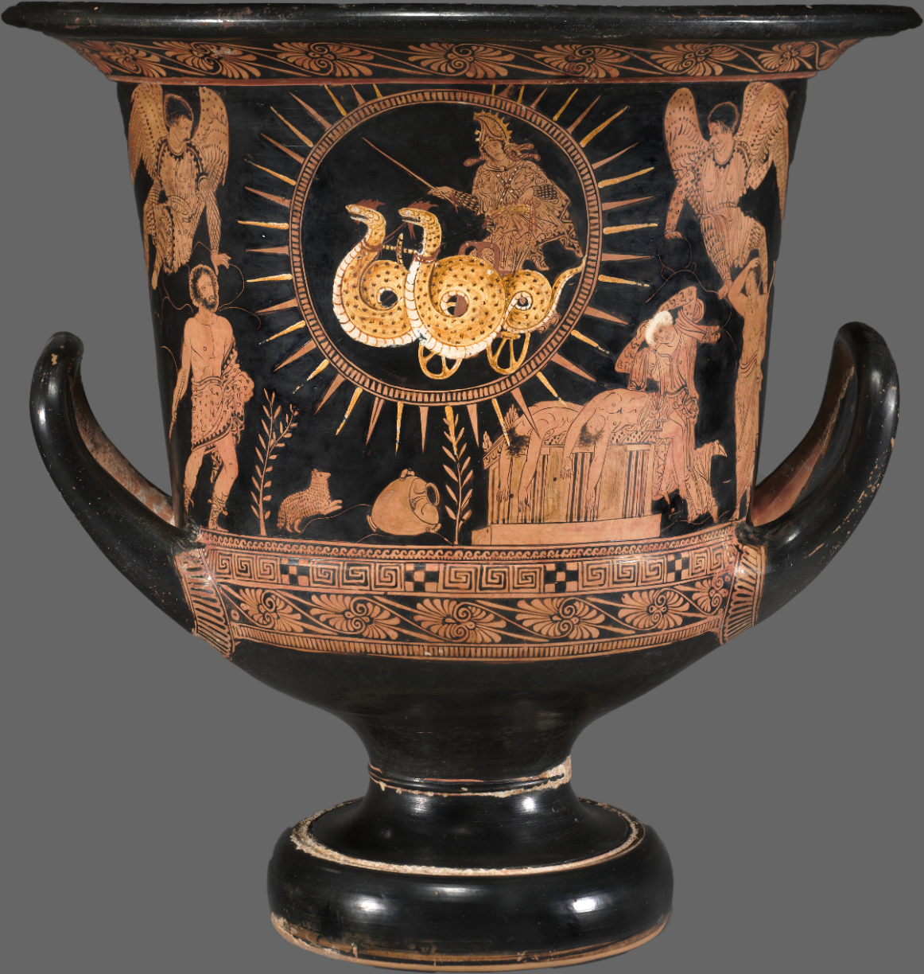
Pity the Mom?
Euripides’ Medea
Medea, Chariot of the Sun. Cleveland Museum of Art

Slide 2
Is tragedy pointless?
“In Anouilh’s Antigone, the Chorus states, ‘In drama you struggle, because you hope you’re going to survive. It’s utilitarian — sordid. But tragedy is gratuitous. Pointless, irremediable. Fit for a king!’ (p. 102).
“Does that statement by the Chorus in Anouilh’s play find support in texts read for this class? In theoretical or thematic frameworks explored this semester? In what your gut tells you?” (Medea Study Guide)
Notes:
Is tragedy pointless? [5 mins discussion]
what is the point of tragedy? does it need to have a point?
is “drama” something that rings true? are our tragedies empty theatrical gestures? are real life tragedies – disasters, etc. – “tragic” only in an empty, rhetorical sense? or does theatrical tragedy capture something real, compelling?
that will be the overarching theme of the second half of the course – and the basic theme of the final exam main essay.

Slide 3
Agenda
Cold Open
  Is tragedy pointless?
Discussion
  Pity the Mom?
Euripides’ Medea
  Introduction to Play
Key Scenes
  Agōn: Jason & Medea. Medea as deus ex machina

Slide 4
Discussion
Pity the Mom?

Slide 5
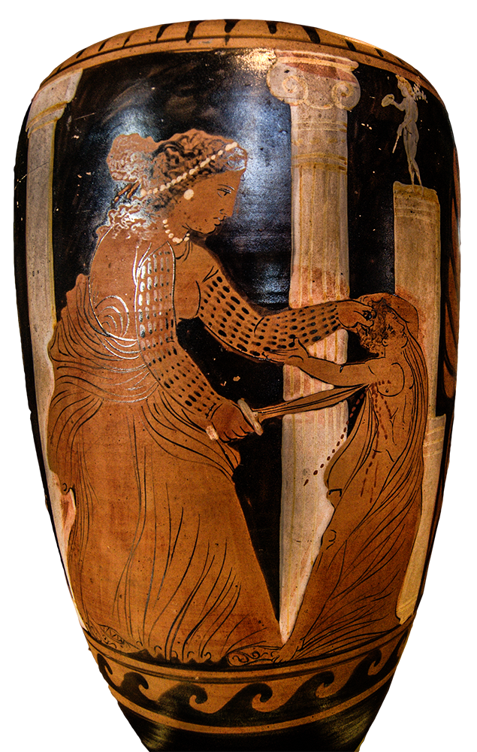
Journal Prompt
Medea, the character:
Maternal?
Monstrous?
In between? Both? Something else altogether?
Notes:
Medea, the character: (a) Maternal? (b) Monstrous? (c) In between? Both? Something else altogether?
If (a), how do we process her killing her children? If (b), aren't there true maternal feelings of hers that mustn't be ignored?
If any of the above, explain.
the larger question is, really, is she tragic? does commit hamartia, something punishable? is she hubristic? does she evoke pity and fear?

Slide 6
Euripides’ Medea
Introduction to Play

Slide 7
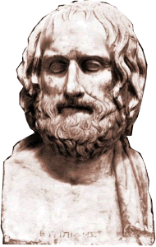
Playwright, Play
Euripides
  485/4 or 480–ca. 406
  22 entries
  5 wins
Production
  431 BCE, war with Sparta
  Patriotic themes?
    “The people of Athens are blessed through the ages” (stasimon 3)
Notes:
485/4 or 480–ca. 406
competed 22 times
455 on…
4 wins
Biographical tradition
reclusive
studious
NERD

Slide 8
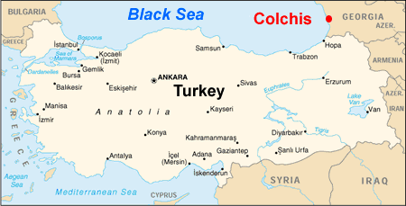
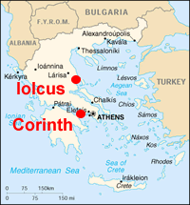
Notes:
study guide backstory:

Slide 9
Medea’s Background
Chariot of the Sun

Slide 10
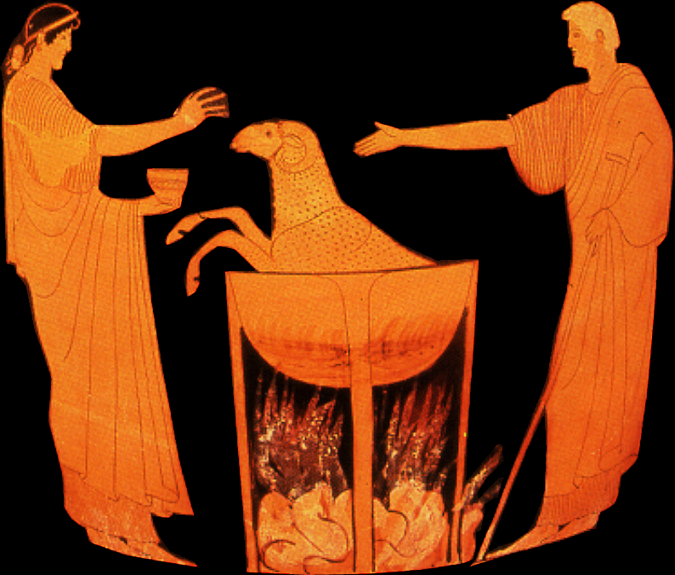
Notes:
Medea demonstrates how to rejuvenate creatures – part of her plan to destroy Jason’s evil uncle.

Slide 11
Analysis, pt 1
prologue
  Nurse, Tutor, Medea (off stage)
parodos
  Chorus, Nurse, Medea (off stage). Medea’s grief and anger
episode 1
  Medea to chorus leader: women’s lot
  Medea, Creon – entrapment
stasimon 1
  misogyny, women’s silence reversed
episode 2
  AGŌN: Jason, Medea
stasimon 2 (20 f.)
  prayer for safe marriage, reasonable love
episode 3 (21 ff.)
  Medea, Aegeus: Medea’s refuge
  Medea, chorus leader: Medea’s plan
Notes:
prologue
classic Euripidean prologue: supplies backstory, but also prepares us for dramatic situation:
medea’s despair and grief (expressed by offstage medea in song), her character (through nurse’s eyes)
new developments (with arrival of tutor)
parodos
is a lyric (sung) and chanted dialogue: chorus, nurse, medea. integrated into the dramatic business of the prologue – the sort of thing aristotle likes
episode 1
“Of all creatures that can feel and think, / we women are the worst-treated things alive“ — to chorus (fellow women), women’s lot in a patriarchal world. keep in mind tragic stage as a space to critique dominant ideologies
medea’s astute manipulation of creon
“MEDEA: Love? It is mankind’s greatest curse. CREON: In my opinion . . . that depends.“ cf. stasimon 2 and 3rd stasimon of soph’s antigone. theme of eros: its blessings and dangers. BIG topic in tragedy. as if some sort of Freudian subtext running through the genre. QUESTION: how does eros relate to this play?
stasimon 1
gender issues at the forefront. injustice inflicted on medea. eur gained reputation as misogynist. here, is he one??
episode 3. medea and Aegeus. medea and chorus leader.
medea as networker, manipulator.

Slide 12
Analysis, pt 2
stasimon 3
  Athens no land for Medea
episode 4
  Jason, Medea – entrapment
stasimon 4
  murder approaches
episode 5
  Tutor. Medea’s monologue
anapestic (chanted) interlude
  Chorus: sorrows of parenthood
episode 6
  Medea, Messenger (poisonings described)
stasimon 5
  desperate hopes (dochmiacs)
exodos
  catastrophe, Medea’s deus ex machina
Notes:
episode 4
Medea lays the trap for Jason – she gives in, just let children stay
Medea’s tears are genuine, yet still leverages for the deception. the boys take the “gift” to creon’s daughter
episode 5
medea’s self-knowledge denies her the kind of tragic status that Sophoclean tyrants attaing to:
“The evil that I do, I understand full well. / But a passion drives me greater than my will. / Passion is the curse of man: it wreaks the greatest ill.”
καὶ μανθάνω μὲν οἷα δρᾶν μέλλω κακά,
θυμὸς δὲ κρείσσων τῶν ἐμῶν βουλευμάτων,
ὅσπερ μεγίστων αἴτιος κακῶν βροτοῖς. 1080

Slide 13
Key Scenes
Agōn: Jason & Medea. Medea as deus ex machina

Slide 14
Episode 2, agōn
Medea | versus | Jason
female | vs. | male
barbarian | vs. | Greek
complexity | vs. | simplicity
intelligence, skill with drugs-poisons-potions-magic-sophistic-rhetoric | vs. | naïveté, problematic heroism
Notes:
in a sense, this agon, like the carpet agon in aesch ag, is a microcosm of conflicts in the story being handled by the playwright in question.
not simply a debate focused on logic, rhetoric, narrowly defined issues (who or what bears responsibility for actions taken by j and m; is j justified in casting m aside), is a clash of world views and gender/ethnic oppositions, as per chart.
Medea, a more systematic marshalling of arguments: “To begin at the beginning, / yes, first things first, / I saved your life”
Jason attempts to deflect her claims of agency:
“JASON: I’ll have to choose my words with no uncommon skill, / it seems, if like a good sailor riding out a storm / I am to sail close-sheeted, madam, / through your lashing, dangerous tongue.“
lame argument: Aphrodite (i.e., J’s sex appeal, perhaps M’s excessive susceptibility to desire) that induced M to help J. following lines (sting of desire) suggest a motif borrowed from other, earlier poetry (“σοὶ δ’ ἔστι μὲν νοῦς λεπτός· ἀλλ’ ἐπίφθονος / λόγος διελθεῖν ὡς Ἔρως σ’ ἠνάγκασεν (530) / τόξοις ἀφύκτοις τοὐμὸν ἐκσῶσαι δέμας – cf. Pindar’s Aphrodite prayer, whip of desire/wryneck: Pythian 4 πότνια δ᾽ ὀξυτάτων βελέων / ποικίλαν ἴϋγγα τετράκναμον Οὐλυμπόθεν 215 / ἐν ἀλύτῳ ζεύξαισα κύκλῳ / μαινάδ᾽ ὄρνιν Κυπρογένεια φέρεν / πρῶτον ἀνθρώποισι)
plus “you got more than I got”
final straw: “What we poor males really need / is a way of having babies on our own — no females, please” – woman as culpable, a liability. dream of a world without them
m attacks j’s sophistry with her own, more adroit marshalling of argument and structure.
MEDEA: [as if to herself ] “Yes, I suppose my outlook / is very different from most. To my mind, the glib hypocrite / is the lowest scoundrel of them all. The more he glozes falsehood with his tongue, / the more brash he grows in villainy, / but ends up by not being very clever.”
MEDEA’s structuring more organized: “To begin at the beginning, / yes, first things first” (ἐκ τῶν δὲ πρώτων πρῶτον ἄρξομαι λέγειν· 475)
medea deflates j’s heroic achievement: the woman’s help essential, j’s treachery is unmanly (“This is not courage. This is not being brave: / to look a victim in the eyes whom you’ve betrayed — somebody you loved — / this is a disease and the foulest that a man can have.” οὔτοι θράσος τόδ’ ἐστὶν οὐδ’ εὐτολμία, / φίλους κακῶς δράσαντ’ ἐναντίον βλέπειν, 470 / ἀλλ’ ἡ μεγίστη τῶν ἐν ἀνθρώποις νόσων / πασῶν, ἀναίδει’)

Slide 15

Medea as deus ex machina
Medea, Chariot of the Sun. Cleveland Museum of Art
Notes:
her divine connections triumph over her tragic humanity. she is her own divine savior. she, as deus ex machina, ties up her own loose ends. she buries her children in a divinely protected space, preventing the mistreatment of their bodies ny angry Corinthians. she establishes her own expiatory cult (explain).
study guide:
"the shrine of Hera on the Cape" — This temple of Hera was located on a cape overlooking the Gulf of Corinth, several kilometers west of the city of Corinth. Medea's choice of Hera's shrine as burial site for her boys may have something to do with Hera's role in protecting marriage. (?)
"I shall inaugurate a solemn festival with rites in perpetuity to exorcise this murder" — In Euripides' plays, it's typical for the deus ex machina, here, Medea, to inaugurate a cult, i.e., to establish special rituals associated with a particular god or gods. The cult itself often is one that existed for real in the historic period. One function of Greek myth is to explain the origins of things, including cults. Something like that may be happening here.

