Slide 1
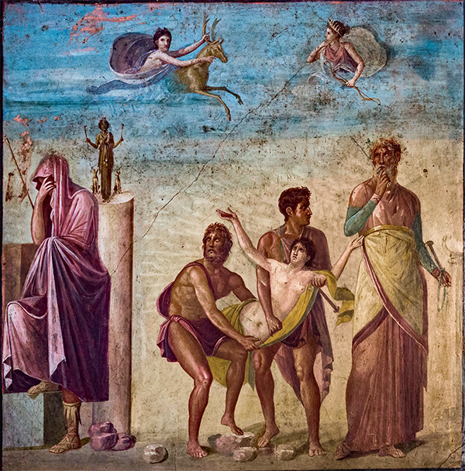
Euripides’
Iphigenia at Aulis
Why?
Sacrifice of Iphigenia. House of the Tragic Poet. Pompeii

Slide 2
What’s she thinking?
Cacoyannis Iphigenia, finale
https://youtu.be/iXQVJiNb884
Notes:
what’s going through Clytemnestra’s head?

Slide 3
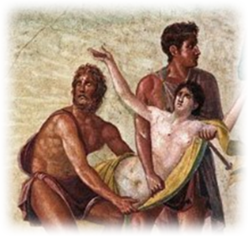
Agenda
Cold Open
  What’s She Thinking? (Clytemnestra in Iphigenia)
Discussion
  Why?
Introduction to Play
  Play Facts, Features

Slide 4
Discussion
Why?

Slide 5
“If asked why, why do you want to kill her, what, pray, will your answer be?”
(Clytemnestra to Agamemnon, Euripides Iphigenia at Aulis)
Peloponnesian War, Athens vs, Sparta, 431–404 BCE
Notes:
"If asked why, why do you want to kill her, what, pray, will your answer be? Or must I say it for you? To get Helen back for Menelaus." (Clytemnestra to Agamemnon, Iphigenia at Aulis p. 259)
Is Clytemnestra, are you quite satisfied with the response, "To get Helen back for Menelaus"? Does that answer the question, Why does Iphigenia have to die? Why does Iphigenia consent to die? Look over what Iphigenia has to say, pp. 266-268 ("A single man is worthier / to look upon the light than ten thousand women" p. 267). Does that answer the question? Don’t characters cast doubt on that rationale from the very start?
don’t agamemnon and Menelaus both suspect that Calchas’ oracle is, somehow, suspect, for reasons they don’t fully clarify?
how is the invasion of Trojan land, the sack of troy, the salvation of greece? isn’t that a jingoistic rationale typical of propaganda?
is this pro- or anti-war propaganda, with Persian rule over greek states as a rallying cry for Panhellenism and an end to internecine conflict?
anti-war quasi-satire?
The concept I’m reminded of "overdetermination," a term coined by Siegmund Freud to explain dream symbolism, but extended to the social-political sphere by Louis Althusser, who
used the idea of overdetermination as a way of thinking about the multiple, often opposed, forces active at once in any political situation, without falling into an overly simple idea of these forces being simply "contradictory." (Wikipedia)
What is striking is how many answers to "Why?" we can come up with, each one equally compelling and, maybe, equally unconvincing and often mutually at odds. What matters in the end, to Iphigenia, to Agamemnon, to Odysseus and his mob, is that there be a slogan, any slogan, around which everyone can rally, whether to justify sacrificing Iphigenia or to justify destroying Troy.
Only Clytemnestra seems to resist buying in. Her "dim view" of the expedition, especially at the end of the film version, but this applies as well to the play, is chilling.

Slide 6
“In drama you struggle, because you hope you’re going to survive. It’s utilitarian — sordid. But tragedy is gratuitous. Pointless, irremediable. Fit for a king!”
(Chorus in Anouilh Antigone p. 102)
Is Euripides’ Iphigenia at Aulis drama or tragedy?
Notes:
is, then the IA drama, tragedy, or something else according to the Chorus in Anouilh’s Antigone?
Is it sordid suspense drama, will the good guys prevail? is it predictable and ritualistic enactment of a pre-determined destiny — kind of unnecessary b/c we know how it’ll end?
what are we missing if we peg it as one or the other?
i wonder if by Anouilh’s standards, antigone, with all its realism, all its teasing uncertainty and suspense, isn’t drama? yet how can we not call this tragedy?
for the final, i’m going to be asking an essay question similar to that for the midterm. only for the final, it’s going to be what this drama-versus-tragedy lens reveals and conceals in plays studied this spring.

Slide 7
Introduction to Play
Play Facts, Features

Slide 8
Iphigenia at Aulis: Play Facts
Production
  March 405 BCE
  Posthumous
  Tetralogy
    Iphigenia at Aulis
    Alcmaeon
    Bacchae
    Satyr play
Text
  Interpolation
  Corruption
Dramaturgy
  Realism
  Suspense
  Pathos
Notes:
Serious textual corruption
incomplete at death?
much interpolation (insertion)
beginning (2 prologues)
ending
just sacrifice?
messenger speech-miracle?
deus ex machina?
?? Artemis to Clytemnestra: “I shall put a horned deer into the dear hands of the Achaeans, and they shall imagine, as they sacrifice it, that they are sacrificing your daughter” (reported Aelian Historia animalium 7.39)
dramaturgy
Plot
suspense
surprise
realism
330. cl & ag. sort of silly genealogy about ach. meant as one of those realistic touches
De-emphasized chorus
more “arias”
anti-hero heroes. ag inconstant. men selfish. ach obsessed with reputation
heroic child
Exodos
patriotic message?
Panhellenic unity…
deus ex machina?

Slide 9
Myth Variants
Epic Cycle
  Agamemnon, boastful hunter
  Wrathful Artemis
  Iphigenia, expiatory sacrifice
    Last-minute substitution
Aeschylus Agamemnon
  Up-front expiation
Euripides Iphigenia Among the Taurians (ca. 414)
  Deer substitution, Iphigenia “wafted” away
Notes:
Other tellings (cont.)
Euripides Iphigenia among the Taurians (411 BCE)
Iphigenia as vowed sacrifice
“the most beautiful thing the year will bring forth”
deer substitution
relocation to Crimea
Our play
motive for adverse winds? (unstated)
genuine/spurious substitution?
context and theme
the war
politics
ag as opportunist
od as vulgar demagogue, calchas in cahoots
mob as tyrant
316. ag now fatalistic. on "high-born": "decorum rules our lives, and we by service / to the mob, become its slaves"

Slide 10
Analysis (much textual corruption)
Double prologue (many textual problems)
  Agamemnon, Retainer.
  Agamemnon on backstory.
Parodos
  Women of Chalcis on fleet.
1st episode
  Menelaus & Retainer.
  Menelaus & Agamemnon (agōn)
1st stasimon
  Good sexual desire (erōs) versus bad.
2nd episode
  Clytemnestra, Iphigenia, Agamemnon (wedding planning, etc.)
2nd stasimon
  Destruction of Troy. May same not befall Greece! Anger at Helen.
3rd episode
  Achilles, Clytemnestra, Retainer. The plot begins to unravel.
3rd stasimon
  Weddings. That of Peleus, and Thetis, parents of Achilles
4th episode
  Clytemnestra, Agamemnon, Iphigenia. Showdown (much added text)
  Lyric (sung) dialogue
  Clytemnestra, Iphigenia. Grief.
5th episode
  Iphigenia, Clytemnestra, Achilles. Achilles’ bad news
Lyric (sung) dialogue
  Iphigenia, Clytemnestra, Chorus. Iphigenia says goodbye.
Exodos
  Clytemnestra, messenger. Messenger narrates the sacrifice miracle.
  Iphigenia probably simply dies. The ending is a very late insertion.
Notes:
characters: ag, men, cly, iph. character never onstage but crucial: odysseus
prologue
ag explains that Calchas, seer, predicts winds won’t come without sacrifice of Iphigenia. not that grks must destroy troy and destroy iphi too.
“There isn’t a breath of breeze for the fleet. We are at a loss. And now the seer Calchas has declared:
my own daughter, Iphigenia, must be sacrificed
to Artemis, the goddess of this place. In no other way shall we set sail to sack Troy.”
“There’re only four of us Achaeans that know the truth:
Calchas, Odysseus, Menelaus, and I. But now I am trying to repair my mistake.
I’ve written another letter—the one you saw me opening—
yes, old man, opening and sealing up again in the gloom of
night.”
this is the secret they’re sitting on. there’s still an opening to avoid the awaiting bloodshed. but if it’s revealed to the men, disaster.
1st episode. ag as really unreliable and variable. then the tragically too late reconciliation between brothers.
“Thousands have acted just like you. They scramble up the ladder to power,
then come slithering down:
some because the public is just too dim to understand them,
but mostly because they themselves haven’t a clue about politics.”

Slide 11
IA: Euripidean Features
Background Prologue
  Agamemnon’s speech, pp. 220 ff.
De-emphasized chorus
Actors singing
Anti-mythological realism
Anti-heroism
Intrigue/deception
Notes:
Background Prologue
Agamemnon’s speech, pp. 220 ff.
abduction of helen. predicament of fleet (this time, no wind). calbhas on iphi's sacr. ag's trick to get her to aulis. letter is to change the plan. ag's weakness: caves to men, caves to soft spot in heart foor iph.
Solo singing
Iphigenia’s aria (Cly + Iphi duet?), pp. 263 f.
“You, dear mother, and I | must chant the selfsame dirge together”
Realism, anti-mythological motivation
Quasi-democratic politicking (Odysseus, Agamemnon)
anti-mythology
[fate seems less important than the inevitability that ruinous decisions lock us into - the oath leading Trojan war]
anti-heroism
ag inconstant. men selfish. ach obsessed with reputation
cly begs ach for help. her supplication. ach will oblige. ach "the lowest maan" if harm come to iph. fatal words. play unpacks nobility, heroicism
Intrigue/deception
Agamemnon’s first letter

Slide 12
Themes
Lust for conquest
  War as mad
Panhellenism
  War as unity
Leadership
  Agamemnon’s vacillation
Class
  Odysseus & mob versus Agamemnon & Achilles
Gender
  Iphigenia’s noble martyrdom
Notes:
a mix of political, social, and gender-related themes
Candidate Agamemnon …
Agamemnon canvasses “friends”
Menelaus to Agamemnon: “And then, when you had got the command, you changed your tune. You were no longer the friend of all your friends” (p. 322)
Leadership inconstancy
Agamemnon’s fear of the okhlos (“mob”)
disparaging term for demos, “the people”
Realpolitik
Menelaus to Agamemnon: “Not for his courage would I make a man chief of his country or commander of its armies. A general must have a head; any man with shrewdness may be governor of a state” (p. 323)
Odysseus as demagogue
Agamemnon: “He is subtle, always with the crowd (okhlos)”
Menelaus: “He is indeed a slave to ambition, a terrible disease” (p. 327)
QUOTES
Achilles: “… A terrible passion (erōs) has seized all Greece to make this expedition - not without / Heaven’s contrivance” (808-809)
Agamemnon to Iphigenia: “O child, a mighty passion (lit., “Aphrodite”) seizes / The Greek soldiers and maddens them to sail / … That they may halt … the rape and seizure of Greek women” (1263-1267)
Clytemnestra to Agamemnon: “Tell me now, / After the sacrifice of your child, what prayer / Can your mouth utter? What things of good / Can you ever pray for when you have / Slain the girl?” (1185-1188)
Iphigenia to Clytemnestra: “Because of me, never more will / Barbarians wrong and ravish Greek women” (1379-1380). “Only let me, if I have the strength, save Greece” (1420)

