Slide 1
Euripides Feminist? Misogynist?
His Hippolytus
Notes:
in plays read so far we’ve seen a complex picture of women: an Antigone standing up to an arbitrary tyrant; a vengeful Clytemnestra take justice, and political power; into her own hands; a betrayed medea teaching her anti-heroically opportunistic husband an almost unthinkably cruel lesson.
interesting is the fact that the ancient tradition as well as modern reception associates eur, more than they do other two giants of Greek tragedy, with women’s themes, though in strikingly different ways:
the ancient tradition, often, makes eur out to be a misogynist
modern critical reception, not always, but with a certain frequency, makes him out to be a feminist
this play, Euripides’ Hippolytus, almost screams out to be located somewhere in that misogynist-feminist spectrum, but where?
that the question we’ll be considering today, though not before talking about the supposed universality of tragic characters in that play. spoiler alert: the play’s treatment of women is a question not separable from the guiding question on the study guide. so,

Slide 2
Agenda
Guiding Question
Tragic fate in Euripides’ Hippolytus?
Euripides’ Hippolytus
Introduction to the play
Her Mistake!
Gender and hamartia in Hippolytus
Notes:
agenda

Slide 3
Guiding Question
Tragic fate in Euripides’ Hippolytus?

Slide 4
Tragic Fate in Hippolytus?
Are there characters in Euripides’ Hippolytus who are somehow complicit in the tragic events that overtake them? And if there are, does that diminish the pity we feel for them? Finally, do we see ourselves in those characters in any way? Do we identify with this idea of tragic complicity?
Notes:
In Tragedy, the Greeks, and Us, Simon Critchley writes, "Tragedy requires some degree of complicity on our part in the disaster that destroys us" (p. 12). He also writes, "But we are tyrants too" (p. 15), that is, all of us, like Oedipus in Sophocles' OTK, are liable to ignore, and, in a sense, shamelessly, our complicity in our fate. So,
Are there characters in Euripides' Hippolytus who are somehow complicit in the tragic events that overtake them? And if there are, does that diminish the pity we feel for them? (As if to say, "Serves them right!") Finally, do we see ourselves in those characters in any way? Do we identify with this idea of tragic complicity?
Please keep in mind that this is an exercise in critical thinking. Put simply, we are trying to test Critchley's ideas. That involves reading and thinking: reading the play, reading the chapter from Critchley's book, thinking about both. No two ways about it — thanks!!

Slide 5
Euripides’ Hippolytus
Introduction to the play

Slide 6
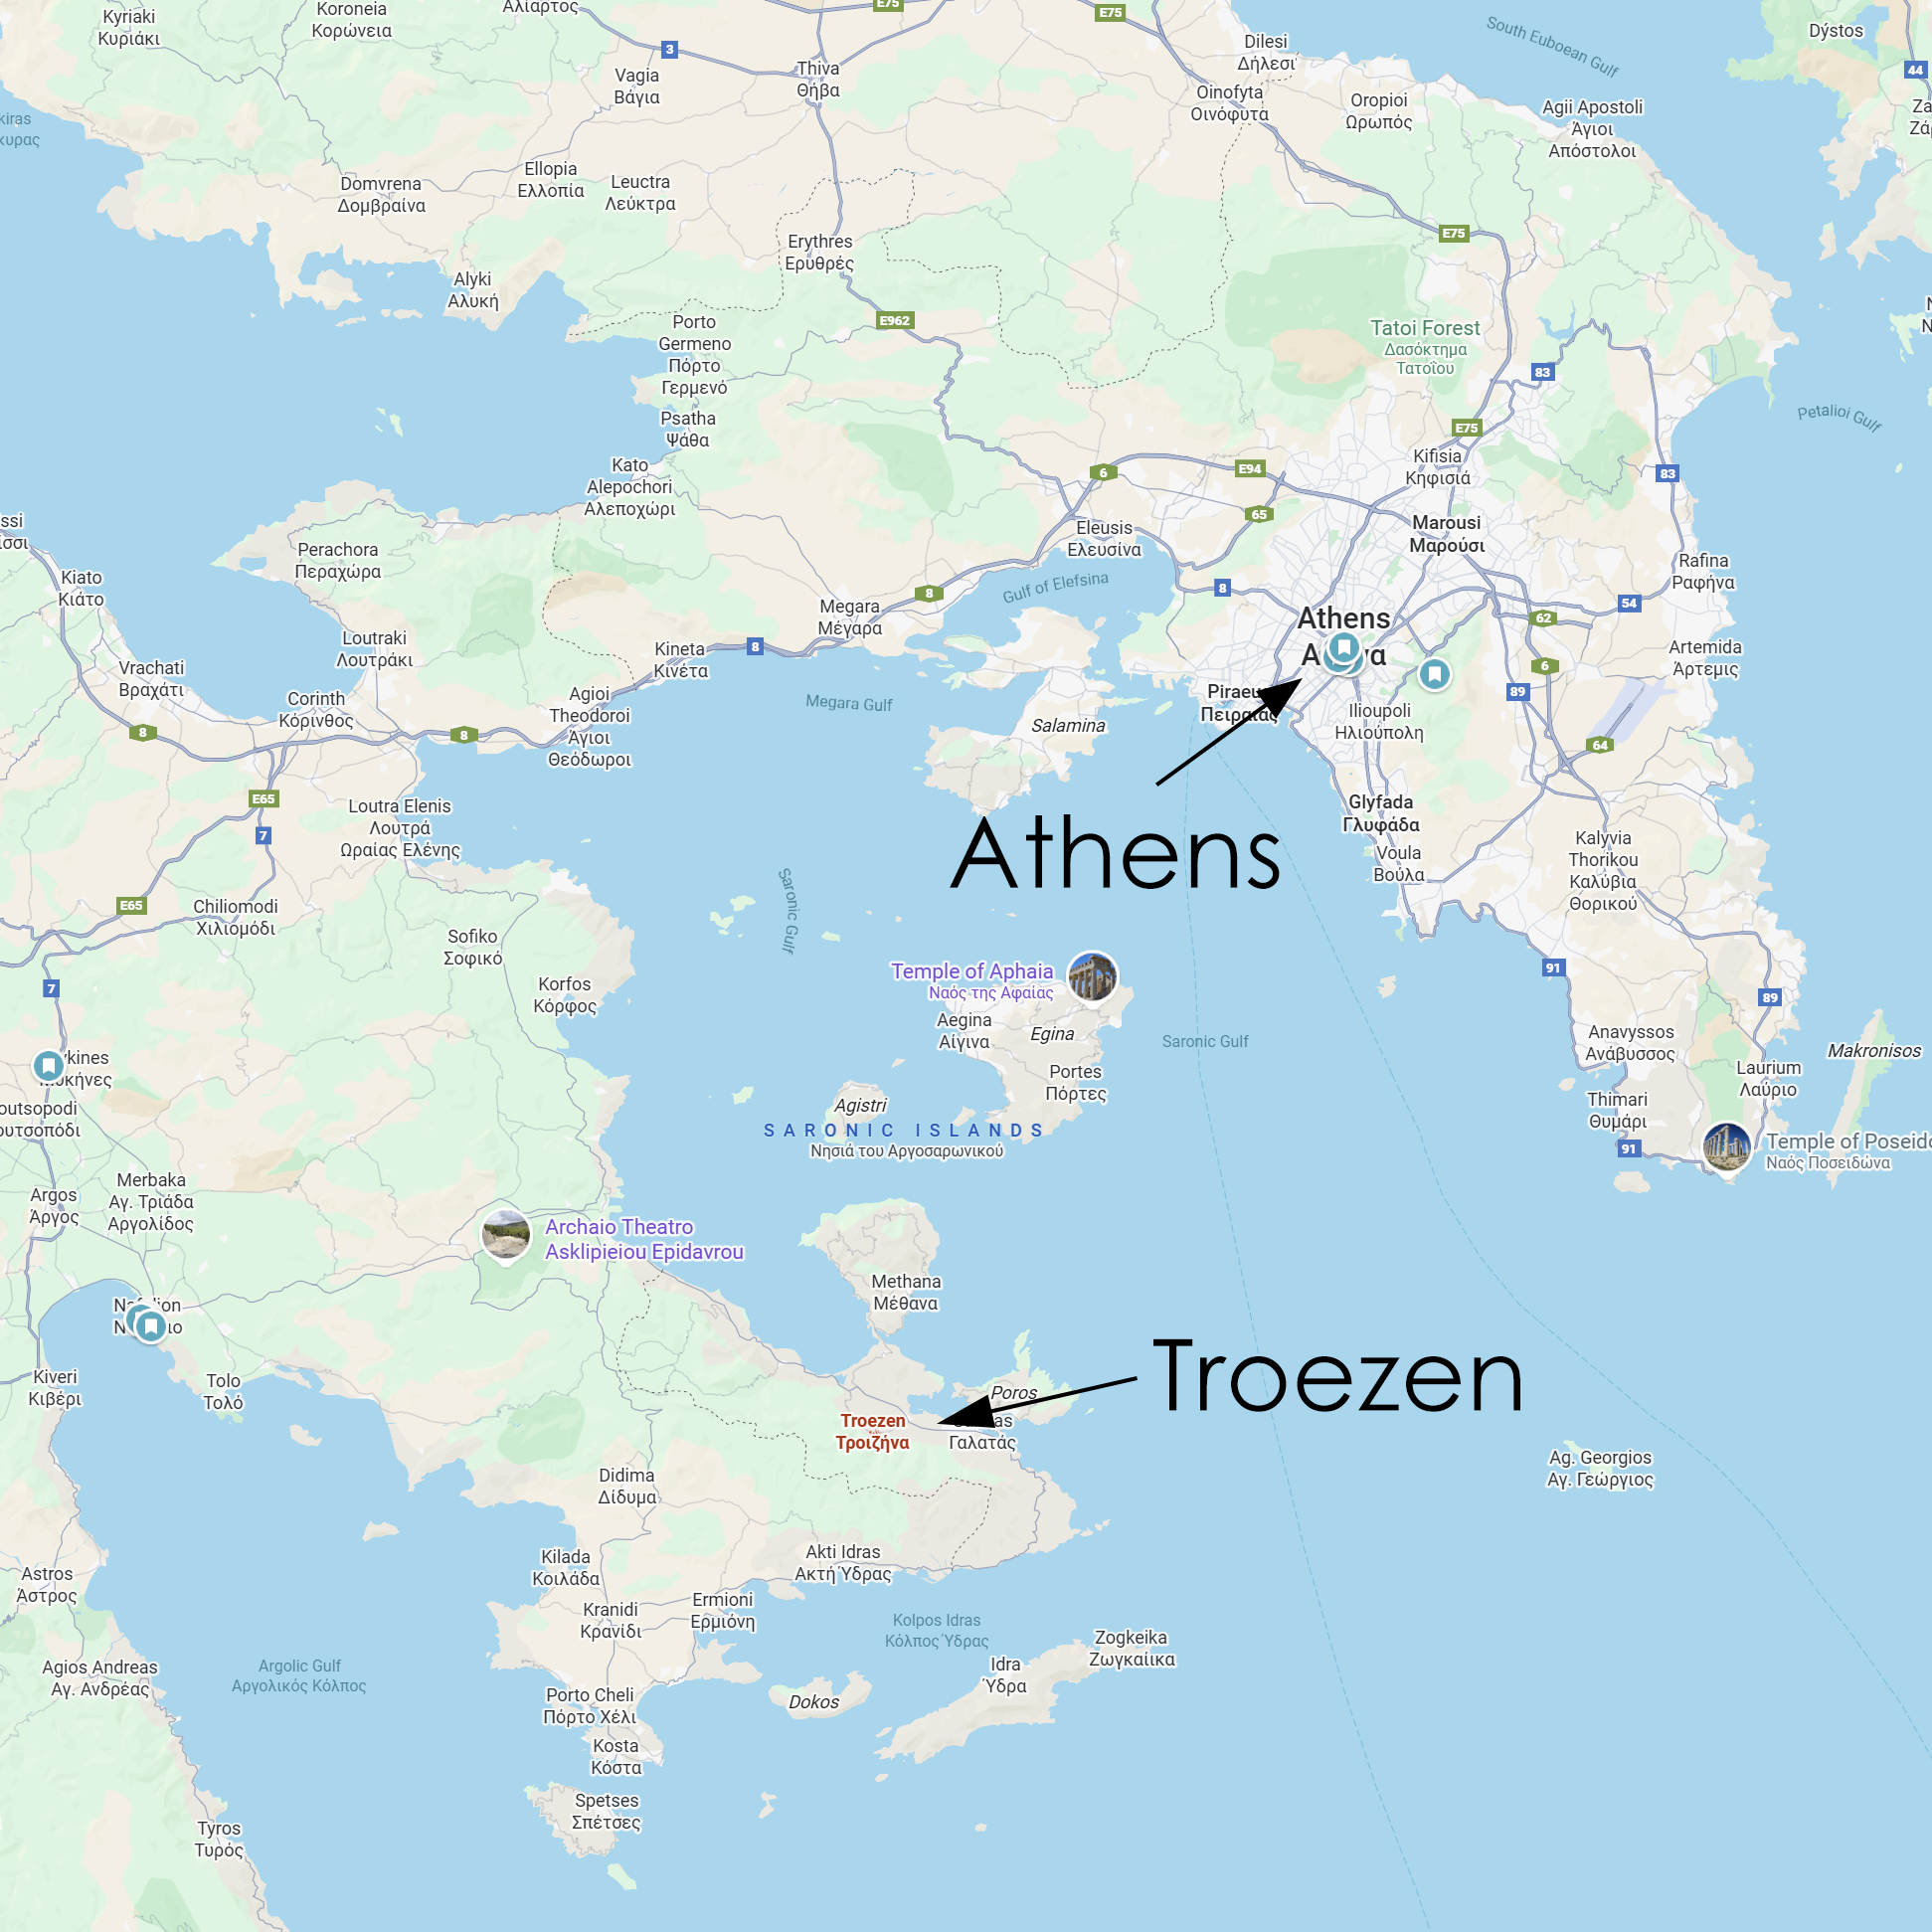
Play Facts
Produced 428 BCE
First prized
Greater Dionysia
Setting: Troezen
Hippolytus take two
Notes:
talk about the myth background: theseus and his relationship to the Athenians, his marriage(s), Pittheus the maternal grandfather of theseus

Slide 7
Tragic/Euripidean Features 1
Divine bookends
Aphrodite prologue
Divine wrath
Artemis ex machina
Divine exoneration
Euripidean characters
Female protagonist’s nurse (cf. Medea)
Servant intimate (cf. Medea, Iphigenia at Aulis)

Slide 8
Tragic/Euripidean Features 2
Solo singing
Extended messenger speech
ekkuklema effect (cf. Bacchae)

Slide 9
Tragic/Euripidean Features 3
Phaedra to Nurse: “And precisely what makes fine cities and happy homes tumble down? . . . sweet but specious double-talk”
Father-son agōn
“THESEUS: What a wizard with words! What a trickster the fellow is!”

Slide 10
Sophistic Resonances
Phaedra to Nurse: “And precisely what makes fine cities and happy homes tumble down? . . . sweet but specious double-talk”
Father-son agōn
“THESEUS: What a wizard with words! What a trickster the fellow is!”

Slide 11
Her Mistake!
Gender and hamartia in Hippolytus

Slide 12
Hamartia in Hippolytus
Nurse to reluctant Phaedra
“Very well then, if you are determined not to sin (hamartanein)”
Artemis to Theseus
“Unwittingly you killed him. Mankind led on by gods errs (examartanein) all too easily”

Slide 13
Misogyny in Hippolytus
Hippolytus with Nurse: “Great Zeus, why ever did you give a place to women under the sun: that pestilent tribe, that curse to man? Was it to perpetuate the human race? That could have been done without womankind. In your temples you could have produced offspring to be bought according to their price in gold, iron, or copper; then men could have lived an untrammeled life in houses free of women.”

Slide 14
Aphrodite the Guilty?
Artemis to a dying Hippolytus: “He [Theseus] was duped by a scheming deity.”

Slide 15
Phaedra’s Dilemma
Phaedra to chorus: “It seems to me this penchant for disaster is not something we were born with. … We know what is right, we understand it, but do not do it . . . partly from laziness, partly from allowing pleasure to swamp our sense of duty. … This being so, as soon as I saw my problem, my compulsion, I knew at once that nothing could cure it, nothing could make me change my mind.”

