Slide 1
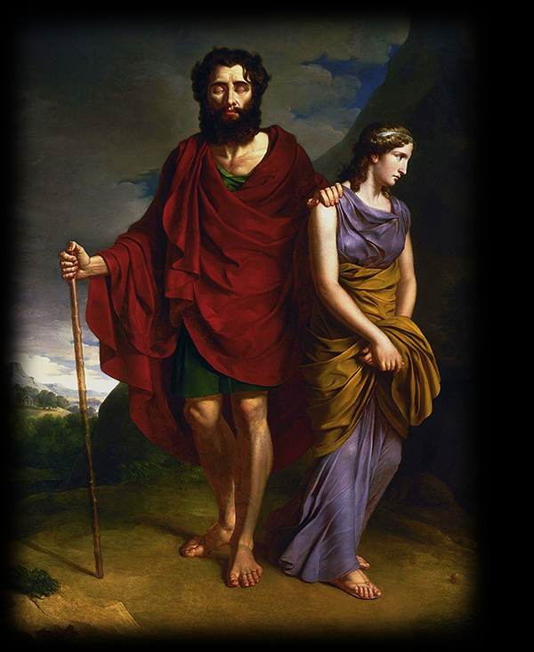
Pity the Man?
Sophocles’ Oedipus at Colonus
Notes:
“Oedipus and Antigon” by Antoni Brodowski (1828)

Slide 2
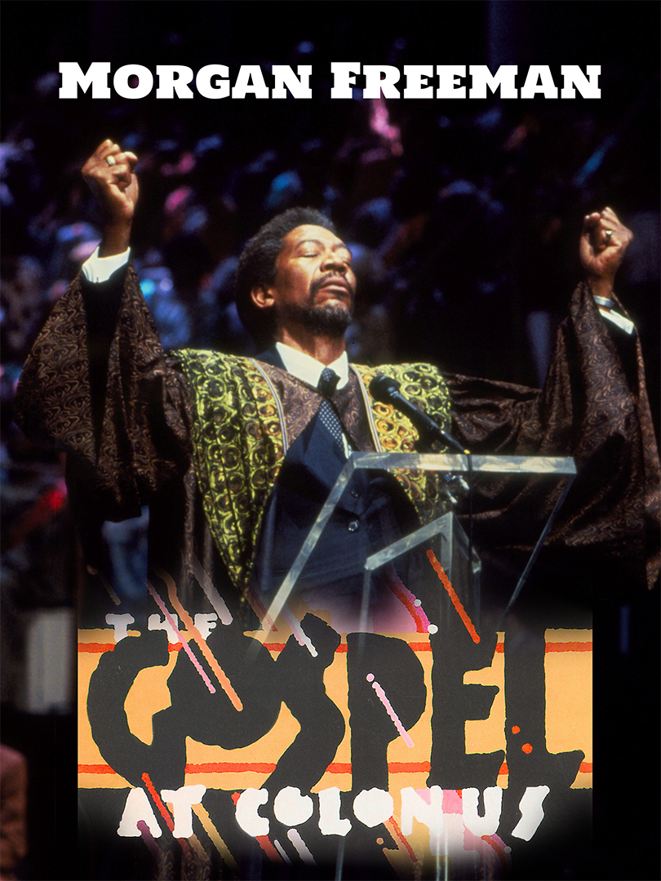
Sophocles’ OAC, third stasimon, adapted for The Gospel at Colonus (produced Broadway, 1988)
YouTube clip (57 mins 45 secs)
Notes:
The Gospel at Colonus opened on Broadway at the Lunt-Fontanne Theatre on March 11, 1988, in previews, officially on March 14, 1988, and closed on May 15, 1988, after 61 performances and 15 previews. Directed by Lee Breuer, the cast featured Morgan Freeman (Messenger), Sam Butler, Jr. (The Singer), Clarence Fountain and the Five Blind Boys of Alabama (Oedipus) and the Institutional Radio Choir of Brooklyn. Breuer was nominated for the 1988 Tony Award for his book. (Wikipedia)

Slide 3
Not to Be Born Is Best?!
“Not to be born is best when all is reckoned in, but once a man has seen the light the next best thing, by far, is to go back back where he came from, quickly as he can.” (Chorus, Sophocles Oedipus at Colonus, p. 358)

Slide 4
Agenda
Discussion: Soph’s OAC 3rd stasimon
“Not to be born is best” — really?
Sophocles’ Oedipus at Colonus
Introduction to play

Slide 5
Discussion: Soph’s OAC 3rd stasimon
“Not to be born is best” — really?

Slide 6
Excerpt: 3rd Stasimon pt. 1
Not to be born is best
when all is reckoned in, but once a [person] has seen the light
the next best thing, by far, is to go back
back where [they] came from, quickly as [they] can.
For once [their] youth slips by, light on the wing
lightheaded ... what mortal blows can [they] escape
what griefs won’t stalk [their] days? (Penguin p. 358)

Slide 7
Excerpt: 3rd Stasimon pt. 2
Envy and enemies, rage and battles, bloodshed
and last of all despised old age overtakes [them],
stripped of power, companions, stripped of love—
the worst this life of pain can offer,
old age our mate at last. (Penguin p. 358–359)

Slide 8
Guiding Question
How is it best not to be born? Or barring that, “to go back … where [we] came from, quickly as [we] can”? Is life that hopelessly “tragic”? Do other plays read thus far bear that out?
Notes:
what if the chorus’ word here isn’t the last word? Critchley argues that, in a sense, we’re all like Oedipus: we ignore the signs and, in ignoring them, we fail to intervene effectively in our own respective destinies. what if the chorus goes in the exact opposite direction? completely paralyzed by the their sense of tragic foom, they, like so many tragic choruses, fail to act? what if they model the opposite extreme, opposite to the hubris of an oedipus? what if they’re just as wrong?

Slide 9
Sophocles’ Oedipus at Colonus
Introduction to play

Slide 10
Sophocles
Playwright
ca. 496-ca. 406 BCE
First victory 468

Slide 11
Sophocles “Theban Plays”
Production dates
Story order
Antigone, ca. 441
Oedipus the King, after 429
Oedipus at Colonus, ca. 406
Oedipus the King
Oedipus at Colonus
Antigone

Slide 12
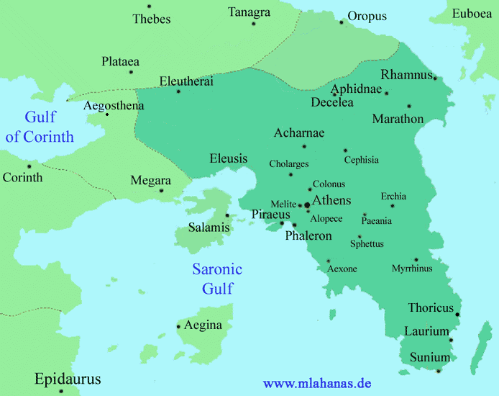
Map: Attica, Thebes
Thebes
33 miles
Colonus
Central Athens
Notes:
the4 point here being that Sophocles that this partly reprises the story told in Aeschylus’ eum in bringing the story to Athens, in seeking closure there, in naturalizing an avenging spirit, in this case, an alastor, Oedipus, as a protection and salvation for sophocoles’ city?

Slide 13
Production, Historical Context
War with Sparta (and Thebes): 431–404 BCE
Great Plague of Athens: 430–426
Oligarchic revolution: 411/10
Colonus cavalry skirmish, 410 (407?)
Compositional Order
Antigone (ca. 442)
Oedipus the King (ca. 430?)
Oedipus at Colonus (ca. 406)
Notes:
series of military, political, even health crises/disasters for athens. possible reflection in plays
edmunds p. 96: scholiast aristid. on 4.172; cf. ds 13.72.3-73. spartan king agis led cavalry attack on athens; theban cavalry included. oedipus appeared at colonus; ralied athenian cavalry. cf. also x hell. 1.1.33.

Slide 14
Ideological Orientations
OEDIPUS: Do you have a king or a common public voice? / CITIZEN: A king in the city governs all these parts. (p. 287)
....
CREON: I bear the mandate of my entire people (p. 329)
Notes:
2ND EPISODE.
with entry of creon, politics of people. creon comes with “mandate of my entire people” – democracy!
thus a conservative athens and radical thebes. creon, the quintessential democratic sophist, his “wicked way with words” (332) – but he’s actually a tyrant!
so creon now embodies 2 political stereotypes: tyrant and demagogue. creon isn’t tragic here; he’s fully a villain.

Slide 15
CHORUS, 2nd stasimon (348)
“… chariots racing down the wind — the enemy will be crushed!
…
They honor Athena, reigning queen of horsemen — honor the Sea-lord, guardian of our earth…”
Notes:
in this stasimon, the chorus imagines Theseus’ cavalry as charging upon the Theban soldiers who seek to bring the captive girls back to Thebes
but what’s wrong with this picture?
Athena, goddess of horses?
horse-drawn chariots racing down the wind?
Clearly, in the attempt to honor both Athens’ aristocratic-“horsey” heritage, and its naval-democratic heritage, the poet finds himself using his metaphors and other associations rather promiscuously
as if, in the attempt to underscore the unity of the state in his rhetoric, his discloses its divisions

Slide 16

Stage Set, Oedipus @ Colonus
South
East
West
skene (stage building)
Statue
Olive grove
To Underworld
Grove of Furies-Eumenides
to Thebes
Altar of Athena, Poseidon
to Athens
Source: Wiles Tragedy in Athens
Notes:
point is: what is the point of that scene?

Slide 17
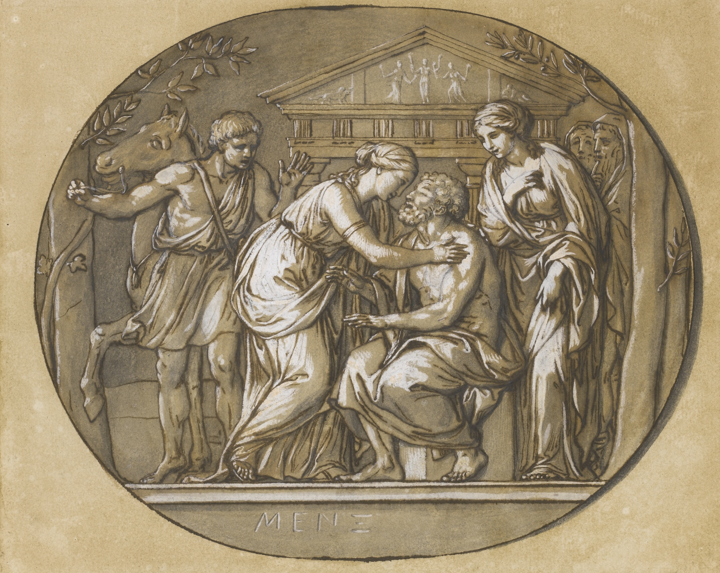
Oedipus at the Temple of the Eumenides (Mengs, 1763)

Slide 18
Analysis 1
Prologue (pp. 284 ff.)
Oedipus, Antigone, Citizen
Identity, positioning
Parodos (291)
Amoibaion (chorus-character dialogue)
Chorus, Oedipus, Antigone
Supplication
1st episode A (298)
Leader, Oedipus, Ismene, Antigone
Amoibaion (314)
Chorus, Oedipus
1st episode B (318)
Leader, Theseus, Oedipus
Supplication, negotiation
Notes:
PREQUEL
this play changes things from what they are in the OTK. here, oed is driven out against his will. thebes exiled oed, the sons could have stopped it. in otk, seems oed is exiled, seemingly, permanently, at the end of the play. here, the sons’ failure – polynicies said to have driven dad put - motivates the father’s anger.
PROLOGUE. like Eumenides, this is explicitly a play seeking closure, reconciliation, atonement. Oedipus and Antigone arrive at the grove of “terrible goddesses,” explicitly ID’d as eums and semnai (p. 289) – i.e., the furies – in colonus just outside ath.
the symbolism should not be lost on us. Oedipus, now at the end of his life, is going to negotiate atonement with the goddesses who, in effect, have hounded him since even before his birth.
but he can’t simply achieve reconciliation with his fated sins with a snap of the fingers. that will involved his transforming into a kind of fury himself. he has to pass final ordeals first.
note deities associated with the spot they’ve arrived at: furies, poseidon, prometheus, and we’ll find out athena. we’ll find those deities hold political significance. statue of colonus, whose statue we can reasonably speculate is on stage.
but note, too, the question to “citizen”: “do you have a king or a common public voice?” answered “a king in the city governs these parts” – here theseus isn’t a proto-democrat but fully-fledged benevolent despot.
PARODOS. note that the parodos is unusual: an amoibaion. dramatizes the chorus entry as an encounter with an Oedipus who’s on stage nearly for the whole play. UNDERSCORES PLAY AS DRAMA OF PLACE, OF POSITION.
among other things, like aesch eum, the story is brought to athens (or a suburb). that is brought to the fore in the undisguisedly patriotic 1st stasimon, which starts with praise of colonus, but finishes with praise of athens – clearly propagandistic during difficult period of pw. (celebration of dem and kore, goddesses of earth, of pos’s horses and athena’s olive.)
the drama here is whether the suppliant will be rejected or accepted. later it will be whether he’ll be hauled off to thebes, whether by creon or by his son, or stay here. so this is a tragedy above all of place.
but it’s also a symbolic drama of place: how do we receive into our midst, not simply our city if we’re the chorus of the play, but into our psyches, the tragic horror of an oedipus? how is this somehow all a boon for us? note the dramatized pity-and-fear-but-also revulsion reaction of the chorus behaving like a stage audience.
but is this grove sacred to these goddesses of vengeance – is a foul, malodorous place??
(it is in fact a place so pure that the cold never touches it, even in winter, and flowers bloom the year round.)
1ST EPISODE
we learn from ismene about eteo’s and poly’s battle for the kingship. eteo (younger bro) seizes throne, poly seeks aid from argos. but ismene also informs Oedipus of oracles proclaiming his body a sacred object after death, powerful to ward off enemies. thebans and poly seek to have oed’s body buried within their respective control, though not within thebes itself (b/c of parricide).
I’ve mentioned oed’s rage – we see that, and grk anti-barbarian bias – in oed’s speech associating oed’s sons with effeminate egyptians (304).
p. 309 we see oed’s anger resurfacing – preview of later transformatiuon into alastor, male spirit of vengeance.
1st stasimon. praise of colonus and of athens
celebrates both places as quasi miraculous. evokes Poseidon and his gift to athens, the horse, initially. then goes on to evoke Athena’s olive and Poseidon’s ships – more blessings evocative of athens’ greatness.

Slide 19
Analysis 2
1st stasimon (326)
Praise (Colonus, Athens)
2nd episode (328)
Antigone, Oedipus, Leader, Creon, Theseus
Tussle over Oedipus
2nd stasimon (348)
Victory song
3rd episode (350)
Leader, Oedipus, Antigone, Theseus
Leave-taking begins
3rd stasimon (358)
“Not to be born is best”
4th episode (359)
Antigone, Oedipus, Polynices
A father’s curse
Notes:
1st stasimon. praise of colonus and of athens
celebrates both places as quasi miraculous. evokes Poseidon and his gift to athens, the horse, initially. then goes on to evoke Athena’s olive and Poseidon’s ships – more blessings evocative of athens’ greatness.
2nd half of play shows us yet again an angry oedipus: angry at Polynices and eteocles, angry at creon. the ferocity of his anger and is shocking:
OEDIPUS: My son, king—that son I hate! His words alone
would cause me the greatest pain of any words,
any man alive. (p. 355)
anger of the gods and fate:
Such was the pleasure of the gods, raging,
perhaps, against our race from ages past. (Oedipus, p. 344)
that same quote, from near the middle of the play, suggests a connection between oed’s supposed guilt and the human condition. the gods have raged against us from the start; Oedipus can make no better sense of his destiny than as some generalized divine animosity. which considered along with the “count no man blest” quote suggests that in pitying Oedipus and his tragic – IF we pity Oedipus and his tragic fate – we are pitying ourselves. at the same time, if oed’s suffering is at some deeper level OUR suffering, does he in showing us that he has beaten the rap, show us how WE have beat the rap? but if so, where is human responsibility and therefore human dignity?
at the same time, 4th episode A shows us another tragic dynamic, a sense of tragic inevitability born of honor. poly’as sense of honor prevents him from renouncing his war against his brother and his city. (“exile is humiliating” etc., p. 367), his determination not to be victimized by hubris leads him to a terrible hubris. poly, almost self-pityingly, paints himself the victim of forces beyond his control, but isn’t he hear the author of his own fate?

Slide 20
Analysis 3
Amoebic kommos, dialogue (371)
Chorus, Oedipus, Antigone
Portents
5th episode (373)
Theseus, Oedipus
4th stasimon (377)
prayers for Oedipus
Exodos (378)
Spoken dialogue, lyric kommos
Messenger, leader, Antigone, Ismene, Theseus
Oedipus’ demise

Slide 21
Destiny, Human Agency
Oedipus the King
Oedipus at Colonus
Apollo to Creon
“Pay the killers back” (164)
Oedipus
“Apollo … ordained my agonies” (241)
Oedipus
“Thebes bound me fast to a bride … my ruin (atē)” (315)
Polynices
“I must travel … doomed by fate and the curses of my father” (368)
Notes:
why does Oedipus now plead innocence?
Oedipus’ bafflement in face of the law drasanta pathein
his refusal to “face” guilt leads to blindness
but does he still refuse to face guilt??
here, angry oed is also supremely pitiful oed. and as such, cannot be so very guilty: has to be maximally subject to deterministic forces, cannot accept responsibility for his crimes.
Oedipus to Creon:
“… if, by an oracle of the gods …”
“… I made her my bride against my will”
“No, I’ll not be branded guilty …” (pp. 344–5)
Polynices – is he unfairly chewed out by his father??:
“So late, to my everlasting shame I learn all this so late”
“… this, I’m certain, must be the work of a Fury, your Fury”
“Exile is humiliating”
“I must travel down that road, doomed by fate” (pp. 360 ff.)
evocation of
cycle of violence as inexorable force
of Oedipus as alastor, personified retribution, a male fury
does then fate let Oedipus off the hook? if so, why not poly (and eteo)?

Slide 22
Oedipal Anger, Oedipus alastōr
“You, you’ve come to … plant me just outside your borders, just / to keep your city free of harm…. Well that is not your destiny, no, this is — / my curse, my fury of vengeance (my alastōr) / rooted deep in your soil for all time to come!” (Oedipus to Creon, p. 331)
“You — die! Die and be damned! / I spit on you! Out!” (Oedipus to Polynices, p. 365)
Notes:
You, you’ve come to … plant me just outside your borders, just / to keep your city free of harm from Athens. / Well that is not your destiny, no, this is — / my curse, my fury of vengeance (my alastōr) / rooted deep in your soil for all time to come! (Oedipus to Creon, p. 331)

