Slide 1
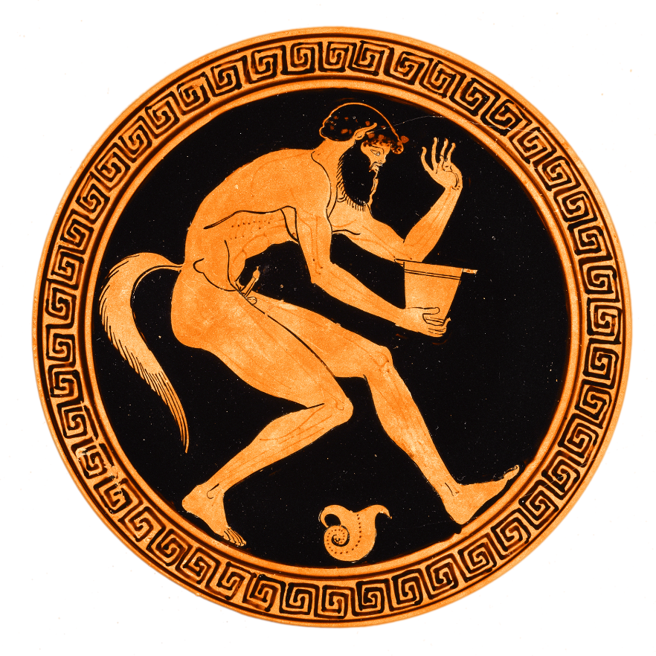
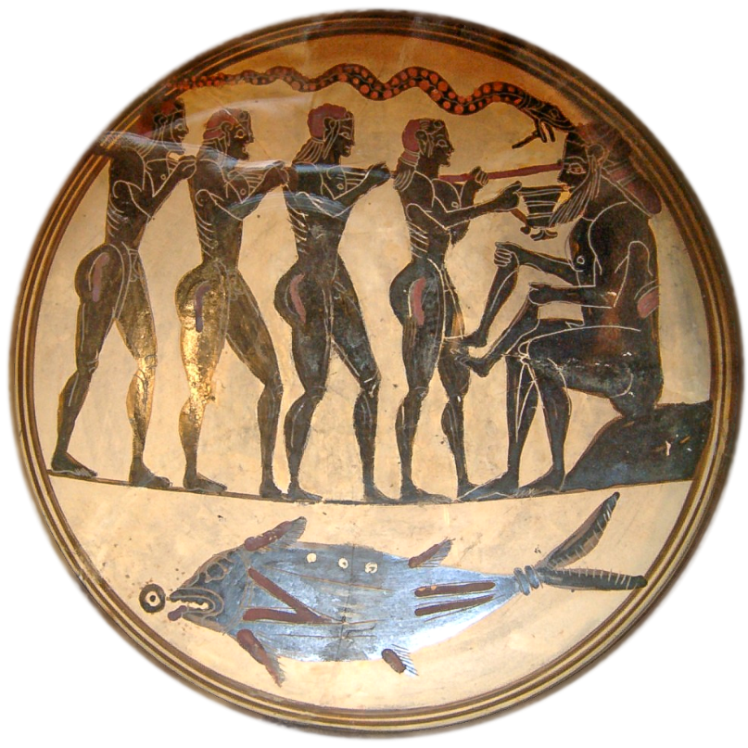
Euripides’ Cyclops
Funny Tragedy?
Notes:
I’d like to start with some discussion. And I’d like to start that discussion by asking that, as we discuss, we keep the chat box from gratuitous comment, jokes, etc. as much as possible. All of us are going to need to follow what’ll be happening there, and we absolutely need to keep the noise level down.
Also, if our discussion today begins to approach sensitive areas, as I think it will with this play, we need to keep discussion respectful and cordial. I’ll do my best to hold up my end, and I hope you do, yours.
Makron (Greek (Attic), active about 490 - 480 B.C.)
Attic Red-Figure Cup, about 480 B.C., Terracotta
8.2 × 25.9 × 19.4 cm (3 1/4 × 10 3/16 × 7 5/8 in.), 86.AE.291
The J. Paul Getty Museum, Villa Collection, Malibu, California
Laconian black-figure cup, attributed to the Rider Painter; ca. 560-550 BCE. Now in the Cabinet des Médailles, Paris.
https://lionofchaeronea.tumblr.com/post/112258183027/odysseus-and-his-men-blind-the-cyclops-polyphemus

Slide 2
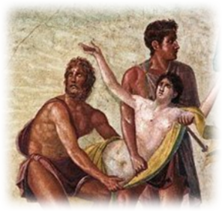
Iphigenia’s End — Why?
“To save Greece ...
  From what or whom?
... of her own free will”
  She had a choice? And human sacrifice?
An overdetermined death?
Notes:
The concept that comes to mind here is "overdetermination," a term coined by Siegmund Freud to explain dream symbolism, but extended to the social-political sphere by Louis Althusser, who
used the idea of overdetermination as a way of thinking about the multiple, often opposed, forces active at once in any political situation, without falling into an overly simple idea of these forces being simply "contradictory." (Wikipedia)
What is striking is how many answers to "Why?“you all were able to come up with, each answer equally compelling and, maybe, equally unconvincing and often at odds, the one with the other. What matters in the end, to Iphigenia, to Agamemnon, to Odysseus and his mob, is that there be a slogan, any slogan, around which everyone can rally, whether to justify sacrificing Iphigenia or to justify destroying Troy.
Only Clytemnestra seems to resist buying in. Her "dim view" of the expedition, especially at the end of the film version, but this applies as well to the play, is chilling.

Slide 3
Agenda
Cold Open
  Iphigenia’s overdetermined demise
Discussion: Satyr Drama is…
  Funny Tragedy?
Introduction to Genre, Play
  Playful Tragedy (Seaford)

Slide 4
Discussion: Satyr Drama is…
Funny Tragedy?

Slide 5
SATYR: Look here, Odysseus,
there’s a matter we’d like to discuss with you.
ODYSSEUS: Go ahead . . . Friend to friend. Nothing nicer.
SATYR: Well, when you laid waste Troy, did you also lay Helen?
ODYSSEUS: [rather shocked] We laid waste the whole house of Priam.
Notes:
So, discussion starts from this brief passage, which I’d like two of you to read for the class.
[they read]
That was from the first episode; you’ll notice that the stage direction in brackets (Euripides didn’t write that; the translator did) has Odysseus as shocked when he delivers his line. That prompts me to ask if any of you were shocked.
Please enter a brief comment in the chat box.
SATYR: Look here, Odysseus,
there’s a matter we’d like to discuss with you. ODYSSEUS: Go ahead . . . Friend to friend. Nothing nicer. SATYR: Well, when you laid waste Troy, did you also lay Helen? ODYSSEUS: [rather shocked] We laid waste the whole house of Priam. SATYR: Yes, but,
when you got hold of that little piece of fluff,
did you all line up to run her through
in a gang-bang fuck—
give her for once her fill of a man? The slut! Bowled over by the sight of men
with embroidered pants and pretty legs,
and a gold chain dangling from his neck,
deserting the best of men all forlorn . . . Poor Menelaus! I just wish there were no women at all in the world, except one or two—for me.
CYCLOPS: You, you mobsters, you’ve done me
in.
But you won’t get out of these rocks alive to celebrate.
I’ll stand here and block the cavern with both hands. [As CYCLOPS spread-eagles himself across the entrance of the cave, the SATYRS mock him from within] A SATYR: What’s the matter, Cyclops? CYCLOPS: I’m wiped out. ANOTHER: You don’t look too good. CYCLOPS: I’m in agony. ANOTHER: Did you fall into the fire—smashed? CYCLOPS: Nobody has destroyed me. ANOTHER: So no one’s hurt you? CYCLOPS: Yes, Nobody blinded me. ANOTHER: So you’re not blind? CYCLOPS: I am—damn you! ANOTHER: But how could nobody blind you? CYCLOPS: You’re jeering at me. Where is Nobody? SATYR (leader): Nobody’s nowhere, Cyclops. CYCLOPS: Idiot, I mean the stranger, the swine:
he’s finished me. Did it with wine. SATYR: Ah, wine! One can’t wrestle with wine. CYCLOPS: For the gods’ sake tell me, have they got away? Or are they still inside? SATYR: They’re standing very still over there,
underneath a ledge of rock. CYCLOPS: On which side? SATYR: To your right. [CYCLOPS deserts his post at the entrance of the cave and starts groping towards the rocks on his right while ODYSSEUS and his CREW slip out of the cave] CYCLOPS: Where exactly? SATYR: Up against that rock. Got it? CYCLOPS: [lunging at a rock]
Oooh! from bad to worse. I’ve split my skull. SATYR: What! did they give you the slip? CYCLOPS: You said they were here. Nothing! SATYR: Not here—over there. CYCLOPS: Where? SATYR: Turn right round. Over to your left. CYCLOPS: Curse you! You’re laughing—
making a joke of my misery. SATYR: Not at all. Nobody’s right in front of you. CYCLOPS: Scoundrel! Where, where?
Roche, Paul. Euripides: Ten Plays (Kindle Locations 10662-10694). Penguin Publishing Group. Kindle Edition.

Slide 6
Question
Can tragedy be funny and still be tragedy? If so, will this be what “funny tragedy” will look like. If not, why not? What is tragedy, anyway?

Slide 7
“In drama you struggle, because you hope you’re going to survive. It’s utilitarian — sordid. But tragedy is gratuitous. Pointless, irremediable. Fit for a king!”
(Chorus in Anouilh Antigone p. 102)
Can we think of Euripides’ Cyclops as drama or tragedy?
Notes:
even if Anouilh’s drama/tragedy dichotomy is kind of false, maybe a bit of a trick, i think it forces us to consider whether (and this is why it fascinates me) tragedy as a kind of universal genre is necessarily
distant, static in its stories, unrelatable, or
dynamic, engaging, even contemporary
this can be asked of this often ridiculous, often hard to stomach play – why? well, the ending is inevitable, but is there no suspense? we’re rooting for the good guy! but who’s the good guy? is cyclops evil or unsocialized? is odysseus good or manipulative and hubristic, taunting the cyclops, as he does, with fake name “no one”? is there pity and fear? reversal and recognition? do we care about the characters?

Slide 8
Introduction to Genre, Play
Playful Tragedy (Seaford)?

Slide 9
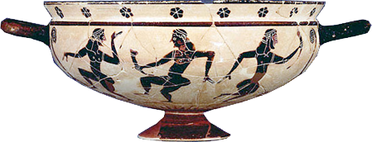
Satyr Drama: Origins
Cultic (Dionysian) precursors
  Impersonation
  Procession
  Carousal-celebration
Chronology, Athens
  Late 500s
    “Tragedies from satyric drama” (Aristotle)
  Early 400s
    First satyr dramas (?)
Komasts: archaic Corinthian vase
Notes:
Dionysian-cultic dimension
komos
thiasos
533 BCE (ca.) tragedy
Late 500s, satyr drama
1st, separately
then, as part of tetralogy
Dionysia: fourth on bill (not at Lenaea)
Satyr drama as restoring Dionysian element to tragic competition (Richard Seaford)
satyrs and dionysian ritual.
PUBLIC satyric komoi during Anthesteria (February)
MYSTIC initiatory satyric thiasoi (probably during Anthesteria)
public-private dimension
PRIVATE revelation-immortality
PUBLIC fertility, well-being of community
likely satyr-, maenad-impersonation
identification of deceased thiasos-members with deified satyrs
terror-levity dichotomy
revelation-release
reflected in traditions associating Silenus (father of satyrs, foster parent of Dionysus) with superior wisdom

Slide 10
Satyr Drama: Elements
Stories, themes
  Myth mixing
Characters
  (Pappo)silenus
  Satyr chorus
  Mythic players
Tragic structure
Tone
  Sexual, scatological, paratragic
Topicality?
Notes:
stories, themes
myth-burlesque plots
Rustic, non-political
Folktale patterns
captivity, liberation (satyrs lost and found, captured, freed, and captured again – satyrs as Dionysus’ slaves, as slaves to appetites)
marvelous inventions (soph’s Trackers: Hermes and the lyre)
AFFIRMATION, REVELATION, (RE)INTEGRATION, REGENERATION
Characters
(Pappo)silenos
independent character but closely associated with his children, the ever present
Satyr chorus
11 choreuts, youthful versions of Silenos – phallic costumes
(Chorus Leader)
satyrs define a non- civilized-human-urban other
rustic (versus urban-civilized)
wine-sex-addicted (versus sober / self-controlled)
godlike license
unpunished attempted rape of hera
unleashed within mortal sphere
divine-immortal (versus human)
thiasos (retinue) of Dionysus
other Mythic players
Dramatic structure
earlier, loose
later, apparently “tragic” – Cyclops:
tone
burlesque, obscene – “aggressive humor” closely akin to Old Comedy (seaford)
Cyclops: drinking, sex jokes
Soph’s trackers: ref to the phallus, “feats of the spear,” i.e., phallic sexual reference. bathroom, excretion humor. and that’s sophocles

Slide 11
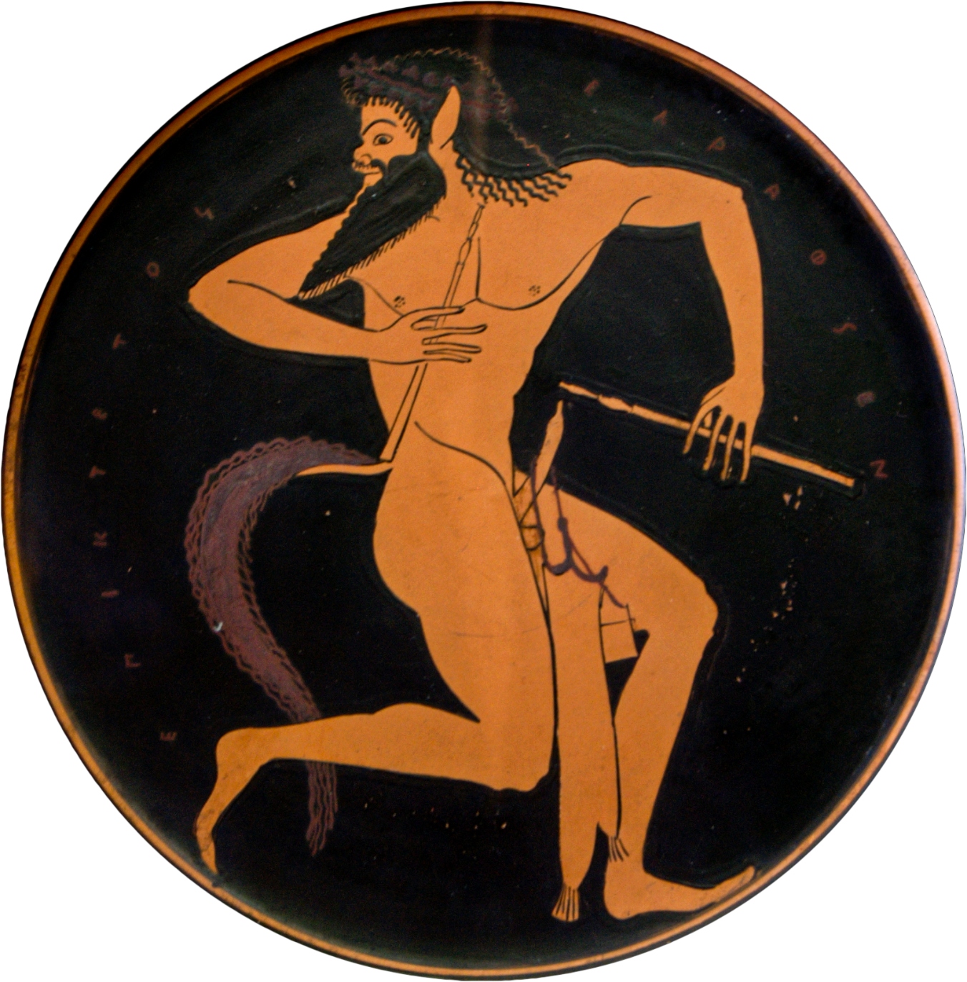
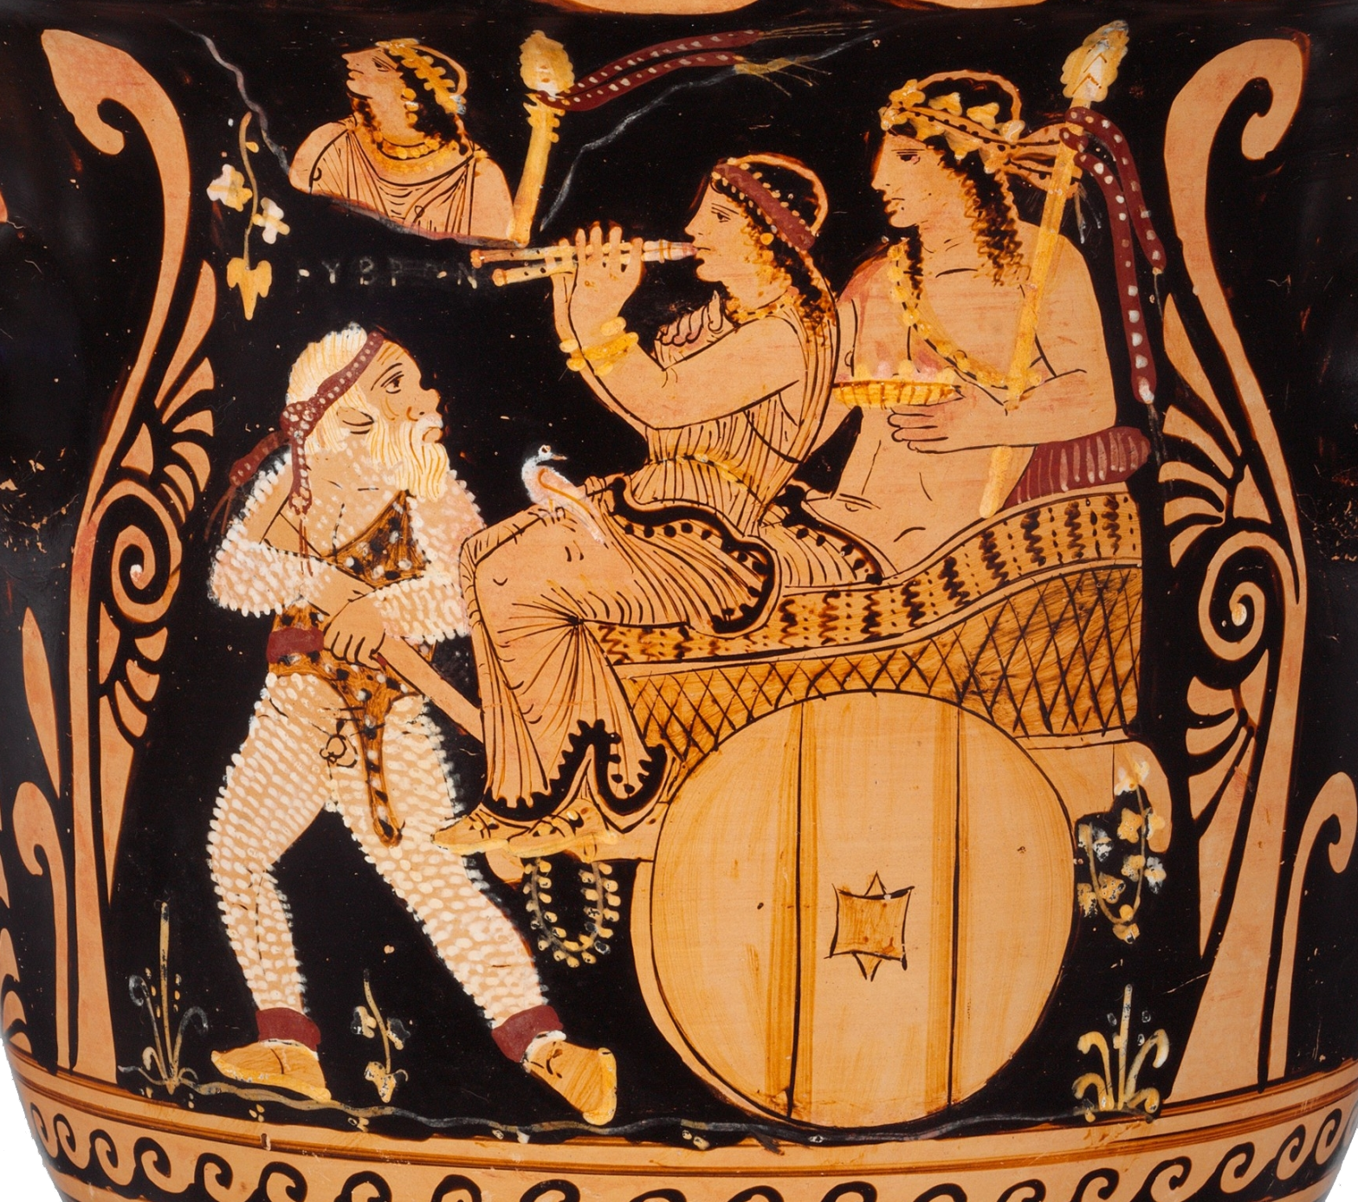
Young satyr
Silen with Dionysus and (?) Ariadne
Notes:
Satyr with pipes and a pipe case hanging on his erect penis. (Tondo of an Attic red-figure plate, 520–500 BC. From Vulci.)
Terracotta bell-krater (mixing bowl). Attributed to Python. ca. 360–350 BCE. South Italian. Above the Silen’s head, hubris
https://www.metmuseum.org/art/collection/search/255907

Slide 12
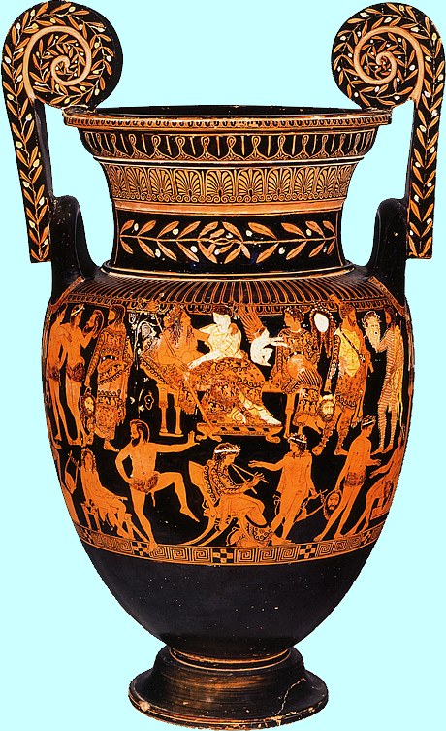
“Pronomos Vase”
late 400s BCE Athenian
(Naples Museum)

Slide 13
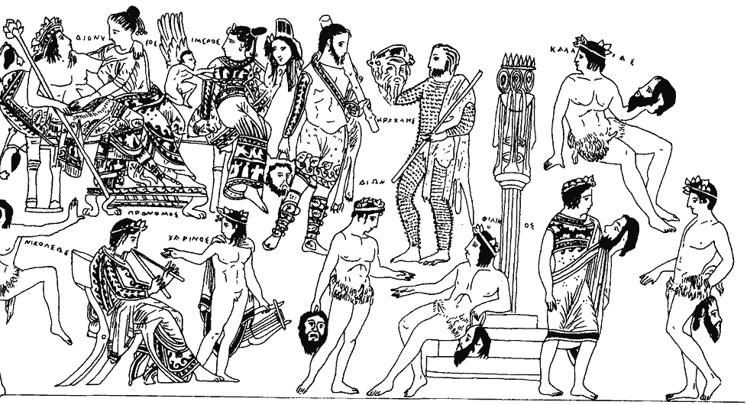
Dionysus and Ariadne
Satyr chorus members
Queen-character
Himeros (= Eros)
Heracles
(Pappo)silenos
Charinus (kithara player)
King-character
Pronomos (piper)

Slide 14
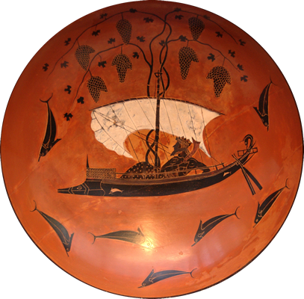
Cyclops: Production, Myth, Characters
Production
Myth, Characters
Composed
  post 411
Produced ca. 408
Myth
  Dionysus and the pirates
  Odyssey
Characters
  Silenus
  Satyr Chorus
    “Leader”
  Polyphemus-Cyclops
  Odysseus
Dionysus and the Pirates
Notes:
Composed
post 411
Produced ca. 408
Tetralogy?
Prize?

Slide 15
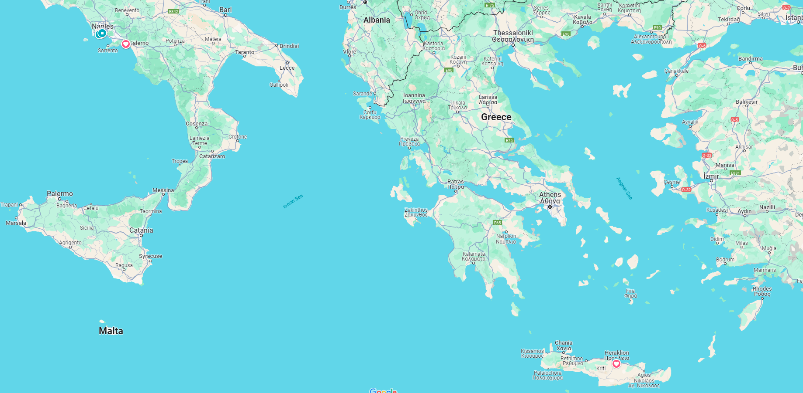
Maroneia
(Maron’s home)
Troy
Ithaca (Odysseus’ home)
Geraestus
Aetna
(home of Cyclops)
Sicily
Odysseus’ route (Euripides’ Cyclops)

Slide 16
Analysis
Prologue (Signet pp. 516 ff.)
  Silenus (backstory)
Parodos (518)
Episode 1 (520)
  Odysseus’ arrival
  Supplication, agōn
Stasimon 1 (531)
  Cyclops’ bestial impiety
Episode 2 (532)
  Cyclopean cannibalism
    Odysseus as messenger
  Odysseus’ plan
Notes:
Episode 1 (520)
Odysseus’ arrival.
521. the non-urban, non-democratic, anarchic, wild character of this place. no wine. no agriculture, though herding. hence no bread. cannibalism.
yet cy is hip to the existence cities, to od’s Trojan story. already signs of sophistication on his part.
524. the wink-wink nudge-nudge bit. again, the hatred-of-helen theme, virtually an affirmation of misogyny. cf. 528. helen theme: "... all that fuss / just for one single female.“
527. in effect, SUPPLIANT PLAY. cyc flagrantly in violation of hospitality - his acute anti-sociality. but note too how od seeks to push blame onto the satyrs. [note too that od in his way presented hubristically: an overbearing hero-type kind of like oedipus of agamemnon, though in od's case, a rascal too.]
528. ff. supplication scene in effect morphs into formal agon. 529. tragic themes. od: "Many have sinned through greed / and paid for the damage it has wrung.“ 529. cycl.: "Money, my little mannikin, / is the god of those who have any sense." asserts the law of self-interest of the stronger. here, sophistic themes. cyc's apprently hubristic scorn for the gods. sacrifices only to self. so another god: cyc's tummy (his appetites).
Episode 2 (532)
Cyclopean cannibalism. 532. od, sats. od delivers messenger speech. cannibalism.
Odyssean plotting. lonely "symposium.“
Episode 3 (537). Odysseus executes plan. element of suspense, intrigue. od plots a characteristically Euripidean deception.
537. od, cycl, sil, sats. compare the dressing scene in bacchae. dionysus is the wine. od executes plan.
540. the "knowledge too late" part - cyc's bacchic seeing. revelation accompanied by his wine-induced ate. will have sex with sil. note that cyc, in comparing sil to gany, in effect makes self out to be a kind of zeus. note too that gan served olympians as cupbearer.
Exodos (542)
Offstage blinding. “Nobody punch line.
Oracular business. fated blinding, the Cyclops’ revenge.
545. cyc mentions oracle. looks ahead to punishment of od too for his hubris. not deus ex machina, but a feature of euripidean DEM endings - the oracle. satyrs head off with od.
IS IT TRAGIC?
do we see tragic patterns? tragic themes? (koros hubris ate dike reversal ) if so, is that tragic parody?

Slide 17
Analysis (cont’d)
Stasimon 2 (536)
  Cyclops weds the wine
Episode 3 (537)
  Odysseus tricks Cyclops
    Moment of entrapment, atē, reversal; cf. Agamemnon’s carpet, Pentheus’ dress-up
Stasimon 3 (541)
  Excited anticipation
Exodos (542)
  Cowardly satyrs, offstage blinding, gloating
  “Nobody” punch line
  Oracular business
    Fated blinding, recognition
    The cyclops’ revenge
Notes:
stasimon 2
cyclops sings with chorus
Episode 3 (537). Odysseus executes plan. element of suspense, intrigue. od plots a characteristically Euripidean deception.
537. od, cycl, sil, sats. compare the dressing scene in bacchae. dionysus is the wine. od executes plan.
cyclops anti-socially boozes alone (so other cyclopses won’t rescue this one)
540. the "knowledge too late" part - cyc's bacchic seeing. revelation accompanied by his wine-induced ate. will have sex with sil. note that cyc, in comparing sil to gany, in effect makes self out to be a kind of zeus. note too that gan served olympians as cupbearer.
"After all the toils of war and triumph at Troy,
do not let Odysseus and his sailors be destroyed
by a creature who cares nothing for man or god;
or we must think blind Chance governs a god
and all other gods are governed by blind Chance.” (Odysseus)
in other words, a world without justice is a world governed by chance. justice represents a necessary ordering principle.
Exodos (542)
Offstage blinding. “Nobody” punch line. pity and fear?
Oracular business. fated blinding, the Cyclops’ revenge.
545. cyc mentions oracle. looks ahead to punishment of od too for his hubris. not deus ex machina, but a feature of euripidean DEM endings - the oracle. satyrs head off with od.
IS IT TRAGIC?
do we see tragic patterns? tragic themes? (koros hubris ate dike reversal ) if so, is that tragic parody?

Slide 18
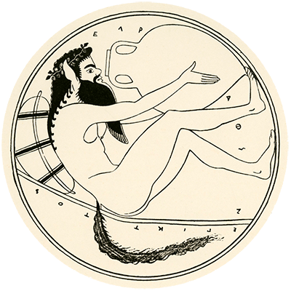
Tragic Themes, Topicality
Koros, hubris, atē, dikē?
  Parallels with Bacchae
Heroic code, hospitality
Sophistic themes
  Culture versus nature
  Right of the stronger
“Sophist”: Professional teacher preparing young men for public life. Teacher of rhetoric, reasoning, etc.
Notes:
issue: to receive or not to receive hospitably.
tragicizing dialogue with political-topical overtones (cf. OAC oed’s arrival):
ODYSSEUS Where are the walls and city-towers?
SILENUS This is no city, No man inhabits here.
ODYSSEUS Who does inhabit it? Wild animals?
SILENUS The Cyclopes. They live in caves, not houses.
ODYSSEUS Who governs them? Or do the people rule?
SILENUS They are savages. There is no government.
TRADITIONAL TREATMENT
Odysseus
crafty
intelligent
resourceful
Poly
stupid
barbaric
naive
… IN AGON IN CYCLOPS
DEBATE
poly p. 530: “No sacrifices do I celebrate – except to myself: … To eat and to drink from day to day / without a care in the world, / that’s the Zeus for any man of sense.”
do we detect here untragic features? tragic ones?
Cyclops sophist
rejects gods
rejects conventional law (nomos): “As for those who embroider human life with their little laws - damn the lot of them”
asserts selfish satisfaction of desires as supreme law
Seaford on resemblance to Callicles in Gorgias: “strong individuals have duty, based on [nature], to satisfy their desires at the expense of [laws], which are to be despised as the creation of weak individuals”
“equality under the law” an axiom of democracy
might is right
in essence, rejects democracy like some oligarch from 411, or like some tyrant
Cyclops’ ate??
antinomian, antipolitical, anticultural Cyclops immediately falls for the attractions of the Dionysian
to be destroyed - to free his “subjects” - he has to be convinced not to be sociable, not to share, not to create society among the savage, hermetic, misanthropic Cyclopes
ironically, the rustic, non-urban satyrs participate in this fatal socialization of the Cyclops
therein lies the Dionysian, poetic justice
the clash of his superhuman and subhuman qualities, of his hubristic rejection of sociality, creates in him the irresistible urge for sociality
like Oedipus, he is blinded and even more radically cut off
with suffering comes initiation into knowledge, but knowledge too late, knowledge that blinds
so beware the rejection of Dionysus!!
end of the Cyclops’ reign, destruction of his house
a very tragic satyr drama
play seems to punish wickedness - to punish the barbarism of Cyclops, who refuses to acknowledge the Greekness of his home island, Sicily
yet we can view Cyclops as a victim too: of Greek hubris, that, like Athenian hubris during invasion of Sicily, feels it can overrun and devastate any land it wants (Troy, e.g.)
if these quasi-”modern” discourses are tragic, what, if anything, does that say about the place and time – democratic athens – that they evoke?

