Slide 1
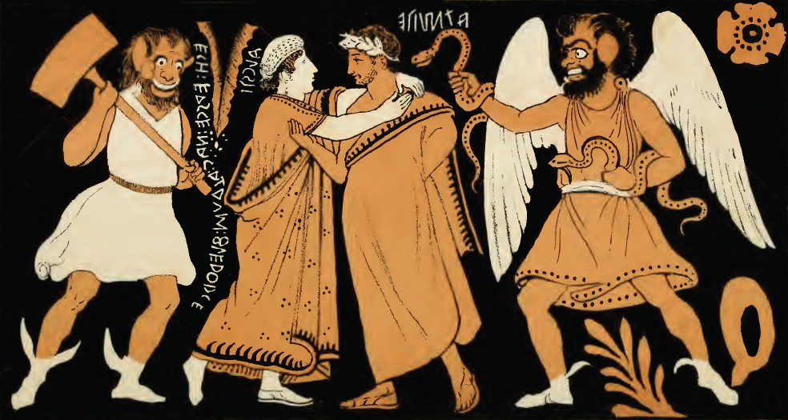
Tragedy with a Twist
Euripides’ Alcestis
Alcestis and Admetus, Etruscan Vase
Notes:
The Farewell of Admetus (ATMITE) and Alcestis (ALCSTI). Etruscan red-figure amphora found in Vulci. Inscription on the left: ECA ERSCE NAC ACHRUM FLERTHRCE (She went and in this way she satisfied Acheron with a sacrifice)
https://en.m.wikipedia.org/wiki/File:Farewell_of_Admetus_%26_Alcestis.jpg
The fourth century Etruscan volute krater from Vulci, now housed in the Bibliothèque Nationale, Cabinet des Médailles in Paris (inv. 918), features the ﬁnest depiction of the farewell scene of Alcestis and Admetus known in red-ﬁgure vase-painting throughout the Mediterranean.
https://www.academia.edu/8757733/_Greek_in_Subject_Etruscan_by_Design_Alcestis_and_Admetus_on_an_Etruscan_Red_Figure_Krater_in_The_Regional_Production_of_Red_figure_Pottery_Greece_Magna_Graecia_and_Etruria_eds_S_Schierup_and_V_Sabetai_Copenhagen_304_310_2014_

Slide 2
Agenda
Discussion
  Promises, Promises
Is It Tragedy?
  Euripides’ Alcestis, I Mean...
Euripides’ Alcestis
  More on the Play

Slide 3
Discussion
Promises, Promises

Slide 4
Admetus’ Promises 1
Promise...
... kept?
ADMETUS (to Alcestis): As in life you alone were mine, so in death no one else shall be called my wife. ... I’ll have a sculptor make an effigy of you and lay it sleeping in my bed. (episode 2)
HERACLES: ... take this woman now into your noble home. ...
ADMETUS: No, by Zeus! …
HERACLES: You’ll be making a mistake if you say no. …
ADMETUS: All right, you win. But it doesn’t give me pleasure. (exodos)

Slide 5
Admetus’ Promises 2
Promise...
... kept?
ADMETUS (to Alcestis, chorus): All celebrations I disallow, all drinking parties: no more song and garlands in my house. (episode 2)
ADMETUS (to Heracles): My being unfriendly would do nothing to reduce my woes. It would simply add the evil of inhospitality and my house would get the name of Unfriendly Hall. (episode 3)

Slide 6
Twisted Reciprocity 1
APOLLO: Those ladies (fates) made this bargain with me: “We’ll let Admetus off his dying, for now, if he’ll exchange one body for another down below.”
APOLLO (to Death): A man is coming to the house of Pherae.... he’ll wrest that woman from you by sheer force. (prologue)

Slide 7
Twisted Reciprocity 2
HERACLES (to Butler): I must go at once and save this lately dead, restore Alcestis to this home of hers, and make Admetus some return. (episode 5)

Slide 8
Journal Prompt
Does friendship with Heracles trump promises made to spouses? And when Alcestis does get her voice back, how will she feel? What's she going to say to her husband?
Notes:
I want you to write a brief speech, what Alcestis says to her husband, when she gets her voice back

Slide 9
Is It Tragedy?
Euripides’ Alcestis, I Mean...

Slide 10
Ancient Commentary
“The drama is rather of the satyr-play variety, because its reversal leads to joy and pleasure, contrary to tragic genre. Inadmissible as examples of tragic poetry are both the Orestes [of Euripides] and the Alcestis, as they start from misfortune and finish ... with the characters well off – a plot pattern holding rather more to comedy.”
(Aristophanes of Byzantium)
Notes:
how much of the play can be played for laughs, the Heracles-butler scene, for instance? should the ending be played for laughs?
Tragic?
Lamentation
“I have overstepped my mark, ... Too late I learn this now” (Admetus, p. 36)
Satyric?
Butler on Heracles (p. 30)
“He grabs the loving cup with ivy round it / and swills it down neat like so much grape juice”
Heracles to Butler (p. 31)
“Have a drink”
“… pay homage to … Aphrodite”
“… take a swig with me”

Slide 11
“In drama you struggle, because you hope you’re going to survive. It’s utilitarian — sordid. But tragedy is gratuitous. Pointless, irremediable. Fit for a king!”
(Chorus in Anouilh Antigone p. 102)
Can we think of Euripides’ Alcestis as drama or tragedy?
Notes:
why ask? again, Anouilh is drawing a distinction between, on the one hand, engaging, suspenseful drama with viewers’/readers’ emotional involvement, on the other hand, unrelatable tragedy with its quasi-ritualistic violence and catastrophe. Alcestis is like the latter, yet it it’s so very untragic. the prologue contains a huge spoiler, Heracles will save the day. it’s not that everything’s hopeless; hope itself is pointless – why worry or fret? so much of the tragedy, the mourning and grief and suffering, etc., turns out to be not simply gratuitous but riotously performative, even self-indulgent, both in Admetus’ case and in Alcestis’.
thus to ask the question, Is Alcestis tragedy? is kind of to ask what tragedy is.
i think the point is that we can begin to map out a few diagnostic features that point in the direction of tragedy and that the connect the dramas of real life with the imagined dramas of print, stage, and screen.

Slide 12
Euripides’ Alcestis
More on the Play

Slide 13
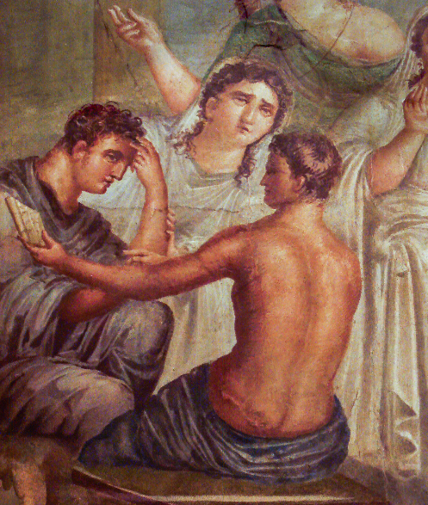
Alcestis: Production Facts
438 BCE
Euripides’ 1st preserved play
Tetralogy
  Cretan Women
  Alcmaeon in Psophis
  Telephus
  Alcestis
2nd place
  1st place Sophocles
Admetus and Alcestis, Pompeii wall painting
Notes:
Alcestis and Admetus, ancient Roman fresco (45–79 CE) from the House of the Tragic Poet, Pompeii, Italy (photo by Stefano Bolognini). https://en.wikipedia.org/wiki/Alcestis#/media/File:Affreschi_romani_-_pompei_-_alcesti_e_admeto.JPG
Euripides
480s-406 BCE
play
438 BCE
1st preserved play of his
first competes 455, age c. 40
myth figures importantly in the background to the eum, where the furies clearly carry a grudge against apollo for interfering in the affairs of the deities associated with earth, death, punishment.

Slide 14
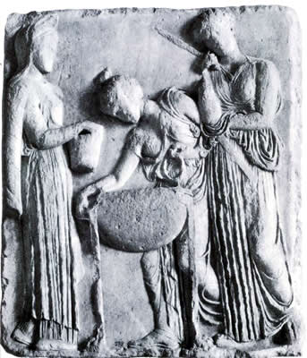
Mythological Background
Asclepius, Apollo
Apollo, Admetus
Alcestis, Pelias, Medea
Pelias takes a bath. . .
Notes:
PROLOGUE: the quasi-agon of apollo and death place the play’s conflicts in the context of virtually the same cosmic conflicts as emerge in aesch’s eum.
noticeable is apollo’s role as a kind of divine exemplar of anti-sociality. mythical background not irrelevant:
hinted at but not mentioned here is the reason for apollo’s having to serve admetus as a kind of servant. apollo’s son, the physician asclepius, had been infringing on the territory of death by bringing the dead back to life. (p. 8, ref to ascl as only god capable of reviving her soul) apollo, in anger, then kills the cyclopses as providers of the lethal thunderbolt (never mind that the cyclopses in at least some sources are gods and immortal.) apollo, for that crime, forced into servitude to admetus, who takes that rather as an opportunity to exhibit his extraordinary hospitality. apollo, pleased, tricks the fates into providing admetus with a one-time pass on avoiding a fated death, provided he can find someone to take his place. our play mentions the “trick” apollo plays on the fates; in aesch’s eum, we hear that apollo had got the fates drunk!!
but alcestis too could be said to have a hand in a potentially transgressive act of rejuvenation if not revival. acc to various sources, medea persuaded the daughters of pelias that, by following a certain magic recipe, they could restore their father to youth - recall that one of pelias’ daughters is alcestis.
well, just as medea had planned, it doesn’t work, and alcestis and her sisters kill their dad. which isn’t to say that act represents hamartia for which alc must pay. but that this play of eur’s is completely suffused with themes of hubristic trespass: ad’s (and, in effect, herc’s) upon proper observance of mourning, and that of a whole bunch of characters – not least, the god apollo – upon proper observance of the boundaries between life and death, of youth and old age.
so students who point out that the alcestis can’t work exactly as a tragedy are right. still, the play, if nothing else – and especially considering its ending – leaves us scratching our heads whether the cosmos has been put back in balance by play’s end, or is just as dysfunctional as it was when it started.
Athens: Agora Altar of Pity relief-Medea and daughters of Pelias Date c.410 B.C. Location Athens (Greece)
marble copy, Rome, Lateran
Athens (Greece)--Agora--Altar of Pity
Greek--5th C. B.C
Medea (Greek mythology) ARTstor CollectionARTstor Slide Gallery

Slide 15
Alcestis: Analysis
Prologue (p. 1 ff., Signet ed.)
  Apollo, death. (Quasi-agōn)
Parodos (6)
  Elders of Pherae. (Alcestis: best of women)
Episode 1 (8)
  Maidservant, Leader
Stasimon 1 (11)
  “Gods: “help!”
Episode 2 (12)
  lyric duet, dialogue: Alcestis, Admetus, Eumelus (grief, fidelity)
Stasimon 2 (19)
  best of women. . .
Episode 3 (20)
  Heracles, leader, Admetus
Stasimon 3 (23)
  Admetus’ hospitality
Episode 4 (25)
  Admetus, Leader, Pheres. (Agōn)
Short choral interlude (29)
Episode 5 (29)
  Butler, Heracles
Stasimon 4 (37)
  Power of fate
Exodos
  Admetus, Heracles, silent Alcestis
Notes:
if a happy ending, still, much that fells deeply tragic.
the play includes plot features desired by aristotle in a tragedy: complication, resolution, recognition, reversal. but the resolutions themselves cause complications. in fact, everything causes complications.
PROLOGUE: backstory, thematic context.
the play’s prologue, with its dramatization of a clash between gods (and therefore clearly alluding to aesch’s eum), prompts the question: is there hamartia here, and if so, what is it? does apollo err by infringing on death’s territory? (apollo has a history of this, precisely what led to the punishment that itself led to ap’s meeting ad.) is it hamartia when ad canvasses for a stand-in death-victim, or when alc extracts from the promise, in return for her life, he must pledge himself not simply to eternal widower-hood, but celibacy too (not sharing his bed with anyone)?
in effect, AGON! between death and apollo. (apollo as trickster god – cf. Eumenides) death rightly suspects apollo. apollo says he has his reasons. what are they? apollo adduces some really pitiful arguments to “bribe” death to spare alc. (the beautiful funeral if she’s carried off old.) apollo takes death’s demurrals as sophistry – an interest of eur’s. apollo utters a thinly veiled oracle predicting the saving of alc by heracles.
PARODOS. the frequently encountered chorus of elderly – and more or less bewildered – men. (is this the day al is to die?)
1ST EPISODE. more later when we do the performance. how to read the seeming over-dramatization of alc’s death? her seeming passive-aggressive behavior? (alc’s farewells – even to her bed. what’s that with obsessive focus on the bed, i.e., on her marriage?)
STASIMON 1. prayer to apollo. chorus insane with sense of loss, almost suicidal.
EPISODE 2. more later, but again, tragedy or paratragedy of alc’s death….
ad declares a full year of mourning.
EPISODE 3. her, ad. ad’s equivocal, nebulous talk. asked a straightforward question, he speaks in enigmatic ambiguities – he trying to say things that maintain the appearance of saying something without actually saying anything. ad the host is trumping ad the husband. in the process, he plays false to both sides of his social self.
STASIMON 3. ostensibly, praise of ad’s hospitality and of ap’s serenely bucolic music. but the irony: implications of both (ad’s hospitality, ap’s association with carefree serenity) source of tension. “for the gentle-born cannot err but in generous wise. all wisdom resides in the noble. it sets me to thinking. deep in my soul a faith abides that the referent man will always fare well” (chorus, 24). that gives utterance to the sorts of platitudes that many on the last exam assumed are the “lessons” of tragedy. but uncritical buy-in to those sentiments must ignore a great deal else contracting that in the play.
EPISODE 4. pheres-ad agon. whatever you think of the back-and-forth (and neither side looks good here), upshot: the deal with death is tearing the family apart – by athenian standards, ad’s disrespect to his father is appalling, however contemptible the father’s relief is (the “what else are wives for?” thing). and the theme of families torn apart very much is close to the heart of tragedy. plus, father shows up son’s cowardice.
EPISODE 5. heracles satyr?? bit of cyclops?
arias and duets. ample kommos.
formal agon: long speeches, stichomythia.
choruses: not simply ornamental, but resonate with action, project an emotional response to it. do not advance plot. but ad unambiguously makes a deal with alc.
exodos. in effect, heracles’ DEM. but does herac actually solve – or create – problems? note the cascading consequences of inept yielding to passion, inclination. if not tragic cycle, still, some sort of cycle.
mirroring, reversal
rejection and welcome
rejection of Pheres
welcome of Heracles
mourning and rejoicing
by Admetus
death and resurrection …
of Alcestis
double …
deception (Ad dec’d H, H deceives Ad)
anagnorisis (recognition, H of the situation in which he finds himself, Ad that it’s his wife)
peripateia (reversal, of H and AL/AD – but al’s death not a reversal, rather is exdpected)
… of
Heracles
Admetus
the untragic action reveals flawed ethos of Admetus. he commits hamartia: whether in entertaining heracl or in breaking his promise to al. but Alcestis exaggerated
note also element of koros: excessive grief of adm (Heracles: "Bear up! Don't overdo your grief,“ p. 40), excessive meddling of alc (? do not remarry, “. . . remember always what you owe to me; / something I can never ask you to repay,” p. 14).
dike: I know most of you want to see the ending as happy, but could we also see this spectral alcestis as a kind of human Fury, an albatross bound to remind him every chance she gets of his failure to keep two of his promises? (ad: "Really her, / not some hallucination from the shades?" ad: "Are you sure she's not some ghost rising from the shades the shades?" herac: "That would make your guest a spirit-raiser,“ p. 42.)
MORE GENERALLY, on the tragic/un-tragic features of play,…
ate? leader on p. 15: “all this he’ll do – or else be raving mad.” leader on page 23, when ad asks that her be hospitably received: “what are you doing, admetus? overwhelmed by catastrophe, and you think of entertaining? are you out of your senses?”
koros? recognition? reversal? not as clear cut as in aesch., but this is a king who in a sense has it all – and wants to keep it that way. just as soon as he consents to his wife’s proxy death, he experiences reversals (the compromising promises he’s forced to make). but when his wife returns, he arguably experiences reversal. but it is reversal with pity and fear? KOROS. not what’s usually meant by the word, but note the servant’s “he’s just too considerate, too hospitable” (31).

Slide 16
Gender, Heroism
Admetus’ Hospitality
Alcestis
“My being ... would simply add the evil of inhospitality and my house would get the name of Unfriendly Hall” (Admetus, episode 3)
“Alcestis who seems to me and all of us best of wives a man could get” (chorus, parodos)
Notes:
Alcestis’ as best of women. Achilles in the iliad is best of the greeks for his warrior prowess and courage. Alcestis in this play is best of women for her self-abnegation, by dying for her husband. so in IA, iph similarly heroic for allowing self to be destroyed: one woman’s life is worth many men’s lives. only here we may see something like a send up ofg that idea: ad comes across as distinctly unheroic. it’s the character type that honig pushes back against for antigone.
7. "Alcestis / who seems to me and all of us / best of wives a man could get." (83-85 Ἄλκηστις, ἐμοὶ πᾶσί τ᾽ ἀρίστη | δόξασα γυνὴ | πόσιν εἰς αὑτῆς γεγενῆσθαι.) [note resonance with thuc fo, homeric "best of the achaeans." her best-ness is in self-negation.]
9. leader: "The noblest consort under the sun!“
but that necessarily involves pure SELF-NEGATION – yet again, glorious action in an outwardly directed direction is denied a woman. (contrast the lordly clyt, cf. also the proactive medea and her concern for her dignity.)
note that chorus leader ominously-ironically foreshadows ad’s faithlessness when says “all this he’ll do – or else be raving mad” (15).
leader on page 23, when ad asks that her be hospitably received: “what are doing, admetus? overwhelmed by catastrophe, and you think of entertaining? are you out of your senses?” this is the tragic setup, you might say – the playwright sets the trap, just as Dionysus does in the Bacchae, where he serves as orchestrator of tragic action.

Slide 17
Pericles to Athenian Women
“... if I am to speak of womanly virtues to those of you who will henceforth be widows, let me sum them up in one short admonition: To a woman not to show more weakness than is natural to her sex is a great glory, and not to be talked about for good or for evil among men.”
(Thucydides History 2.45.2)
Notes:
Nancy Sorkin Rabinowitz, Anxiety veiled : Euripides and the traffic in women. Ithaca: Cornell University Press, 1993.
IAA and Alcestis = sacrificial women fetishized by men.
medea as vengeful destroyer, “uncanny” in psychoanalytic sense. she displaces “audience attention from systemic failings to [the women’s] violence” (108).
Alcestis as uncanny in her doublets: the bedtime doll, the revenant wife? she’ll always be there threatening the males, those who “traffic” in her, with a medea-like revenge undoing their patriarchal order.

