Slide 1

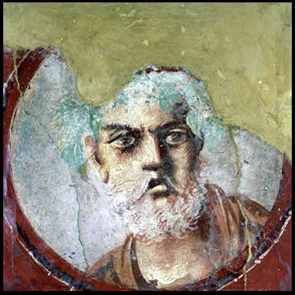
Introduction to
Roman Tragedy

Slide 2
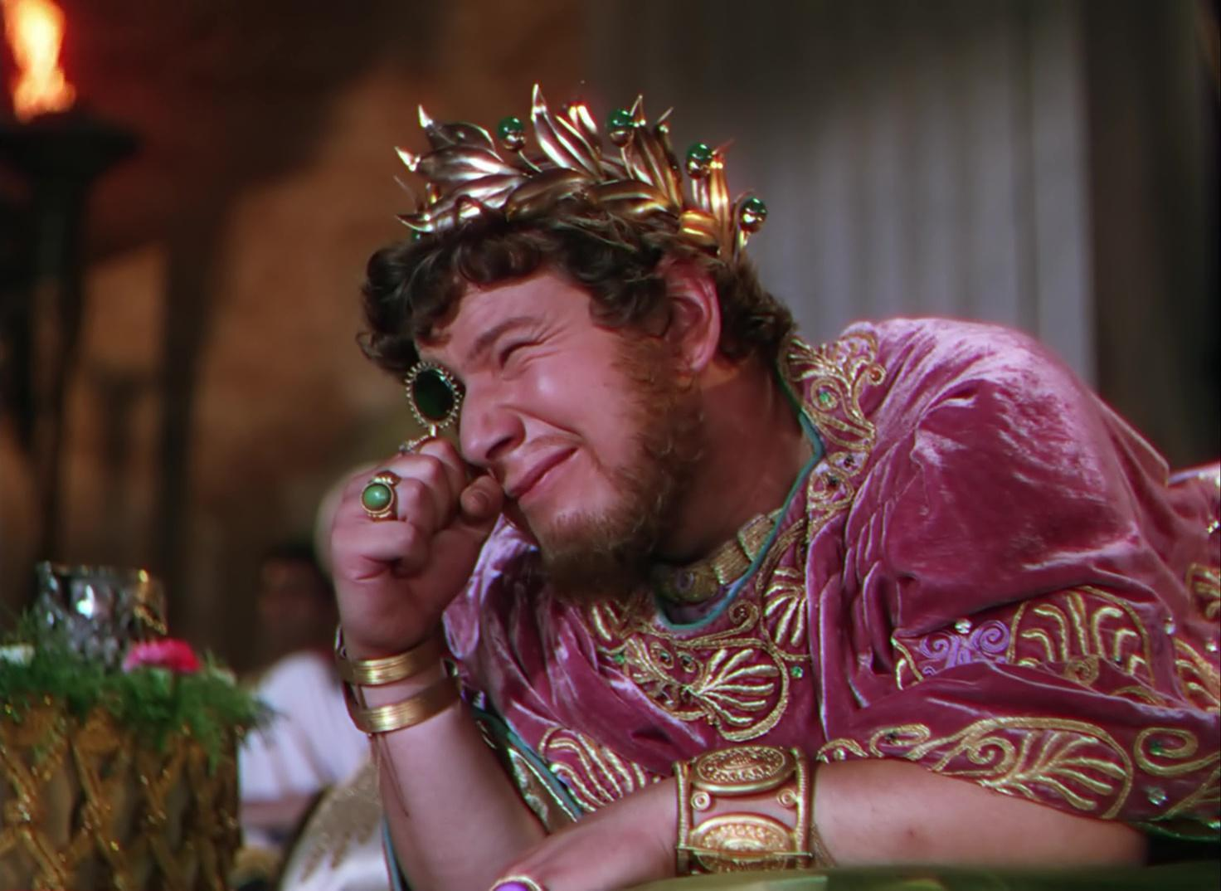
Peter Ustinov as Nero in Quo Vadis (1951)
https://youtu.be/Y4Q_DCgbEz0?si=I69g_ok2OCbIA8hc

Slide 3
“Others, I doubt not, shall with softer mould beat out the breathing bronze, coax from the marble features to the life, plead cases with greater eloquence and with a pointer trace heaven’s motions and predict the risings of the stars: you, Roman, be sure to rule the world (be these your arts), to crown peace with justice, to spare the vanquished and to crush the proud.”
(Vergil Aeneid 6.847-853)
Notes:
which one is more true? or is either true? in truth, each depends on the other....

Slide 4
Agenda
Cold Open
  Decadent Rome, Virtuous Rome
City and Empire
  The Briefest of Historical Surveys
Fascination (fascinum)
  The Gladiator and the Monster
Roman Theater, Roman Drama
  Continuities, Developments
Adventures in Performance
  Republican Tragedy, Choice Quotes

Slide 5
City and Empire
The Briefest of Historical Surveys

Slide 6
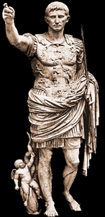
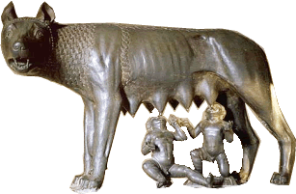
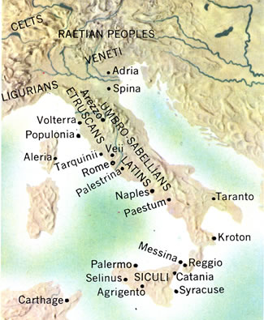
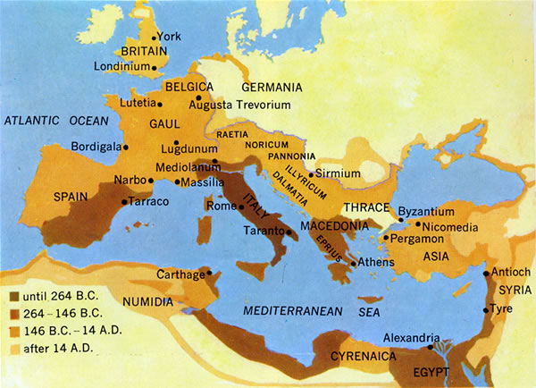
Capitoline Wolf
Augustus
Ancient Italy
Roman Empire

Slide 7
Timeline
753-512 BCE Regal period
Ruled by kings.
510-27 BCE Republic
Mixed constitution: oligarchic, quasi-democratic.
27 BCE-293 CE Principate (Early Empire)
De facto monarchy (imperātor, Caesar, princeps)

Slide 8
Fascination (fascinum)
The Gladiator and the Monster

Slide 9
“In the late Republic and the early Empire the exaggerated and the astonishing permeated life in a manner and to a degree unprecedented in Roman history. The dwarf and the giant, the hunchback and the living skeleton ceased being prodigies and became pets; they ceased being destroyed and expiated and became objects of the attention and cultivation of every class.”
(Carlin Barton, The Sorrows of the Ancient Romans, p. 86)
Notes:
in a word, a fascination with the bizarre, the grotesque, the monstrous

Slide 10
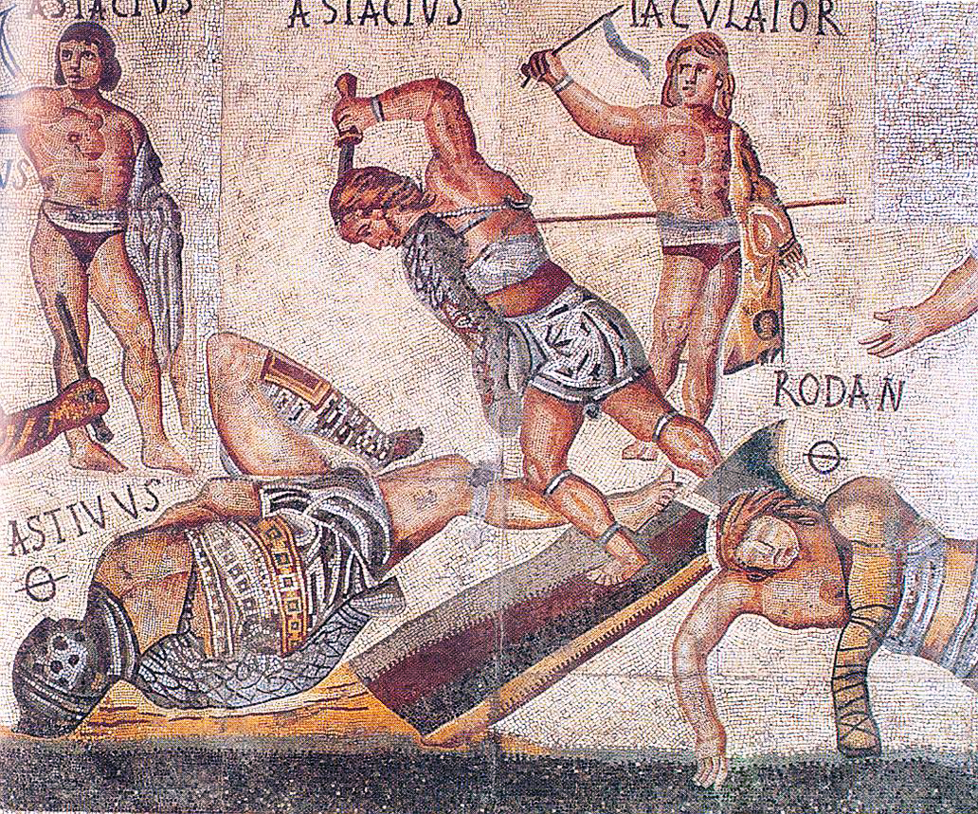
Rome and the grotesque 1
Gladiator mosaic, ca. 320 CE, Borghese Gallery, Rome

Slide 11
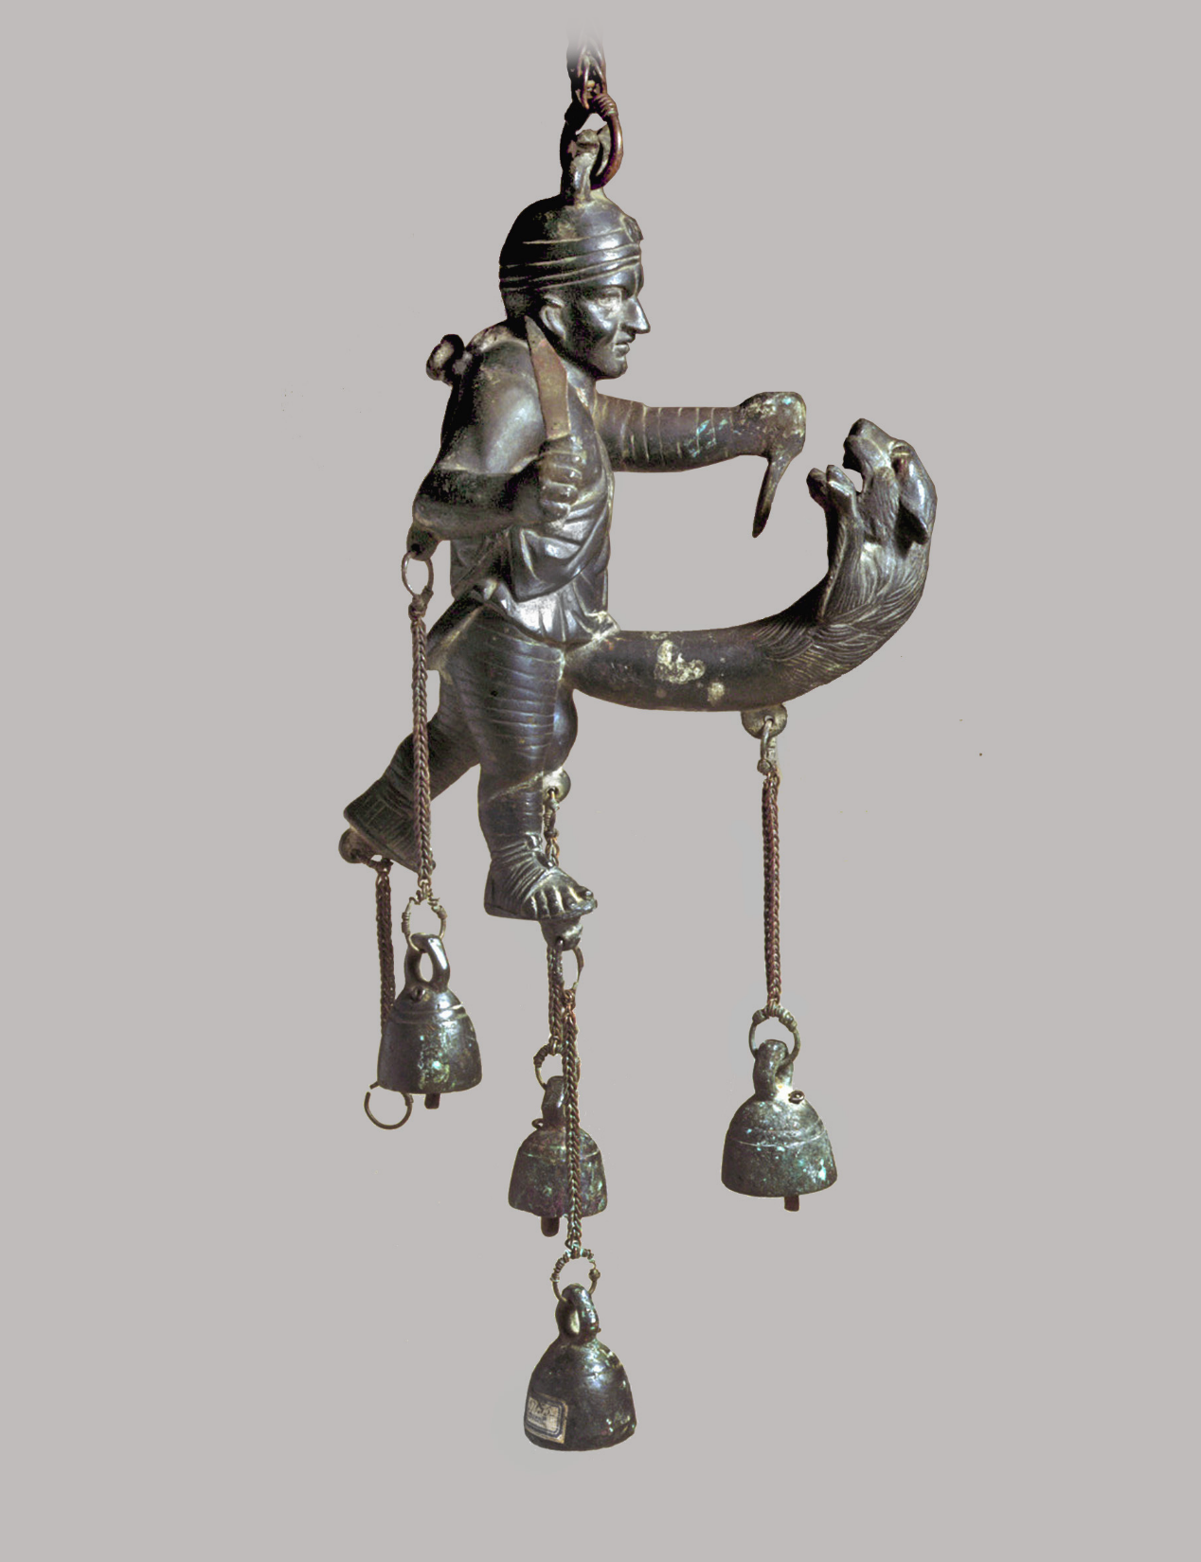
Rome and the grotesque 2
Apotropaic tintinnabulum (fascinum countermeasure), 1st cent. CE. Museo archeologico nazionale di Napoli

Slide 12
Roman Theater, Roman Drama
Continuities, Developments

Slide 13
Roman Drama: Fabula. . .
Comedy, fabula...
Tragedy, fabula...
Palliata
  himation – i.e., Greek-adapted – comedy
Togata
  “toga” – i.e., Italian comedy
Trabeata
  upper-class comedy
Mimus
  popular farce
Crepidata
  “buskin drama” – i.e., tragedy based on Greek myth
Praetexta
  “fringed-toga drama” – i.e., Roman history play
Pantomime
  narrative dance, chorus accompaniment, mythological plots
ca. 240 BCE-early 100s CE
Notes:
How do the fragments of Latin tragedies compare to extant Greek tragedies in terms of style, structure, and thematic concerns?
(I would like to see a discussion of the differences between Roman tragedy and Greek tragedy, and how one draws influence from the other)
I would like to see where thematic elements of Greek and Roman tragedy differ.
During our discussion I'd like to talk about how the Roman's so heavily adapted from Greek works yet still made it so much their own?

Slide 14
Tragic Playwrights
Republican
Imperial
LIVIUS ANDRONICUS
  280/60–200 BCE
Gnaeus NAEVIUS
  Late 2nd cent. BCE
Lucius ACCIUS
  180–ca. 86 BCE, child of ex-slaves
Lucius Annaeus SENECA
  ca. 4 BCE–65 CE
Anonymous author of Octavia (ca. 90 CE)
Notes:
NAEVIUS. “Six titles (Danae, Equos Troianus, Hector proficiscens, Hesiona, Iphigenia, Lycurgus) suggest tragedies of the Attic type. An account of Danae's disgrace (Nonius p. 456. 25, Lindsay) seems to have been set in bacchiac verse rather than in spoken senarii. Naevius also composed original tragedies, one on the story of Romulus the first Roman king, another (the Clastidium) on the defeat of a Gallic army in 222 by M. Claudius Marcellus (1). The latter may have been performed at funeral games for Marcellus in 208 or at the dedication in 205 of the temple of Virtus (see Honos) vowed by the consul before the battle of Clastidium.” (OCD)
ACCIUS. Epic (Annales) and dramatic poet. “The earliest [tragedy], probably the Atreus, was performed in 140 (Cicero Brutus 229). ... The grandeur of Accius' tragic style caused some contemporaries to laugh (Pompon. Hor. Serm. 1. 10. 53). Cicero, however, who was proud to have known him personally, admired his plays almost as highly as he did those of Pacuvius and cited extensive passages in his rhetorical and philosophical dialogues.” (OCD)
PACUVIUS (c. 220-130) stage poet and painter of South Italian birth, nephew and pupil of Quintus Ennius. His family belonged to Brundisium, and he spent his last years in Tarentum.
QUESTION:
Why are actors in Roman tragedy treated so poorly even while they serve as those who entertain? (well, they weren’t, exactly)
the preservation question.

Slide 15
Adventures in Performance
Republican Tragedy, Choice Quotes

Slide 16
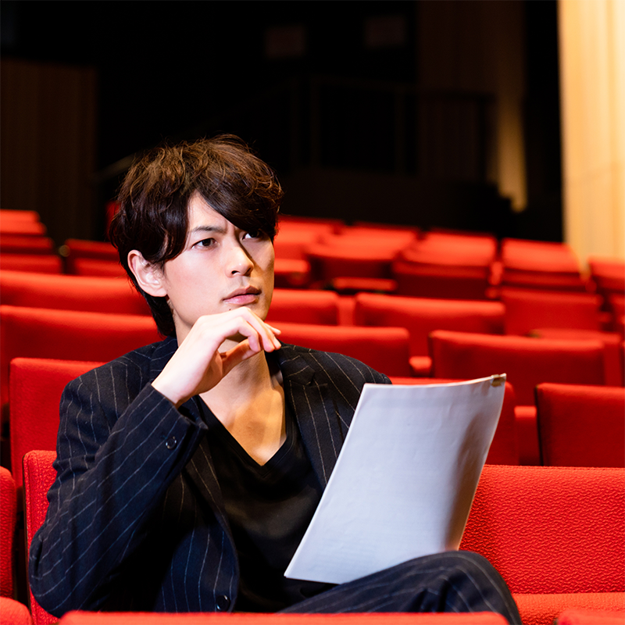
Procedure
Pick four groups.
Each group...
  Pick an actor
  Prepare brief context intro
    If you’re not sure, make something up
  Rehearse lines (direct your actor)
  Deliver lines (via your actor)
  Receive notes (from the audience)
Notes:
what emotions do you want to capture? what is the character of your speaker? given that these are mere fragments, there’s a lot of freedom

Slide 17
1. Crepidata (Accius Atreus frr. 163-166)
... maior mihi moles, maius miscendumst malum
qui illius acerbum cor contundam et comprimam
ATREUS: Again Thyestes comes,
At Atreus to grabble, now again
Approaches me to rouse me from my calm.
More moil for me! A bigger bane to brew,
That I may crush and crunch his grievous soul!
Notes:
note the passages from accius’ atreus – the feast-of-thyestes story. e.g., p. 383: “again thyestes comes.”
also the sententia: “let them hate so long as they fear,” a neat summation of what tyranny is about – accius was renowned in antiquity for his eloquence (disertissimus poeta, cic. sest. 122).

Slide 18
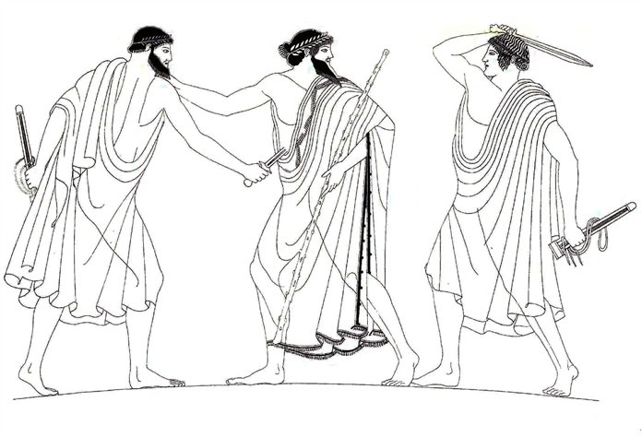
2. Crepidata Accius Atreus fr. 168
ōdērint dum metuant
ATREUS: Let them hate, so long as they fear!
The Tyrant slain, from an Athenian vase
Notes:
note the passages from accius’ atreus – the feast-of-thyestes story. e.g., p. 383: “again thyestes comes.”
also the sententia: “let them hate so long as they fear,” a neat summation of what tyranny is about – accius was renowned in antiquity for his eloquence (disertissimus poeta, cic. sest. 122).

Slide 19
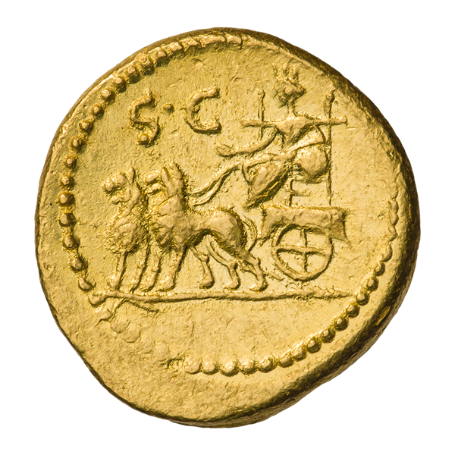
3. Praetexta Accius Brutus fr. 38
SEER (to Tarquin): It was thus most favorably foretold that the Roman state would be supreme.
Cumaean Sibyl
Notes:
“Back to his native land, happy in life never dying”
Naevius Clastidium (performed 195 BCE?)
Naevius (ca. 265-190 BCE). a single line from a lost play, the Clastidium (performed 195 BCE?), which described the victory in single combat of the Consul (high Roman official) Marcus Claudius Marcellus over the Gallic chieftain, Viridomarus, in 222 BCE. In reward, Marcellus received the spolia opima.
accius’ brutus is believed to have celebrated the family brutus, descended from the play’s protagonist, the republic’s founder.

Slide 20
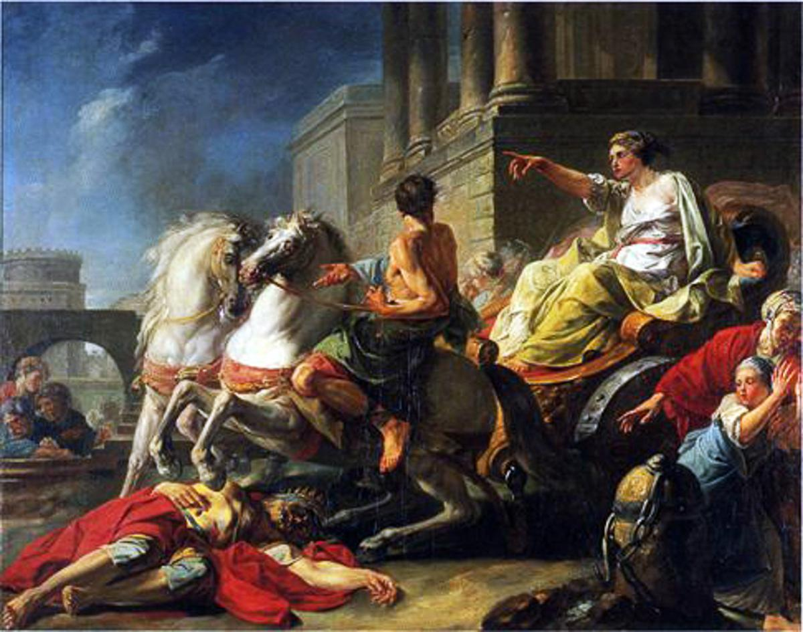
4. Praetexta Accius Brutus fr. 40
[speaker?] Tullius,* who for the citizens had made freedom firm....
  * Servius Tullius, early Roman king.
Servia, wife of Tarquinius Superbus, drives her chariot over her dead father, Servius Tullius, a tragicum scelus (“tragic crime,” Livy)
Notes:
“Back to his native land, happy in life never dying”
Naevius Clastidium (performed 195 BCE?)
Naevius (ca. 265-190 BCE). a single line from a lost play, the Clastidium (performed 195 BCE?), which described the victory in single combat of the Consul (high Roman official) Marcus Claudius Marcellus over the Gallic chieftain, Viridomarus, in 222 BCE. In reward, Marcellus received the spolia opima.
accius’ brutus is believed to have celebrated the family brutus, descended from the play’s protagonist, the republic’s founder.

