Slide 1
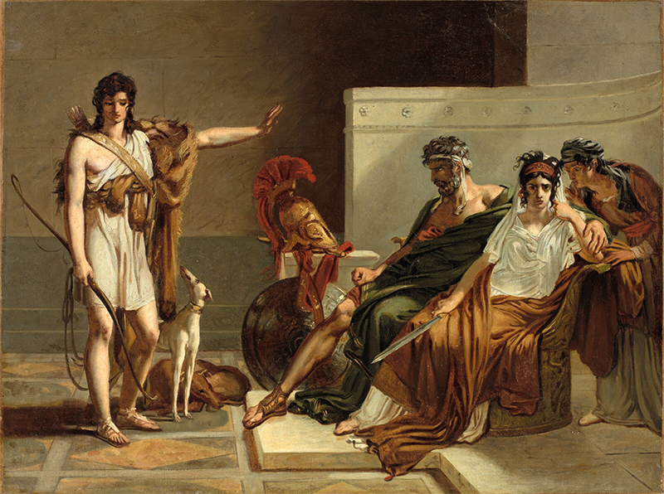
Seneca’s Phaedra, or. . .
“The Explosion of Evil” 2
Pierre-Narcisse Guérin, Phaedra and Hippolytus

Slide 2
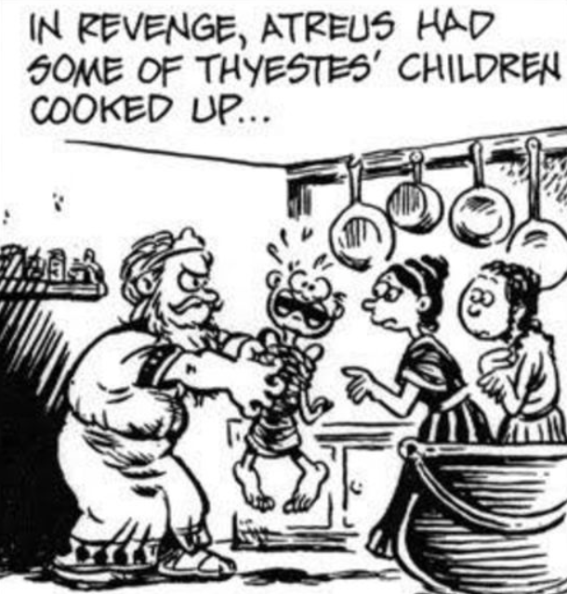
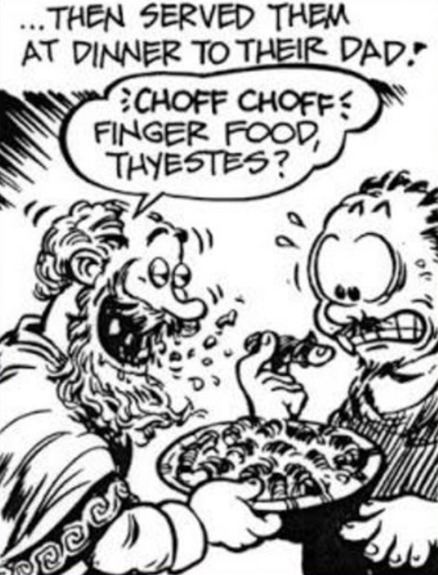
Seneca Thyestes, Thu, 11-Apr Journal
How to perform the “big reveal” in the Feast of Thyestes scene? (pp. 88-90, Penguin Seneca)

Slide 3
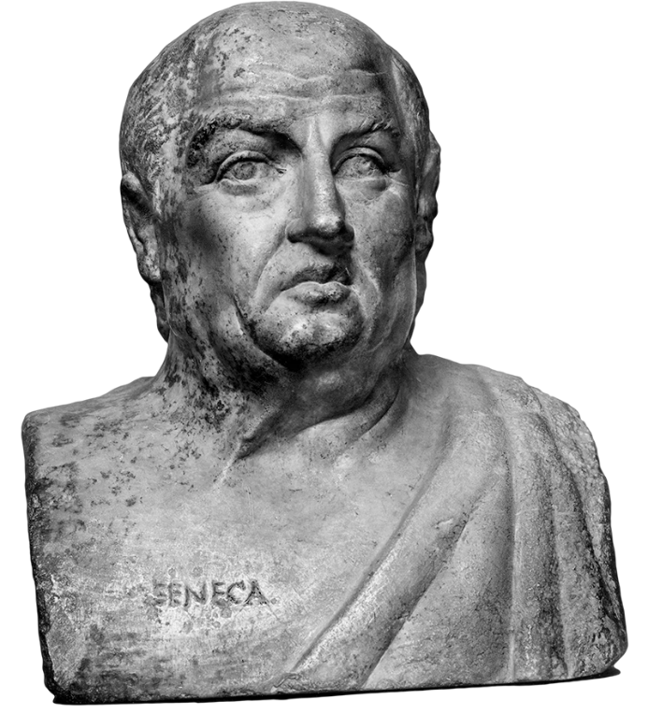
Agenda
Discussion
  Roman Tragedy as Non-Tragedy?
“The Explosion of Evil,” Phaedra
  The Conversation Continues...

Slide 4
Discussion
Roman Tragedy as Non-Tragedy?

Slide 5
“The content of Roman tragedy is not ‘tragic.’ “ (Brill’s New Pauly)
What is meant by that?
Do you agree?
Why?

Slide 6
Procedure
Form groups, pick secretary-respondent.
Quickly (15 mins.??) prepare summary (max 25 words) of group take.
  Type/copy-paste to Brightspace Discussion, “9-Apr discussion”
  Sample: “We think Brill’s means that Roman tragedy isn’t real tragedy b/c it’s funny. We agree. For instance, the end of the Phaedra is a total riot!”
Elaborate. Discuss. Ask one another questions.

Slide 7
“The Explosion of Evil,” Phaedra
The Conversation Continues...

Slide 8
Senecan versus Athenian Tragedy
Athenian
Senecan
Performed
Structure
  Episodes, choruses
Action
  Offstage violence
Links to
  Archaic Greek poetry
  Sophistic rhetoric
Performed?
  “Closet drama”?
Structure
  Acts (5), choruses
Action
  EXTREME violence (on-, offstage)
Links to
  Roman rhetorical tradition
  Roman philosophical interests
Notes:
Marta Straznicky on closet drama: "part of a larger cultural matrix in which closed spaces, selective interpretive communities, and political dissent are aligned."
* Straznicky, Marta (2004). Privacy, playreading, and women's closet drama, 1500-1700. Cambridge, United Kingdom: Cambridge University Publishing. p. 77
Herington* thinks it is stageable and was performed on dramatic or semi-dramatized form.
* Herington, C. J. “Senecan Tragedy.” Arion 5 (1966): 422–471.

Slide 9
“Senecan Schema” (cf. Herington)
Thematic Structure | Dramatic Structure
CLOUD OF EVIL | ACT 1. Hippolytus’ chaste joy, Phaedra’s love agony.
DEFEAT OF REASON BY PASSION | ACT 1 cont. Phaedra’s and nurse’s debate.
EXPLOSION OF EVIL | ACT 2. Attempted seduction, shocked rejection. Criminal plot – “crime must cover crime” (Nurse, p. 127)
 | ACT 3. Phaedra executes plan.
 | ACT 4. Messenger speech, Hippolytus’ death.
 | ACT 5. Phaedra’s suicide, Theseus’ grief.
Notes:
THE CLOUD OF EVIL, which coincides with a given play's prologue, in which an atmosphere of horror and dread is carefully cultivated.
THE DEFEAT OF REASON BY PASSION, often concentrated in the second act, where in several plays a noble and a lesser character debate - though really, REASON debates PASSION, with victory disastrously won by the latter.
THE EXPLOSION OF EVIL. Self-explanatory, it is, of course, action inevitably resulting from passion's victory over reason. Here, "the shockwave of evil races outwards, prostrating both the wicked and the noble" (Herington 456).
Herington, C. J. “Senecan Tragedy.” Arion 5 (1966): 422–471.

Slide 10
Seneca Phaedra: Tragic Motifs? (1)
Koros?
  “A man who can do much would like to do / More than he can” (p. 106)
Theseus’ hubris?
  “PHAEDRA: No shame, deters him. Lust and lawless marriage / In hell Hippolytus’s father seeks” (p. 102)

Slide 11
Seneca Phaedra: Tragic Motifs? (2)
Tragic knowing?
  “PHAEDRA: What we should shun we must desire. Yet knowing, I cannot help myself” (p. 126)
Stoic or tragic theme? (Atē?)
  “PHAEDRA: Reason? … Unreason commands my heart” (p. 105)

Slide 12
Seneca Phaedra: Tragic Motifs? (3)
“NURSE: Willful sin is a worse evil than unnatural passion; that comes by fate, but sin comes from our nature. ... To choose the good is the first rule of life, and not to falter on the way; next best is to have shame and know where sin must stop.” (Nurse, p. 104)

Slide 13
Senecan Tragic Rhetoric (Phaedra)
Sententia (pl. sententiae)
Perverse exaggeration
quod non potest vult posse qui nimium potest (Nurse, line 215)
“A man who can do much would like to do more than he can” (Nurse, p. 106)
“I hate them all; I dread, I shun, I loath them. I choose – whether by reason, rage, or instinct – I choose to hate them” (Hippolytus, p. 120)
Notes:
from Terms:
Sententia (pl. sententiae)
While the Latin noun sententia can simply mean the "sense" of an utterance, it has a technical meaning pertinent to the study of Roman tragedy. In the poetic and rhetorical stylistics of the imperial period (27 BCE onward), sententia comes to the fore as a term describing a short sentence dense with meaning and often dense, too, with irony. Take, for instance, the famous dictum of Arria, whose husband, Paetus, too cowardly to commit suicide to save his family's fortune, had to be coaxed with the words of his much braver wife, who said, Paete, non dolet, "Paetus, it doesn't hurt" (Pliny Letters 3.16). Of course, she was plunging his sword into her own breast at that moment, so the meaning of her utterance extends well beyond throse three short words: "Paetus, you miserable coward, an affront to your noble ancestors! If you can't find the courage to do the honorable thing, however painful — if your own wife, a mere woman, can, then what are people to think?"
Perverse exaggeration, rhetoric of excess
... taking a sentiment, finding its potential to express something over the top, outrageous, or similar, and then exploiting that potential verbally for all its worth. Take, for instance, a made up, non-Roman example like the following: "STUDENT: Professor Snape, do you really hate students that much? SNAPE: Students? I eat them for lunch!" Well, no, he doesn't, but you get the point.

Slide 14
Stylistic/Rhetorical Comparison 1
Sophocles Oedipus the King
Seneca Phaedra
“MESSENGER: “I tell you neither the waters of the Danube / nor the Nile can wash this palace clean” (p. 235)
“HIPPOLYTUS: Will Tanäis wash me clean, will the wild waves / Of far Maeotis, feeding the Pontic sea? / No; nor great Neptune in his whole wide ocean / Drown this great weight of sin” (pp. 126-127)
Notes:
Admetus, but he obviously doesn’t – this is get-out-of-jail BS.

Slide 15
Stylistic/Rhetorical Comparison 2
Euripides Hippolytus
Seneca Phaedra
“The unfortunate youth, inextricably entangled in the reins, was dragged along — his dear head battered against the rocks and his body shredded.” (Roche)
“The speeding wheels trundled the dying body until it caught upon a half-burnt tree-stump, sharp as a stake, which pierced the groin and held him transfixed....” (Messenger, p. 142)

