Slide 1
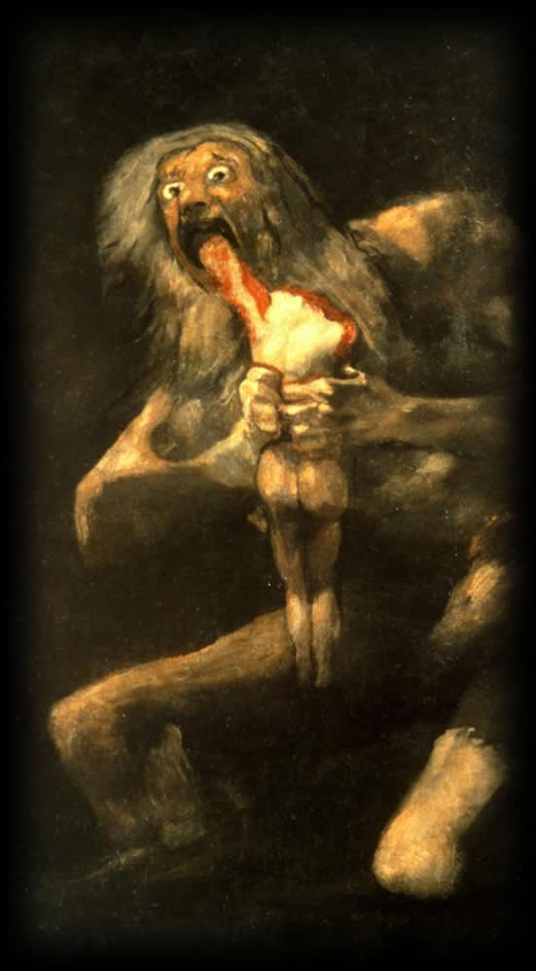
Seneca’s
Thyestes
Tragic Exploration or Lurid Fascination?
Saturn Devouring his Children, Goya
Notes:
so, a question: what is Seneca’s Thyestes?

Slide 2
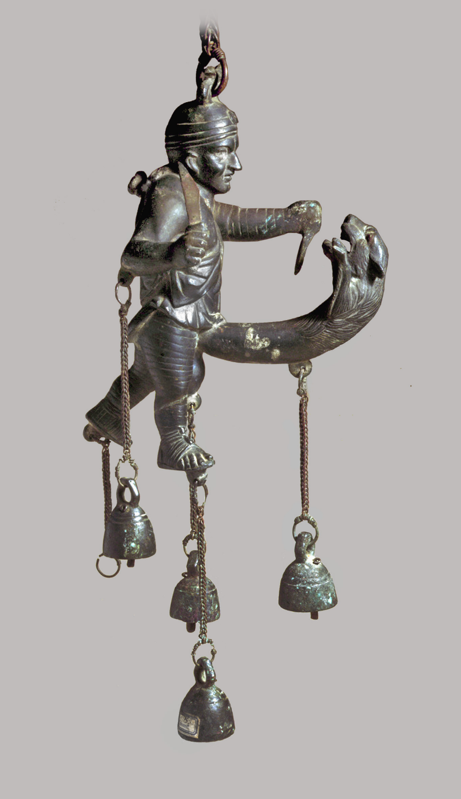
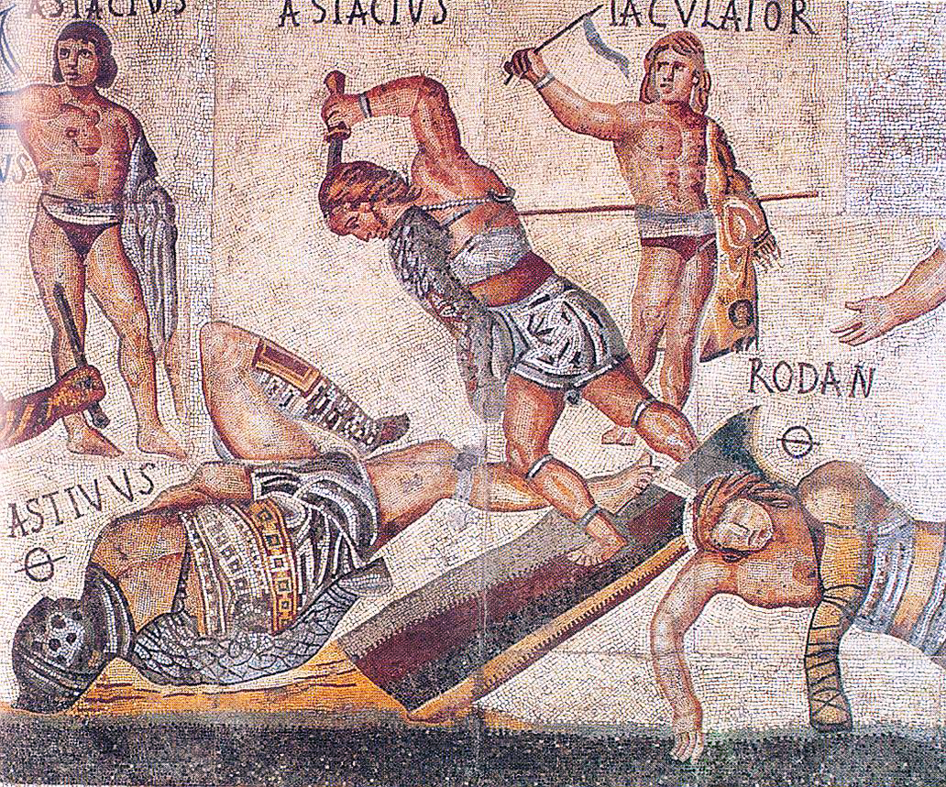
curiositās — the invasive gaze
Notes:
Is Seneca’s Thyestes grotesque? That is, does its action and rhetoric supply imagery designed to satisfy a voyeuristic fascination with the the lurid, the violent, the monstrous?
do we want to cover our eyes? or do we perhaps want to gaze all the more closely through our minds eye? that, arguably, would represent what’s been argued to be (carlin barton) a distinctively roman impulse, the fascination with the curious and with the monstrous. curiosity – curiositas – a passion being possibly abetted, not discourage, by stoic Seneca’s writing.

Slide 3
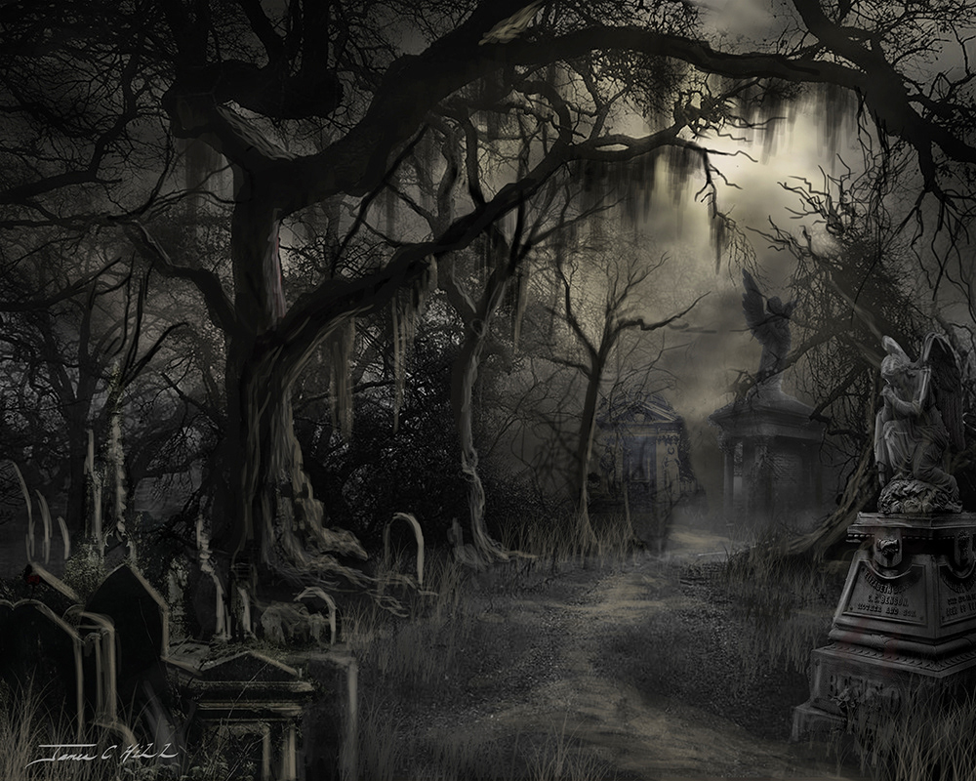
Notes:
Or is the play horror? Think of that scary graveyard on the screen as evocative of the inner garden in the palace of Atreus. (this connection to horror is something that scholars maintain)
(James Hill, Behance. https://www.behance.net/gallery/88013233/Gothic-Classic-Horror-Paintings)
ROMANIZING OF THE GREEK MYTH. the palace is not simply a goofy haunted house. it is emblematic of tyranny, arguably, with a roman twist. so it looms over argos-mycenae (seneca uses both names to refer to one and the same setting of the play.) but its structure is that of a roman domus, a roman house: public rooms in front, private apartments in back, and a kind of peristyle or park emblamatic of suffering and terror as the tools of tyrannical domination. I’m thinking of that weird open-air space where atreus personally murders the children as an offering to the gods of death and destruction, sponsors of his power.
so for all the seemingly gratuitously gory rhetoric, the play’s treatment of political themes undeniably carries with it topical resonances – the abuses of absolute power - frequently encountered in literature of the that time and place: mid first cent. bce.

Slide 4

Mike Myers as Dr Evil, in Austin Powers: International Man of Mystery
Notes:
Or does the play sensationalize horror and the grotesque to the point of parody, even comedy? Is Atreus a Dr Evil figure, trying just a little too hard to be evil?
Mike Myers as Dr Evil, Austin Powers.

Slide 5
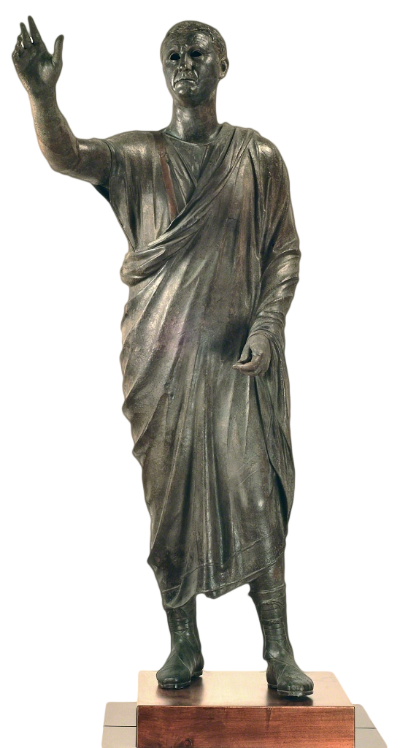
L’Arringiatore, “The Orator” (Aule Metelle)
Museo Archeologico Nazionale, Firenze
Notes:
is it dramatic rhetoric in verse?

Slide 6
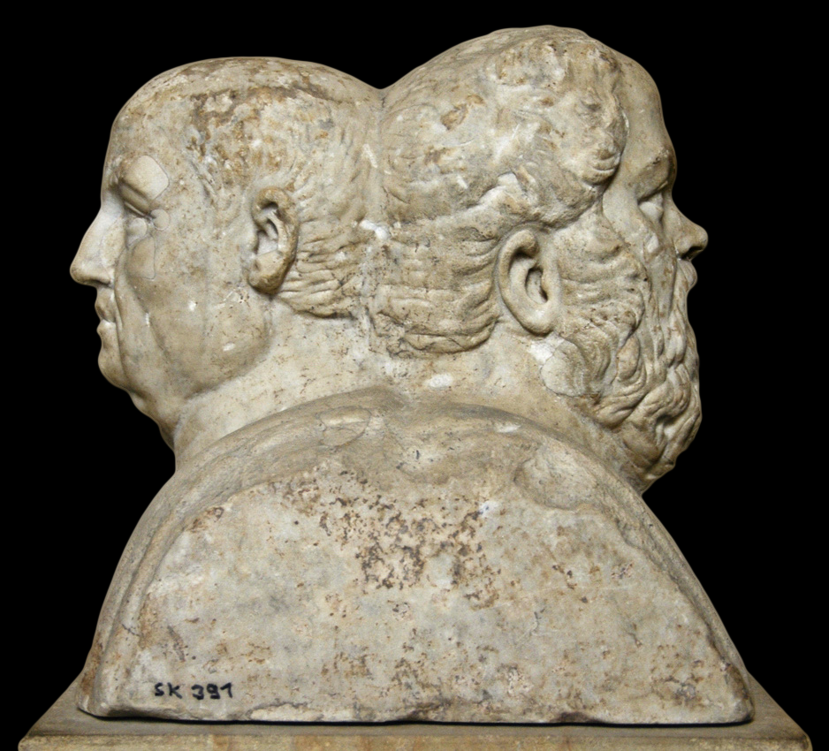
Double Portrait, Seneca and Socrates. Altes Museum, Berlin
Notes:
or is it an essay in stoic philosophy, an exploration extreme passion defeating reason?

Slide 7
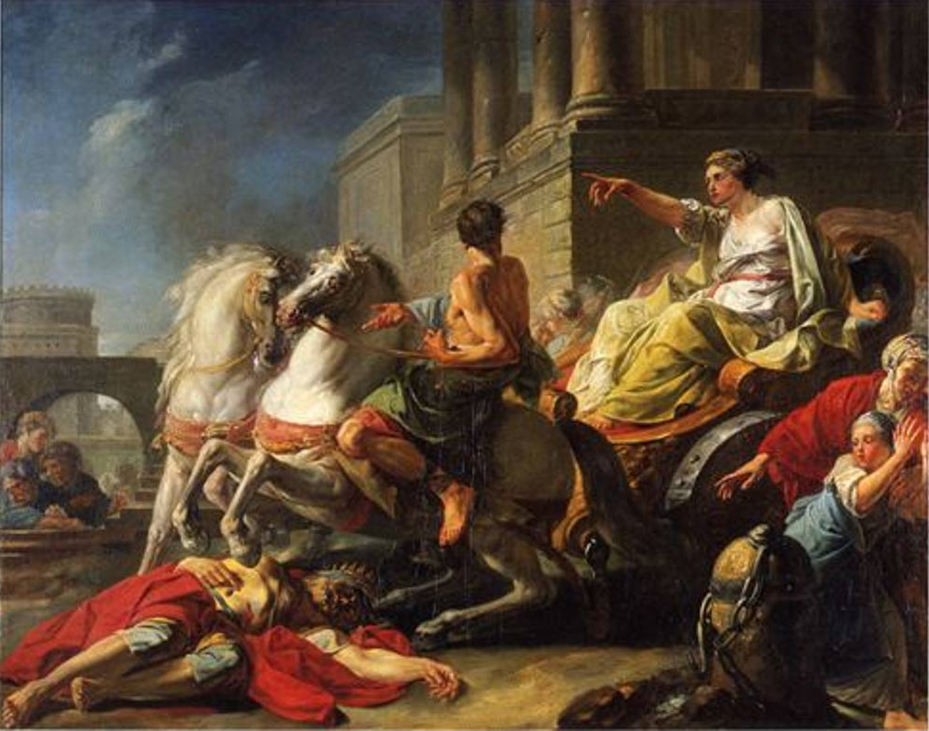
Servia, wife of Tarquinius Superbus, drives her chariot over her dead father, Servius Tullius, a tragicum scelus (“tragic crime”) according to Livy
Notes:
Or is it a combination of them? and even if it’s any one of them, is it really tragedy? one is perhaps tempted to say, with the author of the Brill’s article on Roman tragedy, no. But if that no is correct, why does Seneca himself, in his prose writings, refer to such plays as tragedy, just as he refers to greek tragedy as tragedy? but why then does the Roman historian Livy call the willfully defiant and transgressive crime of Servia’s driving her chariot over the body of the good Roman king Servius a tragicum scelus, a “tragic crime”?
can roman tragedy be its own thing, but, in certain ways, not Greek, and yet be tragic?
if roman elite life was already theater anyway (and in many ways, it was), is the performative rhetoric of roman tragedy so very unnatural, (to them, at least) unrelatable? untragic?

Slide 8
Agenda
Cold Open
  Is Seneca’s Thyestes tragedy?
Recap and Update
  Tragedy Compared, Greek and Roman
Adventures in Performance
  Lurid Feast, Big Reveal

Slide 9
Recap and Update
Tragedy Compared, Greek and Roman

Slide 10
Stylistic/Rhetorical Comparison 1
Sophocles Oedipus the King
Seneca Phaedra
“MESSENGER: “I tell you neither the waters of the Danube / nor the Nile can wash this palace clean” (p. 235)
“HIPPOLYTUS: Will Tanäis wash me clean, will the wild waves / Of far Maeotis, feeding the Pontic sea? / No; nor great Neptune in his whole wide ocean / Drown this great weight of sin” (pp. 126-127)

Slide 11
Stylistic/Rhetorical Comparison 2
Euripides Hippolytus
Seneca Phaedra
“The unfortunate youth, inextricably entangled in the reins, was dragged along — his dear head battered against the rocks and his body shredded.” (Messenger, Roche)
“The speeding wheels trundled the dying body until it caught upon a half-burnt tree-stump, sharp as a stake, which pierced the groin and held him transfixed....” (Messenger, p. 142)

Slide 12
Seneca’s Thyestes: Rhetoric
Perverse exaggeration
Sententia
“The fire seems loath to touch the roasting flesh. . . . The liver on the spits was heard to squeal” (Messenger, p. 79)
“Men compelled by fear / to praise, may be by fear compelled to hate” (Minister to Atreus, p. 54).
Compare:
“Let them hate so long as they fear” (Ōdērint dum metuant, Atreus in Accius’ Atreus)
Notes:
perverse exaggeration: this eagerness push rhetoric to the limits of decorous expression, even to pass beyond those limits, is curiously matched by the Senecan villain’s eagerness to outstrip evil itself.
a kind of ironic reversal of the stoic dictum “live in agreement with nature.” Thyestes seeks to force all nature to react to his evil.

Slide 13
Thyestes: Plot and Theme
(“Senecan Formula”)
Thematic Structure | Dramatic Structure
CLOUD OF EVIL | ACT 1. Fury incites Tantalus’ ghost. Choral ode. Prayer against tragic cycle.
DEFEAT OF REASON BY PASSION | ACT 2. Atreus and Minister. Debate, portrait in tyranny.
 | ACT 3. Thyestes and sons. Retirement v. return.
EXPLOSION OF EVIL | ACT 3 cont. Atreus & Thyestes – “reconciliation.”
 | ACT 4. Messenger. Sacrifice, locus horridus.
 | ACT 5. Atreus, Thyestes. Recognition & reversal.
Notes:
46. fury seeks tantalus to spur family on to further crime as its own punishment. note the seeming simultaneity of chance and fate as operative in the fortunes of characters. note how strife here extending horizontally, i.e., between contemporaries (brother and brother) is turned into a curse by being made to extend vertically, in effect pitting father against son along a chronological axis. The result is to let loose the forces of disorder, which Roman writers often identify with chance (fors) and the human passions. In various ways, this resembles the tragic cycle as in Aeschylean drama, only it goes well beyond it. This can, in other words, be viewed as exemplifying the Roman penchant for extremes. Indeed, malaise and catastrophe penetrate to all corners of a cosmos saturated with human disaster.
53. ACT 2. atreus, minister. atreus a portrait in roman tyranny and exaggerated anger. it seems wrong-headed to speak of atreus’ madness as a roman kind of ate. he willfully commits evil, desires it like a “hungry tiger” (messenger, p. 76). atr's overstated desire for brother's death; the overdetermined plotting. vengeance as competitive retaliation.
54. minister: "Men compelled by fear / to praise, may be by fear compelled to hate." (accius: "let them hate so long as they fear.")
56. atr's "sanctity begone!“

Slide 14
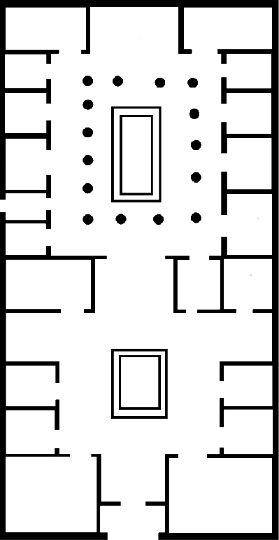
Domestic Space: Greek Myth as Roman Drama
Atreus’
garden
of horrors
garden,
private space
atrium,
public space
public space
entrance
entrance
typical elite Roman house, mid 1st cent CE
Palace of Atreus, Seneca Thyestes
Notes:
act 4 messenger speech, description of Atreus’ palace, public and private spaces, garden of horrors, human sacrifice

Slide 15
Adventures in Performance
Lurid Feast, Big Reveal

Slide 16
Procedure
Performers will form their own group, discuss their approach.
Rest of the class: form groups to reach group takes on performing the scene.
Performers perform their take on the scene, then take notes from the other groups.

Slide 17
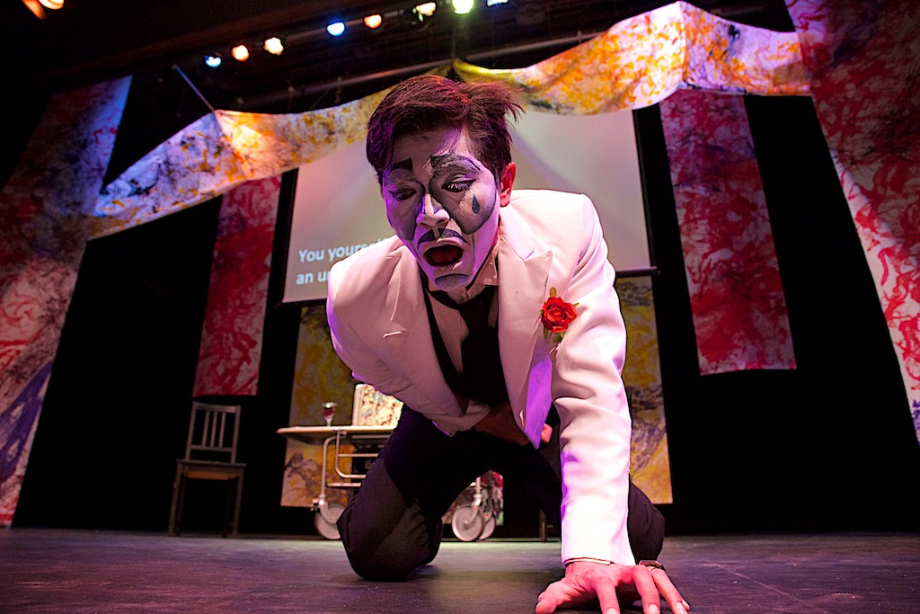
Barnard/Columbia Ancient Drama Group: Seneca's Thyestes (2013)
https://youtu.be/QxoFwDpkg10?si=HfiVWyTSfOlSke3U&t=4392
Notes:
“This monstrous (but tragic??) banquet!” pp. 87-90
from Didaskalia 10 (2013) 2, Timothy Hanford review:
“How could one perform such a horrific ‘freak show’ onstage for a 21st century audience? This production made the bold choice of employing a circus metaphor for much of the play, in which Atreus was intriguingly portrayed as ‘ringmaster’ (and old-time magician) for the ensuing drama. This metaphor strongly activated the sense of horrific exhibitionism present in Seneca’s tragedy, particularly in the last two acts.”

Slide 18
“And are we chosen out of all earth’s children to perish in the last catastrophe of a disjointed universe? Are we to see the world’s end come? A cruel fate brought us to birth, if we have lived to lose the sun, or if our sins have driven him away. But we must not complain, nor fear; too fond of life is he who would not die when all the world dies with him.” (Chorus p. 83)
Notes:
note that chorus doesn't really yet know what's up – they think it's the end of the world. (thus a kind of metaphor) but this also recalls the stoic idea of the empyrosis, the great conflagration that ends a given cosmic order to pave the way for the next.
the retreat of the sun turned into questions whether the universe has simply gone haywire. fear that the world will descend back into primordial chaos - the stoic empyrosis sort of becomes a Ragnarok. the constellations will fall into the sea.
how does this matter?
Dingel in Brill’s New Pauly writes, “It has proved impossible as yet to give a philosophical interpretation of the tragedies of Seneca….”
Herington, by contrast, disagrees: “An essential preliminary to the understanding of Seneca is the realization that, however eclectic he is, he is still Stoic enough by habit to draw little or no distinction between spiritual, moral and material realities.” (Herington p. 434)
Herington also writes:: "There is no difference for Seneca - and this a point which should interest readers of his tragedy Thyestes - between physical or moral light or darkness. . ." (in Arion 5 [1966] p. 433). Put differently, the pathetic fallacy is, in a sense, for Seneca no fallacy at all, it expresses deep truths about the interconnectedness of the physical and the spiritual. Metaphor and simile disappear; the spiritual bleakness of evil becomes the moral equivalent of a starless, moonless gloom.

