Slide 1
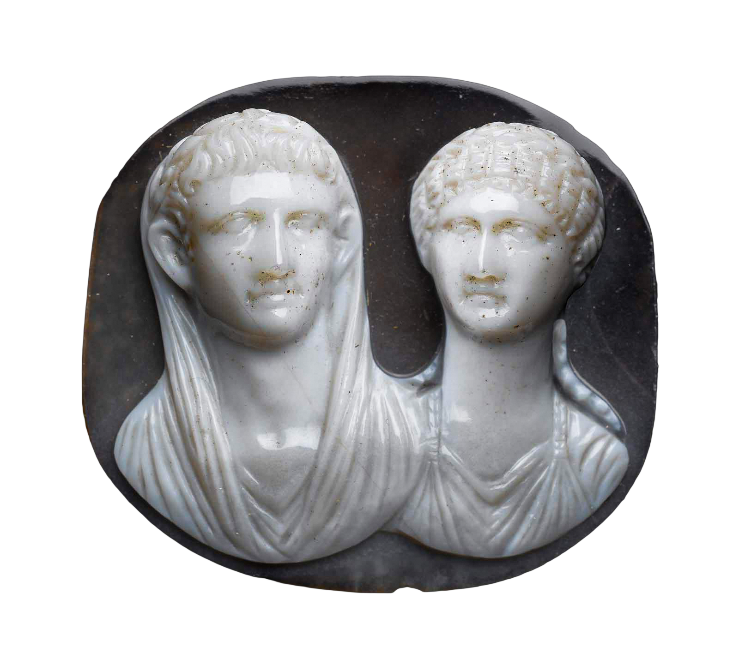
Pseudo-
Seneca’s
Octavia, or. . .
“Tragedy Is US”?. . .
Cameo with busts of Nero and Octavia (?), mid 1st cent. CE
Notes:
hello! i wanted to start out our impressions of this strange beast that we call roman tragedy. first, i’d like to test the relatability of one example of the genre: the Octavia by an anonymous playwright around the year 100 CE or somewhat earlier. then, i’d like to give us a chance to reflect just a bit further on questions of genre: What is this play?
relatability. let’s remember that relatability was a key feature of tragedy for aristotle, writing in the 300s bce. on the one hand, tragic characters are above “us,” the collective audience, on the social and political scale. they’re kings, queens, princes, princesses, heroes, and gods; for the most part, we (the audience), are not. or so aristotle tells us.
on the other, tragedy is defined as drama that elicits the pity and fear of its audience. if we don’t connect emotionally, then it’s not tragedy – at least, not according to aristotle. (and we’re not required to accept his testimony.) but the lofty estate of tragic characters and our pity and fear on their behalf are related. Oedipus’ fall is as devastating emotionally as it is because he has so far to fall. (as we’ve seen, not all tragic characters are exalted beings; think nurses and tutors. but they play a part in the tragic action.)
so, roman tragedy. there, too, characters of lofty estate suffer devastating misfortune. but does it emotionally affect us? if it does, how?
[solicit impromptu responses]
i think there remains some skepticism that we can ID, or at least, empathize with the misfortunes of our Hippolytuses, phaedras, or octavias in roman plays. though we’re reading these last in translation, still, the translations we’re reading preserve a much of the stylistic and rhetorical flavor of the originals, its staid language and the extravagance of its imagery. that can be off-putting. are we, though, maybe missing something? i’d like to try an experiment. [next slide]
Title Cameo with busts of Nero and Octavia (?). MFA, Boston.
PROVENANCE
Said to have been found in Egypt, in the Fayoum
Costume and Jewelry Date 1st century A.D. Material Sardonyx Measurements Length x width: 4.8 x 4.3 cm (1 7/8 x 1 11/16 in.) Style Period Imperial, Julio-Claudian Period Description Full View Repository Museum of Fine Arts, Boston
Boston, Massachusetts, USA
Henry Lillie Pierce Fund
98.754
https://collections.mfa.org/objects/186401/cameo-with-portrait-busts-of-an-imperial-julioclaudian-coup

Slide 2
Octavia’s Emotions Side by Side
Pseudo-Seneca Octavia (ca. 90 CE)
Monteverdi (?) Poppaea (1643 CE)
“OCTAVIA: My mother and my father vilely slain, / My brother lost – now bowed beneath this weight / Of grief and bitterness and woe, I live / Under my husband’s hate, my servant’s scorn. / No day is joy to me, no hour not filled / With terror — not the fear of death alone, / But violent death.” (p. 260–261)
“OTTAVIA: I go to suffer exile in bitter grief, and despairing I sail the unhearing seas. The air that from hour to hour will receive my breaths will bear them, in the name of my heart, to see and kiss the walls of my homeland.” (Act 1 scene 5)
L'incoronazione di Poppea, full text with translation
Notes:
first, lets look at a portion of Octavia’s scene near the beginning of the roman play, then a very similar passage from a much later treatment of the same story, the Coronation of Poppaea, an opera, first performed in 1643 and usually attributed to the Italian composer Monteverdi, though its authorship is actually disputed.
compare the passage from the roman play with the passage from the opera. in both Octavia laments her fate. In both, the language is hardly of the relatable, every-day kind. in the opera, the imagery is even more extravagant than in the play. as ottavia sails to her exile, the sea will listen impassively to her complaints. the wind will carry them back to rome to “kiss the walls of my homeland.” a bit much, but maybe the success or failure of the rhetoric depends on how the lines are delivered.
in what follows, that “how” will be through the medium of opera, considered by many to be one of the least relatable of art forms.
i realize that the medium of music by its very nature imposes emotion, whatever the lyrics. so think of it this way: does the overall effect impact the listener emotionally, and if so, does the performance make real for you emotions residing in the text? or might she just as well be singing the phone book?
what i want you to do is keep pen and paper at the ready to record your impressions, as if you yourselves were, each of you, an emotional Geiger counter. see if you feel for this character, and if so, in what way and how much.
[the nurse is played by a man, ignore]

Slide 3
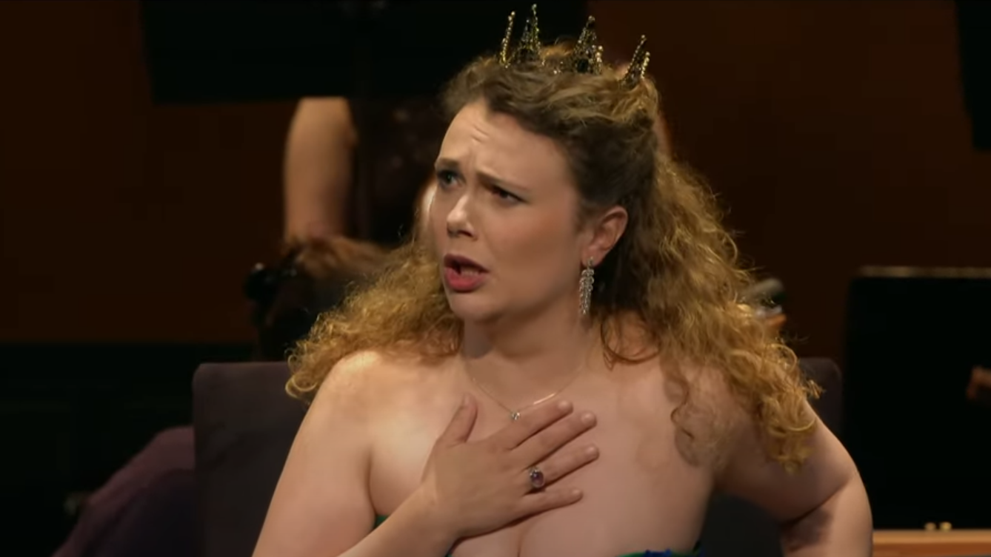
Monteverdi (?), The Coronation of Poppaea (1643)
Act 1 scene 5
https://www.youtube.com/watch?v=KxJUETurqGQ&t=1900s

Slide 4
What (if anything) lies at the intersection?
Greek tragedy
Roman crepidata
?
Roman praetexta
Notes:
Greek tragedy ~ crepidata
stories from greek myth
dialogue punctuated by choruses
high style
reversal-recognition
serious, often contemporary Athenian themes (gender, justice, etc.) – things that matter to US
Senecan crepidata ~ praetexta
allusions to/evocations of Greek myth
dialogue punctuated by choruses
high style
reversal-recognition
serious, often contemporary Roman themes (gender, tyranny, etc.) – things that matter to US
praetexta ~ Greek tragedy
allusions to/evocations of Greek myth
dialogue punctuated by choruses
high style
reversal (recognition?)
serious Roman themes (gender, tyranny, etc.) – things that matter to US
all three
allusions to/evocations of Greek myth
dialogue punctuated by choruses
high style
reversal (recognition?)
serious, often contemporary themes – things that matter to US

Slide 5
Agenda
Cold Open
    Roman Tragedy: Emotion, Genre
Introduction to Play
  Pseudo-Seneca Octavia
Genre, Rhetoric, Theme
  Tragedy Is Us

Slide 6
Introduction to Play
Pseudo-Seneca Octavia

Slide 7
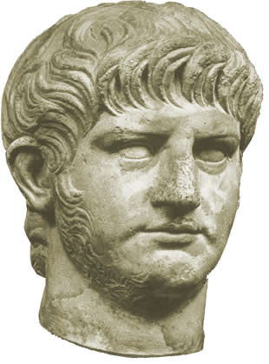
Play Facts
Author (anon.)
Genre (praetexta)
Composition date, context
  Flavian emperors, 69–96 CE?
Setting (Rome, 62 CE)
Nero, ca. 55 CE
Notes:
Author
anonymous, knew his seneca. but pro-claudian tone doesn’t fit with what we know of genuine seneca.
Genre
praetexta – but with strong element of myth and resonance with Senecan tragedy, e.g., Heracles Furens, Phaedra, Thyestes
Composition date, context
Flavians
Setting
Rome, palace of Caesars, three days in 62

Slide 8
Octavia: Characters (& Genealogy)
Messalina
Claudius
Agrippina
Gnaeus Domitius Ahenobarbus
adoption
Rufrius Crispinus
Brittanicus
Octavia
Nero
Poppaea Sabina
Octavia
Octavia’s Nurse
Seneca (minister, philosopher)
Prefect (head of Nero’s guards)
Ghost of Agrippina
Poppaea Sabina
Poppaea’s Nurse
Messenger
Chorus of Romans
Notes:
note that OCTAVIA and NERO are distant cousins, both being descended from JULIA ATIA, the mother of AUGUSTUS.
BRILL’S OCTAVIA. Daughter of the emperor Claudius [III 1] and Messalina [2] and sister of Britannicus, born around 40 AD. She was betrothed at the age of two to L. Iunius [II 36] Silanus Torquatus (Tac. Ann. 12,3,2; Suet. Claud. 27,2; Cass. Dio 60,5,7). On Agrippina’s [3] initiative O. was betrothed to Nero in 49 AD (Tac. Ann. 12,9,1). In order for the betrothal to be legally binding she had to be adopted beforehand by another gens, as Nero, whom she married in 53 AD, was her adoptive brother (Tac. Ann. 12,58,1; Suet. Nero 7,2). However, he soon preferred Claudia [II 4] Acte and Poppaea Sabina to her. Under the pretext of infertility and adultery with the slave Eucaerus (Tac. Ann. 14,60) Nero disowned her and banished her to Campania in spite of public protests (Tac. Ann. 14,60f.; Suet. Nero 35). Later Nero accused her of adultery with Anicetus [1] and of having an abortion (Tac. Ann. 14,63; cf. [1. 62; 94]); he banished her to Pandateria, where he had her murdered on 9 June 62 (Tac. Ann. 14,64; Suet. Nero 35; Jos. Ant. Iud. 20,153). Compare also the tragic drama O. [4] attributed to Seneca [2. 21331].
Crispinus. That's Poppaea's first husband, Rufrius Crispinus [praetorian prefect under Claudius; his and Poppaeus’ son was killed by Nero], whom Poppaea divorced to marry Otho, the future emperor, in 58. But in the same year, she entered into a love affair with Nero and married him. Poppaea died pregnant in 65. (The story that she died from Nero's kicking her in the stomach is probably a fabrication.)

Slide 9
Octavia: Plot Structure
Thematic Structure | Dramatic Structure
CLOUD OF EVIL | SCENE 1, day 1. Octavia, Nurse, Chorus. (Octavia’s plight, what to do.)
DEFEAT OF REASON BY PASSION | SCENE 2. Seneca, Nero, Prefect, Chorus. (Seneca remonstrates with Nero.)
EXPLOSION OF EVIL | SCENE 3, day 2. Agrippina’s Ghost, Octavia, Chorus. (Restless dead, indignant living.)
 | SCENE 4, day 3. Poppaea, Nurse, Chorus. (Poppaea’s dream.)
 | SCENE 5. Messenger, Chorus. (Angry mob. Chorus: Love v. arms.)
 | SCENE 6. Nero, Prefect. (The tyrant rages.)
 | SCENE 7. Chorus, Octavia. (Fickle mob, Octavia’s lament.)
Notes:
AS IN SENECAN TRAGEDIES, the moral cynicism is prominent - contrast soph and aesch (and even eur) trag, where the tragic action aims at, or somehow fits into a pattern of, rebalancing the disequilibrium created by human hubris. THINK ABOUT THAT AS YOU THINK ABOUT THE RELATIONSHIP BETWEEN ROMAN AND OTHER TRAGEDY READ FOR THIS CLASS. . .
257. oct., nurse. roman hist and grk myth combined in all that imagery. oct is narrating her "oft told" (??) travails to nurse. THAT RATHER MYTHOLOGIZES HER STORY, OR AT LEAST ENTERS IT INTO THE KIND OF PUBLIC DOMAIN THAT WE TEND TO ASSOCIATE WITH MYTH- AND HISTORY-BASED DRAMA. but apostrophizes mother, messalina. the "vile stepmother's rule" thing. (agrippina.) she oct's "fury."
258. n's panegyric to the dynasty of claudius. THAT APPEARS PARTISAN. but note who speaks: the nurse.
260. death could end oct's misery, but fears violent death. sees brit in her sleep.
284. poppaea's nurse and poppaea. poppaea's night of nighmares. nurse provides unalarming interpretation - a foolish one. read backwards as "be afraid, be very afraid." tragic thing, these dreams. CF. ATOSSA IN PERSIANS, OR CLYT IN LIBATION BEARERS.
271. scene. seneca, nero, prefect. seneca misses the years of carefree study on corsica.
271 ff. SENECA’S philosophical monologue. 272. the stoic empyrosis. then a return to golden age. recall of sequence of the ages leading to roman era, a period marred by PASSION.
274. justice and the tyrant: "let him be just who has no need to fear." (note that creon in antigone claimed to be just.) this seneca-nero scene recaps the herington deliberation thing. seneca boosts clemency. de clementia. nero insistent on FEAR.
275. nero alleges that oct plotting against him. 276. nero alleges that senate plots against him.
262. Poppaea demands the head of oct. silanus' suicide.
263. the flight of "pure fidelity."
[prev. section shows the usual inferior trying to dissuade a superior. oct's passion will then be her RIGHTEOUS anger, but also her cynical resignation. nurse hopelessly naive.]
264. relationship between brit as cupid and nero's inconstant cupid?? comparison: oct = juno, nero = jup.
266. pathetic fallacy: cosmos is sick. (motifs familair from seneca.). NOTE IMPLICATIONS HERE AND IN CHORUS IN THYESTES THAT WHAT IS BEING STAGED HOLDS SOME SORT OF COSMIC IMPORT. THAT SUGGESTS PARALLELS WITH EUMENIDES, BUT IT ALSO SUGGESTS MORE FOR A HISTORY PLAY: THAT THE COSMIC PROCESS IS, S0MEHOW, ABOUT “US” – THAT “OUR ROMAN ORDER” IS THE SUBJECT OF THE UNIVERSAL TRAGEDY, a self-referential and tragic spin on the trope of decline as a kind of pathetic fallacy.
267. chorus 1. the new wife and threat to family-political order. "we" are to blame. (??) exempla from roman history - including lucr. 269. the old republican family acts compared to recent evils. the trope of decline. narration of killing of agrippina.
278. popp more beautiful than juno or venus.
280. agrippina's ghost enters. explains how nero sought damnatio memoriae against her; narrates death. Claudius demands from Aagrippina the lifed of Nero. foretells Nero's violent death.
282. octavia on the wedding of poppaea.
283. chorus.
287. chorus on jup's paramours, will take up with poppaea.
288. messenger and chorus. the angry mob. note the symbolic dismemberment of p's statue. chorus: the war god cannot defeat love.
289. nero comes in. his over-the-top tyrannical anger.
290. prefect. reports quelling of mob. but nero wants more.
292. the chorus sees resonance with the gracchi, cornelia, etc.
293. Octavia being dragged off.

Slide 10
Genre, Rhetoric, Theme
Tragedy Is Us

Slide 11

Trope of Decline, empyrosis
(Octavia, p. 268, 272)
“SENECA: … our forefathers knew true Roman virtue”
· · ·
“SENECA: Is all this glory doomed to age with time
And perish in blind chaos? Then must come
Once more upon the world a day of death,
When skies must fall and our unworthy race
Be blotted out, until a brighter dawn
Bring in a new and better generation. . . .”
Notes:
272. the stoic empyrosis. then a return to golden age. recall of sequence of the ages leading to roman era, a period marred by PASSION.
AS IN SENECAN TRAGEDIES, the moral cynicism is prominent - contrast soph and aesch (and even eur) trag, where the tragic action aims at, or somehow fits into a pattern of, rebalancing the disequilibrium created by human hubris.
in Phaedra, in thyestes, in the pseudo-Senecan Octavia, the horror seems to be one of inescapable, growing corruption. Seneca the philosopher in the Octavia seems to offer the only solution: that the stoic empyrosis, the cosmic conflagration, incinerate the universe therby allowing a new creation to take shape and with it, a new age of innocence.
if the play dates from the age of Flavians (69-96 CE), then the play could well be flattery of the new dynasty, bringer of a new golden age

Slide 12
Rome’s Tragedy = Lapse in Patriarchy?
“Good” women as fungible
Independent women as “bad”
Virginia
Lucretia
Octavia
Tullia
Messalina
Agrippina
Poppaea
Notes:
something that sets this play apart from the other roman plays we’ve sampled is the focus on women.
HISTORICAL EXEMPLA, Virginia, Lucretia (heroine), Tullia (villainess)
They did well When they avenged the dying soul Of a pure maiden whom her father slew To save her from base servitude, To rob vile lust of its unlawful triumph.1 And, sad Lucretia, for thy sake Grim war began, when thou wast wronged By a base tyrant’s lust, and died By thine own hand. The price was paid Not by Tarquinius alone For his foul deed, but by his wife2 Tullia, who mutilated Her own dead father’s limbs Under her flying chariot wheels, Inhuman daughter, and refused his aged corpse The rite of funeral fire.

Slide 13
Praetexta in crepidata shoes?
Notes:
allusions to greek mythology abound in the play. this should not surprise or shock. as we’ve seen, rome was “conquered,” culturally, by the greek-speaking lands it had conquered. but the Hellenization (greekification) of cultures up and down the Italian peninsula had already begun long before rome’s empire took shape.
in this play, comparison with mythological figures often helps underscore the plight in which our characters find themselves. however bad it was for the heroes and heroines of greek myth, for noble romans, it’s typically worse.

Slide 14
(1) No other fate can equal mine,
No other suffering compare,
Not though I should remember thine,
Ill-starred Electra; thy despair
For father slain was not forbidden;
Thou hadst a brother, whom thy care
And trustful love had saved and hidden,
To avenge the crime. (2) I do not dare
To mourn two parents lost, nor pray
For brother dead; in whom the fair
Hope I might have of brighter day,
And comfort in my sorrow, were. (Octavia, p. 259)
Octavia (2) as
super-Electra (1)
Notes:
Octavia as
Electra
Juno (Hera)
Brittanicus as Orestes.
Claudius as Agamemnon. (Agrippina as Clytemnestra)
Nero as
Jupiter (Zeus)
the nurse tries to persuade Octavia not to despair, things are ok now with Juno’s marriage to her brother-husband, so can they be for Octavia’s marriage with her brother-husband:
“NURSE: No mortal beauty now Tempts Jupiter to leave his court on high. You are a Juno upon earth, Sister and spouse of the August, And you must conquer grief.” (p. 265)

Slide 15
Rhetoric: Seneca and Pseudo-Seneca

Slide 16
SENECA | PS-SENECA
SENTENTIA
quod non potest vult posse qui nimium potest (Nurse, Phaedra line 215). “A man who can do much would like to do / More than he can.” (Penguin p. 106) | odio pari | ardet maritus, mutua flagrant face (Nurse, lines 49-50). “She loathes and shuns; he burns with equal fire of venomous hatred” (Penguin p. 259)
PERVERSE EXAGGERATION
“I walk among the stars! Above the world / My proud head reaches up to heaven’s height” (Atreus, Thyestes p. 84) | “. . . the forum / Stank with putrid gore / that dripped from rotting faces” (Nero on past civil war, p. 277)
THE TYRANT’S CREED, THE TYRANT’S DILEMMA
“Let them hate so long as they fear” (Atreus in Accius Atreus) “Men compelled by fear / to praise, may be by fear compelled to hate” (Minister in Seneca Thyestes) “Let him be just who has no need to fear” (Nero in Octavia)

