Slide 1
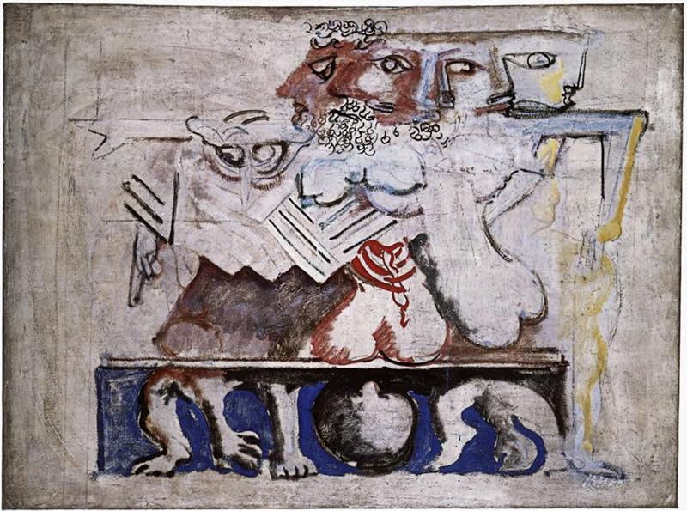
Anouilh’s Antigone, part 1
Tragedy Trashed or Translated?
Mark Rothko, “Antigone”

Slide 2
Is this what tragedy is?
(pp. 101–102)
Notes:
In this play, the chorus has one, lengthy speech consisting of reflections as in a Greek or Roman tragedy. Only the chorus’ reflections in this play are about — tragedy? what’s that about? let’s read the end of that choral “monologue”.....

Slide 3
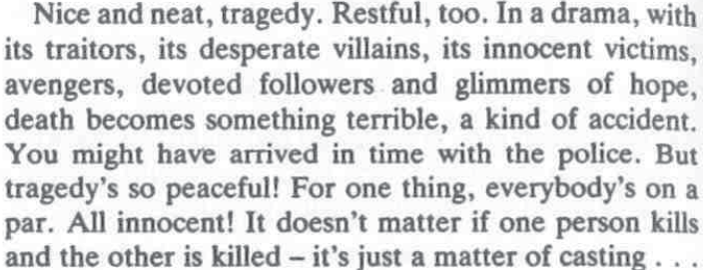
Reader 1

Slide 4
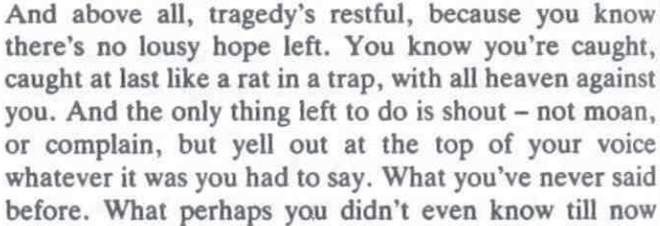
Reader 2

Slide 5
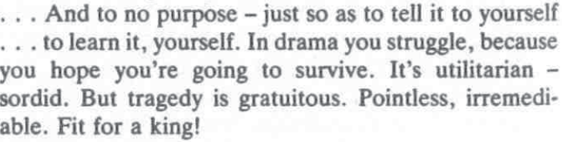
Reader 3

Slide 6
30-Apr Journal Prompt
In Anouilh’s Antigone, the Chorus states:
“In drama you struggle, because you hope you're going to survive. It's utilitarian — sordid. But tragedy is gratuitous. Pointless, irremediable. Fit for a king!” (p. 102)
QUESTION: Thinking about readings up to this point in the course, including Anouilh’s play, does the preceding quotation resonate with you? What kind of response does it prompt from you? Can tragedy be meaningful to those of us who aren't royalty?
Notes:
so for tu the week following next (let me wish you a restful vacation, by the way), i’m asking you to comment on those final lines of the chorus’ long monologue. don’t answer the question now, let’s wait till later.

Slide 7
Agenda
Cold Open
  Anouilh’s Chrorus on “Drama” and Tragedy
Recap and Update
  Tragedy Is “Us,” Anouilh’s Conundrum
Anouilh’s Antigone
  Introduction to Play

Slide 8
Recap and Update
Tragedy Is “Us,” Anouilh’s Conundrum

Slide 9
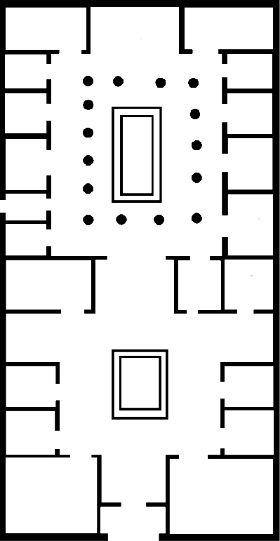
Domestic Space: Greek Myth as Roman Drama
Atreus’
garden
of horrors
garden,
private space
atrium,
public space
public space
entrance
entrance
typical elite Roman house, mid 1st cent CE
Palace of Atreus, Seneca Thyestes
Notes:
act 4 messenger speech, description of Atreus’ palace, public and private spaces, garden of horrors, human sacrifice

Slide 10
(1) No other fate can equal mine,
No other suffering compare,
Not though I should remember thine,
Ill-starred Electra; thy despair
For father slain was not forbidden;
Thou hadst a brother, whom thy care
And trustful love had saved and hidden,
To avenge the crime. (2) I do not dare
To mourn two parents lost, nor pray
For brother dead; in whom the fair
Hope I might have of brighter day,
And comfort in my sorrow, were. (Octavia, p. 259)
Octavia (2) as a
super-Electra (1)
Notes:
praetexta (ocatvia) as rehash or greek tragedy

Slide 11
Tragedy Is “Us,” We Are Myth
Octavia | ≈ | Electra
Brittanicus | ≈ | Orestes
Claudius | ≈ | Agamemnon
(Agrippina) | ≈ | (Clytemnestra)
Octavia | ≈ | Juno (Hera)
Nero | ≈ | Jupiter (Zeus)
Notes:
Octavia as
Electra
Juno (Hera)
Brittanicus as Orestes.
Claudius as Agamemnon. (Agrippina as Clytemnestra)
Nero as
Jupiter (Zeus)
the nurse tries to persuade Octavia not to despair, things are ok now with Juno’s marriage to her brother-husband, so can they be for Octavia’s marriage with her brother-husband:
“NURSE: No mortal beauty now Tempts Jupiter to leave his court on high. You are a Juno upon earth, Sister and spouse of the August, And you must conquer grief.” (p. 265)
If tragedy is “us” (“us” not just as characters in Octavia, but “us” Romans) and we are myth, is gratuitous, pointless, irremediable, fit for a king? Don’t answer that now — maybe think about it.

Slide 12

Trope of Decline, empyrosis
(Octavia, p. 268, 272)
“SENECA: … our forefathers knew true Roman virtue”
· · ·
“SENECA: Is all this glory doomed to age with time
And perish in blind chaos? Then must come
Once more upon the world a day of death,
When skies must fall and our unworthy race
Be blotted out, until a brighter dawn
Bring in a new and better generation. . . .”
Notes:
does “our” tragedy matter if our world (the world of Rome) is about to go up in flames, whether literal or figurative? if that is the prospect we face, can we be sure of the outcome?
272. the stoic empyrosis. then a return to golden age. recall of sequence of the ages leading to roman era, a period marred by PASSION.
AS IN SENECAN TRAGEDIES, the moral cynicism is prominent - contrast soph and aesch (and even eur) trag, where the tragic action aims at, or somehow fits into a pattern of, rebalancing the disequilibrium created by human hubris.
in Phaedra, in thyestes, in the pseudo-Senecan Octavia, the horror seems to be one of inescapable, growing corruption. Seneca the philosopher in the Octavia seems to offer the only solution: that the stoic empyrosis, the cosmic conflagration, incinerate the universe therby allowing a new creation to take shape and with it, a new age of innocence.
if the play dates from the age of Flavians (69-96 CE), then the play could well be flattery of the new dynasty, bringer of a new golden age

Slide 13
Anouilh’s Antigone
Introduction to Play

Slide 14
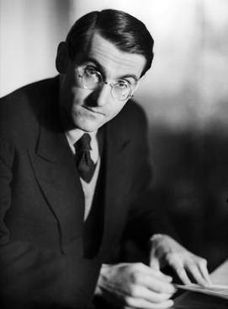
Playwright, Composition, Setting
Jean Anouilh, 1910–1987
Antigone, 1943
“Set without historical or geographical implications” (p. 79)
Notes:
Composed, produced under Nazis (1943)
Creon = occupation?
Antigone = resistance?
Modernist search for meaning

Slide 15
Characters
Prologue
Chorus
Creon
Antigone
Ismene
Haemon
Nurse
Messenger
Guards

Slide 16
Thematic Oppositions
Frivolity
Fate
Pragmatism
“Drama”
Purpose
Free will
Individualism
“Tragedy”
versus

Slide 17
Structure – “scene one”
Prologue (pp. 79 ff.)
Antigone &. . . (82)
Creon &. . . (97)
Chorus (101)
Debates, recognitions, reversals (102)
Antigone’s choice (128)
Dénouement (134)
Notes:
some observations....
79. stage directions. note attempt to remove time-place situatedness. attempt to create sense of ordinary family. prologue speaks as if not there - or as if others not.
79. Prologue - note movement toward impersonalization of this function, like that of chorus. complete breaking of the dramatic illusion - metatheatrical theater. becoming antigone and living out a preexisting myth: an actress playing an actress playing a role - role playing as itself the thing represented, very simulacrum-ish. she plays her part b/c of her name. the increasing isolation of the character is the character. a thing between ism and haem. antig overly thoughtful, ism and haem not very.
p. 79 “The people gathered here are about to act the story of Antigone. The one who's going to play the lead is the thin girl sitting there silent. Staring in front of her. Thinking. She's thinking that soon she's going to be Antigone. That she'll suddenly stop being the thin dark girl whose family didn't take her seriously, and rise up alone against everyone.”
who's the girl if she's not yet antigone? is this an actress req'd to play a dramatic role of heroine? or antigone req'd to play a "dramatic" role of heroine? is fate a playscript? is a playscript a kind of fate? the play pushes together the "real" people (those supposed to be actors playing the characters) and the "roles." but isn't that compression a kind of role too? so where does the stage end and reality begin?
p. 81. spoiler alert: creon to be arrested in his turn, to become the target of the justice he keeps.
89-90. “ISMENE (throwing herself at ANTIGONE), Antigone! Please! It's all right for men to die for their ideas. But you're a girl. ANTIGONE (through clenched teeth). Only a girl! The tears”
[ok for men to die for what they believe, not for women to do so. (echoes of honig. this antigone seeks agency)]
91 ant the girl. the nurse's "strength." ant: "... I'm still a bit small for it all." concern for dog.
93. ant had stolen cosmetics from sister. envies Ismene’s comfort with her assumption of gender roles.
cf. 96:
ANTIGONE. Yes. And you laughed, and we quarreled. My bad temper got the better of me and I flounced off. (Pause. Lower.) But I really came to see you yesterday evening so that you might make love to me — so that I might be your wife already. Before ... (He draws back and is about to speak, but she cries out.) You promised not to ask! (Humbly.) Please ... (Turning away; harshly.) Anyway, let me explain. I wanted to become your wife because that's how I love you ... And because — forgive me for hurting you, my darling — because I can never marry you.
(reconciled with her fate? determination to defy creon’s will?)
100. guard (Jonas) imagines a child buried poly - toy spade found, light foot prints. in a way, a child did.

