Slide 1
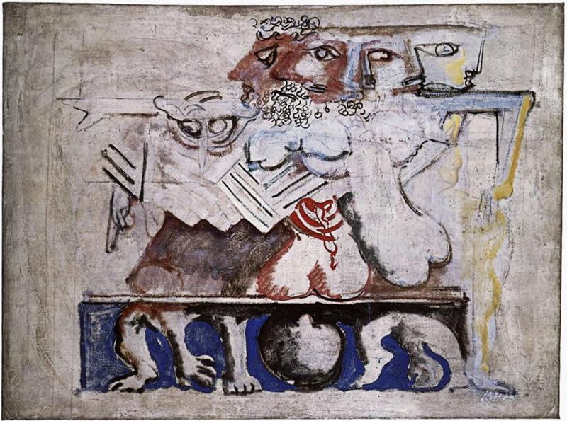
Anouilh’s Antigone, part 2
Tragedy Trashed or Translated?
Mark Rothko, “Antigone”

Slide 2
Agenda
Recap and Update
  Anouilh’s Antigone: The Play and Its Challenges
Discussion
  Is Tragedy Pointless?

Slide 3
Recap and Update
Anouilh’s Antigone: The Play and Its Challenges

Slide 4
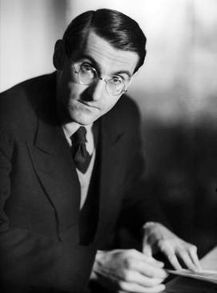
Playwright, Composition, Setting
Jean Anouilh, 1910–1987
Antigone, 1943
“Set without historical or geographical implications” (p. 79)
Notes:
Composed, produced under Nazis (1943)
Creon = occupation?
Antigone = resistance?
«L'Antigone de Sophocle, lue et relue, et que je connaissais par cœur depuis toujours, a été un choc soudain pour moi pendant la guerre, le jour des petites affiches rouges. Je l'ai réécrite à ma façon, avec la résonance de la tragédie que nous étions alors en train de vivre.» (4e de couverture de la première édition, Éditions de la Table ronde, 1946.)
“Sophocles' Antigone, read and reread, and which I had always known by heart, was a sudden shock for me during the war, the day of the little red posters. I rewrote it in my own way, with the resonance of the tragedy we were then experiencing.” the tragedy we were then experiencing. the occupation – real life, uncertainty, struggle. hmmmm.....
Modernist search for meaning

Slide 5
Structure – “scene one”
Prologue (pp. 79 ff.)
Antigone &. . . (82)
Creon &. . . (97)
Chorus (101)
Debates, recognitions, reversals (102)
Antigone’s choice (128)
Dénouement (134)
Notes:
some observations....
79. stage directions. note attempt to remove time-place situatedness. attempt to create sense of ordinary family. prologue speaks as if not there - or as if others not.
79. Prologue - note movement toward impersonalization of this function, like that of chorus. complete breaking of the dramatic illusion - metatheatrical theater. becoming antigone and living out a preexisting myth: an actress playing an actress playing a role - role playing as itself the thing represented, very simulacrum-ish. she plays her part b/c of her name. the increasing isolation of the character is the character. a thing between ism and haem. antig overly thoughtful, ism and haem not very.
p. 79 “The people gathered here are about to act the story of Antigone. The one who's going to play the lead is the thin girl sitting there silent. Staring in front of her. Thinking. She's thinking that soon she's going to be Antigone. That she'll suddenly stop being the thin dark girl whose family didn't take her seriously, and rise up alone against everyone.”
who's the girl if she's not yet antigone? is this an actress req'd to play a dramatic role of heroine? or antigone req'd to play a "dramatic" role of heroine? is fate a playscript? is a playscript a kind of fate? the play pushes together the "real" people (those supposed to be actors playing the characters) and the "roles." but isn't that compression a kind of role too? so where does the stage end and reality begin?
p. 81. spoiler alert: creon to be arrested in his turn, to become the target of the justice he keeps.
89-90. “ISMENE (throwing herself at ANTIGONE), Antigone! Please! It's all right for men to die for their ideas. But you're a girl. ANTIGONE (through clenched teeth). Only a girl! The tears”
[ok for men to die for what they believe, not for women to do so. (echoes of honig. this antigone seeks agency)]
91 ant the girl. the nurse's "strength." ant: "... I'm still a bit small for it all." concern for dog.
93. ant had stolen cosmetics from sister. envies Ismene’s comfort with her assumption of gender roles.
cf. 96:
ANTIGONE. Yes. And you laughed, and we quarreled. My bad temper got the better of me and I flounced off. (Pause. Lower.) But I really came to see you yesterday evening so that you might make love to me — so that I might be your wife already. Before ... (He draws back and is about to speak, but she cries out.) You promised not to ask! (Humbly.) Please ... (Turning away; harshly.) Anyway, let me explain. I wanted to become your wife because that's how I love you ... And because — forgive me for hurting you, my darling — because I can never marry you.
(reconciled with her fate? determination to defy creon’s will?)
100. guard (Jonas) imagines a child buried poly - toy spade found, light foot prints. in a way, a child did.

Slide 6
Thematic Oppositions
fate-destiny
(perceived) duty
pragmatism
“drama”
agency
(perceived) freedom
individualism
“tragedy”
versus

Slide 7
Interpretive Challenge 1
Does destiny negate agency, justice?
  Where is morality if “fate” absorbs all responsibility?
PROLOGUE. … the guards. … are the agents — eternally innocent, eternally complacent — of justice. (p. 81) ....
ISMENE. They’ll kill us!
ANTIG0NE. Of course they will. Everyone has his part to play. Creon has to have us put to death, and we have to go and bury our brother. That's how the cast-list was drawn up. What can we do about it? (p. 87)
Notes:
Anouilh’s ant seems to be in a dialectic with soph’s Theban cycle, taking a stance more cynical than pessimistic on the themes it treats. it’s its own play, but honig is in some ways right: it’s the modern French playwright’s meditation of Sophoclean themes.
questions like these come to the fore in soph’s Theban cycle, where we hear/read oed claiming that forces beyond his control decreed the course of events that saw him enmeshed in horrible acts and a terrible fate.
something similar seems to hold for Anouilh’s ant. but the cynicism, almost dismissiveness, with which the play addresses these questions is striking. in soph’s oac, the chorus declares, “Not to be born is best.” this play seems to assert a kind of pointlessness to everything.

Slide 8
Interpretive Challenge 2
Is Antigone’s resistance (her “no”) easy, self-indulgent?
  Is Creon’s “yes” the harder choice?
CREON. It’s easy to say no!
ANTIGONE. Not always.
CREON. To say yes you have to sweat, roll up your sleeves, grab hold of life, plunge in up to the neck. It’s easy to say no, even if it means dying. All you have to do is keep still and wait. Wait to live. Wait to die, even. It's feeble! (p. 116)
Notes:
Is resistance itself the point of Antigone’s resistance? Creon’s “yes” feels like the chorus’ drama. So is Creon the good guy? Is Antigone dying for nothing? Is she just immaturely playing at being grown up?
PROLOGUE. But there's nothing to be done. Her name is Antigone, and she's going to have to play her part right through to the end. (p. 79) Is fate a playscript that we merely act out? Or do we free ourselves by saying “yes” to Creon’s life of submission to authority?
89. exactly: ok for men to die for what they believe, not for women to do so.
“ISMENE (throwing herself at ANTIGONE), Antigone! Please! It's all right for men to die for their ideas. But you're a girl.” (pre-feminism, still, an exploration of gender)
122. ant is unwilling to settle for the unsatisfactory in marriage with h, for non-realization of happiness. cr's is a paltry happiness.

Slide 9
Interpretive Challenge 3
Does Creon have a choice?
  Is he trapped by his “yes” to power?
ANTIGONE. What do I care about your politics and what you ‘have’ to do and all your paltry affairs! I can still say no to anything I don’t like, and I alone am the judge. You, with your crown and your guards and your paraphernalia — all you can do, because you said yes, is have me put to death. (p. 114)
Notes:
a new wrinkle to the very ancient-tragic theme of tyranny: the tyrant as powerless before the realities and imperatives of rule. the importance of appearances.

Slide 10
Discussion
Is Tragedy Pointless?
Notes:
form groups. usual drill.

Slide 11
Is Tragedy Pointless?
“CHORUS. ... In drama you struggle, because you hope you’re going to survive. It’s utilitarian — sordid. But tragedy is gratuitous. Pointless, irremediable. Fit for a king!” (p. 102)
What does that mean? Do you agree?
Notes:
In Anouilh's Antigone, the Chorus states:
"In drama you struggle, because you hope you're going to survive. It's utilitarian — sordid. But tragedy is gratuitous. Pointless, irremediable. Fit for a king!" (p. 102)
QUESTION: Thinking about readings up to this point in the course, including Anouilh's play (read the play!), does the preceding quotation resonate with you? What kind of response does it prompt from you? Can tragedy be meaningful to those of us who aren't royalty?
PLEASE NOTE: That quotation, perhaps less a straightforward observation than a provocation, needs to be treated with care:
What is "drama" here? I think the chorus means something like melodrama ("a dramatic work in which the plot, typically sensationalized and for a strong emotional appeal, takes precedence over detailed characterization," Wikipedia) or possibly like what we'd call suspense thrillers, but they may also mean real life. (?) In any case, tragedy seems less real to the Chorus than "drama"
But even if tragedy is "fit for a king," is it completely unrelatable, completely remote? And what is tragedy, anyway — or maybe better, why* is tragedy?

