Slide 1
Ancient Tragedy, Greece & Rome
Final Wrap-Up

Slide 2
Raymond Williams: “A Dialogue on Tragedy”
Ridyear Certainly his death was a tragedy.
Holt I agree, but I wonder if Clark agrees.
Clark Of course I agree. I had a very great respect for him.
Holt But that isn’t what I was asking. I remember hearing you say once, with such conviction that you almost convinced me, that an accident is not a tragedy. And this death was an accident.
Clark I see. But all you are doing is taking meanings from quite separate orders of fact. Certainly tragedy, as a dramatic form, excludes accident, because accident has no significance, at least of a tragic kind. It’s true that the same word is increasingly used, in ordinary living, to describe some accident or disaster, and I happen to think this is wrong. But in any case we can discriminate, knowing when we are talking about one thing and when about another.
Notes:
what do they seem to be saying?
does accident have no significance, “at least of a tragic kind”?

Slide 3
Warning: Disturbing images.

Slide 4
Without doing a deep dive,
Was the Challenger disaster* a tragedy?
* 28-Jan 1986, explosion and breakup of the Challenger space shuttle 73 seconds into flight.
“In drama you struggle, because you hope you’re going to survive. It’s utilitarian — sordid. But tragedy is gratuitous. Pointless, irremediable. Fit for a king!” (Chorus. Anouilh Antigone p. 102)
https://youtu.be/AfnvFnzs91s?si=aNVXJ1OdrRdbd5ww
Notes:
Word Notes (Oxford English Dictionary)
utilitarian
sordid
irremediable
gratuitous “without any good ground or reason; ... unjustifiable”
is tragedy not a struggle?
could tragedy
I want you to think about the possibility that our Anouilh quotation is less a straightforward observation than it is a provocation, a call not simply to think with the quotation but to think past it. Note the hints at an ironic tone: “Pointless, irremediable. Fit for a king!” — after all those negatives (“gratuitous,” “pointless,” “irremediable”), were we expecting them to describe something superlative or deluxe, which is, basically, what “fit for a king” means?
so I suspect that we can’t take that quotation entirely at face value. if not, then what does the chorus actually mean? unfortunately, we don’t have Anouilh here to explain. but even if we did, would he answer? and if even if he were here and were to answer, should we take him at his word?
i’m not sure that we should. so, what is tragedy, anyway? is it always suffering, reversal toppling the high and mighty, whose fall from grace we simultaneously fear, pity, and enjoy?
we’ve seen tragedy that ends happy (libation bearers, Alcestis), or at least seems to. we’ve seen tragedy that that at least one important thinker views as self-celebratory “othering“ (Said on Persians). and we’ve seen tragedy that indulges its audience’s taste for, on the one hand, over-the-top violence and rhetoric ([ps-]Seneca); on the other hand, for vulgar and misogynistic humor (Euripides’ cyclops, which really is a kind of tragedy).
in the end, i’m not at all sure that tragedy can reduce to any one thing. still, and if I may share one last thought, i do have to wonder if, whatever else tragedy is, it might not also be precisely the act of asking the question, “Why?” – why does antigone have to die? a “why” that doesn’t just ask but states. For why else would we ask “why” if the tragedy we’re asking about didn’t somehow matter to us and to others, too?

Slide 5
Unstructured Discussion
Final Exam

Slide 6
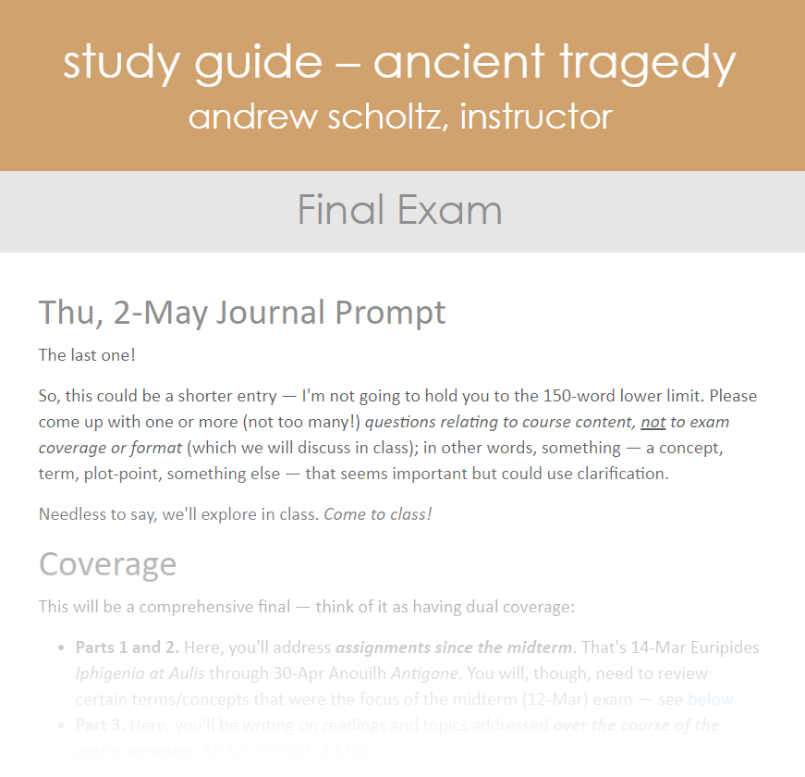
Questions on format, content?

Slide 7
Your Questions, Recurrent Themes
Genre
  Roman v Greek tragedy
    Roman plagiarism? Just (ps-)Seneca?
  Tragedy vs “(satyr?) drama”
    Generic markers? Contemporary significance? Sniff out rhetoric how? Any truly happy tragedies?
  Stoic aspect (empyrosis?)
  Brill’s quote — examples?
Other topics
  Frogs: Why that text? Why the underworld?
Other topics (con’d)
  Medea: DEM scene, conflicts & themes. Why kill the kids?
    Gender roles
  Lenses / interpretive frameworks, pre-, post-midterm
    Quick overview. Non-kingly koros etc.? Self-consciously applied?
  Is each tragedy its own world?
    Narrative, genealogical connections?
  Technical terms, e.g., why speak of stasima (sing. “stasimon”)
Notes:
TRAGEDY VS DRAMA
Composed, produced under Nazis (1943)
Creon = occupation?
Antigone = resistance?
«L'Antigone de Sophocle, lue et relue, et que je connaissais par cœur depuis toujours, a été un choc soudain pour moi pendant la guerre, le jour des petites affiches rouges. Je l'ai réécrite à ma façon, avec la résonance de la tragédie que nous étions alors en train de vivre.» (4e de couverture de la première édition, Éditions de la Table ronde, 1946.)
“Sophocles' Antigone, read and reread, and which I had always known by heart, was a sudden shock for me during the war, the day of the little red posters. I rewrote it in my own way, with the resonance of the tragedy we were then experiencing.” the tragedy we were then experiencing. the occupation – real life, uncertainty, struggle. hmmmm.....
Modernist search for meaning
“Antigone (1942) was interpreted, as it was probably in tended, as a thinly-veiled allegory of France under the Vichy regime.”
“To Anouilh humanity is made up of two kinds of people: the anonymous mass of normal and rational nonentities who accept the banality of daily existence, and the hero. … The ordinary man and the hero belong to different species, and they are condemned to perpetual misunderstanding, suspicion, and enmity; human existence is an eternal struggle between heroism and happiness.” (heiney, college English 16.6 1955)
The content of Roman tragedy is not 'tragic'. In its early form its main purpose was to provide historical arguments. With Pacuvius and Accius tragedy became more literary but continued to focus on the model attribute of virtus (virtue) - either of individual heroes or of the populus Romanus as a whole. Of central concern was not the fate of the individual but rather the advancement of the collective good. Roman heroes do not face tragic decisions between equally important duties since the teleology of Roman society has eliminated such conflicts. Under Nero, tragedy became the genre of the opposition. In their positive aspects Seneca's heroes are Stoic wise men, in their negative aspects monomaniacal criminals. In their own way, both types are autonomous. Entirely self-sufficient, they know neither physical pain nor moral challenges; they are not part of the community. The solution consistently available to them is death.

Slide 8
Please fill out SOOTS for this course
http://soot.binghamton.edu/

