Slide 1
Ancient Tragedy, Greece & Rome
The Truth We Need to Know

Slide 2
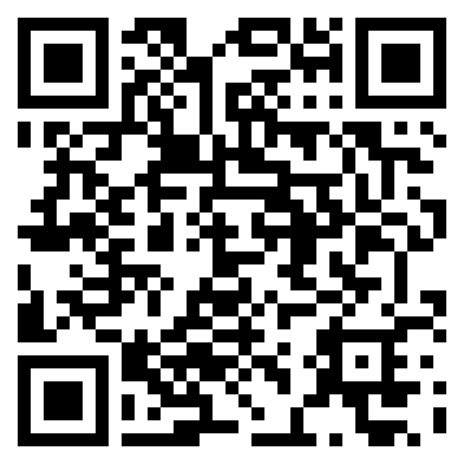
Do we need to know the truth? (Respond to poll)

Slide 3
What was wrong with that question?
Notes:
what kinds of truths are we talking about here?

Slide 4
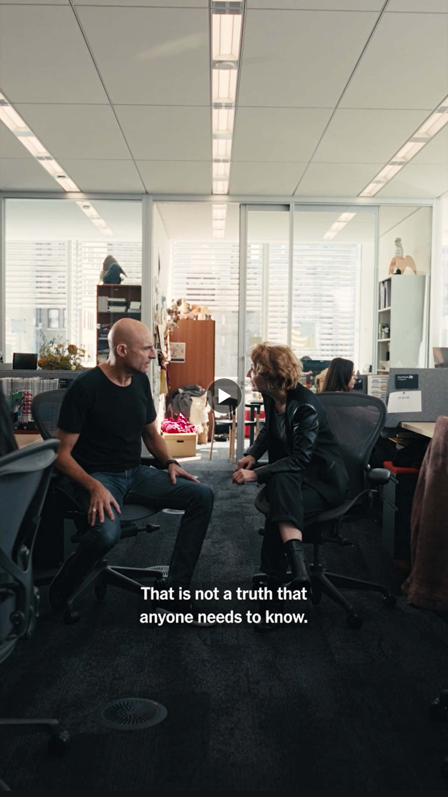
“In its movement from a delusional self-knowledge and the fantasy of an unencumbered freedom to an experience of an insight into truth that costs us our eyes, tragedy gives voice to an experience of agency that is partial and very often painful.” (Critchley Tragedy, the Greeks, and Us p. 14)
Lesley Manville and Mark Strong in a scene from Icke’s Oedipus (NYT Live from the 10th Floor)
Notes:
“a delusional self-knowledge and the fantasy of an unencumbered freedom” — doesn’t that sound at least a little like Seneca’s Atreus or ps-Seneca’s Nero?

Slide 5
Put differently, is truth tragic? Is tragedy truth?
(Discuss, cite examples from our readings)

Slide 6
Your questions (as per study guide)
Notes:
free-form, not via group discussion.
so, what is tragedy, anyway? is it always suffering, reversal toppling the high and mighty, whose fall from grace we simultaneously fear, pity, and enjoy? does it always have to be somehow about us, a reflection of our lives, or can it ever be about a “them” — ancient Greeks, Imperial Romans, folks from other times, places, and cultures that we may never get to know up close, yet folks whose experiences can, through the medium of art, strike a chord with us. in the end, i’m not at all sure that tragedy can reduce to any one thing. still, and if I may share one last thought, i do have to wonder if, whatever else tragedy is, it might not also be precisely the act of asking the question, “Why?” – why does Iphigenia, why does Antigone, why does Phaedra have to die? a “why” that doesn’t just ask but states. For why else would we ask “why” if the tragedy we’re asking about didn’t somehow matter?

Slide 7
Thank you!

