Slide 1
He Loves You, He Loves You Not
Aristophanes’ Knights and the Politics of Passion

Slide 2
Adventures in Writing
Fix the problem…
“In Aristophanes’ Knights, he writes that…”
“In Aristophanes’ Knights, the poet writes that…”
Ambiguous pronoun

Slide 3
Question
Is mis-/disinformation ever justified?

Slide 4
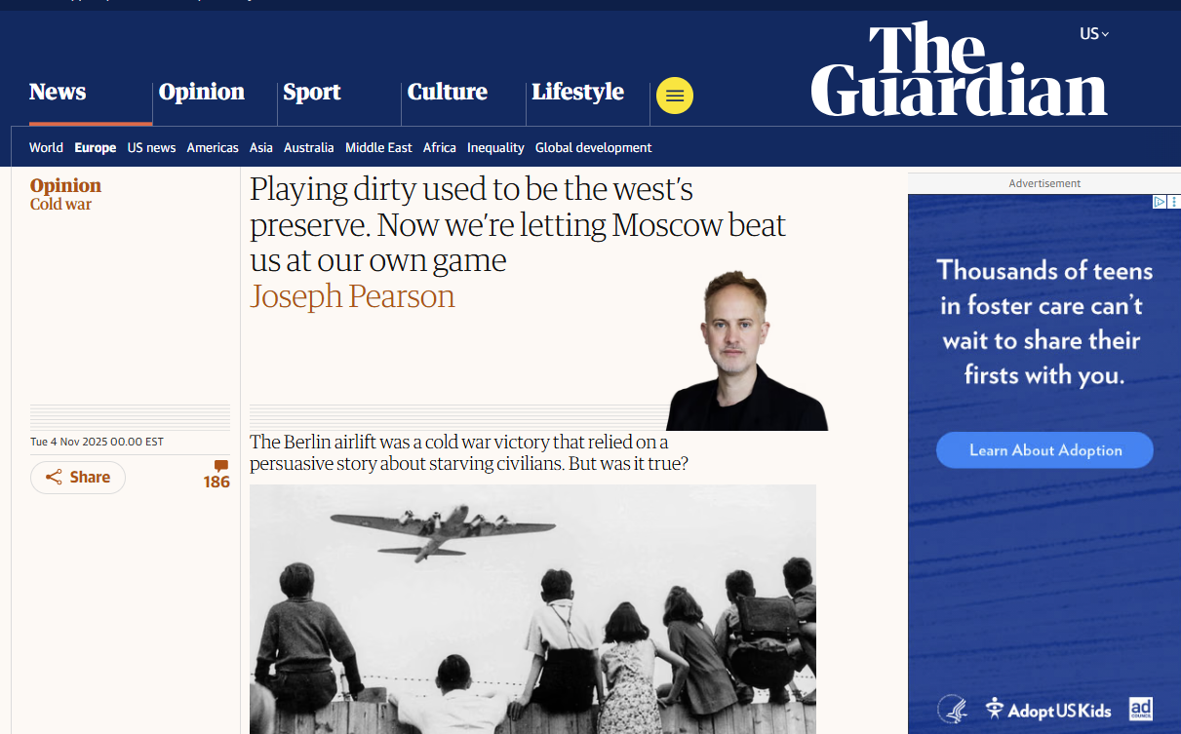
The Guardian on the 1948-49 Berlin Airlift
Notes:
“The cold war arguably began and ended in Berlin, bookended by the 1948-9 airlift and the fall of the wall in 1989. The former was the largest air relief operation in history. It supplied Berlin when Stalin tried to force out the western allies.”
“The biggest western tool, however, was disinformation. The allied airlift cost the equivalent of almost $3bn today, and needed a persuasive narrative to win public support. It’s one that almost everyone still believes today: Berlin was blockaded, its land routes sealed, and women and children were starving. Except, while there was an airlift of supplies, there was no Berlin blockade.”

Slide 5
Discussion
Aristophanes’ Knights: Democratic? Oligarchic?

Slide 6

Short Writing Assignment
Where on the political spectrum would you locate the ideological perspective informing the satire in Aristophanes' Knights?

Slide 7
Aristophanes’ Knights
Introduction to Play

Slide 8
Bibliography
Scholtz, Andrew. Concordia Discors, 2007.
De Luca, Kenneth M. Aristophanes’ Male and Female Revolutions. 2005.
Wohl, Victoria. Love among the Ruins, 2002.

Slide 9
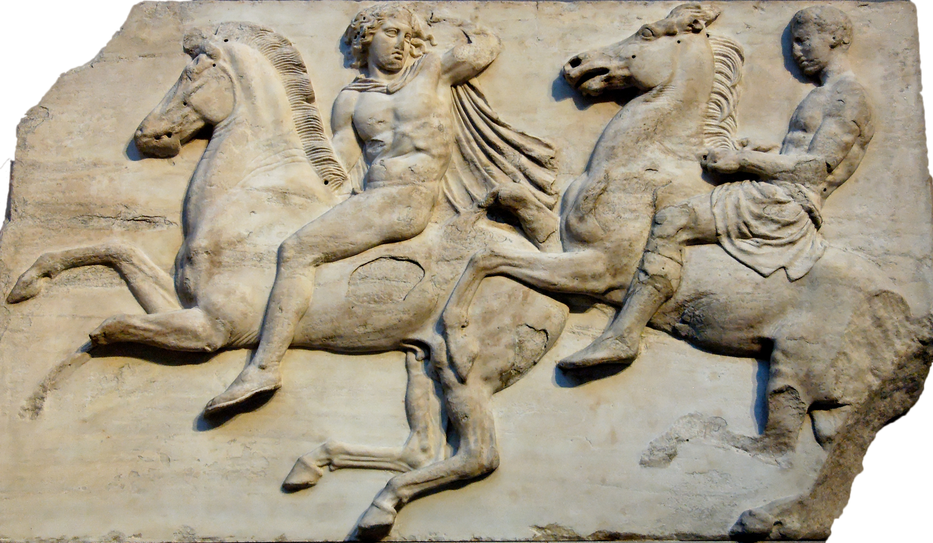
Platy Facts
Produced
January 424
Lenaea festival
Characters
Slaves 1, 2
Sausage-Seller
Paphlagon
Demos
Chrous of Knights
Cavalry, Parthenon Frieze, Athenian Acropolis (British Museum)

Slide 10
New Politicians (Connor 1972)
“… Connor constructs models of Athenian political groupings to explain the rise of the ‘new politicians,’ young men who launched a new kind of democracy by appealing to the citizenry at large. With Pericles as prototype and Cleon as exemplar …, this engaging work provides an important insight into the politics of Athens at the height of its power.” (blurb)

Slide 11
Oracle Predicts Change
First to Second Slave: “The oracle explicitly says that first there arises a hemp seller, 10 who will be the first to manage the city’s affairs. … After him there’s another one again, a sheep seller. … To hold power, until another champion arises who’s more disgusting than he, whereupon he perishes. For his successor is a hide seller, our Paphlagon. … The man who shall destroy Paphlagon is a sausage seller.” (Aristophanes Knights 128–143)
Notes:
what’s the significance of all these sellers?

Slide 12
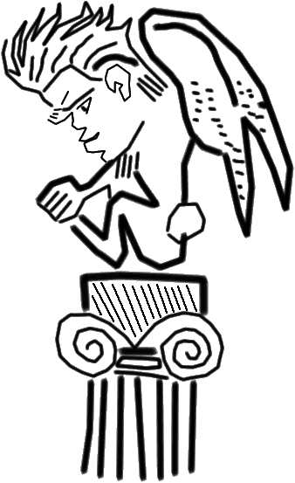
Paphlagon = Cleon 1
431/30 attacks Pericles
Early 420s Jury-pay raise
427 Mytilenian proposal
Death/enslavement
Cleon as Sphinx? (late 400s)
Notes:
in thuc, aristo, and ps-aristotelian ath pol, a demagogue, exemplar of vulgar pol and speaker, though wohl argues a critic of the dēmos’ speech-addiction in thuc bk 2.
evdently, the author of a successful bill to raise jury pay from 2 to three obols.
pericles instituted jury pay 440s, cleon raised that
note discrepant implications:
enables broader spectrum of athenians to serve
looks like political-judicial bribery

Slide 13
Paphlagon = Cleon 2
426
Attempts tax hike on knights
Attacks Aristophanes
Aristophanes’ Babylonians (lost)
425 General
Pylos triumph
Aristophanes Acharnians
Cleon as Sphinx? (late 400s)
Notes:
425 Cleon captures Spartans at Pylos (Cleon's "mission accomplished" moment)

Slide 14
Paphlagon = Cleon 3
424 Aristophanes’ Knights
423 Aristophanes’ Clouds
422 Aristophanes’ Wasps
422 General (again)
Killed, Amphipolis
Cleon as Sphinx? (late 400s)

Slide 15
Action, Representation
Crisis, planning, initial clash
Agonistic courtship
council meeting
assembly meeting
Festive finale
reformation, rejuvenation
Notes:
Crisis and Plan
fight demagoguery with …
demagoguery (36-59)
Agonistic courtship
council meeting (60-62)
assembly meeting (62-83)
Festive finale
reformation, rejuvenation (86-89)

Slide 16
Eros and the City
The Demohphilia topos

Slide 17
Erōs and the City 1
“… you who survive … must daily fix your gaze upon the power of Athens and become lovers of her….” (erastas gignomenous autēs, “becoming lovers of it,” Periclean Funeral Oration, Thucydides 2.43.1)

Slide 18
Erōs and the City 2
“… whenever somebody said in the Assembly, “Demos, I’m your lover and I cherish you, and I alone care for you and think for you,” whenever anybody started a speech with that stuff, you’d flap your wings and toss your horns.” (Knights 1340)
“Why in the world is it, men of Athens, that you . . . are generally no better off now than before. . .? Because, men of Athens, though they say they love you, it is not you they love, but themselves.” (Demosthenes Exordium 53.3)
Notes:
what’s the relationship?

Slide 19
Erōs and the Citizen 3
“He sized up the old man’s character, this rawhide Paphlagon did, so he crouched before the master and started flattering and fawning and toadying and swindling him” (Knights 46 ff.)
“But ever since this breed of orators appeared who ply you with such questions as ‘What would you like? What shall I propose? How can I oblige you?’ the interests of the state have been frittered away for a momentary popularity.” (Demosthes 3rd Olynthiac 22)

Slide 20
Erōs and the Citizen 4
“For we are both lovers, and both of us have two loves apiece. I am the lover of Alcibiades, the son of Cleinias, and of philosophy. And you are lover of the Athenian dēmos, and of Demos son of Pyrilampes.” (Socrates to Callicles in Plato Gorgias 481d)
Notes:
any relationship of this with the previous?

Slide 21
Erōs and the Citizen 5
“And now, so that you not be corrupted by the Athenian people (dēmos) and prove a disgrace, I will not abandon you. For what I fear most of all is that you will become a demerast (demerastēs, “lover of the people”) and be corrupted.” (Socrates to Alcibiades, Plato Amcibiades 1 132a)
Notes:
same question

Slide 22
All’s Well That Ends Well?
“Demos, you’re easily led astray…. there’s purpose in this foolishness of mine.” (Chorus, Demos, 1111 ff.)
“Here he is for all to see, … smelling not of ballot shells but peace accords, and anointed with myrrh.” (Chorus 1331 ff.)

