Slide 1
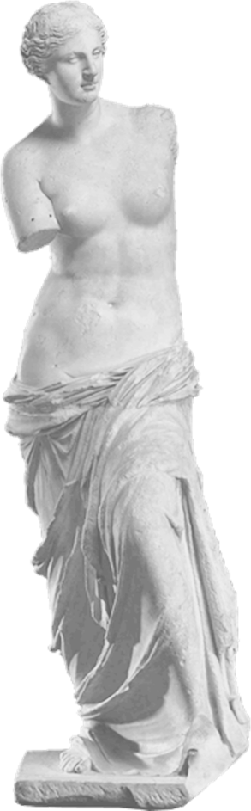
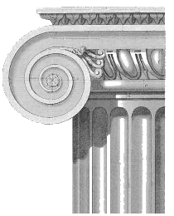
Persuasion to the Rescue
Aristophanes’ Lysistrata

Slide 2
Fix the problem 2
The Sausage-Seller coddles Demos. “Mr. Demos, do have your bath as soon as you’ve tried only one case”
The Sausage-Seller coddles Demos when he says, “Mr. Demos, do have your bath as soon as you’ve tried only one case”
Dropped quotation

Slide 3
Fix the problem 3
Paphlagon and the Sausage-Seller debate each other, Demos chooses the winner
Paphlagon and the Sausage-Seller debate each other; Demos chooses the winner
Comma splice

Slide 4
Fix the problem 4
Paphlagon and the Sausage-Seller debate each other and Demos chooses the winner
Paphlagon and the Sausage-Seller debate each other, and Demos chooses the winner
Variation on comma splice

Slide 5
Agenda
Debate
  Women’s Persuasion in Lysistrata
Persuasion in Lysistrata
  Let’s Count the Ways. . .

Slide 6
Debate
Women’s Persuasion in Lysistrata

Slide 7
Debate Topic
Resolved: Women in Aristophanes' Lysistrata embody positive role models (politically, etc.). We'll choose up sides when we meet in class.

Slide 8
Persuasion in Lysistrata
Let’s Count the Ways. . .

Slide 9
Play and Backdrop
year | event
431 | War begins
421 | Peace of Nicias
415-413 | Sicilian Expedition
412 | Board of (10) Probouloi
411 | Aristophanes’ Lysistrata produced
411-410 | Oligarchic coup, politeia, democratic restoration
Notes:
431 war begins
421 peace of Nicias (with Cleon and Brasidas gone, truce between Sparta and Athens possible)
418 Battle of Mantinea, War between Sparta and Athens renewed; Peace of Nicias is dead-letter
416 conquest of Melos (Melian debate). Sicilian debate at Athens (over Sicilian expedition). Debate at Syracuse (how to meet the Athenian threat)
415-413 Sicilian expedition
413 Defeat of Athenians at Syracuse
412 office of proboulos established: tend elderly men put in place to seemingly to stabilize legislative process. (A) could bring agenda items directly to assembly, bypassing boule. (b) could draw emergency funds. seemed to have been effective: the democracy was able to rebiuld fleet and to make headway against the enemy. but are they a democratic reform or what? note that their office won’t survive into the 300s democracy.
but alc in 412, condemned at athens in absentia for impiety and working now for his erstwhile enemies, the spartans, councils the building of a permanent peloponnesian fort on athenian soil so as to harass athens year round, plus foments rebellion abroad. after fathering a son by the wife of one of the spartan kings, alc, now a fugitive from sparta, too, seeks persian money against sparta and proceeds to plot an oligarchic coup at athens.

Slide 10
Lysistrata: Dramatic Arc
Prologue
Occupation plot
  “Magistrate” scene
Strike-plot
  “Rod”-Myrrhine scene
Reconciliation
  Men and women
  Spartans and Athenians
Notes:
we see here a variety of persuasion modalities in play; our challenge here and now to list and to analyze some.

Slide 11
Thucydides on the Sicilian Debate
NICIAS: “Do not be sick . . . with yearning (erōs) for what is not here” (116)
HISTORIAN’S ANALYSIS: “Now everyone alike fell in love (erōs enepese) with the enterprise” (122)
Notes:
who’s being persuaded how, and which lenses might that resonate with. (circumstances are “persuasive,” as are individuals who spinning for themselves and for interest groups… but if michels-weber right, is democracy stasis?)
CD on Mytilenean debate:
In Thucydides, a pleonectic (pleonexia, “greed”) component to erôs proper emerges from the Mytilenian debate, specifically, from Diodotus speech. There greed (pleonexian) based on wealth (exousia), arrogance (hubrei), and pride (phonêmati) numbers among the “incurable” (anêkestou) passions that, overmastering human beings, cause them to throw discretion to the wind — a pattern with close affinities to the process, discussed in the very next sentence, whereby elpis and erôs, hope and lust, drive people to seek out fortune’s riches at any cost. (66)
Sicilian debate:
the power of irrational thinking – eros – in face of rational thought and speech, logos. Nicias’ frank speech no enough to undo the earlier decision. but his second speech arguably intensified the “sick eros” decried by him vis-à-vis expedition.
but the coercive power of charisma also a factor. al subtly sought to counteract nic’s attempt to peel away the older elements. alc seems to treat that as implicitly contrary to a political ethic of consensus – this is, in other words, the rhetoric of consensus as a coercive element. so thucydides on the eros to sail:
This erôs left Athenians feeling empowered and confident, but it also exercised power over them, a power so forceful that nothing Nicias could say would deter support for the invasion. On the contrary, his attempts at reverse psychology only reinforced the city’s resolve (Thucydides 6.24.2). Nor were those opposed to the motion willing to vote their convictions, since to do so would have involved appearing hostile to the city’s interests (kakonous . . . têi polei, 6.24.4; cf. 6.13.1). Thucydides’ point? Among other things, that consensus, when it gains the kind of momentum this “erôs to sail” did, can create a social-discursive atmosphere hostile to the free exchange of ideas, to dialogue. (CD 28)

Slide 12
Two Quotations
Chorus Leader to Lysistrata:
Magistrate (on Demostratus)
“. . . a noisy rooftop party for Adonis, / just like the one that spoiled our assembly. / That ill-starred, foolish politician moved / we sail to Sicily, while his wife was dancing / and yelling for Adonis.” (p. 112)
“Hail the bravest of all women! / Now you must be more besides: / Firm but soft, high-class but low-brow, / Strict but lenient, versatile. / Delegates from every city, / captured by your potent charms, / Come before you and request your / arbitration of their cause.” (p. 142)
Notes:
DEBATE: Resolved:
Women in Aristophanes' Lysistrata embody positive role models (politically, etc.)

