Slide 1
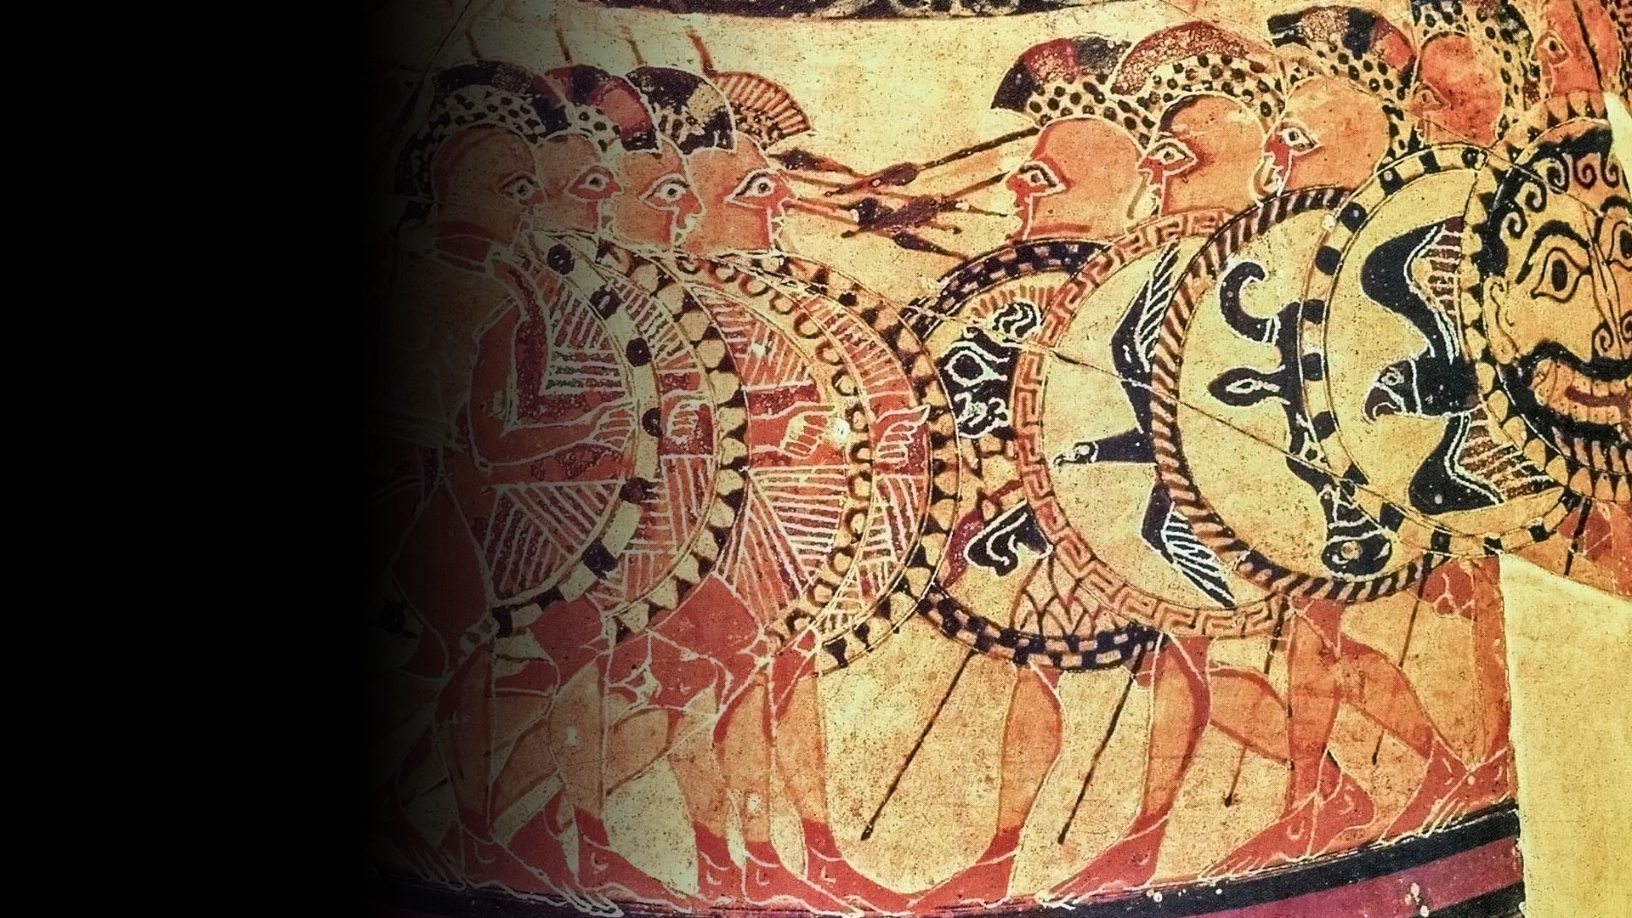
Early Greek Political Theory and Practice
Ca. 800–ca. 450 BCE
Detail from the “Chigi Vase,” ca. 650-640 BCE. Corinthian

Slide 2
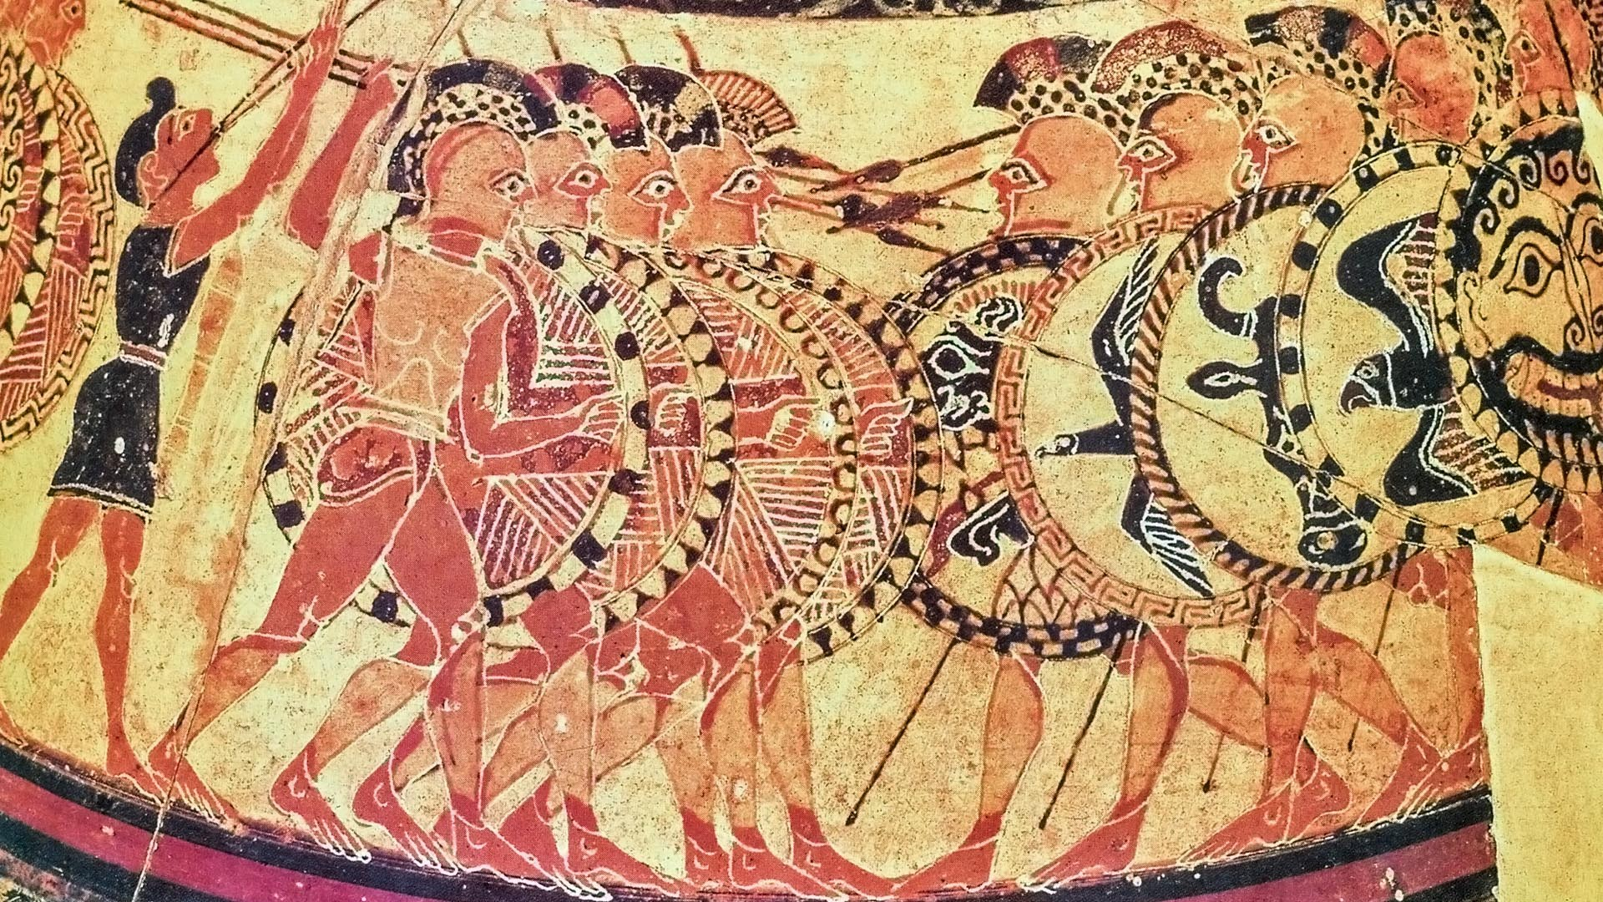
Image of Chigi Vase

Slide 3
Agenda
Discussion
Political Legitimacy and Persuasion
Readings
The Invention of Politics

Slide 4
Discussion
Political Legitimacy and Persuasion

Slide 5
SWA Prompt
“What in these readings, what for us now, legitimizes various ways of ruling and being ruled? How, for our authors, how for us now, can the legitimacy of rulership be made persuasive?”

Slide 6
Readings
The Invention of Politics
Notes:
lots of folk wisdom pertaining to politics. not exactly penetrating polisci analysis, but a partly coherent, partly dissonant, set of nostrums about persuasion, rulership, law, and democracy.

Slide 7
Homer, Hesiod on Rulership
Rulership in Hesiod
Rulers: Cultivate eloquence, justice!
Ruled: Submit!
Eloquence and honor in Homer’s Iliad
Odysseus (3.191-224)
Dispute settlement (“Shield of Achilles,” 18.478-508)
Notes:
Rulership in Hesiod
Rulers: Cultivate eloquence, justice
(Hesiod Theogony lines 75-103) honor accruing to just and eloquent king: "All the people look towards him while he settles causes with true judgments: and he, speaking surely, would soon make wise end even of a great quarrel; for therefore are there princes wise in heart, because when the people are being misguided in their assembly, they set right the matter again with ease, persuading them with gentle words."
Ruled: Submit!
(202-211) tale of the hawk and the nightingale. impotence of sweet song v. sheer might. "One is a fool if one tries to withstand the stronger, for one does not get the mastery and suffers pain besides one's shame."
Eloquence and honor in Homer’s Iliad
Odysseus (3.191-224)
teikhoskopia. point is the contrast between brawney menelaus and eloquent odysseus. menelaus is articulate, but "Odysseus…, when he rose to speak, was at first silent and kept his eyes fixed upon the ground. There was no play nor graceful movement of his scepter; he kept it straight and stiff like a man unpracticed in oratory - one might have taken him for a mere churl or simpleton. But when he raised his voice, and the words came driving from his deep chest like winter snow before the wind, then there was none to touch him, and no man thought further of what he looked like."
Dispute settlement (“Shield of Achilles,” 18.478-508)
the competitive style of judgment delivery in the orderly city on the shield of achilles.

Slide 8
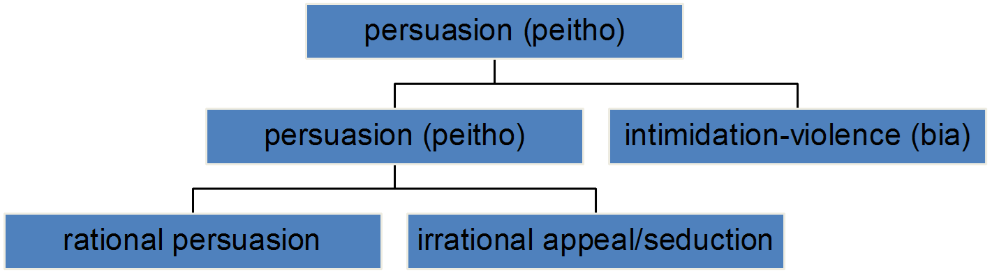
Persuasion, Violence
Notes:
ANOTHER SET OF READINGS illustrates the ambiguity of persuasion, how the category can be divided into itself more narrowly defined and the opposite of this last, and how the element of compulsion cannot ever be fully eliminated from the concept, however much it is crucial that a legitimate political order be viewed as expunging pure compulsion from the realm of the permissible.
pindar
Pindar Pythian Ode 4 lines 213-219. Aphrodite teaches Jason how torments inflicted on the wryneck can be magically transformed into eros felt by Medea for Jason and for his Greek home: “so that lovely Greece might lash her mind into a burning frenzy with the whip of Persuasion (mastigi Peithous).”
Aeschylus Agamemnon lines 385-386 (Lattimore translation)
Persuasion (Peitho) the persistent overwhelms ("forces," biasthai) him, | she, strong daughter of designing Ruin (Ate).
the latter passage concerns Paris' seduction/abduction of Helen. but the whole tenor of peitho in the first two plays of the oresteia suggests ruled by violence and distrust, politically and otherwise. peitho and bia are intertwined. true politics and institutional justice are waiting to be born.
lysias fo
lys fo (from early 300s bce). association of bia with savagery, peitho with democracy. praise of law (which call despises) and reason, this last as the "education" of citizens in a democracy. (all very contrary to call. but illustrates his claim that dēmos fetishizes nomos.)

Slide 9
Interlude: Historic Sketch
from Iron-Age chiefdom
to Archaic polis
village networks
basileus (chieftain-king)
boule (royal council)
dēmos (rank-and-file)
synoecism
archons
boule (aristocratic council)
dēmos (popular assembly)
Iron age, ca. 1000-800 BCE
Archaic age, ca. 800-500 BCE

Slide 10
Athenian Timeline
ca. 620 Draco’s law code
thesmoi
594/3 Solon’s reforms
nomoi
560-510 Peisistratean tyranny
507 Cleisthenic reforms
Notes:
draco: perhaps thesmothete authorized to draw up a law code that was then written down. thus becomes a brake on more arbitrary justice processes. homicide laws to limit blood feuds. motive and extenuating circumstances established as pertinent. other crimes seem punsihed harshly – “draconian” punishments. all but homicide law set aside by solon. “… it cannot be denied that the few soundly attested laws represent an important stage in the process of institutional consolidation in the polis Athens” (Brill’s New Pauly online)

Slide 11
Critical Thinking: Solon (594/3? BCE)
Birth qualification => property qualification.
Cancellation of debt.
End to debt-slavery.
Council (boule) of 400.
Citizen-jury courts (eliaia, dikasteria).
Tyranny? Oligarchy? Democracy?
Notes:
NOTE: we’re told that solon was granted dictatorial powers to draw up his constitution.
basically, created wealth-based oligarchy with key democratic elements.

Slide 12
Cleisthenic Reforms (507 BCE)
from oligarchy
to proto-democracy
clan/village constituencies
4 tribes
archons
Council of 400
deme-trittys organization
10 tribes
archons + stratēgoi
Council of 500
isonomia

Slide 13
Trittys System
dēmos
“city”
“shore”
“inland”
ten trittyes
ten trittyes
ten trittyes
Notes:
divides attica into 3 regions: “city,” “shore,” “inland,” and 139 demes, which are political constituencies. every citizen enrolled in a deme, stays in that deme even if relocates. sons will be members of that deme.
each region into 10 trittyes, with a varying number of demes in each trtttys.
formed 1 tribe from 3 trittyes, 1 trittys from each region = 10 tribes spread out geographically.
by forming a an agenda-preparing council of 500 (50 chosen annually by lot from each tribe), in effect halts aristocratic control over legislative initiatives, and works toward (not quite reaching) a fully sovereign assembly. (boule also finances, foreign policy)
further weakening of old aristocratic identifications in introducing practice of identifying self from one’s deme, evidently with aim of setting aside practice of patronymic, though intermittently practiced.
participation at level of deme crucial: deme exam age 18 = citizenship exam. deme assembly. selection of pool for offices like councilman.
and tribal elections of generals = extension of this new identification, organization. tribal affiliation basis of required citizen military service.

Slide 14
Return to Readings
Founding myth (patriotism as erōs)
Tyrannicides at Athens (514 BCE)
Persian debate (Herodotus book 3)
Otanes: pro democracy
Megabyzus: pro oligarchy
Darius: pro monarchy
Notes:
Tyrannicides at Athens (Panathenaea of 514 BCE)
Cleisthenes elevated them as heroes. that put a democratic stamp on them. it is argued that their love figured symbolically as a kind of erotically charged patriotism. that idea comes back again and again, notably, in periclean fo.
Persian debate (Herodotus book 3, sections 80-82, ca. 522 BCE).
otanes democrat on monarchial hubris and phthonos. vulnerable to flattery, but sensitive as well to being seen to be flattered. but the hubris (lawlessness) main thing. rule of many promotes isonomia. note brief description of democratic state.
megabyzus on oligarchy. ignorance and hubris of "crowd" exceeds that of tyrant. rule by "best" is best.
darius agrees with mega on democracy but not on oligarchy. rule of a single good man best. plurality of rulers conduces to strife (stasis). plus dēmos is corrupt. our liberty (persian liberty from medes) came from a king. all constitutions eventually morph into monarchies.

