Slide 1
Peithō on Trial
Aeschylus’ Eumenides

Slide 2
Preliminary Notes…
9-Oct
Paper 1 due via BrightSpace by midnight
Quiz 1
12-Oct
Paper 1 due via BrightSpace by midnight

Slide 3
Fix the Problem…
“Gorgias defends rhetoric wholeheartedly, Socrates deeply disagrees with Gorgias.”
comma splice
“Gorgias defends rhetoric wholeheartedly, but Socrates deeply disagrees with Gorgias. Very deeply.”
sentence fragment

Slide 4
Aeschylus Eumenides p. 231
PYTHIA: First of the gods I honour in my prayer is Mother Earth, / the first of the gods to prophesy, and next I praise / Tradition, second to hold her Mother’s mantic seat, / so legend says, and third by the lots of destiny, / by Tradition’s free will — no force to bear her down….
Notes:
Curiously, the play opens with the Pythia, the priestess of Apollo’s oracle (place of prophecy) providing us with a run down past and current proprietors of the place [read passage].
Is that, though, how it really happened?
PYTHIA First of the gods I honour in my prayer is Mother Earth,
the first of the gods to prophesy, and next I praise
Tradition, second to hold her Mother’s mantic seat,
so legend says, and third by the lots of destiny,
by Tradition’s free will — no force to bear her down —
another Titan, child of the Earth, took her seat
and Phoebe passed it on as a birthday gift to Phoebus,*
Phoebus a name for clear pure light derived from hers.
* Phoebus = Apollo, whose oracle (place of prophecy) Delphi currently is.

Slide 5
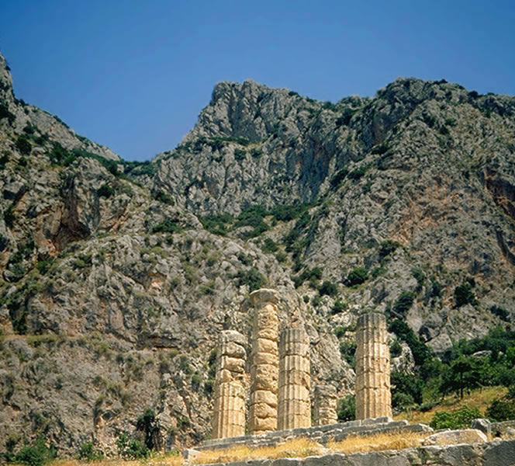
Delphi Foundation Myth, Succession Myth
DELPHI MYTH: Apollo
Slays Python
Seizes sanctuary
SUCCESSION MYTH
Sky sexually smothers Earth
Kronos
Castrates Sky
Eats children
Zeus overthrows Kronos
Notes:
Delphi Foundation Myth, Succession Myth
“οὐδὲ πρὸς βίαν τινός is in syntax and sense a blend of οὐδὲ πρὸς βίαν 'and not by force' and οὐδὲ βίαι τινος 'and not against anyone's will'; it marks an explicit rejection of the dominant tradition according to which Apollo took possession of Delphi by force from a chthonic precursor, either a serpent (h. Ap. 300-74) or a goddess, Earth or Themis (e.g. Pi. fr. 55, Eur. IT 1234-83).”
We should never expect that retellings of myths will always be perfectly consistent, but as Sommerstein points out, the Pythia’s version here rather conspicuously deviates from traditional tellings, where Apollo’s appropriation of the place involves a rather more violent sort of seizure of the property. Here’s it’s a positively orderly hand over, indeed, a birthday present!
What to make of that? Why this rewrite of “mythological history”?
Earth, Tradition (Themis), and Phoebe – all gods belonging to the pre-Olympian order, all women. Apollo: one of the 12 Olympians, the gods who in a violent struggle, wrested the universe from their parents and grandparents, the Titans, who include Phoebe, Apollo’s grandmother, among their number.
[Sommerstein continues: “Aesch.'s version is so well adapted to this play that it is likely to be his own creation (cf. C. Sourvinou- Inwood in J. Bremmer ed., Interpretations of Greek mythology (1987) 231). It fits well with the tone of this prayer as a whole; looks forward to the later reconciliation between the chthonic and Olympian powers; and contrasts sharply with the violent overthrows of Uranus and Cronus mentioned in Ag. 168-75. Zeus's predecessors were there spoken of as utterly gone, and their very names were suppressed; here Apollo's priestess not only makes honourable mention of his predecessors but actually prays to them (1, 20).”]
(Sommerstein commentary pp. 80-81)

Slide 6
Oresteia as Speech Act
Eumenides, Oresteia as speech act
(declarative = assertion “making it so”)
Notes:
I’d like to put out there a suggestion, one seeking to place this myth not simply in the context of the larger myth former the backdrop to this stage of the story – I’m referring to the succession myth, the story of how lordship over the universe passed to successive generations of gods through acts of violence, the myth that the Pythia’s account alters in striking ways. no, I’d like to suggest another backdrop to the play: that of athens’ political and judicial history during the opening decades of the fifth century bce. a backdrop of strife and change leading to the casting off of restraints on popular sovereignty and, in the process, a reduction in aristocratic power. I’d like to suggest that we can view this play, and indeed the oresteia as a whole, as a single, great speech act, as if the city, through this play, were saying to itself, “let the new order (that of judicial and political equality [isonomia, isēgoria]) prevail!” as the city, in so saying, were seeking to make it so. But I also would to complicate that understanding by asking if the forces inaugurating this new order – the Athenian commons (the dēmos) in alliance with select aristocrats – were acting purely out of altruistic motives or were, somehow, in it mostly for selfish reasons. I don’t expect that to be an answerable question. I do, though, hope that somehow by pondering it we might reach a more nuanced understanding of the play.

Slide 7
Agenda
SWA Prompt
Appeals Court, Furies v. Orestes
Recap and Update
What Kind of Progress?

Slide 8
SWA Prompt
Appeals Court, Furies v. Orestes

Slide 9
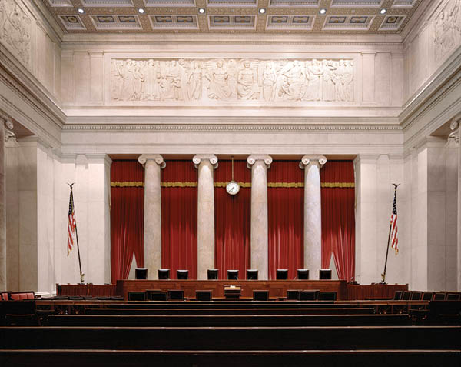
Procedure
Choose
Attorneys for Furies
Attorneys for Orestes
Judges
Arguments
Verdict

Slide 10
Recap and Update
What Kind of Progress?

Slide 11
Question. . .
Can persuasion-based. . .
politics
justice
. . . work?
Notes:
If …
democracy, justice rely on persuasion,
but if …
effective persuasion can prove
deceptive persuasion,
does democracy, does justice really work?

Slide 12
Aeschylus Libation Bearers p. 182–3
LEADER: Now for the murderers. Remember them and —
ELECTRA: What?
I’m so unseasoned, teach me what to say.
LEADER: Let some god or man come down upon them.
ELECTRA: Judge or avenger, which?
LEADER: Just say ‘the one who murders in return!’
ELECTRA: How can I ask the gods for that
and keep my conscience clear?
Notes:
have this read out in class.

Slide 13
Eumenides: Parallel Conflicts
Orestes
Sky gods (Olympians)
Male
Institutional justice
Democrats
Furies
Earth gods
Female
Self-help justice
Aristocrats

Slide 14
Oresteia: Larger Movements
From. . .
To. . .
Matriarchy
Monarchy, tyranny
Vendetta justice
Strife (stasis)
Argos
peithō
Patriarchy
Democracy
Procedural justice
Consensus (homonoia)
Athens
peithō
Notes:
The larger movements encountered in the Oresteia, including those having to do with the trilogy’s political element, can be understood in the context of what C. J. Herington identifies as the characteristically Aeschylean progression from darkness to light, from uncertainty to certainty. Thus the political evolution dramatized in the Oresteia represents a mythologized version of the genesis of the Athenian state. The acutely gendered character of this progression operates at a symbolic level. Thus movements from male to female, from strife to order, from tyranny to democracy, represent a validation and celebration of the here-and-now which is (from the standpoint of the trilogy’s original audience) patriarchal democracy: rule exercised by all, though an all confined to a rather narrowly defined group - free adult Athenian citizen-males.
women’s rule as virtually emblematic of disruption-subversion:
Agamemon: Cly as female ruler; Aeg as “female” ruler.
Libation bearers: 302 ff. ORESTES “the tought that these my citizens … must go subject to this brace of women,” i.e., including Aeg (“since his heart is female”).
It is, then, an illustration of the individual Athenian male’s emotional investment in his national-gender-civic identity. Better than any theoretical writing could (a Plato’s Republic, an Aristotle’s Politics), these dramas designed for consumption by the people as a whole, and to be presented to the people at a festival, the City Dionysia, celebrating civic unity, operates like a kind of political Christmas pageant or Thanksgiving play: it’s us telling us where we came from and who we are.
Yet it also contains an acutely ambivalent element: peitho.

Slide 15
Lind & Tyler on Procedural Justice
Self-interest model
“The idea that a focus on procedural justice may be associated with a long-term view of self interest” (p. 224)
Group value model
“When procedures are in accord with fundamental values of the group and the individual, a sense of procedural justice results” (p. 232–3)
Lind & Tyler The Social Psychology of Procedural Justice (1988)
Notes:
procedural justice = an organized sort of third-party justice, like arbitration.
in eum, what Athena ultimately seeks is to establish procedural justice as a non-zero-sum game, a win-win (in the longer term) for all who buy in. but is it self-interested or group-value-based? it’s necessarily both: the group identity forged by the goddess (furies now as sharing in the city’s judicial fabric) won’t work without creating a sense for the furies that their interests are still being served, that they retain their ancient prerogatives over punishing the guilty.

Slide 16
Foundation: Areopagus Court
ATHENA: And now if you would hear my law, you men of Greece, you who will judge the first trial of bloodshed. Now and forever more, for Aegeus’ people this will be the court where judges reign. This is the Crag of Ares … (Aeschylus Eumenides p. 262)
Notes:
Athena p. 262 (political resonance along with judicial):
Never pollute
our law with innovations. No, my citizens,
foul a clear well and you will suffer thirst. Neither anarchy nor tyranny, my people.
Worship the Mean, I urge you,
shore it up with reverence and never
banish terror from the gates, not outright.

Slide 17
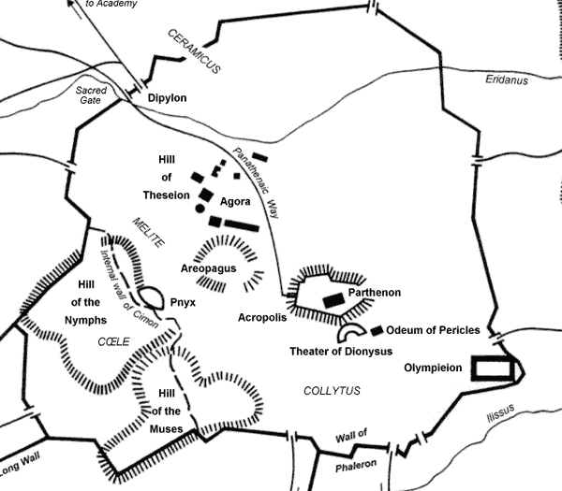
Map of Ancient Athens
Sanctuary of the Semnai theai-Erinues-“Furies”
Notes:
Map of Ancient Athens

Slide 18
Historical Context
508 Athenian democracy
479 Persia defeated
461 Constitutional crisis
Areopagus’ veto-power rescinded
Full democracy achieved
Ephialtes assassinated
Athenian Acropolis
Notes:
pre-461
Staffing
ex-archons
aristocratic
Functions
legislative veto (?). had duty to “protect the laws”
judicial. . .
impeachment
murder
sacred olives
agenda (removed very early - by Solon
other shifts
lessening of oligarch cimon’s influence
shift from friendship with sparta
reduction of areopagus’ powers = almost unlimited legislative power in hands of people (demos)
murder of ephilates met not with no retribution from Pericles
further democratization
pay for boule
pay for dicasts
archon property qualifications substantially lowered
458/7 peril at home: Athenian oligarchs encourage Thebes to take to the field versus Athenian democracy (Battle of Tanagra) - danger of stasis

Slide 19
Historical Context (cont’d)
460 Democracy at Argos
Alliance with Athens
458 Oresteia produced
Athenian Acropolis
Notes:
pre-461
Staffing
ex-archons
aristocratic
Functions
legislative veto (?). had duty to “protect the laws”
judicial. . .
impeachment
murder
sacred olives
agenda (removed very early - by Solon
other shifts
lessening of oligarch cimon’s influence
shift from friendship with sparta
reduction of areopagus’ powers = almost unlimited legislative power in hands of people (demos)
murder of ephilates met not with no retribution from Pericles
further democratization
pay for boule
pay for dicasts
archon property qualifications substantially lowered
458/7 peril at home: Athenian oligarchs encourage Thebes to take to the field versus Athenian democracy (Battle of Tanagra) - danger of stasis

Slide 20
Peithō in Eumenides
Delphic spin (prologue)
Apollo’s peithō (234)
Furies’ Binding song (245 ff.)
Pistis entekhnos (258 ff.)
“Artful proof” (Apollo’s gambit)
Athena-Furies “buy-in”
Athena’s peitho
Notes:
Delphic spin (opening)
matriarchy → patriarchy
Apollo’s peithō (234)
“with judges of your case, with a magic spell – / with words”
“I persuaded you. . .”
Binding song (245 ff.)
“this chant this frenzy striking frenzy”
Pistis entekhnos (258 ff.)
Apollo warns furies to ignore oath (p. 259 “bend to the will of zeus. no oath can match the power of the father” – that’s a threat)
plays the “parternity card”
offers to bribe Athena with offer of argos (ruled by Orestes) as a firm ally
2nd agōn: Athena’s
“I am the only god who knows the armoury where [Zeus’] lightening bolt is sealed”
“let me persuade you” (su d’ eupeitheis emoi)
“If you have any reverence for Persuasion”
“Yes, I love Persuasion!”

Slide 21
Apollo to Orestes
And once you reach the citadel of Pallas, kneel and embrace her ancient idol in your arms and there, with judges of your case, with a magic spell — with words — we will devise the master-stroke that sets you free from torment once for all. I persuaded you to take your mother’s life. (p. 234)

Slide 22
Apollo’s Slam-Dunk?
“Here is the truth, I tell you — see how right I am. | The woman you call the mother of the child | is not the parent, just a nurse to the seed”
Notes:
260. "Here is the truth, I tell you" — as the commentator Sommerstein points out, the audience for the play would have found Apollo's claim doubtful that mothers are not, properly speaking, parents or blood relations.
Though there were intellectuals who seem to have claimed such things, Athenian audiences — and Athenian juries especially — often mistrusted that kind of intellectualizing.
Apollo's argument ignores the Furies' line of argument. The Furies aren't claiming that Orestes sprang from his mother's genetic material (her blood) but were nourished by her blood in the womb — not so far from scientific fact as we now know it!
Athenians held the unbreakable bond between mother and child as extremely special — more special than that between father and child. (The bond between father and child was breakable through adoption.)
Athena really wasn't, as Apollo claims by way of example, without a mother; her mother is usually given as Metis, "wisdom." Zeus ate pregnant Metis (absorbed Wisdom) and then gave birth to Athena from his head.
Note how the jury will split down the middle: some clearly aren't convinced by the case Apollo makes.

Slide 23
“Binding Song” (307 ff.)
“Over the victim’s burning head / this chant this frenzy striking frenzy / lightning crazing the mind / this hymn of Fury / chaining the senses (humnos ex Erinuōn desmios phrenōn), ripping cross the lyre, / withering lives of men!” (329 ff.)
Notes:
the thing about this “binding song”: that the furies have accepted that it will go to trial. this song is then not so much rhetoric itself as much as it is a speech act to disable the speech act of of judicial adversaries in the court, Orestes and Apollo.
epi de tōi tethumenōi
tode melos, parakopā,
paraphorā phrenodalēs,
humnos ex Erinuōn
desmios phrenōn, aphor-
miktos, auona brotois.
a song of their timeless prerogatives:
in this frenzied, violent song, Furies affirm a function:
“we are the just and upright (euthudikaioi). we maintain”
their chant ŗaw and harsh, produces the effect of ate -ruinous delusion - through which the furies - the erinyes - immobilize their victims in preparation for their destruction
but this can also be viewed as a judicial curse, and attempt to rob orestes of the power of speech at his trial
is the spell successful? does orestes actually turn out as inarticulate, or at lest, ineloquent, as the furies hope?
how powerful is the furies power of speech, especially in relation to athena’s? how in fact does athena overcome the furies’ power of speech?

Slide 24
Athena’s (Semi-)Veiled Threat
ATHENA: I put my trust in Zeus and . . . must I add this? I am the only god who knows the keys to the armoury where his lightning-bolt is sealed. (p. 268)

Slide 25
Athena in “Buy-in” Scene
By all my rights I promise you your seat / in the depths of earth, yours by all rights…. My people will revere you. (p. 267)
I put my trust in Zeus and . . . must I add this? / I am the only god who knows the keys / to the armoury where his lightning-bolt is sealed. (p. 268)
Yes, I love Persuasion, / she watched my words, she met their wild refusals. (p. 274)
Notes:
ATHENA: No, I will never tire
of telling you your gifts. So that you,
the older gods, can never say that I,
a young god and the mortals of my city
drove you outcast, outlawed from the land. But if you have any reverence for Persuasion,
the majesty of Persuasion,
the spell of my voice that would appease your fury -
Oh please stay . . .
and if you refuse to stay,
it would be wrong, unjust to afflict this city
with wrath, hatred, populations routed. Look,
it is all yours, a royal share of our land -
justly entitled, glorified for ever.
LEADER: Queen Athena,
where is the home you say is mine to hold? (p. 270)
LEADER: Your magic is working . . . I can feel the hate,
the fury slip away. (p. 271)

Slide 26
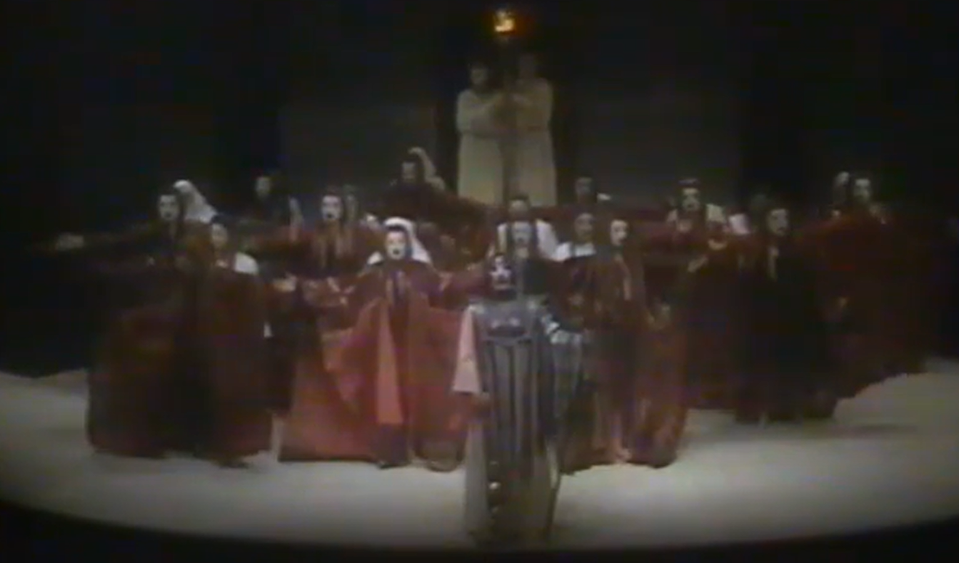
All’s Well That Ends Well?
THE WOMEN OF THE CITY: Cry, cry, in triumph, carry on the dancing on and on! (p. 280)
Athena leads Furies robed in red (1983 Tony Harrison Eumenides)

