Slide 1
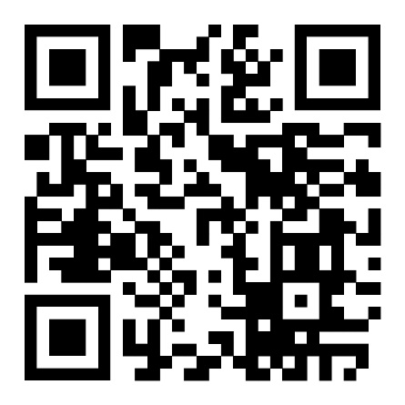
Persuasion in Ancient Greece
Andrew Scholtz, Instructor
Bingdev website

Slide 2
For Thursday. . .
Plato’s Gorgias pt. 1

Slide 3
Does Plato in the Gorgias (or his mouthpiece, Socrates) treat rhetoric fairly?

Slide 4
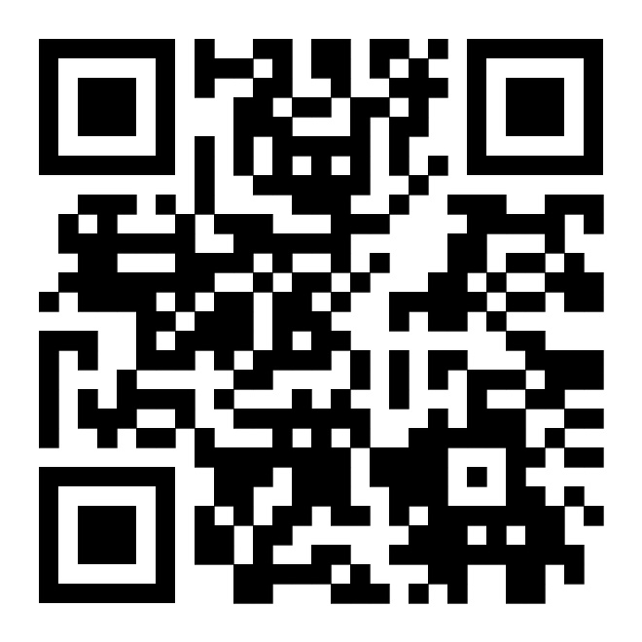
Introductions
Andrew Scholtz
  ascholtz@binghamton.edu
  LT 508
Office Hours
  Walk-in W 1-2 in LT 508
  Or by appointment (email me!)
My Homepage

Slide 5
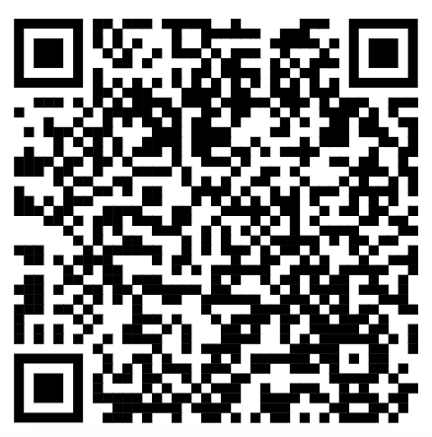
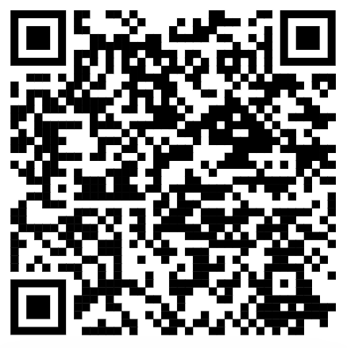
Dual WebSites
Brightspace
  https://brightspace.binghamton.edu/d2l/home/465531
Bingdev
  https://bingdev.binghamton.edu/ascholtz/ams355/
Brightspace
Bingdev

Slide 6
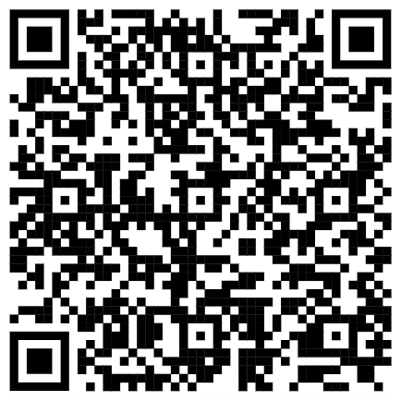
First Assignment: Plato Gorgias Pt 1
Read study guide (req'd!)
Read Gorgias sections 447a-481b via web
Do Short Writing Assignment (SWA) prompt #1
  On Brightspace
  For SWAs, Bingdev Syllabus
Bingdev Syllabus

Slide 7
An Exercise…
In spin control

Slide 8
What is Nick is here trying to get people to do or think?
What challenges does he face?
How does he overcome those challenges?
Thank You for Smoking
https://youtu.be/yrxRCTUt6OY?si=-kjDewzJL-N1J4XH
Notes:
prompt students to suggest something difficult to persuade people to do. (not sexual, not violent or weird; something more or less believable but also extremely challenging from the persuader’s perspective.)
then solicit and discuss suggestions for successful persuasion. what are the challenges; how to overcome?
next, show clip starting 2:35. share a trigger warning: offensive, belittling language will be heard. shocking insensitivity will be exhibited. before showing, ask students to keep in mind the following questions:
what is it that nick is here trying to get people to do or think?
what challenges does he face
how does he overcome those challenges?
then ask them is they see anything that looks familiar. that surprises

Slide 9

Notes:
pretty cynical, no? the idea of exploiting a kind of cancer mascot that way seems to prove nick’s point. and yet....
can we really afford to ignore spin? does the study of spin — of managing perceptions — have a place in a moral world?
note that, without even answering the question of whether spin has a place, shouldn’t the well-educated individual be educated to recognize, to know when others are trying to manipulate our perceptions?
on the other hand, when we interview for a job, when we put ourselves before a group whose opinions matter to us, can we afford to ignore appearances, the impressions we leave?

Slide 10

Ancient Counterparts
Captatio benevolentiae
  Winning over the audience
Koinos topos
  Aka commonplace: shared truth
Notes:
Captatio benevolentiae (curring goodwill)
“Let me share something with the fine, concerned people in the audience”
Koinos topos (rhetorical commonplace)
“I think that we can all agree that there is nothing more important than America’s children”

Slide 11
Ancient Counterparts (cont’d)
Rhetorical questioning
  … answers itself
eikos
  Argument from probability
kolakeia
  Flattery, promisses
Notes:
Rhetorical questioning
“How on earth would big tobacco profit off of the loss of this young man?”
Provocative questioning/statement (safe? speakers in Pl Gor makes extensive use of). [“How on earth would big tobacco profit off of the loss of this young man?”]
Argument by probability
“If anything, we’d be loosing a customer”
kolakeia. Telling/promising the audience what it wants to hear (the $50m campaign)
in Gorgias and other sources is termed kolakeia
it’s all about…

Slide 12
controlling the discourse
Notes:
it’s all about controlling the discourse

Slide 13
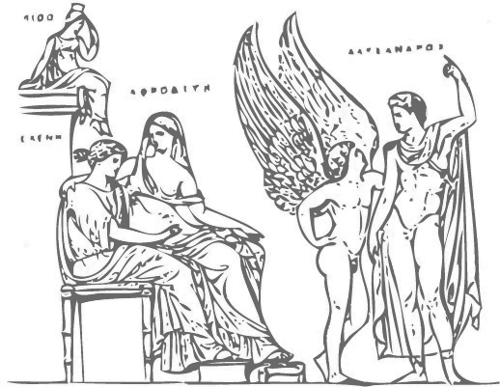
Course Issues
Helen Relief, Naples Archaeological Museum
Notes:
Persuasion (peitho): its…
modalities
venues
applications
power
value
weakness
hazards
analogies, ideologies

Slide 14
Shape of Course
Introduction to peitho (“persuasion”)
peitho transformed
peitho in action
peitho in Crisis
Notes:
basic topics
cultural meaning of persuasion in ancient grc
with special attention to the athenian democacy - role of persuasion therein, its relation to athenian-style democracy as a system
can democracy today shed light on ancient
and vice versa
sequence of units
intro to peitho (abstraction, personification [and thus a divine or magical power])
genesis of peitho in athenian state
as imagined in aesch oresteia
as imagined, and thus insight into its ideological value in, athenian politics, justice
historical overview of the genesis of politics - of the polis - in Greece and thus in the western historical tradition; of democracy at athens, and the role of persuasion therein
the crisis in persuasion, later 400s BCE, and how (or if) resolved
ATHENIAN DEMOCRACY AS A LABORATORY IN PERSUASION

Slide 15
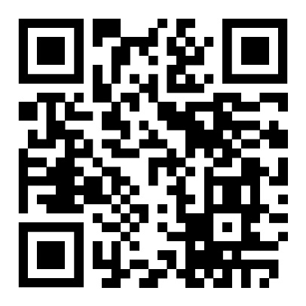
Course Essentials
Procedures, Access, etc. (Bingdev, Brightspace)
Bingdev website
Notes:
geneds and related
daily assignments
SWAs
oral assignments
harpur w assignments
quizzes
honesty, use of AI

