Slide 1
Persuasion in Ancient Greece
Peithō Personified, Reified

Slide 2
Sample Paper 1s…
Form groups
Read assigned paper
Give it a title
Provide writer with feedback

Slide 3
Agenda
Presentation, Paper 1
  Topics, Expectations, Critical Thinking
Recap and Update
  Dahl, Ober
Peitho / peithō
  Semantics, Myth, Allegory, Cult
Sex and the City?
  Peitho and Aphrodite in Public Cult

Slide 4
Presentation, Paper 1
Topics, Expectations, Critical Thinking

Slide 5
Recap and Update
Dahl, Ober

Slide 6
Dahl’s Strong Principle of Equality
The belief that “all members of [an] association are adequately qualified to participate on an equal footing with others in the process of governing the association”
(Dahl 31)
Notes:
i.e., no one is more qualified, “more equal than others,” a primus inter pares
contradicts oligarchy, “guardianship,” noblesse oblige etc.
dahl sees this, or something like this, not just in greek democracy, but in many different kinds of societies (non-western) worldwide.
under strong principle, a democracy is “democratic” with respect to self but not necessarily to others
seeming paradox: democracy can be imperialistic!!
can we affirm/deny the strong principal of equality at athens, whether as ideological “reality,” or as socio-politcal actuality?

Slide 7
“Criteria for a democratic process”
Effective participation by citizens.
Voting equality at the decisive stage.
Citizens’ enlightened understanding of issues.
Popular control of agenda.
Problems?
Notes:
108 ff. CRITERIA FOR A DEMOCRATIC PROCESS
the above understood as requiring a certain set of preconditions, hence what can be understood as “benchmarks” of democracy.
109. EFFECTIVE PARTICIPATION. citizens must be able to have a voice, be allowed to participate. (ISEGORIA) related to princ of equal consideration of interests.) equality and freedom as essential to democracy, a principal that goes back to aristotle.
those who make the decisions must be the same as those who are subject to the decisions if it is to be thought of as a democratic order. (cf. ari's rule and be ruled in turn.)
111. ENLIGHTENED UNDERSTANDING.
citizens ought to have the opportunity somehow to make informed choices.
these three criteria allow us to judge whether a system more or less democratic, and therefore, more or less good - if we presume "good" to equate with "democratic." but "agenda" and even "demos" can imply limiting elements: agendas necessarily restrict the discussion, a demos might itself be constituted restrictively [which leaves us not with democracy but with oligarchy].
111 f. CONTROL OF THE AGENDA.
hence the need for a fourth criterion: control of the agenda in the hands of the people. Even if demos decides that some matters to be up to other sorts of process (e.g., justice), still, "As long as the demos could effectively retrieve any matter for decision by itself, the cdriterion would be met.“
116. PROBLEMS
there is the problem of what should the demos be constituted out of. is a limited franchise democratic?? early in book (as already noticed) considers conflicting visions of what democracy should be about. p. 5: “Critics, not only the adversaries but those who are sympathetic to 'rule by the people,' contend that a process of collective decision-making, no matter how 'democratic,' cannot be justified unless it produces-or at least tends to produce-desirable results.”

Slide 8
Ober’s Challenge
Responding to Michels’ “Iron Law of Oligarchy”
Proving elitist democracy (Athens) = democracy for real

Slide 9
Ober’s Dialectical Model. . .
Operative antitheses
Ideological negotiations
Mass/elite
Equality/inequality
Freedom/consensus
Popular sovereignty/rule of law
Rhetorical mediation
  Topoi
Ideological...
  Elitism
  Popular hegemony
Notes:
Mass v. elite
elites: social power
masses: political power
Political equality
material inequality
Freedom (isēgoria)
consensus (homonoia)
Popular sovereignty
rule of law
Ideological negotiations
312. "... public speech was a natural medium of social mediation." feedback, basically dialogical process leading to a dicourse evolving, ultimately, in dialectical ways.
compromise, smoothing out of differences, stress on community of interests, diffusion of tensions. “Public rhetoric not only revealed public tension, it was a primary vehicle for resolving tensions” (308 – same page, “symbols of social mediation”)
since contradiction could not be balanced constitutionally, it had to be balanced "on the ideological plane." the "trick" was to balance somehow power of masses and that of elite: not too much power to latter, but former had to surrender something to them - community over individual interests ultimately. here courtroom oratory - where ideological compromises - played a role. courts where elite litigants often explained themselves to the masses, the mainstay of the large athenian juries "well-established language," i.e., topoi, through which elites reconciled their elite status to the many.
“The importance of being elitist”
the need for some sort of better equipped advisory class.
political rhetoric could involve more incentive to a speaker to demonstrate elite status, a value insofar as wishes to present self as deserving to lead. birth and wealth could suggest patriotism, integrity, generosity.
“Ideological hegemony of the masses”
“The ideological hegemony of the masses effectively chanelled the fierce competitiveness of elites, a legacy of the aristocratic code, into patterns of behavior that were in the public interest” (333).
Ober Mass and Elite p. 294:
“On the other hand, the existence of the democratic political order posed a quandary for the elite Athenian. As Aristotle noted (Rhet. 1378b26-1379a9; cf. Pol. 1283b34-1284b34), an individual who is superior to his fellows in any one way tends to believe he is entitled to a generally privileged position in society. He who considers himself worthy of privilege because of his social superiority may regard it as an injustice to be placed on equal political footing with average citizens.”

Slide 10
Peitho / peithō
Semantics, Myth, Allegory, Cult
Notes:
the ambivalence of peitho-persuasion is very much a question relevant to today’s readings – it may be the single most important question of the class.
– and will, too, in some of the art I’m going to show. to be precise, we have examples of persuasion, here mostly designated by the greek word peitho (whether as common noun or as proper name) showing up in distinct realms of activity – sex, politics, etc. – though at least sometimes, maybe often, with the sense that these are not wholly separate, but parallel, even overlapping, areas. and the way all of this is showing up strongly suggests that we’re touching persuasion as a key matter of concern in ancient greece, at a variety of levels and in complex ways.

Slide 11
Peithō: Word Notes
peithesthai
  “obey/comply”
peithein
  “persuade”
“Peitho”
  female name
peithō
  feminine noun
Notes:
and that ambivalence gets expressed at the symbolic level by a flip-flopping between metaphor and literality in the treatment of persuasion in our sources
there’s sexual and political persuasion, really two different things
but by talking about political persuasion as if sexual, maybe we can shed light on the irrational, passionate aspect of political decision-making
no, hold on, they’re really the same thing. they’re eros either way – eros, passionate, irrational desire, enters the political and sexual arenas in surprisingly similar ways
But first, some word notes.
[….]
The Greek noun peithō means "persuasion," but it seems to have started life as a proper name! In our evidence, Peitho as proper name refers to a minor deity, possibly multiple minor deities, connected somehow to persuasion.
In some cases, Peitho seems to be the byname, or "epithet," of another goddess: Aphrodite (goddess of sex) or Artemis (goddess of the hunt and of young people).
So Peitho (proper name) in such cases will be a personification, and when dealing with personifications, it isn't always easy to tell whether one is dealing with a person, the thing personified, or both at once. But what aspects of persuasion will Peitho personify? It depends. In some cases, there will be reason to think it's all about sexual persuasion. Hence Peitho as goddess of seduction. In other cases, it may something else, for instance, the persuasiveness of a ruler or of a politician or speaker. In any case, Peitho as personification (in art, poetry, or religious cult) represents something held up as important in the cultural system that we're finding her in.

Slide 12
Peithō: Problematics
Opposites? | Analogues?
peitho (persuasion) | bia (force, violence)
verbal persuasion | non-verbal persuasion
sexual persuasion | non-sexual persuasion
Notes:
by ambivalence I mean the curious flip-flopping of our ancient sources on it
now persuasion is a really good thing!
now it’s a really bad thing!
it’s so good because it’s the opposite of bad things like violence – it allows for free choice, a kind of political-personal empowerment
it’s bad because it’s just like violence: it makes you do stuff you don’t want to

Slide 13
Historical Sketch
Archaic Period, ca. 800–500 BCE
  Emergence of polis
  Homer, Hesiod, Sappho, Pindar, Alcman
“Classical” Period, ca. 500-300 BCE
  Athenian democracy (508–323 BCE)
  Empedocles, Euripides, Archippus, Demosthenes
  Aphrodite Pandemos at Athens (?)
Post-classical Period, ca. 300–
  Political dedications to Aphrodite
  Plutarch (CE 46–120)

Slide 14
Allegory-Personification
Daughter of Ocean
  Hesiod Theogony 349-363
  Pherecydides of Athens F 66
Daughter of Aphrodite
  Sappho fr. 90
Kinship cont’d. Peitho as…
  Fortune’s (Tukhe’s) mother
  Foresight’s (Promathea’s) daughter
    Alcman fr. 64
Notes:
what the evidence listed on the slide does is locate peitho within a web of shared values expressive of identity – narratives that, at a mythical level, express who “we” are. peitho and admete in hesiod: if nothing else associate a quality like persuasiveness or attractiveness with the origin of the world order.
“He (Ocean) begat a holy race of daughters to watch over men upon the earth with lord Apollo and the rivers: Peitho and Admete and …. These, then, were born of Ocean and Tethys, their eldest daughters”
Hesiod Theogony 349-363
“Peitho, daughter of Ocean”
Pherecydides of Athens F 66
“In other poems she [Sappho] has called Peitho a daughter of Aphrodite”
Sappho fr. 90
“[Fortune] is sister of Good-Law (Eunomia) and Peitho, and daughter of Foresight”
Alcman fr. 64

Slide 15
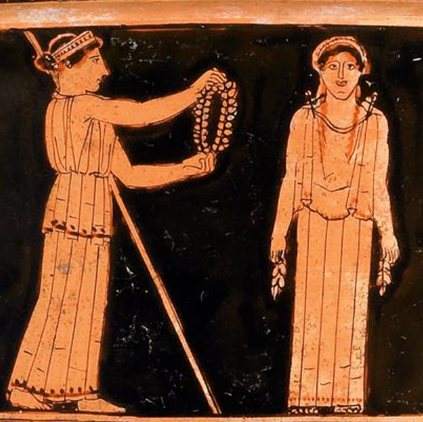
Peitho, Pandora in Hesiod
“… and the divine Graces and queenly Peitho put necklaces of gold upon her, ….” (Hesiod Works and Days)
Athena adorns Pandora. Attic red-figure vase (British Museum), ca. 425 BCE
Notes:
more complicated is hesiod’s tale in the works and days, which dates from the late 700s, some 200 years earlier than the Athenian democracy. Pandora embodies sexiness; peitho helps with that. but the poetry, reflecting strongly male perspectives, is deeply ambivalent about all the sexiness. that sexiness, and men’s ambivalence toward same, translate to the idea of persuasion (peitho) as something potent yet dangerous.
Hesiod Works and Days 60-82:
(60-68) So said the father of men and gods, and laughed aloud. And he bade famous Hephaestus make haste and mix earth with water and to put in it the voice and strength of human kind, and fashion a sweet, lovely maiden-shape, like to the immortal goddesses in face; and Athene to teach her needlework and the weaving of the varied web; and golden Aphrodite to shed grace upon her head and cruel longing and cares that weary the limbs. And he charged Hermes the guide, the Slayer of Argus, to put in her a shameless mind and a deceitful nature.
(69-82) So he ordered. And they obeyed the lord Zeus the son of Kronos. Forthwith the famous Lame God [Hephaestus] moulded clay in the likeness of a modest maid, as the son of Kronos purposed. And the goddess bright-eyed Athene girded and clothed her, and the divine Graces and queenly Peitho put necklaces of gold upon her, and the rich-haired Hours crowned her head with spring flowers. And Pallas Athene bedecked her form with all manners of finery. Also the Guide, the Slayer of Argus [Hermes], contrived within her lies and crafty words and a deceitful nature at the will of loud thundering Zeus, and the Herald of the gods [Hermes] put speech in her. And he called this woman Pandora [? "All Gift," "Gift for All"], because all they who dwelt on Olympus gave each a gift, a plague to men who eat bread.

Slide 16
Homer: Aphrodite’s “Girdle”
“As [Aphrodite] spoke she loosed from her bosom the curiously embroidered girdle into which all her charms had been wrought - love, desire, and that sweet flattery which steals the judgment even of the most prudent.” (Homer Iliad 14.214-217)
Notes:
more of same in the “deception of zeus” episode in homer’s iliad, which dates from even earlier than hesiod. it’s not that hera, zeus’s wife, is persuading her husband to alter his stance on the Trojan war. rather, it’s the interconnection of all those lovely devices contained in Aphrodite’s pouch – qualities later will imagined to play a role in persuasion, verbal and otherwise, political and otherwise.

Slide 17
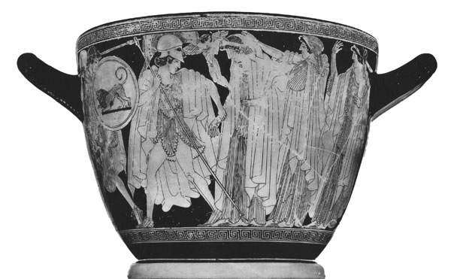
“Makron Vase” – early 5th BCE, Athenian (Boston Museum)

Slide 18
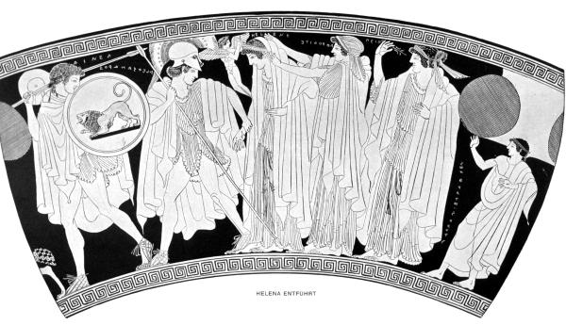
Makron Vase, abduction scene. L to R: Aeneas, Alexandros (Paris), Eros, Helen, Aphrodite, Peitho

Slide 19
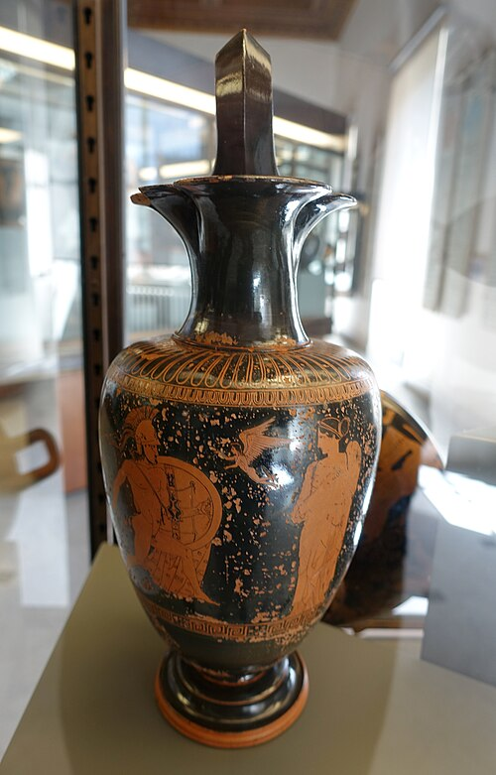
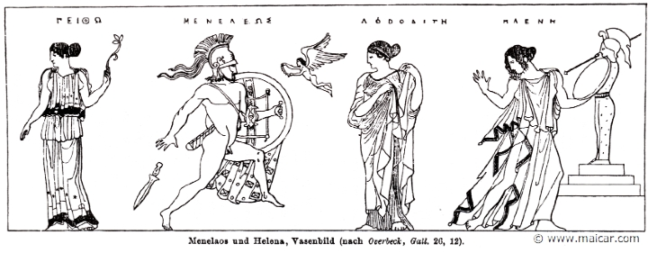
Menelaus-Helen Reunion Scene
Athenian Red-Figure vase (Vatican Museums), ca. 425 BCE. Left to right: Peitho, Menelaus, Eros, Aphrodite, Helen
Notes:
What do you see going on?
Collection:Vatican MuseumsSummary:The Rape of HelenWare:Attic Red FigurePainter:Attributed to the Heimarmene PainterContext:VulciDate:ca. 430 BC - ca. 420 BCDimensions:H. 0.355 m; max. diam. (body) 0.138 mPrimary Citation:ARV2, 1173.3Shape:OinochoeBeazley Number:215554

Slide 20
Sex and the City?
Peitho and Aphrodite in Public Cult

Slide 21
Political-Sexual Aphrodite Pandemos
Pausanias Description of Greece 1.22.4
  When Theseus had united into one state the many Athenian demes, he established the cult of Aphrodite Pandemos [“Aphrodite of the Whole People”?] and of Persuasion.
Nicander of Colophon, quoted by Athenaeus
  [Solon established public sex work at Athens “for … youths in their prime.” Founds cult of Aphrodite Pandemos with proceeds.]
  Philemon (comic poet ca. 300 BCE) Brothers
  Solon: Your inventions have served all human kind! For they say that you first devised the custom, once that is democratic and has saved the city. For you saw the city full of young men, and that they were possessed of a nature that inclined to things they ought not do. So you purchased young women and set them up in public spots — they stand there naked.....
Notes:
QUESTIONS:
Why politicize this sexual goddess? (Why sexualize this political goddess?)
Do these two views of the goddess present us with any kind of a contradiction? Could there be connections?
What can they tell us about attitudes to persuasion, to its role under democracy?
WHAT CULTURAL ASSUMPTIONS MAY BE ENCODED HERE?

