Slide 1
Plato’ Gorgias 1
Is rhetoric Fake? (Persuasion 21-Aug)
Notes:
Is rhetoric Fakery?
Is it it justified as a practice? As a discipline to study?

Slide 2
Agenda
Discussion
  Does Socrates Treat Rhetoric Fairly?
Plato’s Gorgias
  Introduction

Slide 3
Discussion
Does Socrates Treat Rhetoric Fairly?

Slide 4
Plato’s Gorgias
Introduction

Slide 5
Text Facts
Author
Date
  Dramatic
  Compositional
Setting, context
  Situational
  Social/political…
Map: Ancient Leontinoi, Athens
Notes:
Author 428-348 BCE
Date
dramatic 380s BCE (Gorgias, Born c. 480, died c. 380 BC, “G. led the legation of his city in order to plead for help from Athens against the neighbouring city of Syracuse” brill’s)
compositional 427 BCE
Setting, etc.
situational
embassy from leontinoi – gorgias’ challenge in peitho
social
well-to-do hosts of ambassadors
political
athenian democracy

Slide 6
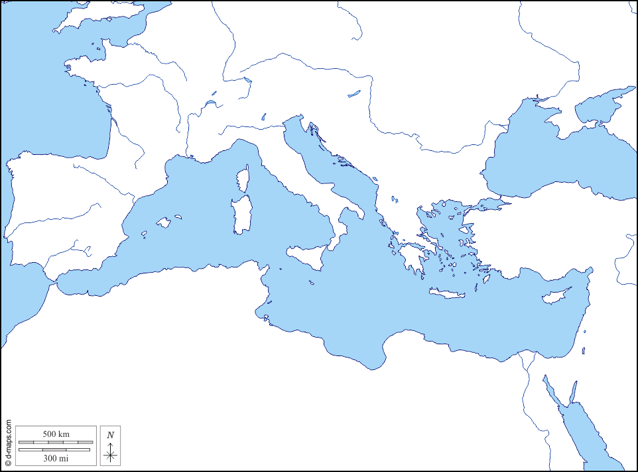
Social-Political Context (con’t)
Oligarchy
  “Rule of the few/wealthy”
  E.g., 400s BCE Corinth
Monarchy
  “Rule of the one”
  E.g., Persian Empire
Persian Empire
Corinth
Persian
Empire

Slide 7
Social-Political Context (con’t)
Tyranny
  Rule by usuper
  E.g., 400s Syracuse
Democracy
  “Rule of the dēmos/poor”
  E.g., 400s-300s Athens
Athens
Syracuse
Persian Empire
Corinth
Persian
Empire

Slide 8
Social-Political Context (con’t)
Mixed constitution
  Monarchy, democracy, oligarchy
  E.g., 400s-300s Sparta
Athens
Syracuse
Persian Empire
Corinth
Athens
Persian
Empire

Slide 9
Text: Structure
Overture
  epideixis
ACT 1. Socrates & Gorgias
  Rhetoric. . .
    definition?
    utility?
ACT 2. Socrates & Polus (& Gorgias)
  Same questions
  Different answers?
ACT 3. Callicles
  to be continued!
Notes:
Overture
epideixis
ACT 1. Socrates & Gorgias
Rhetoric. . .
definition?
utility?
socrates seems to get no farther with gorgias than to establish that rhetoric is the art of validating appearances: the appearance of wisdom. if not wholly an art to replace skills like medicine, still, virtually indispensable
affirms that rhetoric endows user with power, but also affirms that the power in question should not be abused
“[456d] And yet, Socrates, rhetoric should be used like any other competitive art, though not against everybody. The rhetorician ought not to abuse his strength any more than a boxer or pancratiast”
ACT 2. Socrates & Polus (& Gorgias)
Same questions
Different answers?

Slide 10
ACT 2 scene 2 (Socrates, Gorgias)
Real (tekhnai, “skills”)
Imitative (empeiriai, “knacks”; kolakeia, “pandering”)
Soul governance
  Legislation
  Justice
Body governance
  Gymnastic
  Medicine
Soul governance
  Sophistic
  Rhetoric
Body governance
  Cosmetics
  Cooking

Slide 11
ACT 2 scene 3 (Socrates., Polus). What Tyrants Want
Polus
Socrates
Power
Pleasure
Impunity
The beneficial
Justice
Correction
When is it fitting not to punish injustice?

