Slide 1

Plato’s Phaedrus
Erōs and Rhetoric
Notes:
what are those sounds?
what are they doing and why are they doing that?
“SOCRATES: A lover of music like yourself ought surely to have heard the story of the cicadas, who are said to have been human beings in an age before the Muses. And when the Muses came and song appeared they were ravished with delight; and singing always, [259c] never thought of eating and drinking, until at last in their forgetfulness they died. And now they live again in the cicadas; and this is the return which the Muses make to them — they neither hunger, nor thirst, but from the hour of their birth are always singing, and never eating or drinking; and when they die they go and inform the Muses in heaven who honors them on earth. [259d] They win the love of Terpsichore [Muse of dancing] for the dancers by their report of them; of Erato for the lovers, and of the other Muses for those who do them honor, according to the several ways of honoring them; — of Calliope the eldest Muse and of Urania who is next to her, for the philosophers, of whose music the cicadas make report to them; for these are the Muses who are chiefly concerned with heaven and thought, divine as well as human, and they have the sweetest utterance. For many reasons, then, we ought always to talk and not to sleep at midday.”

Slide 2
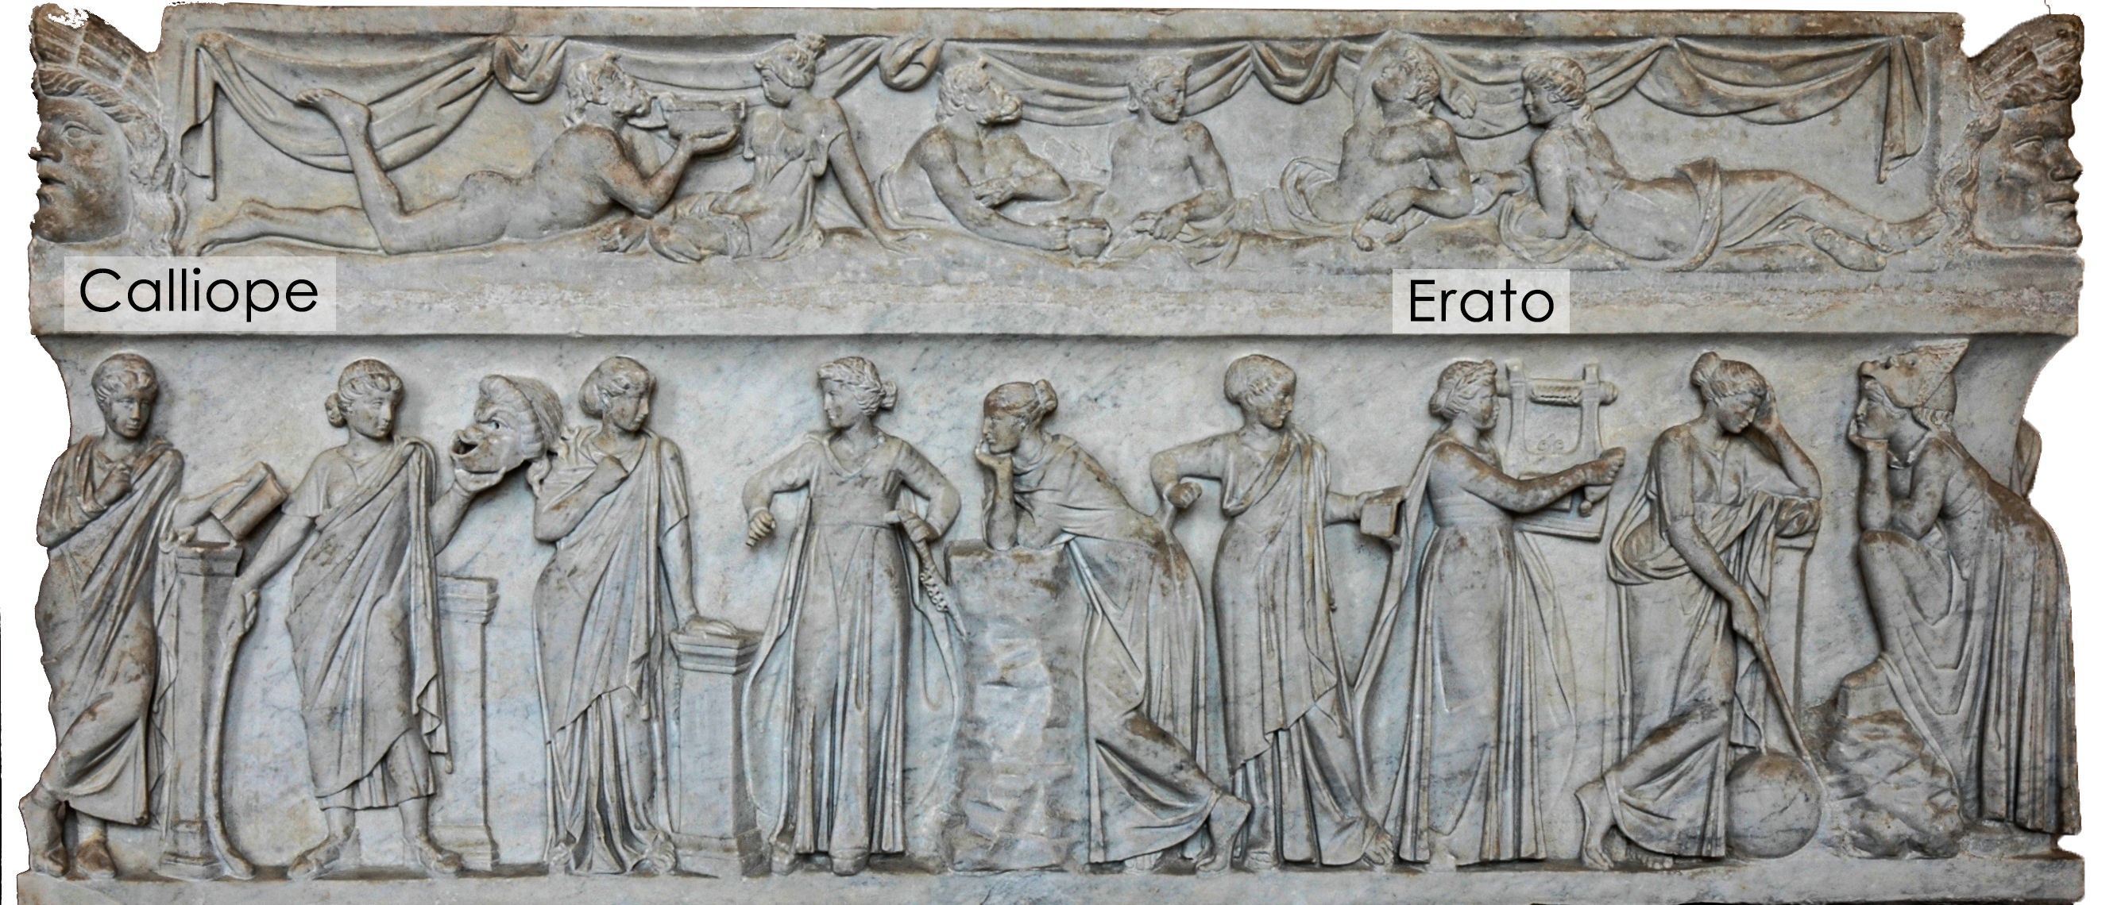
The Nine Muses (2nd CE, Louvre)
Notes:
(Sarcophagus of the Muses, , first half of the 2nd century AD, Louvre)
we’d not wish to anger Calliope, muse of, among other things, eloquence, nor Erato, muse of love poetry. so with a properly reverent attitude, let’s see what we make of this dialogue, what it can tell us about rhetoric, and especially rhetorics connection to erōs, “love”

Slide 3
Agenda
Disucssion
  What’s erōs got to do with it?
Plato’s Phaedrus
  Introduction to the dialoge
Let’s Outline a Paper!
  Thinking Critically about the Phaedrus
Wrap-Up
  What the Cicadas Are Saying…

Slide 4
Disucssion
What’s erōs got to do with it?

Slide 5
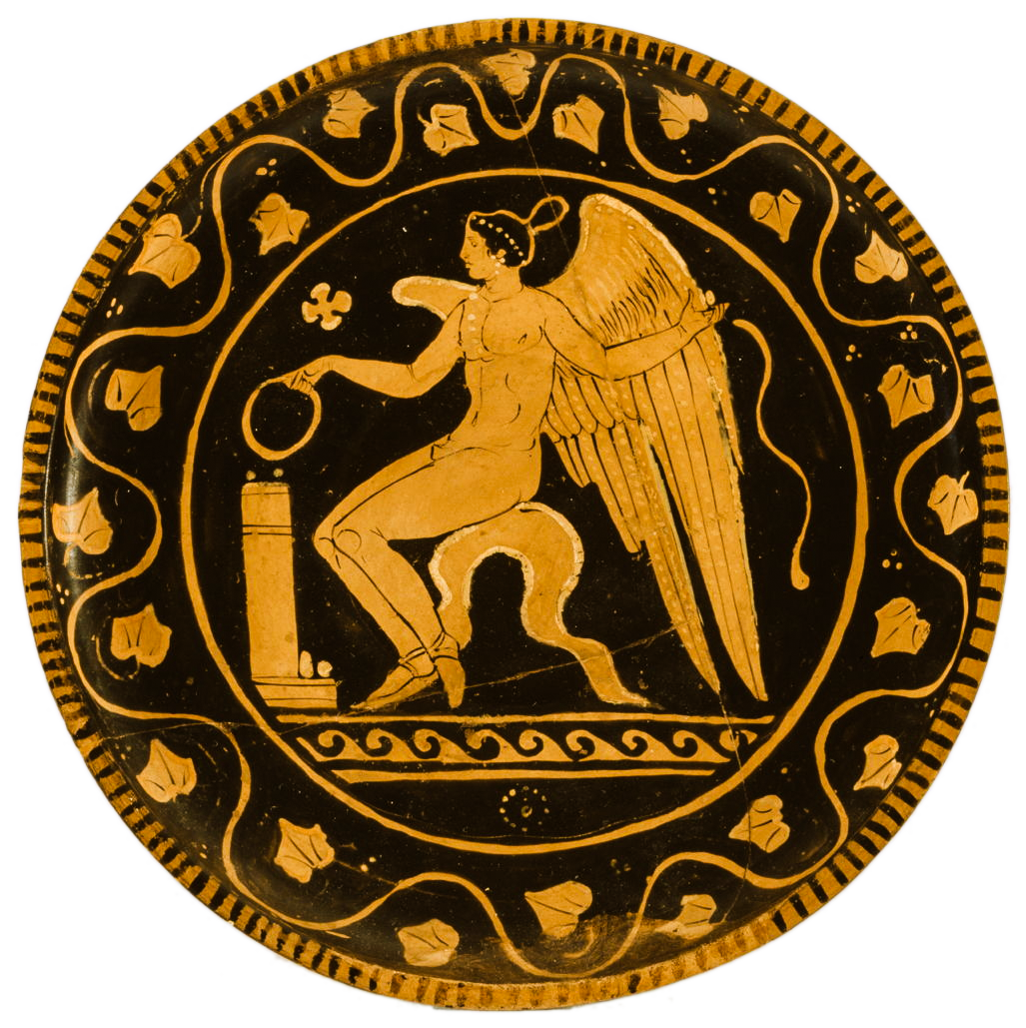
SWA Prompt
Why do you think Socrates uses love speeches to explore rhetoric in the Phaedrus? Plus, are Socrates’ ideas on rhetoric different here from what we see in Plato’s Gorgias? If so, different how?
Eros, 4th cent BCE red-figure plate
Notes:
What legitimizes rhetoric here? (knowledge possessed by the rhetor.) What are Dahl’s criteria for a democratic process? Among other things, #3.: Citizens’ enlightened understanding of issues.
can rhetoric legitimately enlighten the dēmos? acc to Plato’s Socrates in the Phaedrus, no; true knowledge comes only from philosophical study, i.e., through dialectic. rhetoric has only to do with doxa; the connection with erōs implies that the rhetor’s task is to make the better argument appear attractive to the legislators and electorate. but the rhetor still must possess knowledge of subject matter as well as knowledge of the audience. thusly knowledgeable, the rhetor finally practices an art, a tekhnē. (in plato’s Theaetetus, knowledge is finally defined as true opinion accompanied by a reasoned explanation.) in the end, rhetoric-sophistic is sine qua non for the democratic leader, but that implies that a properly led democracy must function as an oligarchy – michels’ iron law. not that much has changed from plato’s gorgias, only that Socrates has finally found a practical use for rhetoric and a way to elevate it from “knack” to “art.”

Slide 6
Plato’s Phaedrus
Introduction to the dialoge

Slide 7
Phaedrus 1: epideixis (demonstration)
Prelude
erōtikoi logoi (“love speeches”)
Lysias’ (against erōs)
Socrates’
  Lysianic re-do
  Stesichorean recantation
Notes:
explores rhetoric through three examples of rhetoric, which become basis for a preliminary theory of rhetoric as psychological influence exercised through human speech.
the speeches are love speeches, but they really represent courtroom and political speeches, the two main areas of the practice of ancient rhetoric.
as political speeches: they seek to influence the decision of someone to do something or not to do it
as courtroom speeches, they in effect put eros - but also logos - on trial.
Seduction (prelude)
eros for logos. socrates’ ostensible purpose will be to cure phaedrus of his eros for rhetoric
Speeches: Go with erastes?
>> the point here is to illustrate the potential and the limits of monological, rhetorical discourse. all three speeches are monological rhetoric and thus inferior to dialectic. all three seek to argue a counter-intuitive point, to make the seemingly weaker argument stronger. all three are in a sense sophistic.
Lysias
No. (a formally messy attempt to spin “friends with benefits” as more prudent than consorting with lovers)
Socrates
No. (a formally more systematic version of preceding.)
Yes but… (yet more systematic still, it presents the more acceptable thesis morally, but still buts up against common opinion: that love as madness is carries serious drawbacks)

Slide 8
Phaedrus 2: didaxis (instruction)
Cicadas (interlude)
Systematization
  definition, dialectic
  psychology
  rhetorical elements
Superiority of
  Speaking to writing
  Dialectic to rhetoric
  Philosophy to sophistic
Notes:
Part 2: didaxis
(instruction)
myth of the cicadas
systematization
rhetoric like meds. again, a response to sophs. (270b)
definition, dialectic
writing versus speaking
myth of Thoth
writing inferior because the mere static image of discourse. writing can only be a pastime. conversation - dialectic - the true occupation of the philosopher.

Slide 9
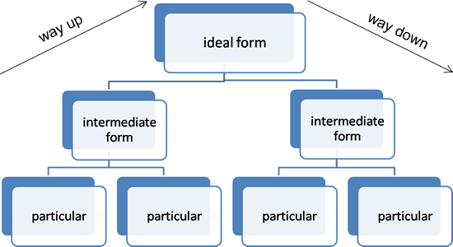
Phaedrus: Dialectic v. Rhetoric
Dialectic
Rhetoric
Definition
  “enchanting the mind (psukhagōgia) by arguments (logoi)”
Requirements
  mastery of topic
  mastery of psychology
  mastery of presentation
Notes:
It isn’t stated in myth of cicadas that orators expected to be philosophers as well, but that seems to be the implication. Thus the necessary prerequisite for rhetoric would seem to be dialectic, the art of systematizing knowledge.
dialectic is essential to determine the difference between
the non-debatable (axiomatic premises, shared “truths”)
the debateable
. . . and establish share definitions
ultimately, dialectic is superior to rhetoric, as it requires a dynamic interchange between perspectives, so that propositions can receive a proper testing (elenchus).
yet “mere knowledge of the truth will not give you the art of persuasion” (260d). this an attempt to lay the groundwork for a better, i.e., more beneficially efficacious, rhetoric. think of socratic rhetoric as the higher seduction.
socrates account of socratic rhetoric makes a number of key concessions to sophists:
that rhetoric deals in doxa
that it is like an enchnatment applied to the minds (“souls”) of others
but he parts company as to need to base persuasion on wide-ranging technical knowledge.
the real knowledge that practitioner must master.
ELEMENTS & RULES OF SYSTEMATIZED OR “SOCRATIC” RHETORIC:
ARRANGEMENT:
(proem, etc.). argumentational modes (e.g., probability). topoi.
RHETORICAL RULES:
know your subject matter.
likeness to truth will produce more persuasive deception. so knowledge of subject matter essential.
define topic area - be on same page as audience. be sure you’re clear where the divide lies between the mutually accepted and the to-be-persuaded. nature of love debatable; its def. not. speech 3 a paignion, but still illustrates clear definition of terms and dialektike.
know your audience – audience psychology.

Slide 10
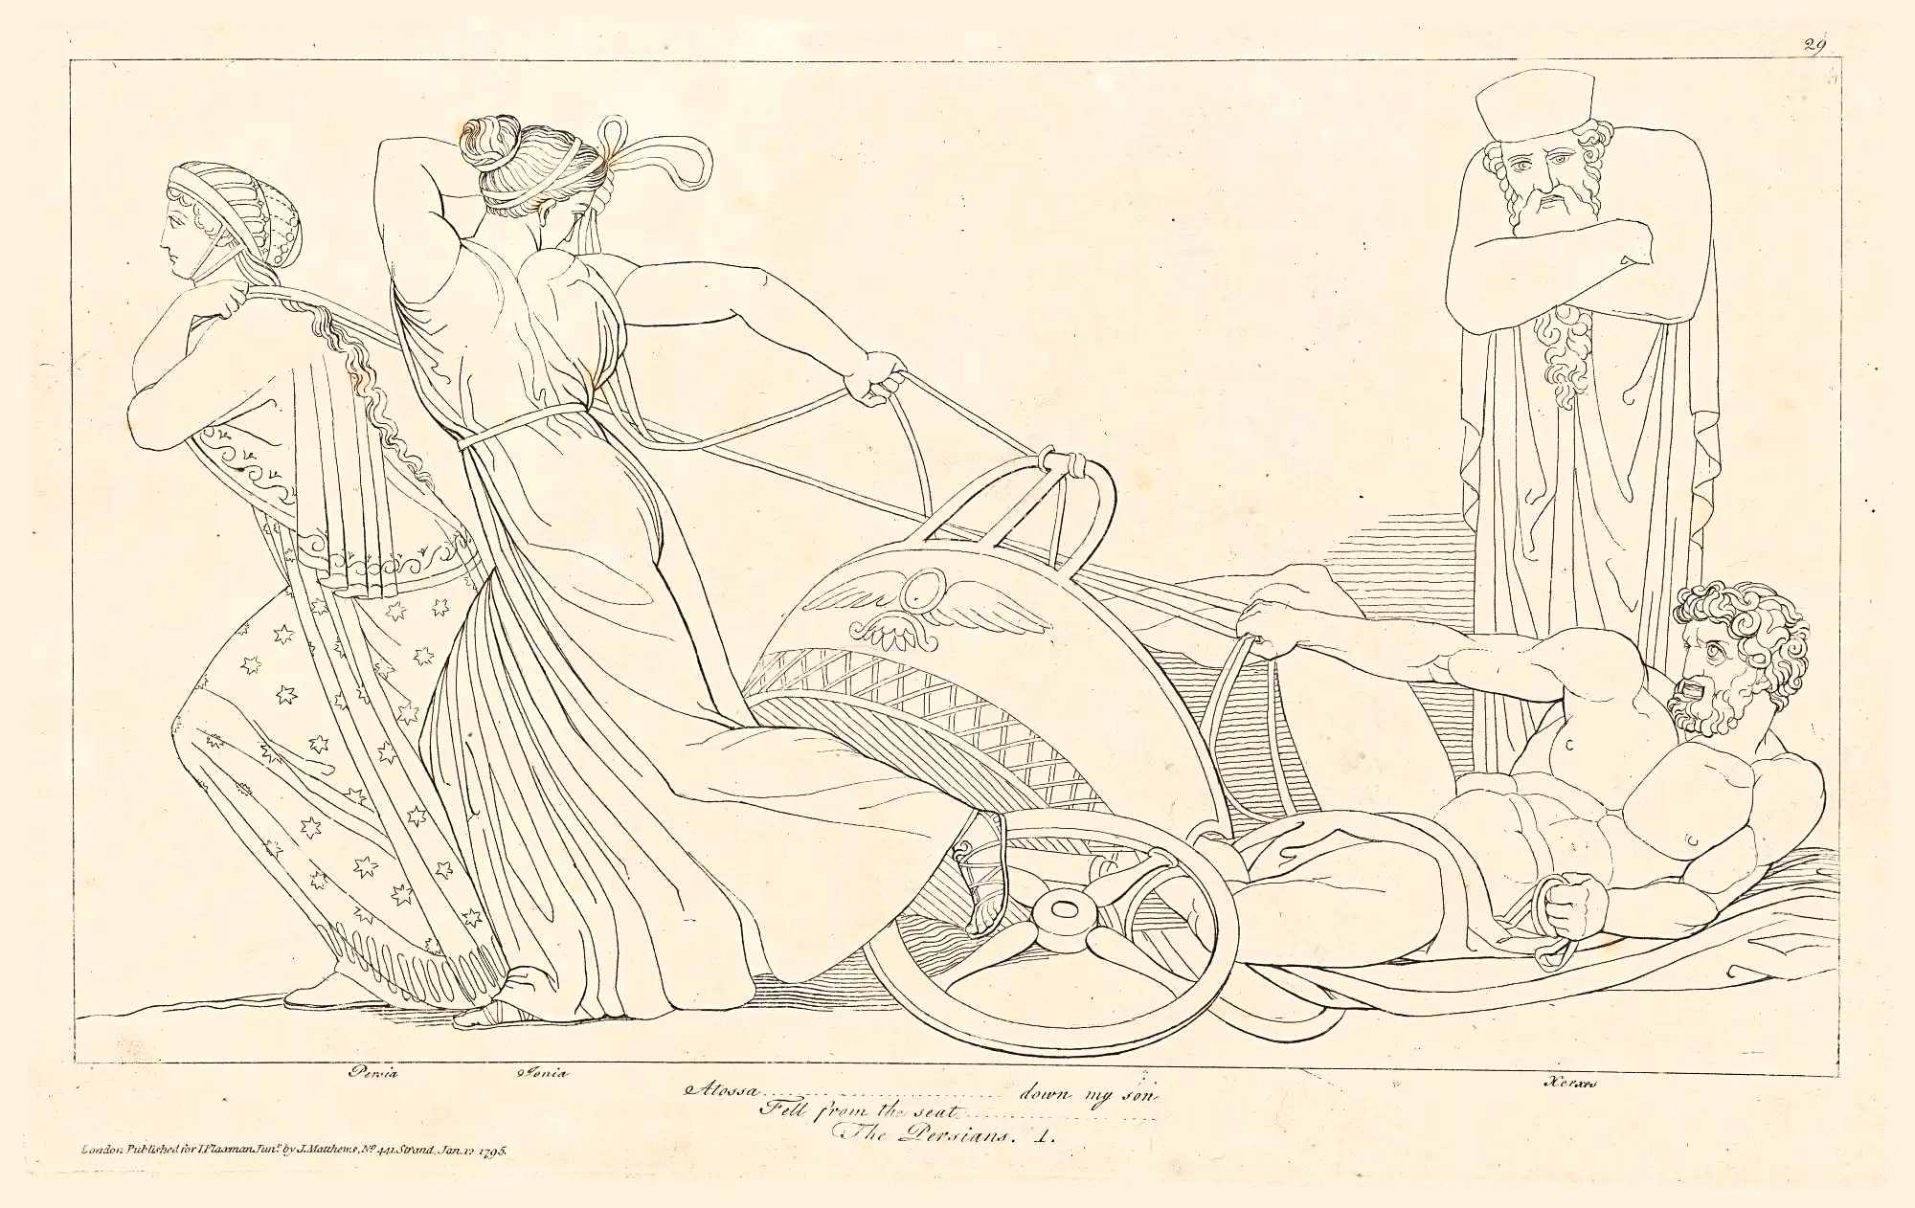
Aeschylus Persians: Atossa’s Dream, Xerxes’ Chariot
(John Flaxman 1795)

Slide 11
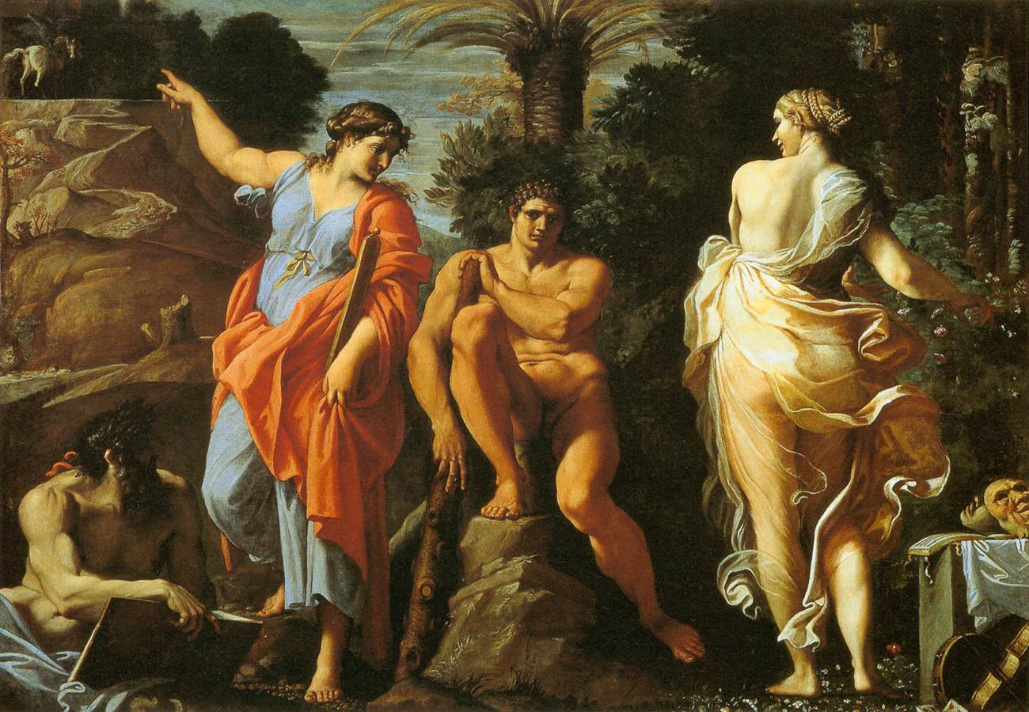
Choice of Heracles (allegory of Virtue and Vice: Prodicus, Xenophon, Caracci)
Virtue (aretē)
Vice (kakia)

Slide 12
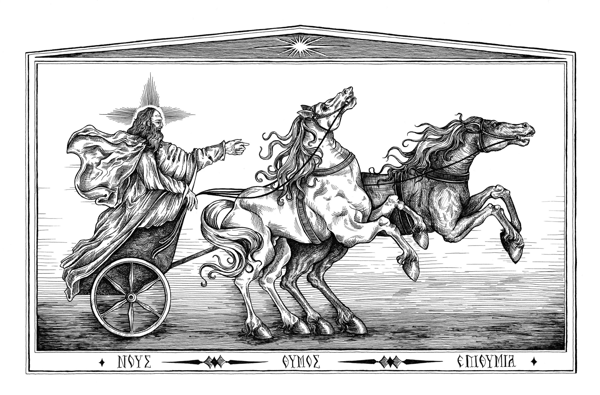
Phaedrus: Parable of the Chariot

Slide 13

Let’s Outline a Paper!
Thinking Critically about the Phaedrus

Slide 14
Question/Problem

Slide 15
Thesis, Approach

Slide 16
Argumentation, Documentation

Slide 17
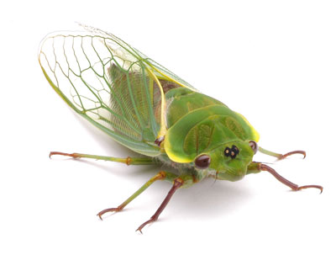
Wrap-Up
What the Cicadas Are Saying…
Notes:
while there exist forms of discourse higher than monological speechifying, those (dialectic, philosophy) won’t fly in any number of real-life situations, in court, in politics, etc., an appealing – i.e., quasi-sexy – sort of persuasiveness cannot but be deployed. that requires, according to plato’s socrates, talent, knowledge, and technical skill. human beings aren’t so stupid that their instincts for reading appearances – the faculty of doxa – can easily be bamboozled. in fact, knowledge is necessary to spin minimally, and thus convincingly. but the speaker cannot at the same time simply ignore human prediklections, biases, eros. hence no surprise that socrates identifies pericles the erudite and psychologically astute pericles as the consummate orator. as you’ll remember, in the FO written for him by thuc, he makes selfless sacrifice seem like the ultimate self-indulgence.
so i really want you to consider whether “that old black magic” that we call peitho is quite as wicked a thing as some may take it to be. the romans defined the orator as “a good person skilled at speaking.” now, i don’t know if they were right, but the mere fact that they could even think that perhaps suggests that we should give rhetoric a chance, too.

