Slide 1
Plutarch’s Alcibiades
Extreme Charisma?

Slide 2
Women without a (Long-Term) Plan?
Magistrate
You can stop these wartime hardships…?
Lysistrata’s weaving metaphor
[Unravel the war. Re-weave body politic and empire to banish faction (stasis), to foster consensus.] (Lysistrata pp. 118–119)
Notes:
Magistrate
You can stop these wartime hardships, I'm to gather?
Lysistrata
Sure!
Magistrate
And how?
Lysistrata
Open up your sewing basket: see the skein of tangled wool? Put it to the spindle this way, wind it here, now wind it there. Thus the war can be unravelled, making truces here, and there.
Magistrate
Skiens and spindles? I don't get it.
Lysistrata
Sense and skill is all you need.
Magistrate
Show me.
Lysistrata
Gladly. First you wash the city as we wash the wool, cleaning out the bullshit.0 Then we pluck away the parasites; break up strands chat clump together, forming special interest groups; Here's a bozo: squeeze his head off. Now you're set to card the wool: use your basket for the carding, the basket of solidarity. There we put our migrant workers, foreign friends, minorities, immigrants and wage-slaves, every person useful to the state. Don't forget our allies, either, languishing like separate strands. Bring it all together now, and make one giant ball of yarn. Now you're ready: weave a brand new suit for all the citizens.

Slide 3
Bibliographical Notes 1
Sophists, Thucydides
Crane, Gregory. Thucydides and the Ancient Simplicity: The Limits of Political Realism. Berkeley: University of California Press, 1998.

Slide 4
Bibliographical Notes 2
Pericles (Plut., Thuc.); Cleon, Knights, Lysistrata, political oratory
Connor, W. Robert. 1971. The New Politicians of Fifth-Century Athens. Princeton: Princeton University Press.
Saxonhouse, Arlene W. 2006. Free Speech and Democracy in Ancient Athens. Cambridge ; New York: Cambridge University Press. [library reserves]

Slide 5
Bibliographical Notes 2 (cont’d)
Scholtz, Andrew. 2007. Concordia Discors: Eros and Dialogue in Classical Athenian Literature. Washington, D.C.: Center for Hellenic Studies.
De Luca, Kenneth M. 2005. Aristophanes’ Male and Female Revolutions: A Reading of Aristophanes’ Knights and Assemblywomen. Lanham, Md.: Lexington Books.
Wohl, Victoria. 2002. Love among the Ruins: The Erotics of Democracy in Classical Athens. Princeton, N.J.: Princeton University Press.

Slide 6
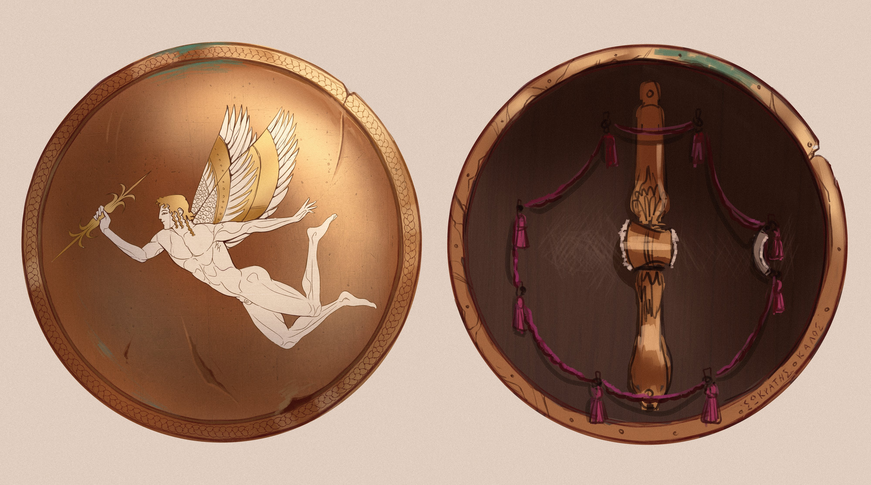
Alcibiades’ shield, image
Alcibiades’ shield reimagined. @a1ienrat
Notes:
Alcibiades’ shield.
“He had a golden shield made for him, which was emblazoned not with any ancestral device, but with the figure of Eros armed with a thunderbolt.” (Plutarch Alcibiades p. 58)

Slide 7
Agenda
SWA: Epideixis
In Praise/Censure of Alcibiades
Alcibiades Life and Times
Introduction to Plutarch’s Alcibiades
Our Alcibiades Problem
Charm and Legitimacy

Slide 8
SWA: Epideixis
In Praise/Censure of Alcibiades

Slide 9
Alcibiades epideixis
Introduction (prooimion).
Argument/divisions (diaireseis).
Proofs
Refutations
Conslusion (epilogos).

Slide 10
Alcibiades Life and Times
Introduction to Plutarch’s Alcibiades

Slide 11
Alcibiades’ Life and Times
ca. 450 Born.
431 Peloponnesian War starts.
432-431 Potidaean campaign.
ca. 427 Follower of Cleon.
424 Battle of Delium.
421 Peace with Sparta .
417/6 Melian debate.
416 Olympic victory. Ostracism survived. Sicilian Debate.
415 Mysteries affair. Defection to Sparta.
413 Fortification of Decelea.
413-412 Sicilian disaster. Defection to Persians.
411 Oligarchic coup.
408 Repatriation.
406 Re-exile.
404 Sparta defeats Athens.
404-403 Tyranny of 30. Al murdered.
Notes:
Alcibiades born.
431 War breaks out.
432-431 Potidaean campaign: Socrates saves Alcibiades.
424 Battle of Delium: Alcibiades saves Socrates.
421 Peace with Sparta (“Peace of Nicias”).
416 Annus mirabilis: Olympic victory, ostrakophoria survived, Sicilian Debate. Nearly clinches prostasia tou dēmou.
415 Sicilian expedition; desecration of Herms, Mysteries at Athens; defects to Sparta.
413-412 Sicilian disaster; Al. defects to Persians.
411-410 Al. foments oligarchic revolution and counter-revolution.
408 Repatriated.
406 Re-exiled (defeat at Notium).
404 Sparta defeats Athens.
404-403 30 at Athens; Al. murdered.

Slide 12
Our Alcibiades Problem
Charm and Legitimacy

Slide 13
Kharis, Charisma, Charm
“Charisma” < kharis
“charm,” “pleasure,” “favor”
Compare
pros kharin legein (Demosthenes)
kharizomai (“gratify”) & cognates (Aristophanes Knights)

Slide 14
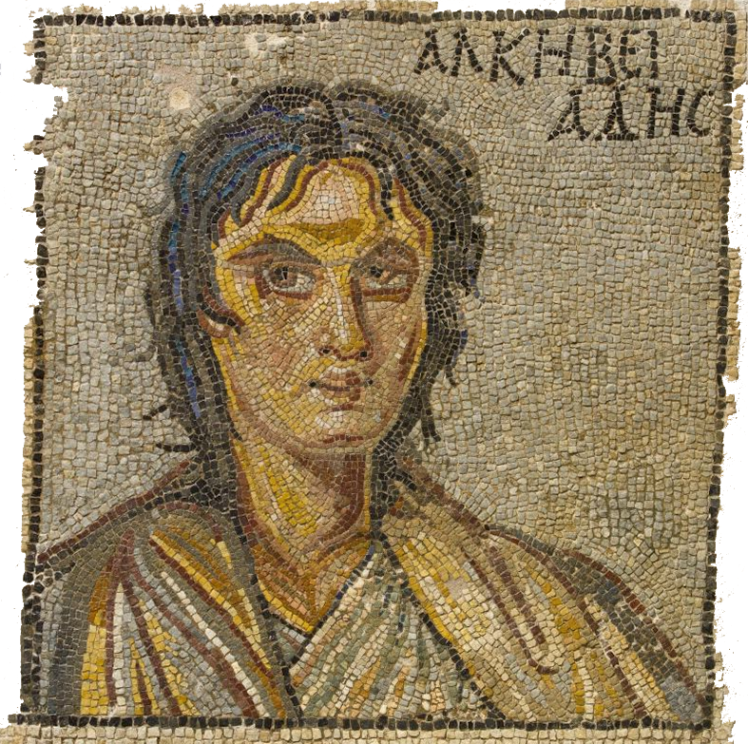
Kharis
“As for Alcibiades’ beauty, . . . it flowered at each season of his growth in turn, and lent him and extraordinary grace and charm (erasmion kai hēdun). . . . Even his lisp is said to have suited his voice well and to have made his talk persuasive and full of charm (kharis)” (Plut. Alc. 245-246)
Alcibiades, 3rd/4th-cent CE Mosaic, Sparta
Notes:
kharis literally conferred upon al’s speech (1.6, 245).

Slide 15
Savvy Orator?
General assessment:
“Alcibiades possessed in a higher degree than any of his contemporaries the faculty of discerning and grasping what was required of a given situation.” (Plutarch Alcibiades p. 253)
Samos, 411:
“He not only convinced the people and showed them their danger by his speeches in public, but he appealed to them as individuals, using entreaties with some and force with others.” (pp. 272–3)
Notes:
we don’t know that al ever learned a great deal from any teacher – the tradition suggests that he was a very bad student. BUT, xenophon suggests that he and his arch-frenemy, critias, attached themselves to socrates to get from the philosopher what aspiring politicians typically sought from sophists: a knowledge of rhetoric and argumentation. quotes like these, whatever their value as factual evidence may be debateable, do at least suggest an orator who had absorbed the lessons taught in a work like plato’s phaedrus: know your material, know your audience’s mind.

Slide 16
Our Alcibiades Problem 1
“The sway which he held over the humbler and poorer classes was so potent that they were filled with an extraordinary passion (an erōs thaumastos) for him to rule them as a dictator (a turannos)….” (Plutarch Alcibiades p. 280)

Slide 17
Our Alcibiades Problem 2
Dionysus
The city’s in travail about him.
Aeschylus
And what does the city think of him?
Dionysus
I’d say, it yearns for him (pothei), detests him, and wants to have him. (Aristophanes Frogs loc. 1902)

Slide 18
Lenses 1
Michels p. 349, Political Parties 1911, 1962
Theophrastus noted long ago that the strongest desire of men who have attained to leadership in a popularly governed state is not so much the acquirement of personal wealth as the gradual establishment of their own sovereignty at the expense of popular sovereignty.

Slide 19
Lenses 2
Weber p. 268, Economy and Society 1921, 1978
The leader (demagogue) rules by virtue of the devotion and trust which his political followers have in him personally.
Notes:
charisma. allegiance to inspiring individual, cult of personality. (none of that really applies to athenian demagogues. charismatic domination is “extraordinary,” “revolutionary.”
“Plebiscitary democracy”: the dēmos recognizes, and thus legitimizes, charismatic authority, thereby concealing its authoritarian character. we learn from finley that, for weber, pericles and cleon were charismatocrats.
pure charismatic authority is unstable. the challenge is to maintain it beyond the leadership of any one individual – who’s going to be the next castro, the next hugo chavez?
1114: the leader gains authority “solely by proving his powers in practice.” the perfect charismatic leader = the thief-king.” – maybe a roman caesar, but not an athenian pericles.

Slide 20
Lenses 3
Finley p. 98, Ancient History: Evidence and Models, 1986
Greek writers about politics all thought that the ‘demagogues’ gained and maintained their authority through substantive promises [i.e., rather than through emotional appeals]…. The evidence, as I read it, fully supports that view.

