Slide 1
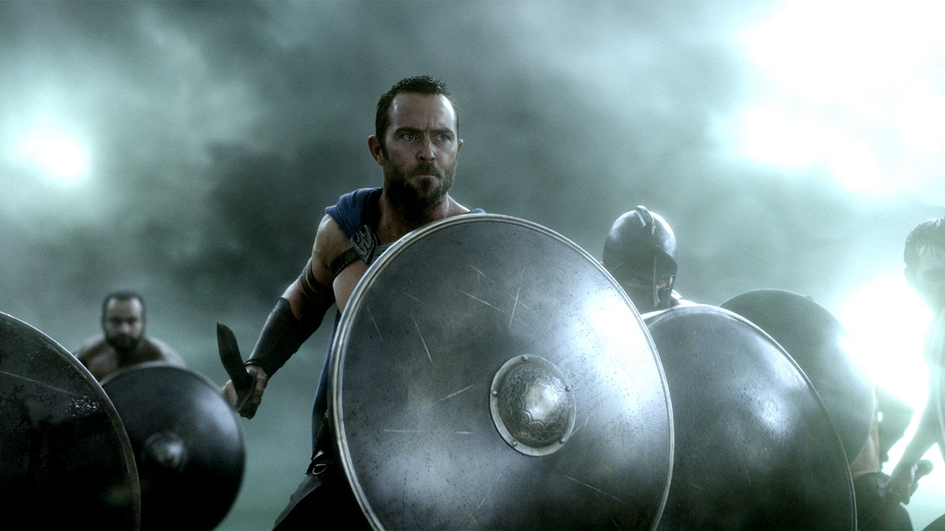
Plutarch’s Life of Themistocles
Peitho in the Service of City and Self
Sullivan Stapleton as Themistocles in 300: Birth of an Empire

Slide 2
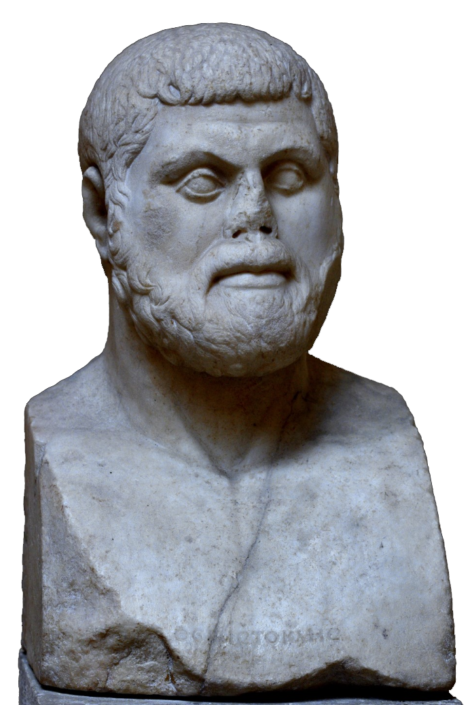
Agenda
Discussion
Themistoclean leadership — thoughts?
Recap and Update
The Road to Democracy, continued…
Themistocles Son of Neocles
Biographical Overview
Theory to the Rescue!
How to Parse Plutarch’s Themistocles?
Bust of Themistocles, Ostia Archaeological Museum

Slide 3
Discussion
Themistoclean leadership — thoughts?
Notes:
QUOTATIONS:
“… his master [teacher] remarked to him more than once: ‘At least there will be nothing petty about you, my boy. You are going to be a great man one way or the other, either for good or evil’ ” (Plutarch The Rise and Fall of Athens p. 78).
“It is said, in fact, that Themistocles was quite carried away by his yearning for fame and that his ambition to play a part in great events had become a passion with him” (praxeōn megalōn hupo philotimias erastēs, “driven by ambition to lust for great deeds,” p. 80).
“… he was the only man who had the courage to come before the people and propose that the revenue from the silver mines at Laurium, which the Athenians had been in the habit of dividing among themselves, should be set aside and the money used to build triremes for the war against Aegina” (p. 80).
More on that issue: “… he had only to play upon the enmity and the jealousy the people felt towards the Aeginetans to make them agree to the outlay” (p. 80).
Seeking to persuade Athenians to evacuate Athens rather than defend it from the Persian army, “Themistocles, seeing no hope of winning over the people to his plans by any power of human reasoning, set to work to influence them with oracles and signs from heaven” (86).
goes on: “He seized upon the episode of the snake, which is believed to have disappeared at this time from its sacred enclosure on the Acropolis, and treated it as a divine portent. When the priests discovered that the first-fruits of sacrifice which were offered to it every day had been left untouched, they gave out to the people on Themistocles’ instructions that the goddess Athena had abandoned her city and was showing them their way to the sea. In his efforts to sway the people he again invoked the famous oracle from Delphi, 1 and insisted that the ‘wooden wall’ could only refer to their ships and that Apollo had spoken of Salamis in his verses as divine, not as terrible or cruel, for the very reason that its name would one day be associated with a great blessing for the Greeks.
On Themistocles fortification of Athens’ port town (the Piraeus) and expansion of Athens’ navy: “The effect of this was to increase the influence of the people at the expense of the nobility and to fill them with confidence, since the control of policy now passed into the hands of sailors and boatswains and pilots” (i.e., the common folk, previously marginalized politically because too poor to pay for infantry weapons, as paid sailors felt central to Athens’ military might, p. 96).
OTHER GOOD QUOTATIONS?

Slide 4
David Brooks on Themistocles (25-Mar 2008)
“… it's worth pointing out that Leonidas didn’t win the Persian Wars. Themistocles did, and Themistocles had an altogether different set of qualities. He was not straightforward; in fact, he could be deceptive and manipulative. He was not self-sacrificing; there was an air of corruption and fierce ambition about him. He was not charming or cultured; historians from Herodotus on down have had trouble warming to him.”

Slide 5
SWA Prompt
Is there a place for a leader like Themistocles in today's USA? Would you welcome such a leader? Why? Why not?

Slide 6
Recap and Update
The Road to Democracy, continued…

Slide 7
Athenian Timeline
ca. 620 Draco’s law code
thesmoi
594/3 Solon’s reforms
nomoi
560-510 Peisistratean tyranny
507 Cleisthenic reforms
Notes:
draco: perhaps thesmothete authorized to draw up a law code that was then written down. thus becomes a brake on more arbitrary justice processes. homicide laws to limit blood feuds. motive and extenuating circumstances established as pertinent. other crimes seem punsihed harshly – “draconian” punishments. all but homicide law set aside by solon. “… it cannot be denied that the few soundly attested laws represent an important stage in the process of institutional consolidation in the polis Athens” (Brill’s New Pauly online)

Slide 8
Cleisthenic Reforms (507 BCE)
from oligarchy
to proto-democracy
clan/village constituencies
4 tribes
archons
Council of 400
deme-trittys organization
10 tribes
archons + stratēgoi
Council of 500
isonomia

Slide 9
Trittys System
dēmos
“city”
“shore”
“inland”
ten trittyes
ten trittyes
ten trittyes
Notes:
divides attica into 3 regions: “city,” “shore,” “inland,” and 139 demes, which are political constituencies. every citizen enrolled in a deme, stays in that deme even if relocates. sons will be members of that deme.
each region into 10 trittyes, with a varying number of demes in each trtttys.
formed 1 tribe from 3 trittyes, 1 trittys from each region = 10 tribes spread out geographically.
by forming a an agenda-preparing council of 500 (50 chosen annually by lot from each tribe), in effect halts aristocratic control over legislative initiatives, and works toward (not quite reaching) a fully sovereign assembly. (boule also oversees finances, foreign policy)
further weakening of old aristocratic identifications in introducing practice of identifying self from one’s deme, evidently with aim of setting aside practice of patronymic, though intermittently practiced.
participation at level of deme crucial: deme exam age 18 = citizenship exam. deme assembly. selection of pool for offices like councilman.
and tribal elections of generals = extension of this new identification, organization. tribal affiliation basis of required citizen military service.

Slide 10
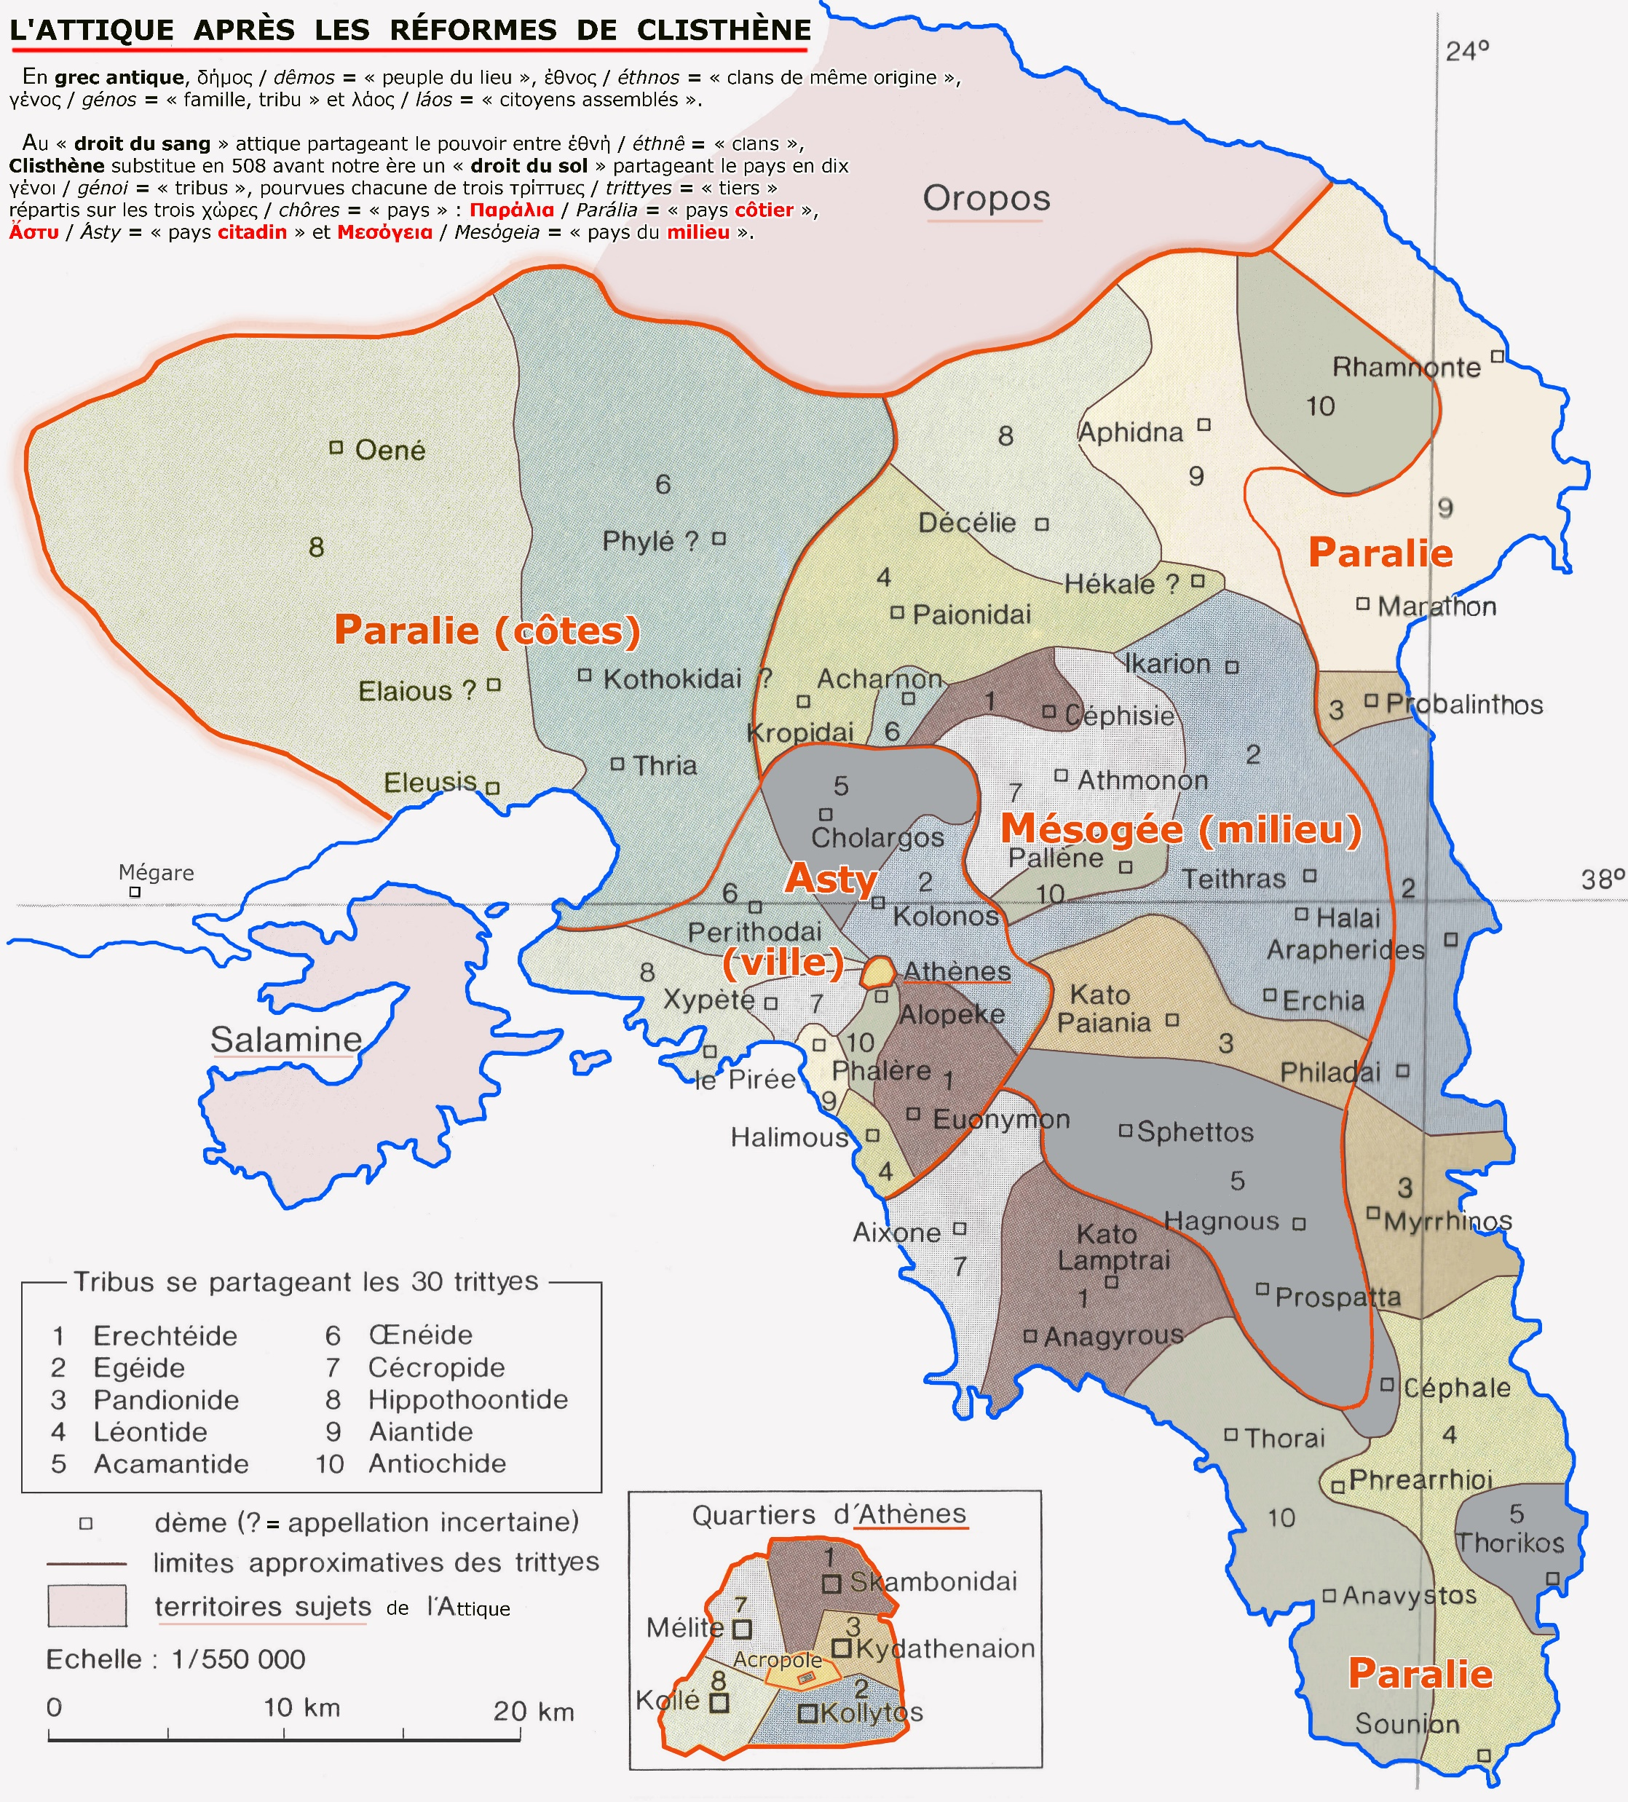
Map of Cleithenic Reorganization of Attica
Notes:
Map of Cleisthenic reorganization of tribal-political redistricting in Attica. Tribal affiliations distributed across separate geographical divisions

Slide 11
Athenian Democracy ca. 485
dēmos
9 archons
boulē 500
diskas-tēria
10 stratēgoi
“The polis . . .
Areopagus…
. . . of the Athenians”
Notes:
[brief comment on chart]
THEMISTOCLEAN DEVELOPMENTS
487/6 BCE. The nine archons (chief officials of state) henceforth elected from “pre-elected” pool, 100-500 (??) by either tribes or demes. Promotes honesty in office but not ability.
Chief archon (ARCHON EPONYMOUS) still from the wealthy, but this makes it more difficult for a wealthy elite to control officials beholden to them etc. wider distribution of offices leading to weakening of offices.
strategoi (“generals”) promoted
nothing to connect th’s name to this development but important. archonships opened to knights (hippeis), by lottery.
487/6 BCE. Because the polemarch archon ("commander in chief") now chosen by lottery, the 10 generals (strategeoi) elected by the tribes now the de facto chief military and civil officials.
in consequence, the stratēgia, an elective office, promoted in functional importance.
stratēgoi could be re-elected.
likely to reduce prestige of Areopagus, filled exclusively by ex-archons.

Slide 12
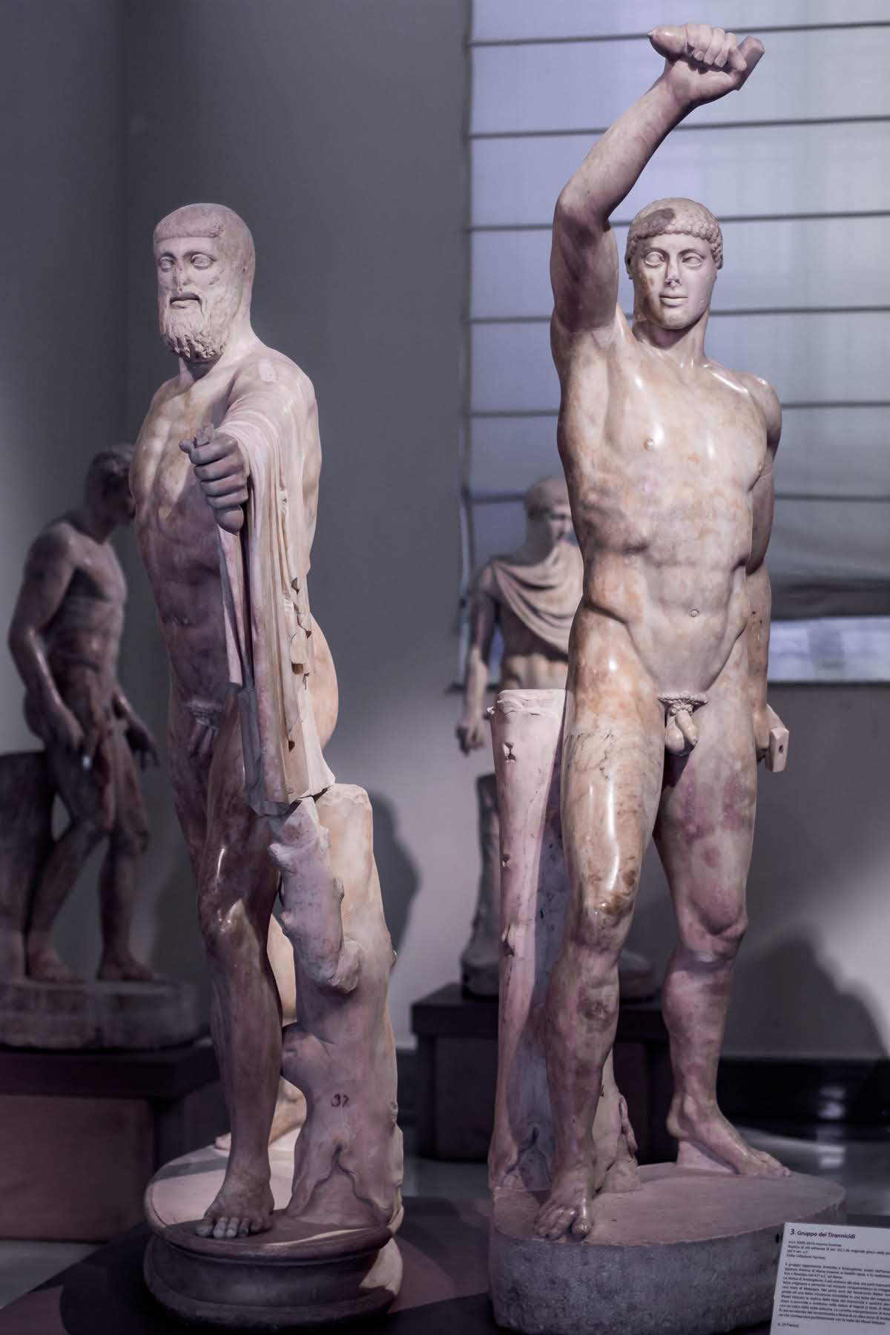
Founding Myth
Tyrannicides at Athens (514 BCE)
Patriotism as erōs
Tyrannicides, Museo Archeologico Nazionale di Napoli
Notes:
Tyrannicides at Athens (Panathenaea of 514 BCE)
Cleisthenes elevated them as heroes. that put a democratic stamp on them. it is argued that their love figured symbolically as a kind of erotically charged patriotism. that idea comes back again and again, notably, in periclean fo.
Tyrannicides ("tyrant slayers"), Roman copies of 5th-cent BCE Greek originals

Slide 13
Persian Debate (Herodotus book 3)
Otanes: pro democracy
Megabyzus: pro oligarchy
Darius: pro monarchy
Notes:
Persian debate (Herodotus book 3, sections 80-82, ca. 522 BCE).
otanes democrat on monarchial hubris and phthonos. vulnerable to flattery, but sensitive as well to being seen to be flattered. but the hubris (lawlessness) main thing. rule of many promotes isonomia. note brief description of democratic state.
megabyzus on oligarchy. ignorance and hubris of "crowd" exceeds that of tyrant. rule by "best" is best.
darius agrees with mega on democracy but not on oligarchy. rule of a single good man best. plurality of rulers conduces to strife (stasis). plus dēmos is corrupt. our liberty (persian liberty from medes) came from a king. all constitutions eventually morph into monarchies.

Slide 14
Themistocles Son of Neocles
Biographical Overview

Slide 15
Biographical, Historical Info
ca. 528. Birth-social class
493/2. Archon
490-479. Persian Wars
483/2 expansion of fleet
482–1. Aristides
Ostracized
Recalled
490-479. Persian Wars (cont’d)
480. Themistocles strategos
Unifier of Greeks
Battle of Salamis
ca. 471–470. Themistocles
Ostracized
Condemned
462. Death in exile
Notes:
ca. 528, born
father Eupatrid (Lycomids), mother foreign
493/2 archon
begins to develop Piraeus as port
487/6 archon lottery
from 70 to 200 triremes
in response to news of Persian fleet build-up
490 Battle of Marathon
Miltiades victorious
Themistocles envious
483 Fleet commissioned
mining surplus
482 Aristides ostracized
480 Themistocles strategos
Battles of …
Artemisium
Salamis
Plataea
early 470s fortification
Athens, Piraeus
on Themistocles’ and Aristides’ urging.
471 Themistocles ostracized
ca. 471/0 condemned traitor
exile
confiscation
disfranchisement
462 death in exile

Slide 16
Quotation: Plutarch Themistocles pp. 7
“… his family was too obscure to have lent him any distinction at the beginning of his career. … On his mother’s side he was an alien…. Themistocles persuaded a number of young men of good family to go out to Cynosarges and take their exercise there with him, and by this ingenious social manoeuvre he is believed to have done away with the discrimination between pure Athenians and those of mixed descent. In spite of his own alien origins, it is clear that he was also connected with the family of the Lycomidae….” (Plut. Them. pp. 7)
Notes:
then again:
Again, when he went to Olympia, he annoyed the Greeks by trying to rival Cimon in the dinners he gave and in the magnificence of his furniture and the tents in which he entertained his visitors. People were prepared to excuse this kind of extravagance in Cimon because he was young and belonged to a great family. But coming from a man who had neither made himself a reputation nor possessed the means to support these expenses, such an attempt to raise himself above his station was regarded as sheer imposture.
Plutarch. The Rise and Fall of Athens: Nine Greek Lives (Classics) (p. 82). Penguin Books Ltd. Kindle Edition.

Slide 17
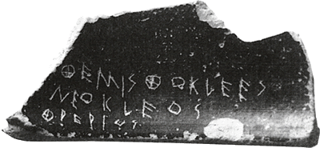
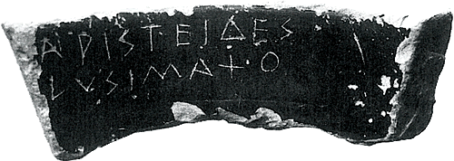
Ostracism
Themistocles son of Neocles, of the deme Phrearrus
Aristides son of Lysimachus
Notes:
10-year banishment
without loss of
citizenship
property
dignity
invented?
every year, once a year, assembly votes: should we hold an ostracism?
if yes, then an ostracism held shortly afterwards. in agora. you could vote for anyone you wished. the winner (with a minimum of 6000 votes total - possibly a minimum of 6000 for one individual [philochorus]) sent away for 10 years.
comes into own 487
last ostracism: hyperbolus in 417.
used by themistocles against his rival aristides, among others (484).
found was a hoard of pottery sherds - 190 - all inscribed with the name themistocles, written by only a few individual inscribers: clearly a campaign against them.
them finally ostracized in ca. 470.
ober p. 74: “Ostracism was a way to expel from the community any individual who threatened the national consensus, especially by advocating ideas or acting in ways that threatened the values of political society. Ostracism also served as a public demonstration of the binding nature of democratic decisions on an individual.” seemingly, a kind of social control sending the message that “Active dissent is unacceptable.”
anti-stasis, anti-tyranny?
elite “time out”?
political weapon

Slide 18
Quotation: Plutarch Themistocles p. 83
“But the greatest of all his achievements was to put an end to the fighting within Greece, to reconcile the various cities with one another and persuade them to lay aside their differences because of the war with Persia. In this task he is said to have been greatly helped by Chileos, the Arcadian.” (Plut. Them. p. 83)

Slide 19
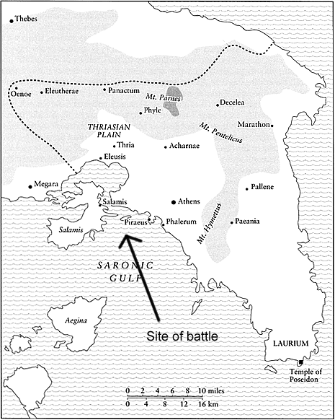
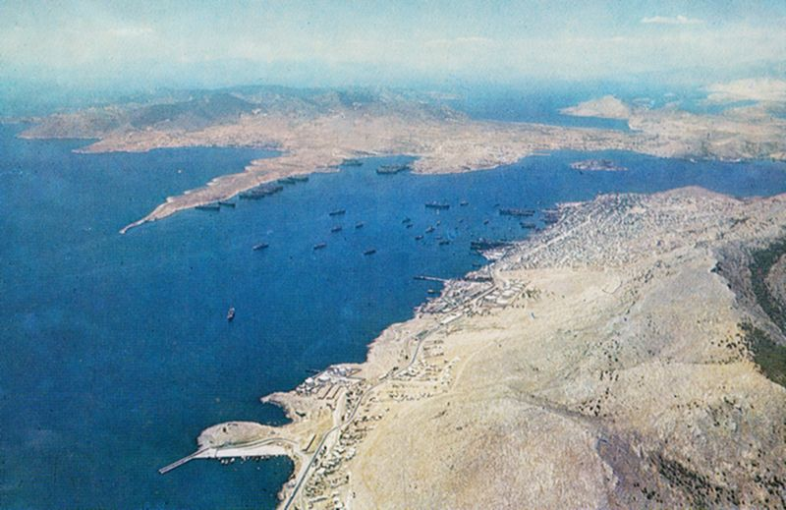
Maps: Battle of Salamis
Battle of Salamis

Slide 20
Theory to the Rescue!
How to Parse Plutarch’s Themistocles?
Notes:
discussion

Slide 21
Our Theorists
Dahl
Ober
“Strong equality”
Four criteria
Ideological contradictions
Ideological negotiations
Notes:
Dahl’s
“Strong equality”
The belief that “all members of [an] association are adequately qualified to participate on an equal footing with others in the process of governing the association” (Dahl 31)
Four criteria
1. Effective participation by citizens.
2. Voting equality at the decisive stage.
3. Citizens’ enlightened understanding of issues.
4. Popular control of agenda.
Ober’s
Ideological contradictions
Mass/elite
Equality/inequality
Freedom/consensus
Popular sovereignty/rule of law
Ideological negotiations
Rhetorical mediation
Topoi
Elitism
Popular hegemony

