Slide 1
Theoretical Readings 1
Dahl and Ober as Lenses
Notes:
talk briefly about paper pitch oral prez

Slide 2
March on Washington Anniversary
28-Aug 1963
“Tell ’em about the dream, Martin!”
  https://shorturl.at/kbPTN
  https://shorturl.at/W14oW

Slide 3
Agenda
Lenses and Their Use
  Theory 1 Readings
Discussion
  And Plato’s Gorgias?
Background
  Athenian Democracy, 461–404 BCE
Dahl and Ober
  As Lenses

Slide 4
Lenses and Their Use
Theory 1 Readings

Slide 5


What are “Lenses”?
Modern theoretical texts
Tools of analysis for…
  Perspective
  Classification
  Focus
  Insight
Ideally!
Notes:
for our course, they are….
theoretical texts intended to supply perspective (an angle of view), a way to look at things with a view to focus, clarity, insight

Slide 6
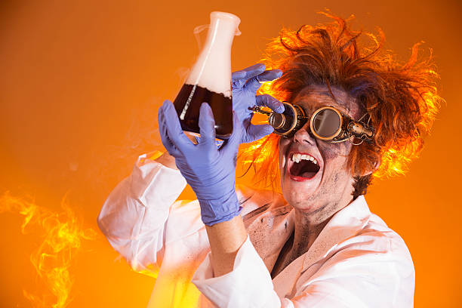
What are “Lenses”? (cont’d)
Experimental subjects for…
Critical-Thinking

Slide 7
What is critical thinking?
Knowing who, what, where, when
Identifying, evaluating arguments
  Sniffing out bias
Formulating arguments
  Avoiding bias
See Syllabus

Slide 8
Why Dahl and Ober?
To understand
  Persuasive speech
  Athenian democracy
  Their connection
To prepare
  For paper 2
To practice
  Critical thinking

Slide 9
Discussion
And Plato’s Gorgias?

Slide 10
Study Guide:
“Pick a passage from Plato’s Gorgias. Do either of the readings assigned for today relate to that passage? How?”
– Form groups –
– Share-discuss findings –
– Write on wall –

Slide 11
Background
Athenian Democracy, 461–404 BCE

Slide 12
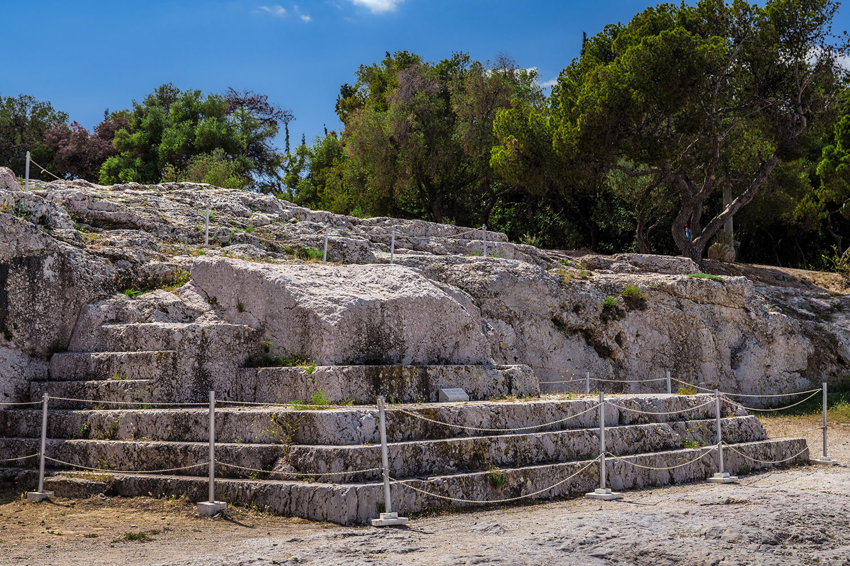
Athenian Democracy: Definitions
Democracy
  dēmos “people” (or “mob”)
  kratos “power”
Aristotle’s definition
  Ruling / being ruled in turn (Politics)
Bema = speaker’s platform,
Athenian assembly

Slide 13
Athenian Democracy: Offices
Paid officials (archons)
  Lottery-selected
  E.g., eponymous archon
    after whom the year was named
Unpaid officials
    Vote-selected
    E.g., generals

Slide 14
Athenian Democracy: Councils
Council (boulē) of 500
  Lottery-selected
  Agenda setting
  Paid
Areopagus council
  Ex-archons
  Homicide trials
  Unpaid

Slide 15
Athenian Democracy: People’s Role
Popular assembly
Popular courts
ekklēsia, dēmos
  Adult citizen males
  Equal speech (isēgoria)
  Legislation
  Paid
ēliaia, dikastēria
  Adult citizen males
  Randomized jury selection
  Paid

Slide 16
Dahl and Ober
As Lenses

Slide 17
Dahl’s Strong Principle of Equality
The belief that “all members of [an] association are adequately qualified to participate on an equal footing with others in the process of governing the association”
(Dahl 31)
Notes:
i.e., no one is more qualified, “more equal than others,” a primus inter pares
contradicts oligarchy, “guardianship,” noblesse oblige etc.
dahl sees this, or something like this, not just in greek democracy, but in many different kinds of societies (non-western) worldwide.
under strong principle, a democracy is “democratic” with respect to self but not necessarily to others
seeming paradox: democracy can be imperialistic!!
can we affirm/deny the strong principal of equality at athens, whether as ideological “reality,” or as socio-politcal actuality?

Slide 18
Dahl’s “Assumptions”
… for a political order
… for a democratic order
Purposeful association
Decision making
  Agenda setting
  Outcome-deciding
Equality before the law
Equality of interests
Notes:
106-7. ASSUMPTIONS OF A POLITICAL ORDER
106. starts with idea of a purposeful association, one with aims and binding rules designed with a view to those aims. the decision making process = governmental or collective decision making process.
deals with issue of social control: binding does not = coercive. but something induces obedience. democratic order can thus describe non-state (non-coercive) situations.
107. decision-making involves 2 elements: setting the agenda and deciding the outcome (decisive stage), this last the "moment of sovereignty." "Until the decisive stage is completed, the process of decision making is tentative. ... Decisions become binding only at the conclusion of the decisive stage. ... In principle, a stage is decisive if all prior decisions can still be recalled or reversed. Thus, prior to the decisive stage decisions may be thought of as having been delegated but not alienated by those who participate in the decisive stage, a distinction we return to below."
107 ff. ASSUMPTIONS JUSTIFYING A DEMOCRATIC POLITICAL ORDER
no lawmaker may be above the law.
the interests of all members equally deserving of consideration.
No adult member of the association should ever be required to demonstrate adequate competence for protecting that member's own interests, except where compelling justification could be shown. that "presupposes that each member of the association is, taken all around, a better judge of his or her interests than others would be. ... let us call the adult members who satisfy this presumption citizens; collectively the citizens constitute the demos, populus, or citizen body."
In the decision-making process, each citizen's claim as to what is desirable is as valid as the next, none more or less valid - hence, what Dahl calls "strong equality" will obtain within the citizen body under democracy.
"... scarce and valued things should be fairly allocated." (fairness, not equality - deserts may justify larger allocation.) but at times equal chance to gain scarce item must not be denied.

Slide 19
“Criteria for a democratic process”
Effective participation by citizens.
Voting equality at the decisive stage.
Citizens’ enlightened understanding of issues.
Popular control of agenda.
Problems?
Notes:
108 ff. CRITERIA FOR A DEMOCRATIC PROCESS
the above understood as requiring a certain set of preconditions, hence what can be understood as “benchmarks” of democracy.
109. EFFECTIVE PARTICIPATION. citizens must be able to have a voice, be allowed to participate. (ISEGORIA) related to princ of equal consideration of interests.) equality and freedom as essential to democracy, a principal that goes back to aristotle.
those who make the decisions must be the same as those who are subject to the decisions if it is to be thought of as a democratic order. (cf. ari's rule and be ruled in turn.)
111. ENLIGHTENED UNDERSTANDING.
citizens ought to have the opportunity somehow to make informed choices.
these three criteria allow us to judge whether a system more or less democratic, and therefore, more or less good - if we presume "good" to equate with "democratic." but "agenda" and even "demos" can imply limiting elements: agendas necessarily restrict the discussion, a demos might itself be constituted restrictively [which leaves us not with democracy but with oligarchy].
111 f. CONTROL OF THE AGENDA.
hence the need for a fourth criterion: control of the agenda in the hands of the people. Even if demos decides that some matters to be up to other sorts of process (e.g., justice), still, "As long as the demos could effectively retrieve any matter for decision by itself, the cdriterion would be met.“
116. PROBLEMS
there is the problem of what should the demos be constituted out of. is a limited franchise democratic?? early in book (as already noticed) considers conflicting visions of what democracy should be about. p. 5: “Critics, not only the adversaries but those who are sympathetic to 'rule by the people,' contend that a process of collective decision-making, no matter how 'democratic,' cannot be justified unless it produces-or at least tends to produce-desirable results.”

Slide 20
Ober’s Challenge
Responding to Michels’ “Iron Law of Oligarchy”
Proving elitist democracy (Athens) = democracy for real

Slide 21
Ober’s Dialectical Model. . .
Operative antitheses
Ideological negotiations
Mass/elite
Equality/inequality
Freedom/consensus
Popular sovereignty/rule of law
Rhetorical mediation
  Topoi
Ideological...
  Elitism
  Popular hegemony
Notes:
Mass v. elite
elites: social power
masses: political power
Political equality
material inequality
Freedom (isēgoria)
consensus (homonoia)
Popular sovereignty
rule of law
Ideological negotiations
312. "... public speech was a natural medium of social mediation." feedback, basically dialogical process leading to a dicourse evolving, ultimately, in dialectical ways.
compromise, smoothing out of differences, stress on community of interests, diffusion of tensions. “Public rhetoric not only revealed public tension, it was a primary vehicle for resolving tensions” (308 – same page, “symbols of social mediation”)
since contradiction could not be balanced constitutionally, it had to be balanced "on the ideological plane." the "trick" was to balance somehow power of masses and that of elite: not too much power to latter, but former had to surrender something to them - community over individual interests ultimately. here courtroom oratory - where ideological compromises - played a role. courts where elite litigants often explained themselves to the masses, the mainstay of the large athenian juries "well-established language," i.e., topoi, through which elites reconciled their elite status to the many.
“The importance of being elitist”
the need for some sort of better equipped advisory class.
political rhetoric could involve more incentive to a speaker to demonstrate elite status, a value insofar as wishes to present self as deserving to lead. birth and wealth could suggest patriotism, integrity, generosity.
“Ideological hegemony of the masses”
“The ideological hegemony of the masses effectively chanelled the fierce competitiveness of elites, a legacy of the aristocratic code, into patterns of behavior that were in the public interest” (333).
Ober Mass and Elite p. 294:
“On the other hand, the existence of the democratic political order posed a quandary for the elite Athenian. As Aristotle noted (Rhet. 1378b26-1379a9; cf. Pol. 1283b34-1284b34), an individual who is superior to his fellows in any one way tends to believe he is entitled to a generally privileged position in society. He who considers himself worthy of privilege because of his social superiority may regard it as an injustice to be placed on equal political footing with average citizens.”

