Slide 1
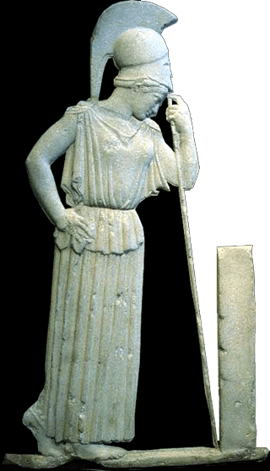
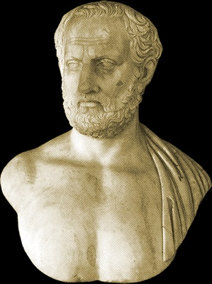
Thucydides
Adventures in Spin
“Mourning Athena”
Thucydides

Slide 2
What is “spin”?
Oxford English Dictionary:
“fig. A bias or slant on information, intended to create a favourable impression when it is presented to the public; an interpretation or viewpoint. Freq. in phr. to put a positive (negative, etc.) spin on. colloq. (chiefly U.S. Polit.).”

Slide 3

Questions
How is this spin?
Why spin?
Is spin lying?
http://wapo.st/2kTFfZp

Slide 4
Agenda
Discussion
  “Spin” in Thucydides
Background
  Thucydides’ History of the Pelopon­nesian War
Thucydides’ Preoccupations
  Illustrative Quotations

Slide 5
Discussion
“Spin” in Thucydides

Slide 6
SWA Prompt
Do we find spin in speeches in Thucydides? If so, where? How does it work? Does Thucydides comment on spin? How would you comment on spin? Is it a valid means of persuading?

Slide 7
From the Periclean Funeral Oration
“… in name our constitution is called ‘democracy’ (dēmokratia) because of majoritarian administration in preference to that oriented to the few. … Yet a man here receives preferment on the basis of merit…. For us, it is excellence mostly, not portion, that qualifies one for service to his city.” (Thuc. 2.37, in Scholtz 2007)

Slide 8
Spin, Step by Step
Start with a raw
  Fact
  Statement
Apply an
  Interpretation
  Perspective
Altering / affecting
  Emotions
  Impressions
To suit
  Needs
  Circumstances

Slide 9
More on Spin
Khrōma (Greek), color (Latin)
  Rhetorical “coloring”
Spin “spun”
  “Spin can itself be spun in order to connote the artful dissemination of untruths and evasions of the truth” (Hesk Deception and Democracy in Classical Athens 205)
Notes:
Khrōma (Greek), color (Latin)
“rhetorical coloring”
Spin “spun”
“spin can itself be spun in order to connote the artful dissemination of untruths and evasions of the truth” (Hesk Deception and Democracy in Classical Athens 205)

Slide 10
Background
Thucydides’ History of the Pelopon­nesian War

Slide 11
Thucydides Son of Oloros (not Melesias)
ca. 460–ca. 395 BCE
Athenian
  Aristocrat
  General
    Fall of amphipolis, 423 BCE
    Exile
  Historian
Notes:
thucydides son of oloros. ca. 460-ca. 400 BCE. Athenian aristocrat, general, historian.
his history of the peloponnesian war.
victim of plague, 430
Brill’s: “T. fell ill with plague in 430, but survived. Although his perceptive, seemingly medically competent description of the disease (2,48-53), whose impact on morality and religion he recounts, is less technical in its medical vocabulary than the Hippocratic treatises, it surpasses the medical writings in terms of close inspection: T. recognizes the phenomena of infectious transmission and of immunity acquired through the disease (cf. Epidemic diseases).”
POLITICAL FOCUS
Realpolitik: “
PSYCHOLOGICAL FOCUS
p. 48 (1.22) “It will be enough for me, however, if these words of mine are judged useful by those who want to understand clearly the events which happened in the past and which (human nature being what it is) will, at some time or other and in much the same ways, be repeated in the future.”
GROUP PSYCHOLOGY
RHETORICAL FOCUS
p. 47 (1.22) “… my method has been, while keeping as closely as possible to the to the general sense of the words that were actually used, to make the speakers say what, in my opinion, was called for by each situation.”
AN ESSAY IN PEITHO
what works / what does not work
under which circumstances
with which kind of audience

Slide 12
Timeline 1
Date | Event
431 | War begins.
430-429, 427/6 | Plague.
428-427 | Revolt of Mytilene, stasis at Corcyra.
421 | Peace of Nicias.
416 | Melian debate, conquest of Melos.
Notes:
431 war begins
430-426 plague (on and off) decimates the population of Attica
429 Pericles dies of plague
420s Cleon prostates tou demou (leader of the democracy)
428-427 revolt of Mytilene. Mytilenian debates (over whether to impose extreme punishment on Mytilene)
427-425 stasis at Corcyra
425 Cleon captures Spartans at Pylos (Cleon's "mission accomplished" moment)
424 Aristophanes' Knights
422 death of Cleon and Spartan Brasidas at Amphipolis
421 peace of Nicias (with Cleon and Brasidas gone, truce between Sparta and Athens possible)
418 Battle of Mantinea, War between Sparta and Athens renewed; Peace of Nicias is dead-letter
416 conquest of Melos (Melian debate). Sicilian debate at Athens (over Sicilian expedition). Debate at Syracuse (how to meet the Athenian threat)
415-413 Sicilian expedition
the speeches in our book take place after the first assembly meeting, at which it had already been decided to send a force to sicily officially to help the egesteans and also the leontinians if possible, but really reduce the island to athenian control as a source of grain and timber, and possibly as a steppping stone to the western mediterranean. the second round of debate officially concerned preparations, but nicias attempted to use the occasion to dissuade athenians from the project.415 mutilation of herms, profanation of the mysteries. Indictment and recall of Alcibiades. Alcibiades defects to Sparta; Alcibiades' speech to the Spartans
413 Defeat of Athenians at Syracuse

Slide 13
Timeline 2
Date | Event
415 | Sicilian Debate, Expedition.
412 | Board of probouloi (10).
411-410 | Oligarchic coup, politeia, democratic restoration.
404 | Athens’ defeat, 2nd oligarchic coup
Notes:
431 war begins
430-426 plague (on and off) decimates the population of Attica
429 Pericles dies of plague
420s Cleon prostates tou demou (leader of the democracy)
428-427 revolt of Mytilene. Mytilenian debates (over whether to impose extreme punishment on Mytilene)
427-425 stasis at Corcyra
425 Cleon captures Spartans at Pylos (Cleon's "mission accomplished" moment)
424 Aristophanes' Knights
422 death of Cleon and Spartan Brasidas at Amphipolis
421 peace of Nicias (with Cleon and Brasidas gone, truce between Sparta and Athens possible)
418 Battle of Mantinea, War between Sparta and Athens renewed; Peace of Nicias is dead-letter
416 conquest of Melos (Melian debate). Sicilian debate at Athens (over Sicilian expedition). Debate at Syracuse (how to meet the Athenian threat)
415-413 Sicilian expedition
the speeches in our book take place after the first assembly meeting, at which it had already been decided to send a force to sicily officially to help the egesteans and also the leontinians if possible, but really reduce the island to athenian control as a source of grain and timber, and possibly as a steppping stone to the western mediterranean. the second round of debate officially concerned preparations, but nicias attempted to use the occasion to dissuade athenians from the project.415 mutilation of herms, profanation of the mysteries. Indictment and recall of Alcibiades. Alcibiades defects to Sparta; Alcibiades' speech to the Spartans
413 Defeat of Athenians at Syracuse

Slide 14
Thucydides: Some Highlights
Pericles' First Speech
Periclean Funeral Oration
Pericles’ Last Speech
  Thucydides Assessment
Mytilenean Debate
Stasis at Corcyra
Melian Dialogue
Sicilian Debate

Slide 15
Thucydides’ Preoccupations
Illustrative Quotations

Slide 16
Thucydides’ Aims (1.22, speeches)
Therefore the speeches are given in the language in which, as it seemed to me, the several speakers would express, on the subjects under consideration, the sentiments most befitting the occasion, though at the same time I have adhered as closely as possible to the general sense of what was actually said.

Slide 17
Thucydides Aims (1.22, achievement)
And it may well be that the absence of the fabulous from my narrative will seem less pleasing to the ear…. And, indeed, it has been composed, not as a prize-essay (agōnisma) to be heard for the moment, but as a possession for all time.

Slide 18
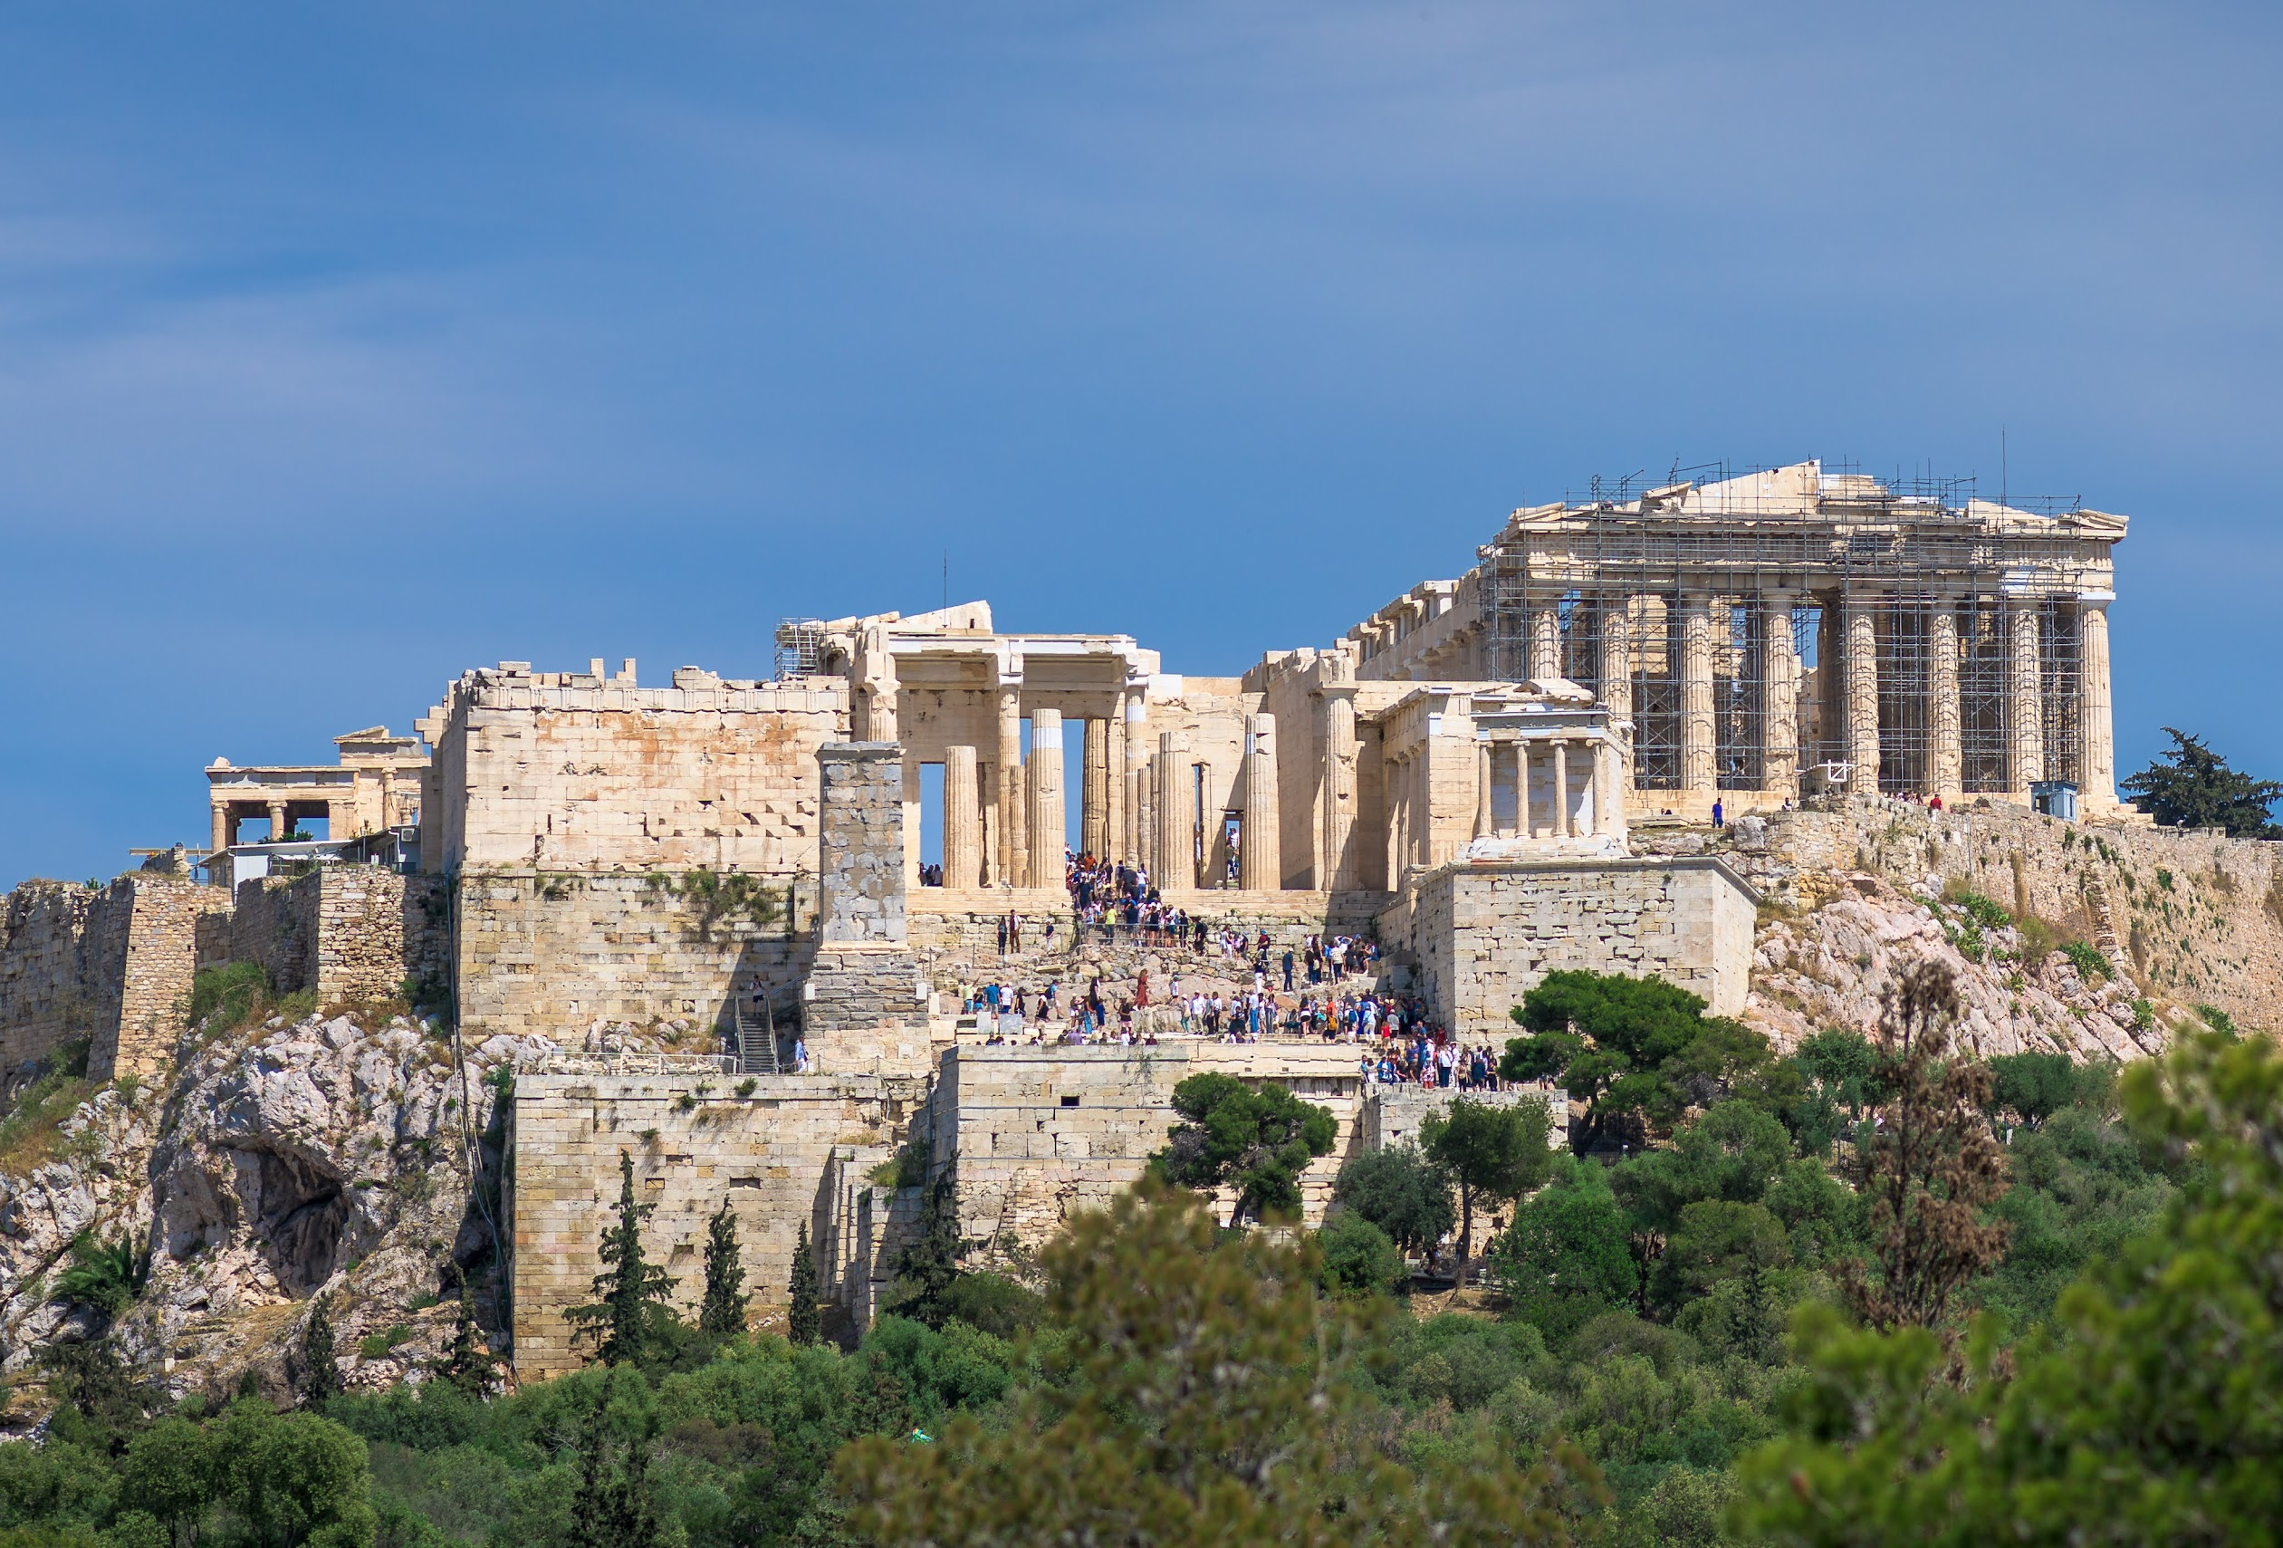
Thucydides’ on erōs (2.43, Pericles)
“… you who survive … must daily fix your gaze upon the power of Athens and become lovers of her….” (erastas gignomenous autēs, “becoming lovers of it”)
Athenian Acropolis

Slide 19
Thucydides’ on erōs (6.13, Nicias)
“I make a counter-appeal not … to have a morbid craving (duserōtas) for what is out of reach, knowing that few successes are won by greed, but very many by foresight.”
Eros
Notes:
Eros, red-figure vase painting, ca. 490 BCE

Slide 20
Thucydides’ on erōs (6.24)
And upon all alike there fell an eager desire (erōs) to sail — upon the elders, from a belief that they would either subdue the places they were sailing against…; upon those in the flower of their age, through a longing for far-off sights and scenes …; and upon the great multitude … who hoped … to acquire additional dominion which would always be an inexhaustible source of pay.
Notes:
And upon all alike there fell an eager desire to sail—upon the elders, from a belief that they would either subdue the places they were sailing against, or that at any rate a great force could suffer no disaster; upon those in the flower of their age, through a longing for far-off sights and scenes, in good hopes as they were of a safe return; and upon the great multitude — that is, the soldiers — who hoped not only to get money for the present, but also to acquire additional dominion which would always be an inexhaustible source of pay

