Slide 1
Race for Glory: Greek Civilization Under Rome. Andrew Scholtz, Instructor
Race for Glory: Greek Civilization Under Rome
Randy Scholtz, Instructor

Slide 2

Agenda
Rapid-fire Q&A
Course Focus
Time, Place, Themes
Course Procedures
Websites, Assignments
Monday’s Assignment
Plus academic honesty...

Slide 3

Rapid-Fire Q&A
Notes:
we’re going to start with rapid-fire question-and-answer. this is a critical-thinking exercise (this is a critical-thinking class), but only insofar as we’re practicing brainstorming, and a particularly free-form version of it. so, when asked something, let’s raise our hands but not feel afraid to blurt out the first thing that comes to mind!

Slide 4

Envy Wins!
Let’s learn about it…

Slide 5
What, though, does the name mean?
Notes:
No, no – I mean, is the team saying that they are this emotion, and as such, they win? What does the name mean?

Slide 6
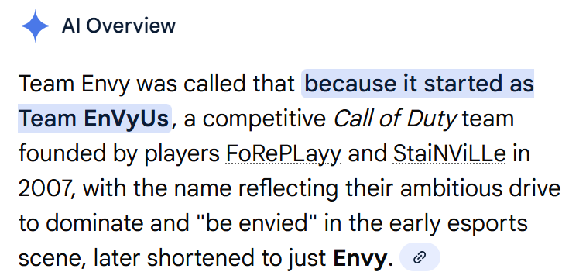
Let’s ask AI!

Slide 7
So, Envy wins, but does envy win?

Slide 8
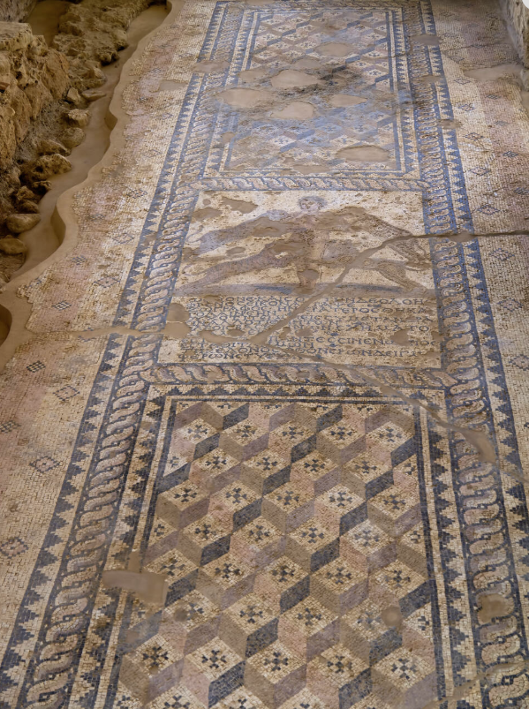
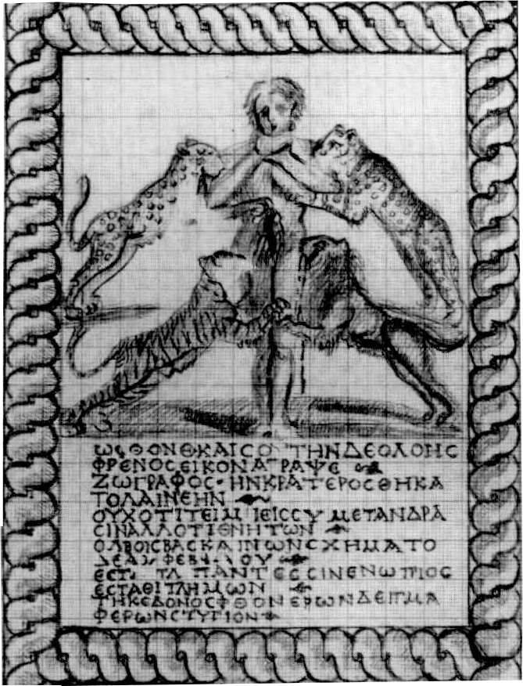
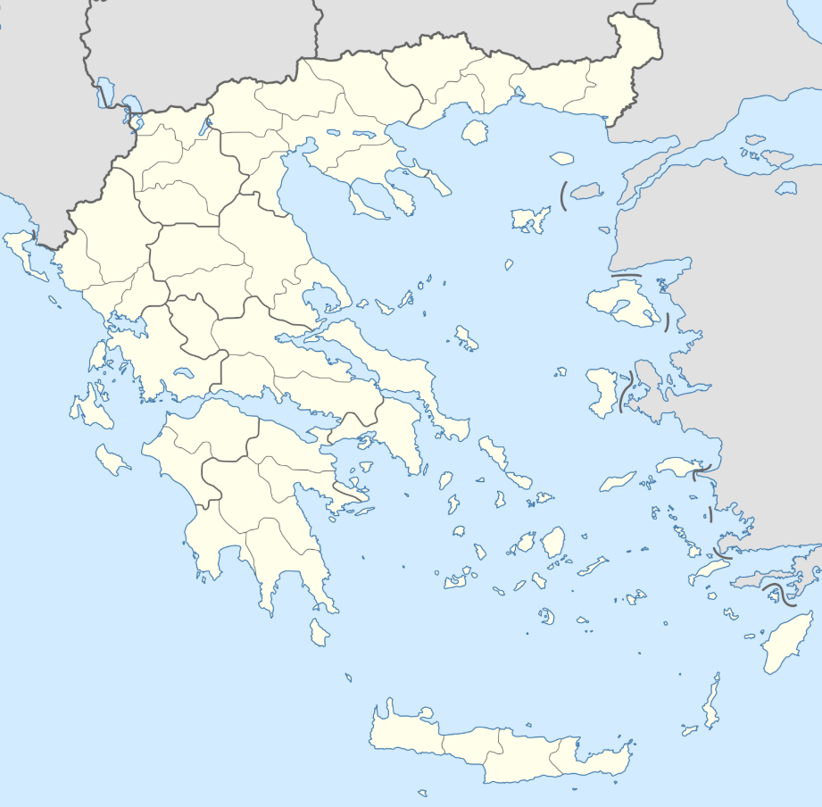
Skala Envy mosaic
Skala Envy Mosaic, ca. 200 CE
Kefalonia, Greece
Notes:
What do you see here? If Envy doesn’t win, can’t win somehow, why are those big cats attacking him?
What does this association of emotion and, in particular, negative emotion with rivalry, contest, and so on? One thing it says is that contest mattered, that people really cared, that it was no joke — that the stakes were high!

Slide 9
Skala Envy Mosaic: Inscription
“O Envy, even yours, this image of baneful passion that a draftsman has sketched, and Krateros has set in stone, not because men honor you, but because you, who cast your evil eye on mortal bliss, have taken this form on yourself. Come stand before the gaze of all, stand, you wretch, bearing the vile mark of wasting that the envious bear!” (https://shorturl.at/uPpUj)

Slide 10
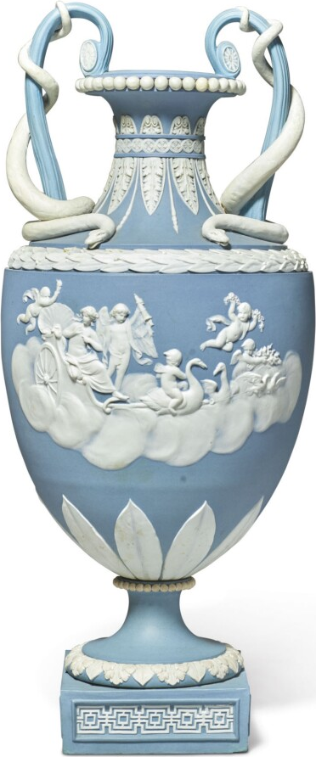
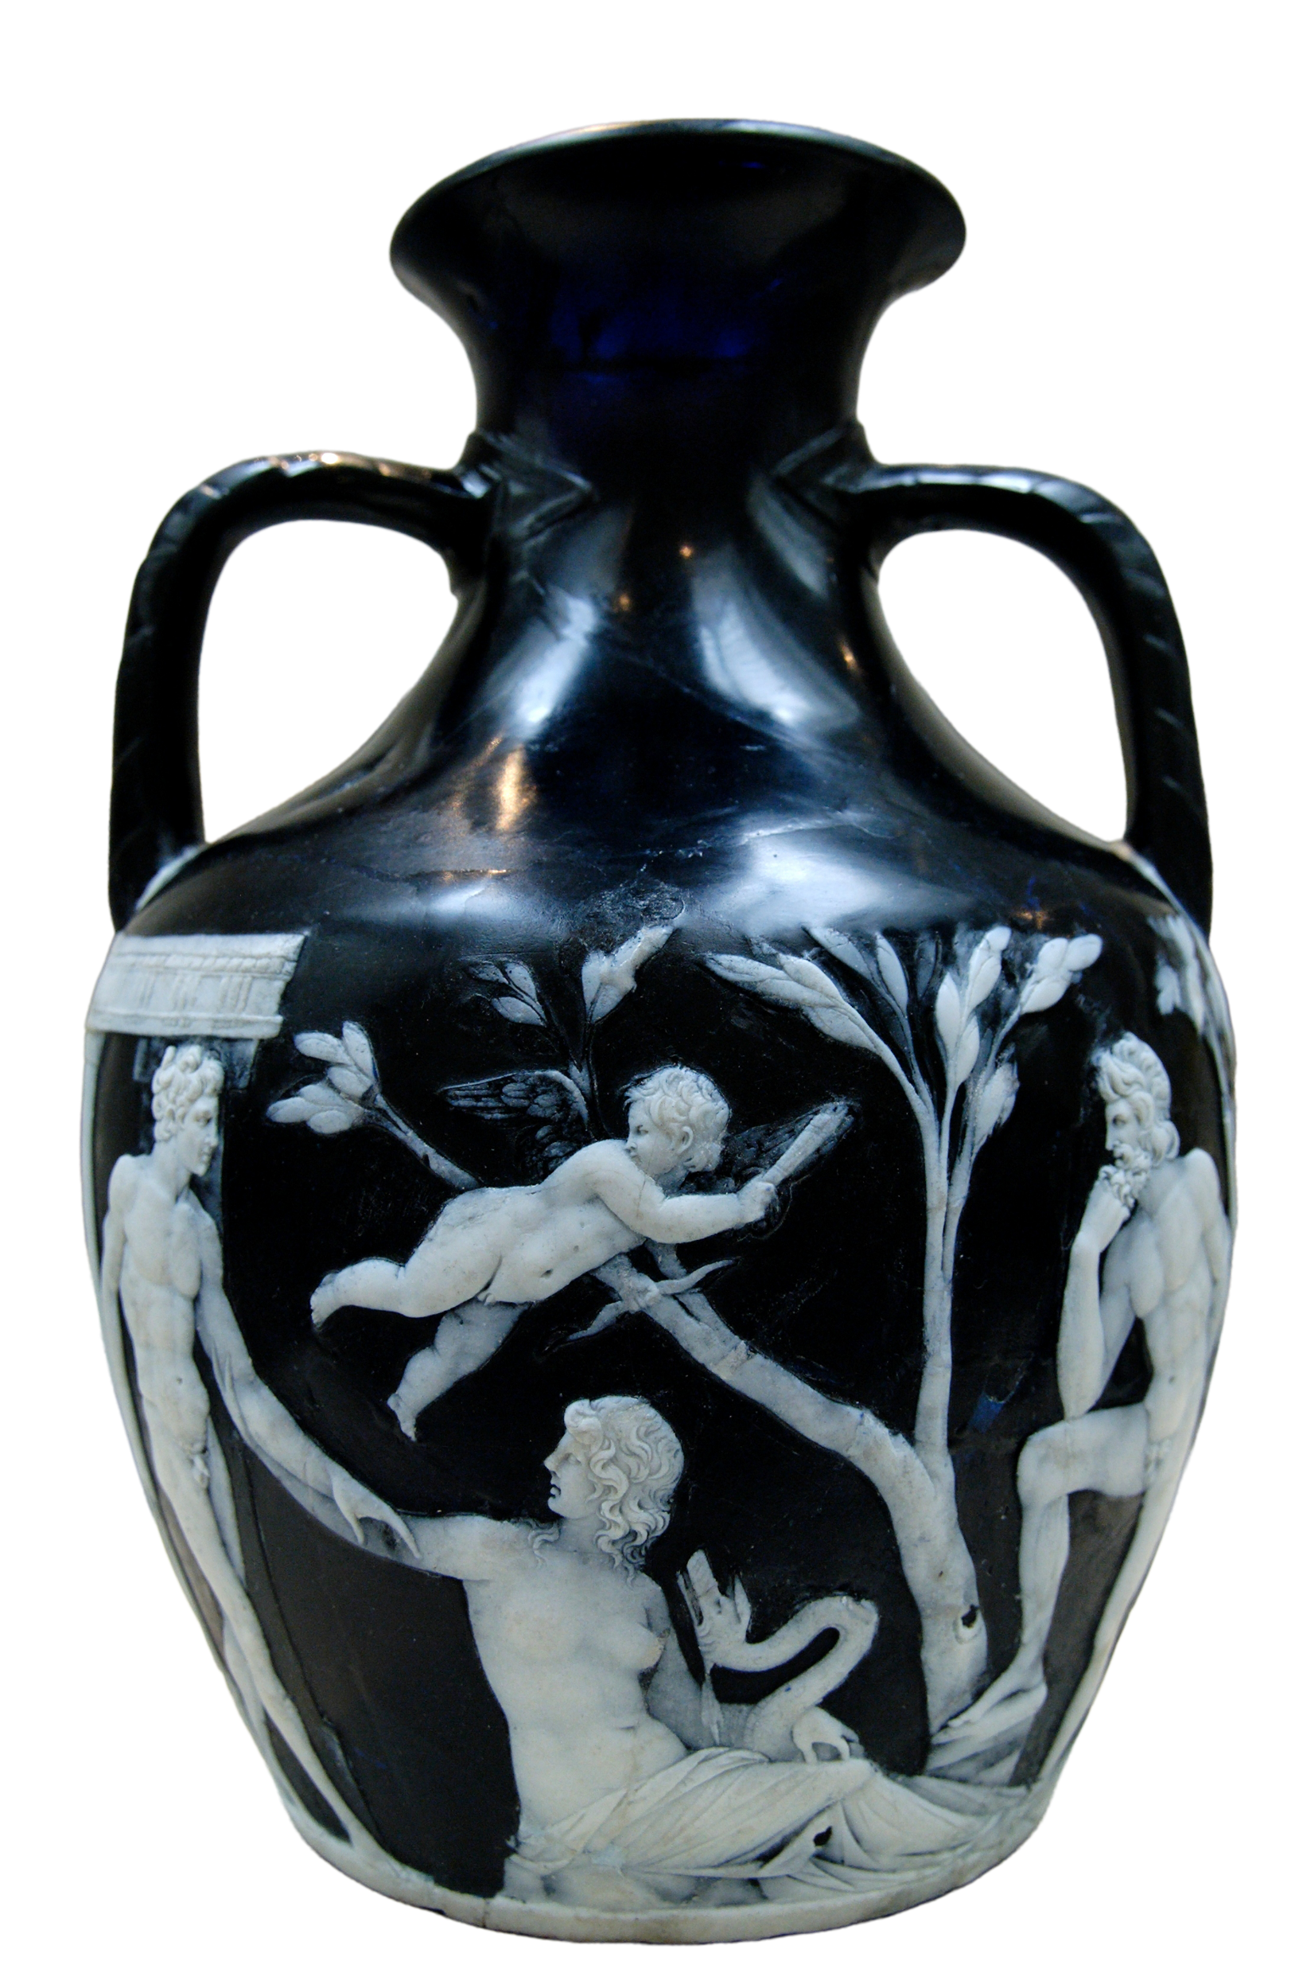
What do you see?
Wedgwood two-handled vase, ca. 1785
Portland Vase, early 1st cent CE
Notes:
How can we broaden the picture? So, again, what do you see?

Slide 11
Let’s take stock…
Notes:
Are there connections? The scenes on the Portland vase remain something of a mystery. Some claim they somehow refer to the Roman emperor Augustus, but even if they do (and that’s debatable ), they do so in ways meant to evoke Greek myth and bucolic poetry — a never-never land of shepherds, nymphs, and so on, a sort of eternal past captured in Keats’ Ode on a Grecian Urn (“What leaf-fring'd legend haunts about thy shape / Of deities or mortals, or of both”). The English ceramicist Wedgwood, inspired by the Portland vase, produced a whole line of products meant to appeal to a clientele keen on demonstrating their taste and refinement, their appreciation of the classical past, but much the same can be said of the appeal exerted during the Roman Imperial period by earlier Greek works of art and literature. Now the villa with the envy mosaic that we just looked at contains a mosaic depicting a sylvan scene not unlike the one on the Portland vase, while the Envy mosaic itself, which would have greeted visitors to the villa is saying, aggressively, this is what happens to you if you resent my success. Put differently, all three of these objects speak to the taste and refinement of the owner and to a kind of race for glory: wealth, prestige, and so on, such as ancients and, as the esports team Envy demonstrates, moderns, too, as their success is meant to pain the rest of us losers.
these are themes that we’re going to examine in this course, those of competition, prestige, and identity in the Greek-speaking eastern Mediterranean during the period of the Roman empire, first through third centuries CE.

Slide 12
Course Focus
Time, Place, Themes

Slide 13
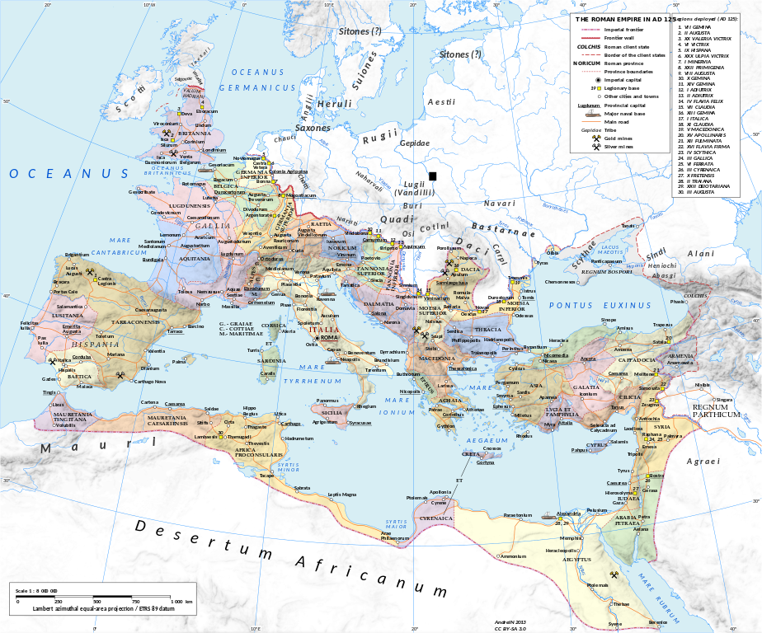
Roman Empire in 125 CE.
Andrei N. Creative Commons Attribution-Share Alike 3.0 Unported license
Notes:
The Roman Empire? But this is a course about ancient Greece, right?? It’s about Greece under Rome, the revival that came to the eastern Mediterranean after a century and half of conquest, the challenge of being a cultural superpower subject to a military superpower.

Slide 14
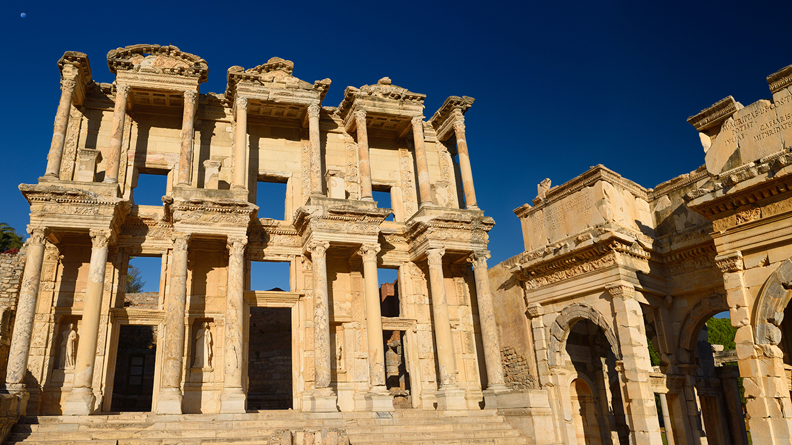
Library of Celsus, Ephesus, Turkey. Completed 1st half 2nd cent. CE
Notes:
In some ways, the Library of Celsus is emblematic of our project.
seeks to commemorate honors won in service to the Roman military and political spheres
but it also highlights the honoree’s dedication to Greek civilization
it testifies to the family’s commitment to serving the city of Ephesus, whose importance and prominence testify to Anatolia —modern Turkey — as having displaced old Greece and Athens as the center of gravity of the Greek-speaking world

Slide 15
Agonism (agōn, “contest”)
Athletics
Politics
Philanthropy
Rhetoric
Social life
Business
Alexander and Helix, champion pancratiasts. Ostia Antica, Italy. 210 ~ 235 CE
Notes:
Gaius Perelius Aurelius Alexander. of Thyatira, Lydia. Pankratiast, ca. 200 CE. High priest of the association of Athletes, Rome.
Aurelius Helix, Phoenicia. ca. 200 CE. pancratiast and wrestler. Victor at the Olympics, Capitolia.
another focus of our attention will be agonism, the culture of competition that seems to have reached most every corner of life in the Roman east. take, for example, athletics. Olympic competitive sport — running, wrestling, and so on — retained its Greek character even when practiced in Rome itself. but interest in Greek sport exploded during the first three centuries after Christ and shaped the way people thought, spoke, and wrote about other fields, notably, rhetoric, which, during our period, became a highly competitive performance art.

Slide 16
Emotion
Envy-phthonos
Emulation-zēlos
Ambition-philotimia
Desire-erōs
Skala Envy mosaic, Kephalonia, ca. 200 CE
Notes:
and we’ll be looking at emotion, with a special focus less on subjective feelings than on emotion as a factor in inter-personal dealings and, not least, in the race for glory itself

Slide 17
Course Procedures
Websites, Assignments

Slide 18
Dual Websites
Brightspace
Bingdev
https://shorturl.at/FcA8k
Announcements
PDF readings
Writing upload
Grades
https://tinyurl.com/56dwz2as
Syllabus
Assignments
Other informational pages
PPT lectures

Slide 19
Types of Assignments
Readings
Short Writing Assignments (SWAs)
Quizzes
Oral presentations
Papers

Slide 20
Monday’s Assignment
Plus academic honesty…
https://tinyurl.com/36k5u4tb

