Slide 1

The Past Is Ever New
Longus Daphnis & Chloe 1
Background: Chagall, Daphnis and Chloe

Slide 2
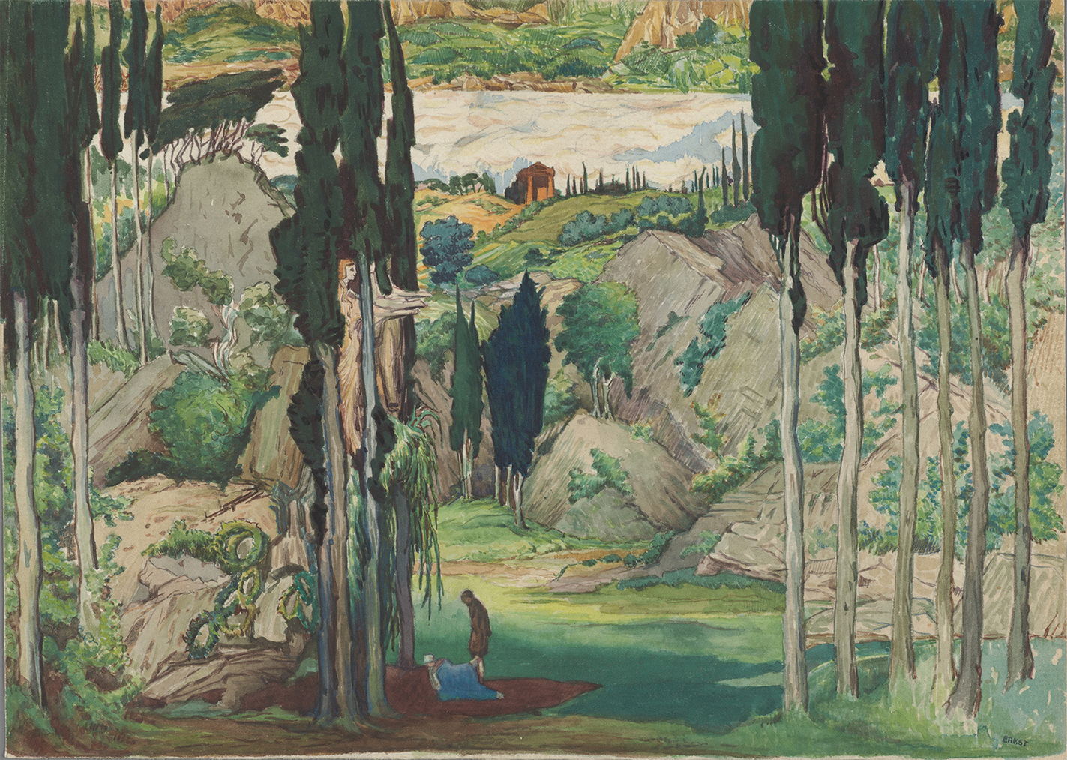
Set design by Léon Bakst for the world premiere of Daphnis et Chloé, Paris 1912.
Notes:
show them this image and ask them, with the music in mind (do they need to hear it again?), what story they “hear” and “see” to go along with the music and the image.
then explain that the music is ravel’s 1912 ballet and the image a set design for the premier performance. music and image capture the dreamy, never-never-landish atmosphere of the ancient novel of the same name. the sense of an imaginary past, sometimes with clear reference to a particular period, sometimes an eternal past purely of the imagination, will be central to a lot of what we’ll be studying. but how can something be both imaginary and real, both past-tense and present-tense (“present-tense in the sense of belonging to someoneś, not necessarily our, here and now), at the same time? shifting focus from ravel’s ballet to the text assigned for today, I’d suggest that some such question likely will guide much of our discussion today.

Slide 3
Agenda
Discussion
  Daphnis and Chloe, Your Impressions
Introduction to
  Longus Daphnis and Chloe
Issues in D&C
  Agōn, Emotion

Slide 4
Discussion
Daphnis and Chloe, Your Impressions
Notes:
I’m always interested in students’ impressions of readings from this period. Things like Homer’s Odyssey or Sophocles Oedipus Rex — they’re real grabbers, they have that air of universality almost without even trying. D&C tries pretty hard to create a certain atmosphere, but it’s not always clear that it’s one that instantly appeals to a modern readership. so, what are your thoughts?
Short Writing Assignment (SWA) prompt, very subjective this time, not particularly critical-analytical: Write 100-200 words conveying your impressions of the text. For instance, what kinds of stories/films/anything does it remind you of? What's different about it? Really, anything, provided it has to do with the reading. (Just a reminder that for these SWAs, we're working on our writing. Please don't use AI for any part of it: I want to read you, not some robot. Plus, how can I help you with your writing if there's nothing there of you for me to comment on?
my impression: the reading is full of lots of little events that kind of happen and disappear, and there’s not a lot of structure or suspense — this wouldn’t make a great movie. but it does kind of feel like how days pass when you’re maybe 12 and it’s summer and school’s out. it feels more decorative than substantial. so if any substance is there, we’re going to have to be really sensitive to it.

Slide 5
Introduction to
Longus Daphnis and Chloe

Slide 6
Daphnis & Chloe: Basics
Story
  Education in love
  Adventures, suspense
Characters include…
  Daphnis, Chloe, parents
  Dorco
  Philetas
  Pirates, enemy army, city folk, animals, etc. etc.
Composition date, author
  ca. 200 CE, “Longus” (?)
Language
  Atticizing (already old-fashioned) Greek
Setting
  “Classical” Lesbos = what?
  Country versus city
  “Then” = “Now”
Notes:
“It is especially concerned with the countryside because its heroes are exposed urban aristocrats who are brought up there as foundlings by peasant farmers.” (Swain)
the tokens are a conventional touch having to do with exposure.
what is the where and when of the story?

Slide 7
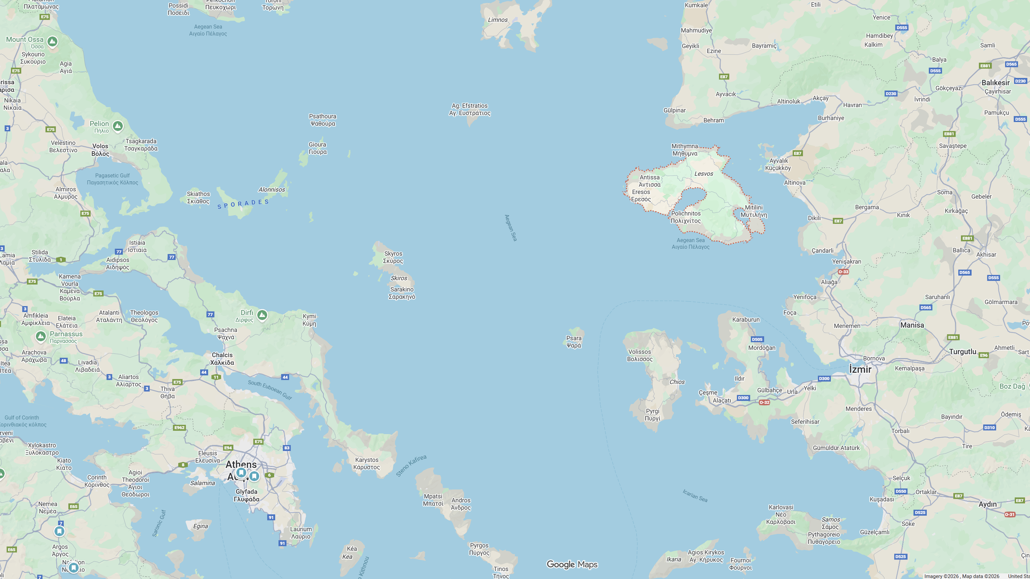
Map. Aegean, Lesbos
Methymna
Lesbos
Mytilene
Aegean Sea
Athens

Slide 8
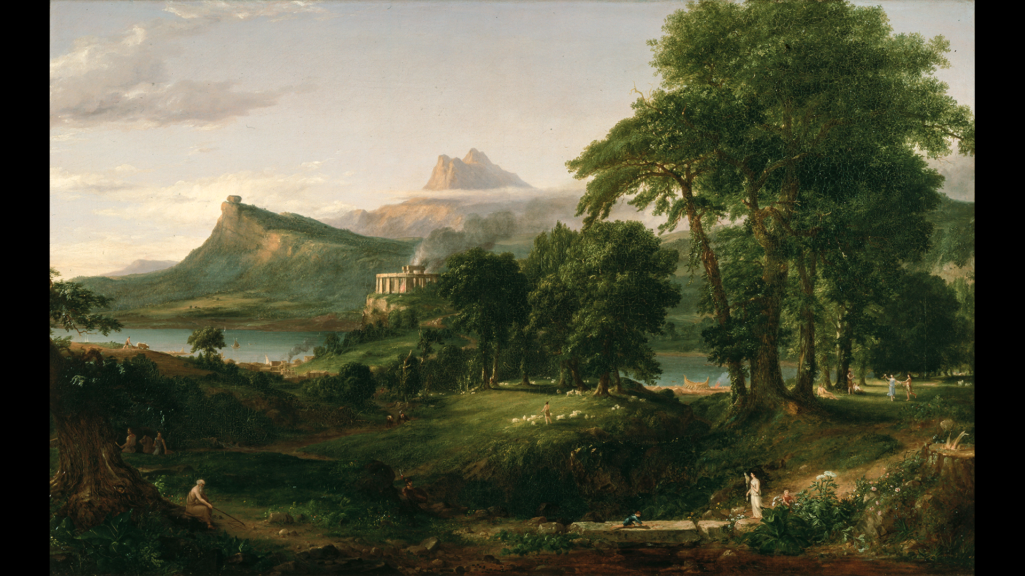
D&C: Literary Resonances
Bucolic (pastoral) poetry
  Theocritus (200s BCE)
Sappho (ca. 600 BCE) and others
Background image: Thomas Cole, Arcadia
Notes:
The novel’s focus on the loves of shepherds strongly recalls bucolic poetry and Sappho. Both have pastoral elements, both feature eros

Slide 9
Issues in D&C
Emotion, agōn, socialization

Slide 10
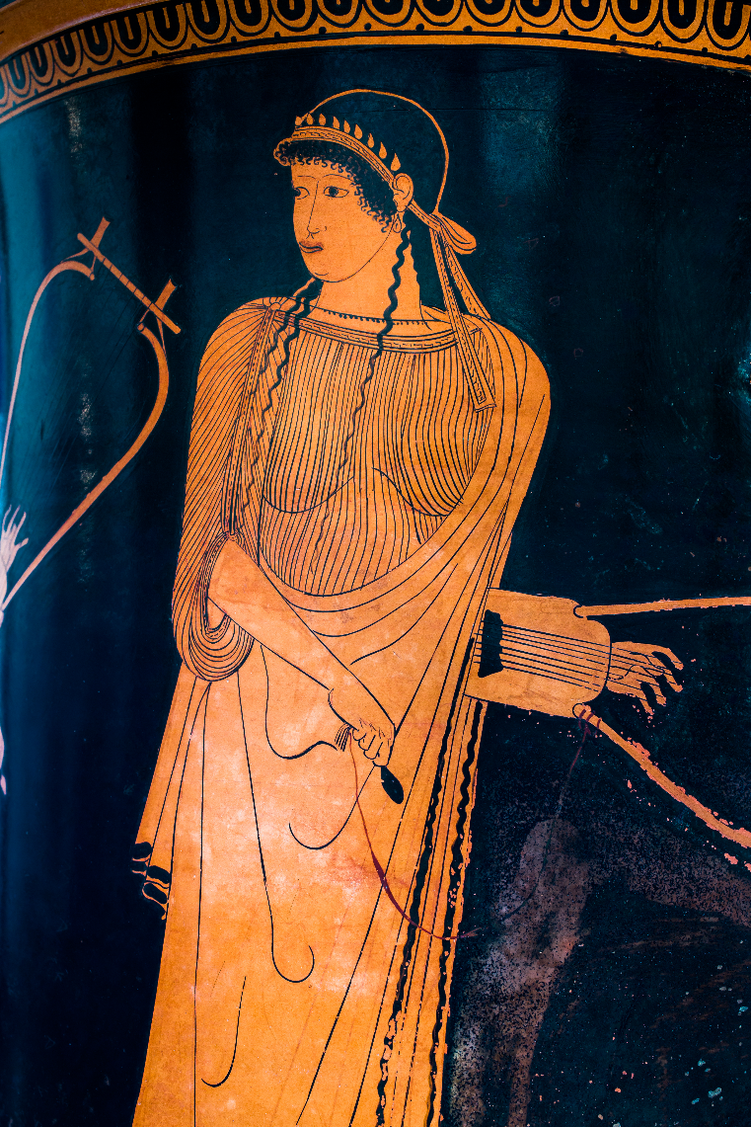
erōs: “desire,” “lust,” “love”
“… Whom should I persuade (now again)
to lead you back into her love? Who, O
Sappho, is wronging you?
“For if she flees, soon she will pursue.
If she refuses gifts, rather will she give them.
If she does not love, soon she will love
even unwilling.”
(Sappho fragment 1, trans. Carson)
Sappho, vase painting 480–470 BCE
Notes:
echoes and evocations of Sappho are especially prominent in D&C. though Sappho wrote most about her desire for women, she also wrote on marriage. for the ancient Greco-roman world, she simply was the preeminent poet of love.

Slide 11
A Love Triangle
Chloe
Daphnis
Dorco
Notes:
let’s break up into groups to put together the story of d, c, and d. how the three get to know one another, how the relationship develops, how it all ends
complex emotions
she-wolf harasses flocks
herders build a trap
wolf ignores, rival goats, daf in hot pursuit, fall for it
dorco’s aid summoned
dorco (sexually mature, experienced) conceives a passion for chloe
beauty contest
dorco loses, in pain (phthonos?)
daf also in pain, but b/c of kiss = eros
dorco proposes marriage, fails
d will abduct c. dorc will become a wolf, symbol of out-of-control desire. wolf-dorc attacked by c's dogs. evocation of actaeon. naively, d/c don't get it, think a mere game
pirate episode. daf kidnapped. chl to avenge dorc and rescue daf. with syrinx song chl rescues daf and the cattle. dorco dies

Slide 12

D v D Beauty Contest (pp. 35–37)
How conducted?
Through rhetoric and debate!
  Antithesis
  Analogy
  Spin (khrōma, “color”)
Notes:
dorco: “I, my girl, am bigger than Daphnis, and I’m a cowherd 16while he’s a goatherd, so I’m as superior to him as cows are to goats. … He tends he-goats and smells terrible himself, and he’s too poor to keep even a dog.”
daf: “… I have plenty of cheese, bread baked on a spit, and white¹⁵ wine—the sort of goods that make countrymen rich. … And if you must kiss someone, you can kiss my mouth but only the hairs on his chin. Remember, my girl, that a sheep nursed you, but you are beautiful.”

Slide 13
Arrow of Emulation (zēlos)
subject of emulation = author
emulation (zēlos)
object of emulation = painter

Slide 14
Prologue: Ambition
Viewing
  “An image …, a story of love, … lovelier [than the grove]”
Feeling
  “A longing seized me to rival the depiction in words”
Achieving
  “… an offering to Love and the Nymphs and Pan, a delightful possession for all [hu]mankind”
Notes:
underneath it all lies a sophisticated interior that belies the naïve exterior.
the author’s writing seeks to outstrip in beauty the painting and, by extension, the reality represented by both painting and writing..
the prologue is an example of ecphrasis, a description, a rhetorical genre prominent at this time. the aim was to produce a word picture at least as vivid as a visual picture. and with its numerous and learned allusions to Greek classics, its stylish language showing a command of great writers of the past (imagine if I assigned you to write an essay in the style Shakespeare or Charles Dickens), the piece fits neatly into the culture of the second sophistic.
“… a delightful possession for all mankind that will heal the sick and encourage the depressed, that will stir memories in those experienced in love and for the inexperienced will be a lesson for the future” – that is a deliberate evocation of the opening of Thucydides History of the Peloponnesian War , which thuc describes as a “possession for all time.” from some six centuries earlier (!). this book is to be to the love novel what Thucydides was to history. (keep in mind that the painting and the writing both tell a “history.”) but because the novelist, unlike the earlier historian, seeks to introduce mythological material and to entertain, this is a direct challenge to thuc, who explicitly refuses to do so.

Slide 15
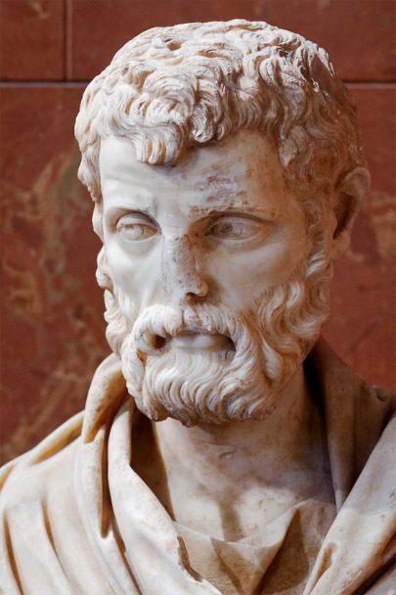
Context (Second Sophistic)
1st – 3rd century CE
Greek revival featuring (among others)
Sophists =
  Teacher-performers of rhetoric
  Wealthy philanthropists (often)
  Exemplars of paideia-“culture” (always)
Herodes Atticus (ca. 101–177 CE)
Notes:
the allusions in d&c are learned allusions; they test the reader’s knowledge of the classics.
but they’re also demonstrations of the author’s paideia, their education and refinement.
as such they signal the author’s desire to measure up to what’s expected of an educated person, in other words, the author’s literary ambition, they’re desire to excel.

Slide 16
Socialization
Nature
Equality
Country
amathia
  Ignorance
Nurture
Hierarchy
City
paideia
  Education, savoir-faire
Notes:
the novel illustrates

