Slide 1

The Past Is Ever New
Longus Daphnis & Chloe 2
Background: Chagall, Myth of Syrinx (D&C)

Slide 2
What do you hear?
https://youtu.be/jNLa4Uc2mIg?si=Jbmd2pbWGRDEcX3s

Slide 3
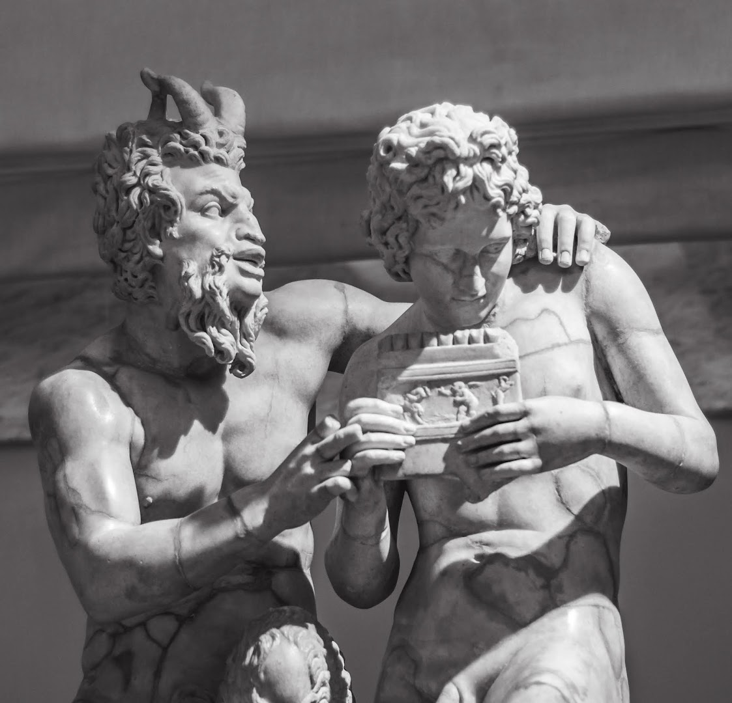
Pan, Daphnis with syrinx. National Archaeological Museum, Naples
Notes:
Il gruppo statuario in marmo (h. 1.58 m) di Pan e Dafni, facente parte della Collezione Farnese, è esposto nel Museo archeologico nazionale di Napoli (inv. 6329). Copia romana da un originale greco di Eliodoro (III-II secolo a.C.), mostra il dio-capro intento ad insegnare al giovane pastorello Dafni a suonare la siringa (flauto di Pan), ed intanto tradisce nei suoi gesti affettuosi, nello sguardo, e nel sesso eretto il suo amore e desiderio per il grazioso discepolo.

Slide 4
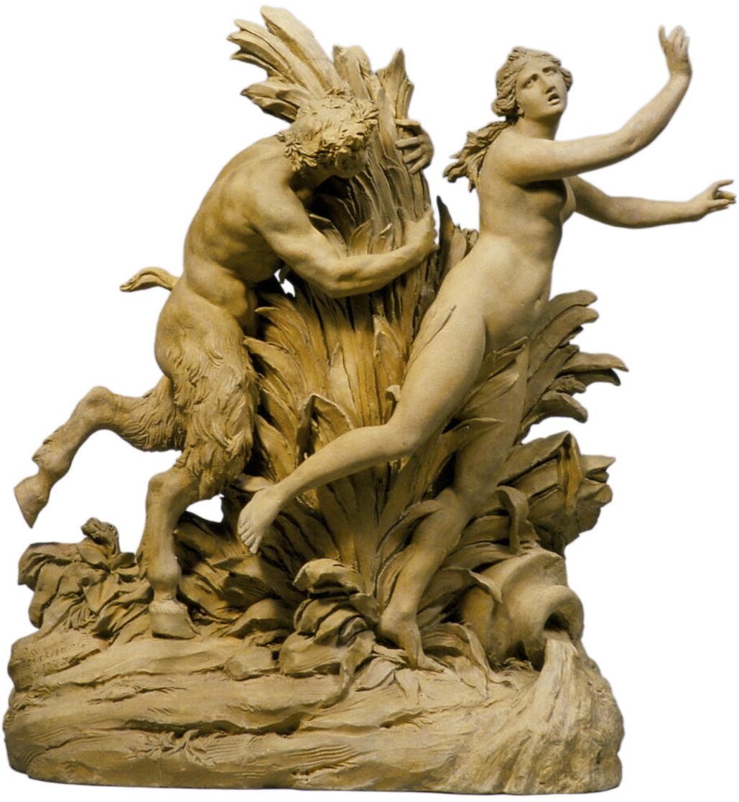
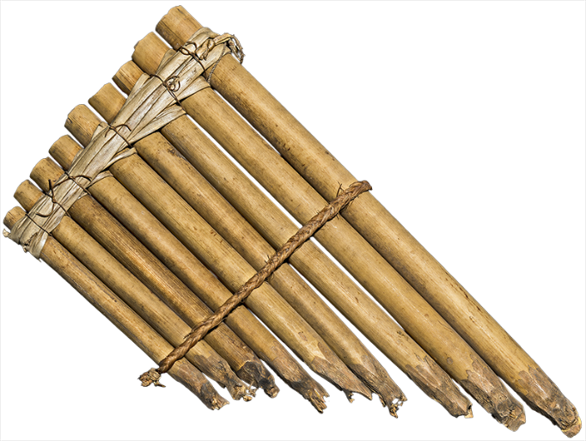
Myth of Pan and Syrinx (D&C pp. 97-99)
Godecharle. Pan, Syrinx (Louvre)
Pan flute (syrinx), Solomon Islands
Notes:
anyone want to help reconstruct the myth of pan and syrinx? (D&C pp. 97-99).how does this myth digression fit into the text? is it just a cute story?
the myth of the amorous pursuit of the nymph Syrinx by the god Pan, in which Pan falls in love with Syrinx, however, as Syrinx does not return the love to Pan, she turns herself into a water reed and hides in the marshes. Pan cuts the reeds to make his pipes, in turn killing his love. D&C pp. 97.
at the celebration party (rescue of chloe), lamo tells story of the invention of the syrinx. pan attempts rape syrinx. "When she tired from running, she hid in some reeds and vanished into a marsh." pan fashions the reeds into an instrument. violence, including, but not limited to, sexual violence, as ever present in this fantasy world. a dose of reality. what the music perhaps fails to capture.
this section of the story begins to introduce reality into the frame: maturation, the transformation of innocent symmetry into asymmetrical maturity. the violent punishment of the unwilling echo by an angry pan, the god of unrestrained
Meanwhile Lamo agreed to tell them the story of the syrinx, which a Sicilian goatherd had sung for him for the price of a goat and a syrinx.
“This syrinx was originally not an instrument but a fair maiden with a musical voice. She grazed goats, played with the Nymphs, and sang as she still does. As she was grazing, playing, and singing, Pan approached her and tried to talk her into what he wanted by promising to make all her she-goats have twins.
“But she scoffed at his love and refused to accept a lover who was not a full-fledged goat or man. Pan started to chase her with force in mind. Syrinx started running from Pan and his force. When she tired from running, she hid in some reeds and vanished into a marsh.
“Pan angrily cut away the reeds, could not find the girl, realized what had happened to her, and thought of the instrument after he had bound reeds together with wax, of unequal lengths just as their love had been unequal. And what was once a fair maiden is now a musical syrinx.”

Slide 5
Agenda
Discussion
  Competition as Lens?
Recap and Update
  Emotion, agōn, socialization

Slide 6
Discussion
Competition as Lens?

Slide 7
Competition as Lens? (CT exercise)
What does competition as lens bring into focus in Daphnis and Chloe, what does it reveal? What does it miss?
https://bingdev.binghamton.edu/ascholtz/ams365/critical_thinking.html
Notes:
I apologize for the framing of the question: I probably should have said “up to this point in the story,” as competition is, if anything, more prominent in book 1 of the novel. so, feel free to include that in your conversations….

Slide 8
Recap and Update
Emotion, agōn, socialization

Slide 9

D v D Beauty Contest (pp. 35–37)
How conducted?
Through rhetoric and debate!
  Antithesis
  Analogy
  Spin (khrōma, “color”)
Notes:
dorco: “I, my girl, am bigger than Daphnis, and I’m a cowherd 16while he’s a goatherd, so I’m as superior to him as cows are to goats. … He tends he-goats and smells terrible himself, and he’s too poor to keep even a dog.”
daf: “… I have plenty of cheese, bread baked on a spit, and white¹⁵ wine—the sort of goods that make countrymen rich. … And if you must kiss someone, you can kiss my mouth but only the hairs on his chin. Remember, my girl, that a sheep nursed you, but you are beautiful.”

Slide 10
Prologue
Viewing
  “An image …, a story of love, … lovelier [than the grove]”
Feeling
  “A longing seized me to rival the depiction in words”
Achieving
  “… an offering to Love and the Nymphs and Pan, a delightful possession for all [hu]mankind”
Notes:
underneath it all lies a sophisticated interior that belies the naïve exterior.
the author’s writing seeks to outstrip in beauty the painting and, by extension, the reality represented by both painting and writing..
the prologue is an example of ecphrasis, a description, a rhetorical genre prominent at this time. the aim was to produce a word picture at least as vivid as a visual picture. and with its numerous and learned allusions to Greek classics, its stylish language showing a command of great writers of the past (imagine if I assigned you to write an essay in the style Shakespeare or Charles Dickens), the piece fits neatly into the culture of the second sophistic.
“… a delightful possession for all mankind that will heal the sick and encourage the depressed, that will stir memories in those experienced in love and for the inexperienced will be a lesson for the future” – that is a deliberate evocation of the opening of Thucydides History of the Peloponnesian War , which thuc describes as a “possession for all time.” from some six centuries earlier (!). this book is to be to the love novel what Thucydides was to history. (keep in mind that the painting and the writing both tell a “history.”) but because the novelist, unlike the earlier historian, seeks to introduce mythological material and to entertain, this is a direct challenge to thuc, who explicitly refuses to do so.

Slide 11
Arrow of Emulation (zēlos)
subject of emulation = author
emulation (zēlos)
object of emulation = painter
Notes:
zēlos is surely the key emotion in the novel’s prologue. the whole work is dramatically framed by this implied (unstated dc never explicitly mentions zēlos, philotimia, or related )

Slide 12
More zēlos (pp. 97–99)
Philetas’ syrinx performance
Daphnis’ superior performance
Philetas’ conditional gift
Pan flute (syrinx), Solomon Islands

Slide 13
More agōn: Trial Scene (pp. 77–79)
Yacht set adrift, Daphnis blamed
War declared
Chloe abducted, case arbitrated, speeches delivered
  Methymnians’ speech (unartful )
  Daphnis’ speech (polished, detailed, emotional)
Notes:
77-79. mini meletai pro and con. this matters for our class. (quaint and cute d's speech. easily analyzable: proem, pisteis, emotional epilogue (tears); d’s rhetorical panache belies his lack of education and is a nod to his (so far) unrevealed elite status. that a naive country lad would give such a speech validates rhetoric for the novel's audience.
d’s speech clearly structured: intro summarizes case. itemized proofs. emotional finish (strategic tears)

Slide 14
Socialization (in erōs and other)
Nature
Equality
Country
amathia (ignorance)
Nurture
Hierarchy
City
paideia (education, savoir-faire)
Notes:
we see this process in the introductory lesson that Philetas provides in eros. the couple learn the god’s name and learn the preliminary steps in curing their “malaise.” but Philetas, too modest to reveal complete the picture, leaves the young people erotically hanging from the proverbial cliff. how will it end? that’s for next time. for now, I want to stress that this education in eros, the theme of the novel, cannot be considered apart from Imperial Greek conceptions of morality, or Imperial Greek conceptions of morality, from intellectual maturation. it’s all connected, as we’ll soon see.
question: is this how we see education today? as an effort to socialize young people into civil society? to tame their natural instincts for self-gratification and violence, and harness that energy for the good of the state? to confer on them the savoir-faire befitting their station in life?

