Slide 1

The Past Is Ever New
Longus Daphnis & Chloe 3
Background: Chagall, Daphnis and Chloe

Slide 2
Various
Wed 4-Feb
Swain chapter, serious critical-thinking
Mon 9-Feb
Research session LN 1305 with readings and SWA prompt
Attendance taken 9-Feb onward

Slide 3

Various (cont’d)
ID the errors:
“Longus’ description of Dionydorus’ garden was quite evocative. A prose-poem that activated feelings of longing for a lost past.”

Slide 4
Agenda
Discussion
D&C: Idyllic Fantasy? Social Reality?
Stuff Gets Real
Vignettes from Daphnis and Chloe
“Erōs Makes Great Rhetoricians”
Sophistic Evocations in D&C

Slide 5
Discussion
D&C: Idyllic Fantasy? Social Reality?

Slide 6
SWA Prompt: Daphnis and Chloe 3
Is this just a bucolic idyll?
Do social realities begin to matter?

Slide 7
Stuff Gets Real
Vignettes from Daphnis and Chloe

Slide 8
Vignettes: Group Activity
Three passages
2 groups per passage
Myth of Pan and Echo
Chloe: Why Exposed?
Daphnis: Why Exposed?
Mini summary of assigned passage
Your thoughts on assigned passage?

Slide 9
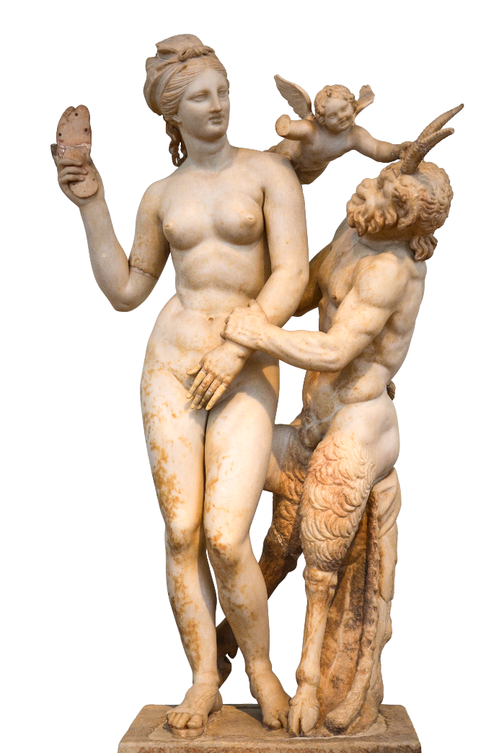
Myth of Pan and Echo (pp. 131–133)
Mini summary
Pan doesn’t get girl, has her torn up
Your thoughts?
Romance through horror
Inverse of Daph’s relationship to Pan/divinity
2nd instance of Pan’s violence
Aphrodite, Eros, Pan, ca. 100 BCE
Notes:
note the connection with the sex lesson with Lycaenion: Daphnis reluctant to inflict sexual violence on Chloe (fraw blood from her). d man-splains the myth. d will be c’s teacher in sex.
3.23.1. D&C hear the echo of sailors’ songs.
3. After they had sailed by and the glen was quiet, she asked Daphnis whether there was sea behind the cape too, with another ship sailing by and other sailors singing the same songs and all falling silent together.
4. Laughing sweetly and giving her an even sweeter kiss, Daphnis fitted the garland of violets on her and began to tell her the story of Echo, asking a fee of ten more kisses for teaching her.
“Manifold is the race of Nymphs, my girl: there are Meliae and Dryads and Heleii, all beautiful, all musical. One of them had a daughter, Echo, mortal in having a mortal father but beautiful in having a beautiful mother.
2. She was brought up by Nymphs and taught by Muses to play the syrinx and the pipes, <to sing> tunes for the lyre, tunes for the cithara, every kind of song. So when she reached the flower of maidenhood she danced with the Nymphs, she sang with the Muses. She shunned all males, humans and gods alike, liking her maidenhood.
3. Pan grew angry with the girl, being jealous of her music and unsuccessful at winning her beauty. He afflicted the shepherds and goatherds with madness, and they tore her apart like dogs or wolves and scattered her limbs, still singing, over all the earth.
4. As a favor to Nymphs, Earth hid all her limbs and preserved their music, and by will of the Muses, she has a voice and imitates everything just as that girl once did: gods, humans, instruments, animals. She even imitates Pan himself as he plays the syrinx,
5. and when he hears her he jumps up and chases over the hills, yearning only to know who his invisible pupil is.” When Daphnis finished this tale, Chloe gave not only ten but a great many kisses, for Echo had repeated virtually everything, as if to testify that he told no lies.

Slide 10
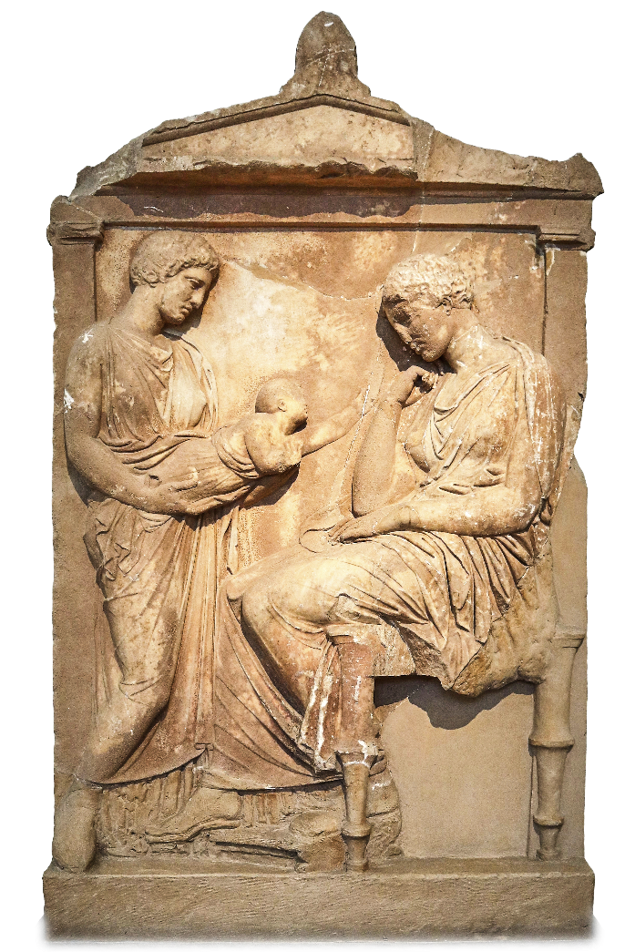
Chloe: Why Exposed? (p. 191–3)
Mini summary
Megacles comes up with at best confusing explanation
Your thoughts?
Metaphor/irony – someone would want to adopt her. Irony of the fostering
Grave stele of Phylonoe, 300s BCE
Notes:
[Megacles has just recognized tokens left with Chloe when an infant.]
4.35.2. Please tell me, Dionysophanes, how did you come by my child’s tokens? After discovering Daphnis, don’t begrudge me my own discovery!” But Dionysophanes told him to speak first about the abandonment, and without lowering his voice at all he replied,
3.“There was a time when I had little to live on: what I had I had spent on fitting out choruses and warships. During that time a daughter came along. Reluctant to raise her in poverty, I adorned her with these tokens and abandoned her, knowing that many men are eager to become fathers even in that way.
4. So the child was left lying in a cave of the Nymphs, entrusted to the goddesses, while for me wealth started to pour in day after day, though I had no heir.
5. For I never had the luck to become a father again, even of a daughter, but as if having a laugh at my expense the gods kept sending me dreams at night, that a sheep would make me a father.”

Slide 11
Daphnis: Why Exposed? (pp. 179–81)
Mini summary
Too many kids
Your thoughts?
Irony of two dying
Grave stele of Phylonoe, 300s BCE
Notes:
[Dionysophanes has just recognized tokens left with Daphnis when an infant. Dionysophanes addresses Daphnis and D’s elder brother, Astylus]
4.24.1. “My sons, I married quite young, and after a while I became a happy father, or so I thought. First I had a son, second a daughter, and third was Astylus. I thought my family was large enough, and when this child came along on top of all the others I abandoned him, leaving these things with him not as tokens of identity but as funeral offerings.
2. But Fate had other plans: my elder son and my daughter perished of the same illness in a single day, but you were saved by the gods’ providence so that we would have more hands to support us.
3. Please, never bear a grudge against me for that abandonment, and Astylus, please bear no resentment that you will receive a portion of my wealth instead of the whole: for sensible people, no possession is greater than a brother. Come, love one another, and as far as money is concerned you will rival even kings.
4. For I shall bequeath you land, many competent servants, gold, silver, everything else that fortunate people possess. Only I award this place exclusively to Daphnis, along with Lamo and Myrtale and the she-goats that he himself used to graze.”

Slide 12
Socialization (in erōs and other)
Nature
Equality
Country
amathia (ignorance)
Nurture
Hierarchy
City
paideia (education, savoir-faire)

Slide 13
“Erōs Makes Great Rhetoricians”
Sophistic Evocations in D&C

Slide 14
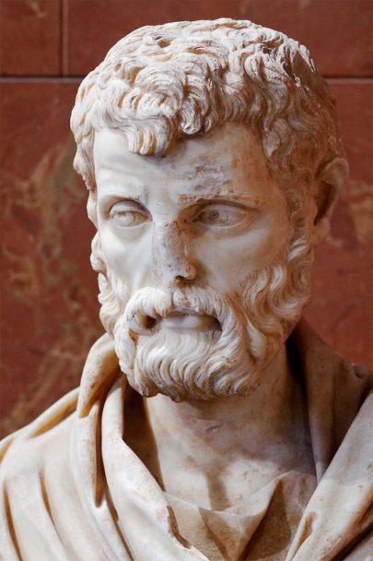
Context (Second Sophistic)
1st – 3rd century CE
Greek revival featuring…
Sophists (sophistai)
Orator-teachers
Exemplars of paideia (education, refinement)
Herodes Atticus (ca. 101–177 CE)
Notes:
the allusions in d&c are learned allusions; they test the reader’s knowledge of the classics.
but they’re also demonstrations of the author’s paideia, their education and refinement.
as such they signal the author’s desire to measure up to what’s expected of an educated person, in other words, the author’s literary ambition, they’re desire to excel.

Slide 15
Daphnis sophistēs
Debate: beauty contest
Daphnis versus Dorco (pp. 35–7)
Trial scene
Daphnis versus Methymnians (pp. 77–79)

Slide 16
Gnatho sophistēs (pages 168-73)
Comic-suicidal entreaty
“Please rescue your own Gnatho, and defeat invincible Love”
Refutation of Astylus
Gnatho’s “… love for the body of a slave but the beauty of a free man”
“I’ve followed the gods’ example…”
Notes:
mini-meletai:
“Your Gnatho’s done for, master,” he said. “I’m the one one who until now loved only your table, who used to swear that nothing has a more youthful bloom than old wine, who said that your chefs are choicer than any boys in Mytilene, but now I think Daphnis is finer than anything. I have no taste for expensive food, even though there’s so much meat, fish, honey cakes prepared every day. I would gladly become a she-goat and eat grass and leaves so long as I could listen to Daphnis’ syrinx and have him take me to pasture. Please rescue your own Gnatho, and defeat invincible Love! Otherwise, I swear by you, my own god, that I will take a dagger, cram my belly with food, and kill myself on Daphnis’ doorstep, and no more will you be calling me Gnathipoo, as you always did when you were kidding.”
Wanting to steer him toward having his own second thoughts, he asked with a smile whether he felt no shame to be in love with a son of Lamo and indeed eager to bed down with a young man who herded goats; as he said this he burlesqued disgust at the reek of goats.
“But Gnatho, a veteran of debauched drinking parties, was well schooled in the whole of erotic mythology and did not miss the mark in defending both himself and Daphnis
(mastery of mythological allusion)
4.17.6. ‘What lover wouldn’t pray to get sweet kisses from that mouth? If I’ve fallen for a herdsman, I’ve followed the gods’ example. Anchises was a cowherd, and Aphrodite took up with him; Branchus grazed goats, and Apollo held him dear; Ganymede was a shepherd, and the king of the universe snatched him.’” [learned myth allusion]
7. Let us not look down on a boy whom, as we have seen, even she-goats obey as if they were in love with him; no, we should instead be grateful to Zeus’ eagles for allowing such beauty to remain on earth.”

Slide 17
Learned Allusion
“Astylus ... said that Love (Erōs) makes great rhetoricians (sophistas)” (D&C p. 173)
"Eros, mischievous sophist” (Xenophon Education of Cyrus 6.1.41, ca. 400 BCE)
“Eros is a teacher more powerful than any tricky sophist” (Anaxandrides, ca. 350 BCE)
Notes:
“Astylus laughed gaily, particularly at this last remark, and said that Love (Erōs) makes great rhetoricians (sophistas).”
Ἡδὺ γελάσας ὁ Ἄστυλος ἐπὶ τούτῳ μάλιστα τῷ λεχθέντι καὶ ὡς μεγάλους ὁ Ἔρως ποιεῖ σοφιστὰς εἰπὼν ἐπετήρει καιρὸν ἐν ᾧ τῷ πατρὶ περὶ Δάφνιδος διαλέξεται.
but this sophistry, which deploys tricky sleight of hand, like 1st sophistic, seeks a negative outcome
bowie ad 4.18.1: “L. hints at the fusion of poetic and sophistic traditions that his own work exemplifies and invites readers to wonder whether he too owes his skill to his subject Eros”

