Slide 1
You Are What You Read Swain on the Greek novel
4-Feb 2026

Slide 2
Agenda
Recap and Update
“Erōs Makes Great Rhetoricians”
Adventures in Critical Thinking!
Swain on the Greek Novel
A Further Question (depending…)
Nostalgia in the Greek Novel

Slide 3
Recap and Update
“Erōs Makes Great Rhetoricians”

Slide 4
D&C as Socialization
Nature
Equality
Country
amathia (ignorance)
Nurture
Hierarchy
City
paideia (education, savoir-faire)

Slide 5
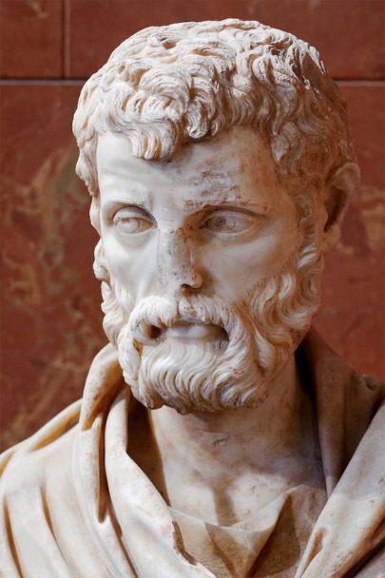
Second Sophistic
1st – 3rd century CE
Greek revival featuring (among other things)
Sophists (sophistai)
Orator-teachers
Exemplars of paideia (education, refinement)
Herodes Atticus (ca. 101–177 CE)
Notes:
the allusions in d&c are learned allusions; they test the reader’s knowledge of the classics.
but they’re also demonstrations of the author’s paideia, their education and refinement.
as such they signal the author’s desire to measure up to what’s expected of an educated person, in other words, the author’s literary ambition, they’re desire to excel.

Slide 6
Daphnis sophistēs
Debate: beauty contest
Daphnis versus Dorco (pp. 35–7)
Trial scene
Daphnis versus Methymnians (pp. 77–79)

Slide 7
Gnatho sophistēs (pages 168-73)
Comic-suicidal entreaty
“Please rescue your own Gnatho, and defeat invincible Love”
Refutation of Astylus
Gnatho’s “… love for the body of a slave but the beauty of a free man”
“I’ve followed the gods’ example…”
Notes:
mini-meletai:
“Your Gnatho’s done for, master,” he said. “I’m the one one who until now loved only your table, who used to swear that nothing has a more youthful bloom than old wine, who said that your chefs are choicer than any boys in Mytilene, but now I think Daphnis is finer than anything. I have no taste for expensive food, even though there’s so much meat, fish, honey cakes prepared every day. I would gladly become a she-goat and eat grass and leaves so long as I could listen to Daphnis’ syrinx and have him take me to pasture. Please rescue your own Gnatho, and defeat invincible Love! Otherwise, I swear by you, my own god, that I will take a dagger, cram my belly with food, and kill myself on Daphnis’ doorstep, and no more will you be calling me Gnathipoo, as you always did when you were kidding.”
Wanting to steer him toward having his own second thoughts, he asked with a smile whether he felt no shame to be in love with a son of Lamo and indeed eager to bed down with a young man who herded goats; as he said this he burlesqued disgust at the reek of goats.
“But Gnatho, a veteran of debauched drinking parties, was well schooled in the whole of erotic mythology and did not miss the mark in defending both himself and Daphnis
(mastery of mythological allusion)
4.17.6. ‘What lover wouldn’t pray to get sweet kisses from that mouth? If I’ve fallen for a herdsman, I’ve followed the gods’ example. Anchises was a cowherd, and Aphrodite took up with him; Branchus grazed goats, and Apollo held him dear; Ganymede was a shepherd, and the king of the universe snatched him.’” [learned myth allusion]
7. Let us not look down on a boy whom, as we have seen, even she-goats obey as if they were in love with him; no, we should instead be grateful to Zeus’ eagles for allowing such beauty to remain on earth.”

Slide 8
Learned Allusion
“Astylus ... said that Love (Erōs) makes great rhetoricians (sophistas)” (D&C p. 173)
"Eros, mischievous sophist” (Xenophon Education of Cyrus 6.1.41, ca. 400 BCE)
“Eros is a teacher more powerful than any tricky sophist” (Anaxandrides, ca. 350 BCE)
Notes:
“Astylus laughed gaily, particularly at this last remark, and said that Love (Erōs) makes great rhetoricians (sophistas).”
Ἡδὺ γελάσας ὁ Ἄστυλος ἐπὶ τούτῳ μάλιστα τῷ λεχθέντι καὶ ὡς μεγάλους ὁ Ἔρως ποιεῖ σοφιστὰς εἰπὼν ἐπετήρει καιρὸν ἐν ᾧ τῷ πατρὶ περὶ Δάφνιδος διαλέξεται.
but this sophistry, which deploys tricky sleight of hand, like 1st sophistic, seeks a negative outcome
bowie ad 4.18.1: “L. hints at the fusion of poetic and sophistic traditions that his own work exemplifies and invites readers to wonder whether he too owes his skill to his subject Eros”

Slide 9
Adventures in Critical Thinking!
Swain on the Greek Novel

Slide 10
Swain on the Greek Novel
In 280 characters or fewer (an X-tweet), summarize the article.
What is Swain’s overall point?
How does that relate to D&C?
Do you have feedback for the author?

Slide 11
A Further Question (depending…)
Nostalgia in the Greek Novel

Slide 12

Question…
Why are Swain’s “ideal” novels (for us, why is Longus’ Daphnis and Chloe) so fixated on the Greek past?
Notes:
I called the first unit of our course, “The past is ever new: Longus' Daphnis and Chloe.” So, what’s with this fixation on the past, a past with no hint of Rome?
Swain’s comment:
104. why do novels treat "age-old polarities" (men v women, etc.) while ignoring contemporary world?
104-105. novels originate from the Imperial Greek need for self-reflection.
109. novels served as an expression of the "cultural hegemony" of the their elite readership.
110-112. similar concern for the past as in declamation, some novels with historically fictive elements, others with a "Greek world independent, indeed oblivious of Rome" (110).
112-113. on the elite's pleasure in the past, its appeal in terms of the "the role of the past in their [that of Imperial Greek-speaking elite society] ideology of power" (112).
[the novel is a reflection of Greek paideia as an element of specifically Greek identity]
this connects to sexuality and marriage.
129. marriage, genealogy, elite identity. this last sustained by the two preceding items:
"The elite in the Greek city was formed through intermarriage, that is, it depended upon the deployment of alliance. This was certainly designed to ensure control over the circulation of wealth and the government of the city. But more than this it is a fact that such alliance looks to the past and is founded upon the mystique of ancestry. … In this regard it is no surprise to find the marriage relation becoming an important locus of self-identity for the Greek male. He married into a good family, firmly tied into the city's heritage. And by procreation he ensured the continuation of his own kind and therefore of the city he ruled.“
so d&c isn’t actually focused on the past, or rather, the past matters for the part it plays in the present, for the work it does in reminding “us” that we have an identity that extends beyond and past the reality that hangs over us, that of Roman Imperial rule rule.

