Slide 1
Sophia, agōn, paideia: Introductory Readings

Slide 2
Thematic Foci
sophia
agōn
paideia
pathos

Slide 3
Thematic Foci
sophia | “wisdom/skill”
agōn
paideia
pathos
Notes:
Philostratus vs 1.493 uses sophia to describe the skill with which the old sophist gorgias composed the funeral oration. similar use in vs 1.501, 502. also 1.520, on scopelian. sophōs is a compliment-cheer in latin author Petronius.

Slide 4
Thematic Foci
sophia | “wisdom/skill”
agōn | “contest/struggle”
paideia
pathos

Slide 5
Thematic Foci
sophia | “wisdom/skill”
agōn | “contest/struggle”
paideia | “education/culture”
pathos

Slide 6
Thematic Foci
sophia | “wisdom/skill”
agōn | “contest/struggle”
paideia | “education/culture”
pathos | “emotion/passion”

Slide 7
Agenda
Next Assignment
Historical, Geographical Background
Class Procedures, etc. (cont’d)
Accommodations, Graded Quiz responses
Readings: agōn, pathos, danger!
Lucian Slander, a Warning
Readings: agōn, pathos, paideia
Lucian The Vision

Slide 8
Next Assignment
Historical, Geographical Background

Slide 9
Class Procedures
Accommodations, Graded Quiz responses

Slide 10
Readings: agōn, pathos, danger!
Lucian Slander, a Warning

Slide 11
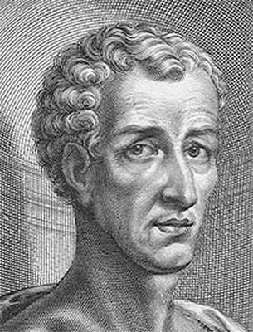
Lucian: Author Notes
ca. 120-ca. 190 CE
Syrian (not Greek, ... or was he?)
Sophist, satirist
Widely travelled
Artist’s best guess...

Slide 12
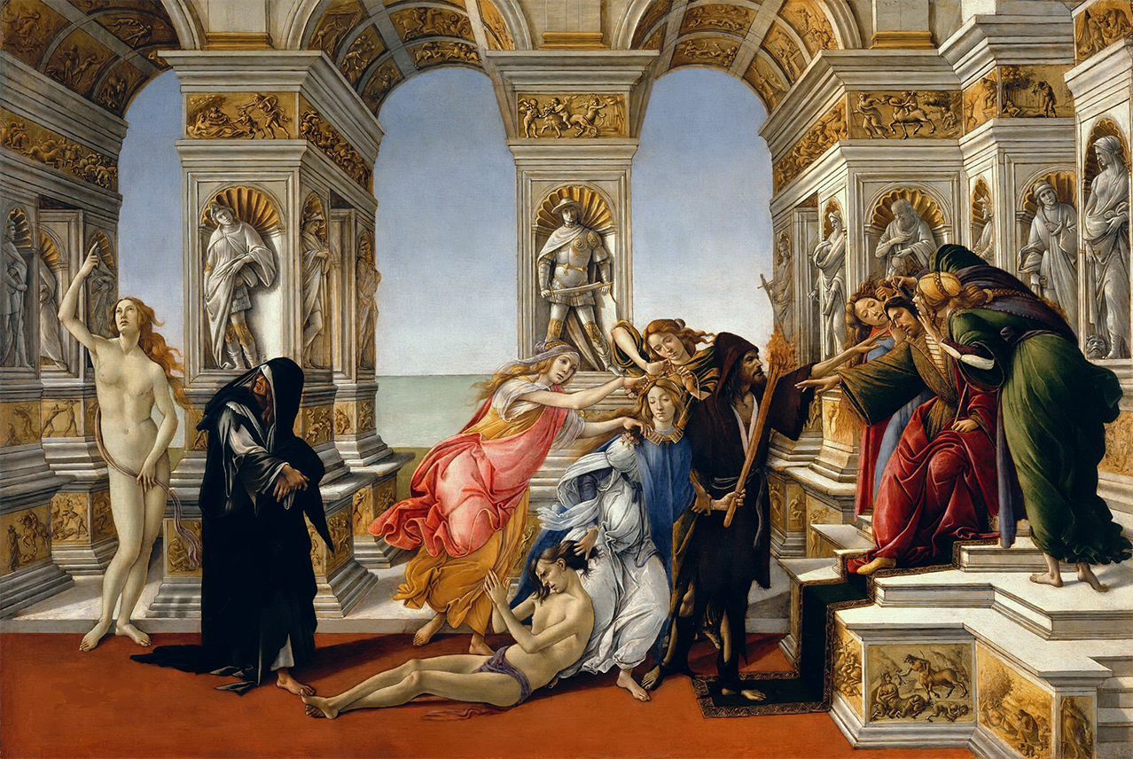
Botticelli’s
(not Apelles’!)
“Slander”
Notes:
ask what about, prompt for sharing of quiz responses. ask, what happens in the piece? what examples are used?
what emotions are involved
slander as capture, as blockage
agon rendered asymmetrical, improperly conducted, secretive
runners at the games (fair play v cheaters)
physicians => poisoners, wealth => tyranny
exploitation of the “hearer’s own nature,” enthusiasm, etc. (Ptolemy and Demetrius, Alexander and Agathocles, Antea and Bellerophon)
role of flattery
how is that relevant? who are these “kings”?

Slide 13
“Convinced that the prize is great, they elaborate their mutual stratagems, among which slander is at once the speediest and the most uncertain; high are the hopes with which this child of envy or hatred is born ; pitiful, gloomy and disastrous the end to which it comes.” (Lucian Slander p. 5)
Notes:
“it is in kings’ courts that these creatures are mostly found” (kings are salient because??) unscrupulous courtiers, rat-race. “Convinced that the prize is great, they elaborate their mutual stratagems, among which slander is at once the speediest and the most uncertain ; high are the hopes with which this child of envy or hatred is born ; pitiful, gloomy and disastrous the end to which it comes.” (p. 5)

Slide 14

Job Seach: BU Chair in Rhetoric

Slide 15
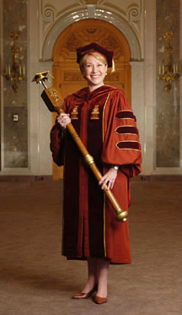
Project Slander, Counter Slander
Slander
Counter Slander
“Candidate Red ...”
“Hold on! ...”
Our President
Notes:
choose a president. ½ room works on slander (note taker, 5 mins), other half, counter slander (notetaker, 5 mins)
then each side sends forward an orator to (counter) slander
President chooses sides – why that side?

Slide 16
Readings: agōn, pathos, paideia
Lucian The Vision

Slide 17
Tekhnē versus paideia (impressions)
tekhnē
paideia
Notes:
judging from the reading, a costly education:
“Most of his [my dad’s] friends considered that the life of culture was very exacting in toil, time, and money : a life only for fortune's favourites.” (1)
“' Dear youth, I am Statuary—the art which you yesterday began to learn, and which has a natural and a family claim upon you.” (3). tekhnē presents an overall positive account of herself. but she’s less physically beautiful, and less persuasive, than paideia.
paideia on tekhne, also sketches out paideia:
“… being a worker with your hands, your whole prospects in life limited to that; you will be obscure, poorly and illiberally paid, mean-spirited, of no account outside your doors ; your influence will never help a friend, silence an enemy, nor impress your countrymen; you will be just a worker, one of the masses, cowering before the distinguished, truckling to the eloquent, living the life of a hare, a prey to your betters.”
debilitating toil. (banausic, i.e., vulgar)
paideia on paideia
history
moral education, include greatness of soul: “fair adornments, with self-mastery and justice and reverence and mildness, with consideration and understanding and fortitude, with love of what is beautiful, and yearning for what is great.”
social mobility: “This penniless son of who knows whom, contemplating but 1 1 now a vocation so ignoble, shall soon be admired and envied of all, with honour and praise and the fame of high achieve ment, respected by the high-born and the affluent, clothed as I am clothed”
immortal fame

