Slide 1
And Your Point Is?
Declamation and Lucian’s Tyrannicide

Slide 2
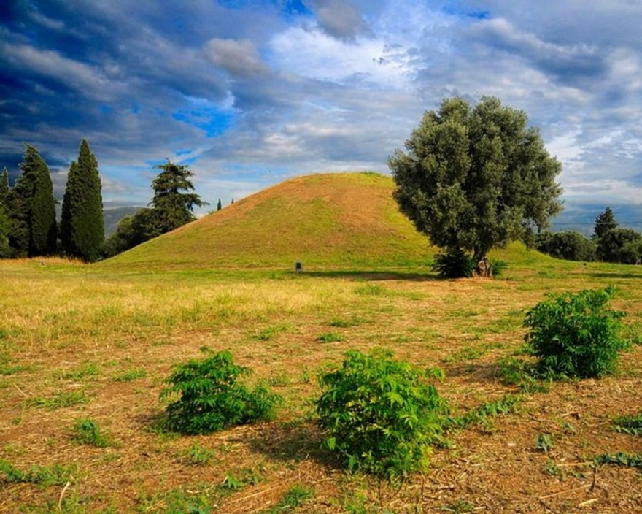
Polemon Declamations
“Of Polemon sophist, the law at Athens being that the father of him who died most nobly should speak the funeral oration. The fathers of Cynegirus and Callimachus plead their cases.” (Hypothesis)
Burial mound at Marathon (battle fought 490 BCE)
Notes:
You’ll remember that last time Bianca read for us a passage from one of two surviving declamations, or meletai, by the sophist Polemon. I asked what the speaker’s aim was, and it was agreed that he sought to demonstrate his son’s superior courage at the battle of Marathon in 490 BCE, that with a view to being selected to deliver the speech honoring the 192 greeks who had died in the battle.

Slide 3
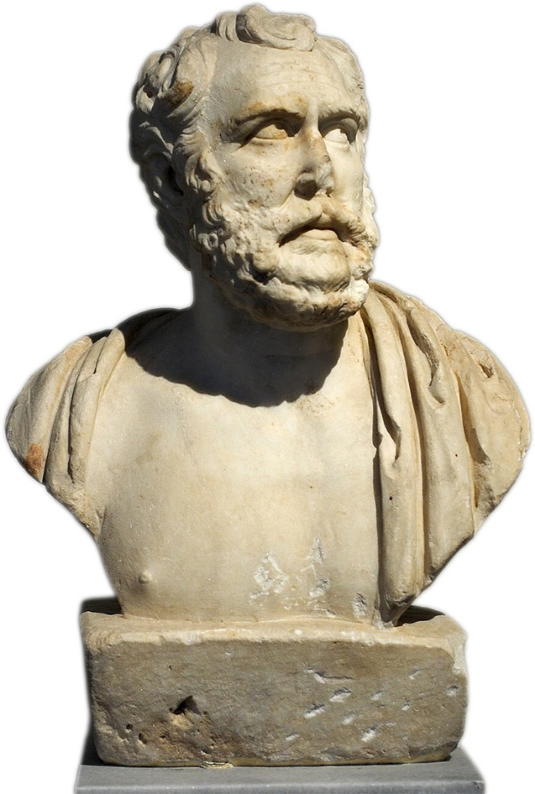
Polemon Sophist
90–146 CE
  Emperors Domitian, Nerva, Trajan, Hadrian, Antoninus Pius
Orator, teacher, diplomat
  Dueling declamations, Marathon 490 BCE
Polemon (?)
Notes:
but that was the fictitious speaker, whereas the declaimer, none other than Polemon, will have created and, one assumes, performed the piece some 600 years after the dramatic date of the piece. not only that, this is but one of two speeches Polemon composed, one for each of the two fathers, and it stands to reason that the declaimer did his best to in behalf of each of the two fictitious speakers.
so, what’s the deal, who wins this contrived debate? if memory serves, two suggestions emerged. On the one hand, the real-life speaker — we’ll call him the “declaimer“ — has the chance to score points for demonstrating rhetorical skill. On the other hand, declaimer and his real-life audience have a chance to relive a moment of ancient Greek greatness.

Slide 4
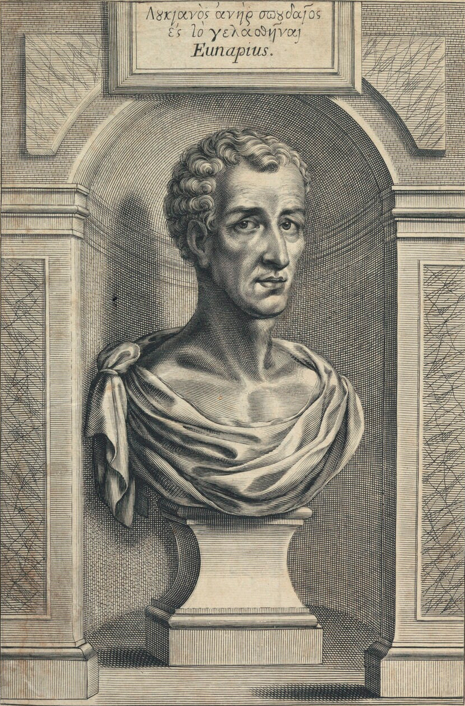
Lucian of Samósata
ca. 120-ca. 190 CE
Syrian
  not Greek, ... or was he?
Sophist, satirist
Widely travelled
Lucian, artist’s best guess...
Notes:
if only it were that simple for Lucian, an author known for his tongue-in-cheek treatment of all manner of topics.
so we’re wondering what the point of the speech is. it can’t be to advocate for the slaying of despotic rulers; that would be, well, dangerous. so there must exist other possibilities.

Slide 5
Agenda
Quick Review
  What is Declamation?
Let’s Refresh Our Minds
  Key Passages from Lucian’s Tyrannicide
Discussion
  What Does Lucian’s Tyrannicide Prove?
Compelling Reasons
  Lucian’s Tyrannicide and Rhetorical Logic

Slide 6
Quick Review
What is Declamation?

Slide 7
What Is Declamation?
A speech
Fictitious
Persuasive
It has rhetorical questions, subtexts, to make yu think
Argument with yourself
  The declaimer plays all roles
Performance, display of skill
Persuasive
  In a dramatic-recreation sort of way

Slide 8
Let’s Refresh Our Minds
Key Passages from Lucian’s Tyrannicide (4 student readers)

Slide 9
Hypothesis
“A man went to the Acropolis to slay the tyrant. He did not find him, but slew his son and left his sword in the body. When the tyrant came and saw his son already dead, he slew himself with the same sword. The man who went up and slew the tyrant’s son claims the reward for slaying the tyrant.” (Loeb p. 447)

Slide 10
Speaker’s Claims
“It was I, then, who put an end to the tyranny, and the sword that accomplished everything was mine. But I inverted the order of executions, and made an innovation in the method of putting criminals to death, for I myself destroyed the stronger, the one capable of self-defence, and resigned the old man to my unaided sword.” (Loeb p. 447)
Notes:
and tis is how we’re going to go about investigating those.

Slide 11
Speaker’s Claims, cont’d
“It was my thought, therefore, that I should get for this a still more generous gift from you, and should receive rewards to match the number of the slain, because I had freed you not only from your present ills, but from your expectation of those that were to come….” (Loeb p. 447)

Slide 12
Speaker’s Claims, cont’d 2
“But now there is danger that after all these achievements I may come away from you unrewarded and may be the only one to be excluded from the recompense afforded by those laws which I maintained.” (Loeb p. 447)

Slide 13
Discussion
What Does Lucian’s Tyrannicide Prove?

Slide 14
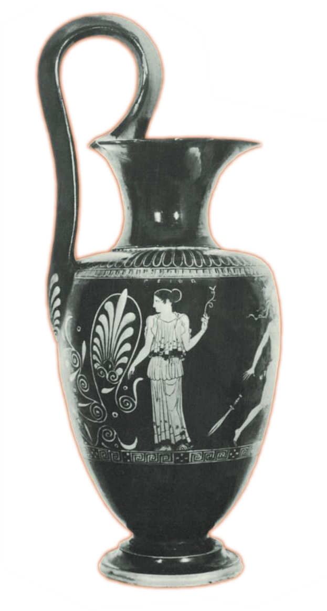
Elements of Persuasion
Reason (logos)
Character (ēthos)
Emotion (pathos)
Peitho (“Persuasion”), vase painting
Notes:
[explain each] We probably will concentrate mostly on 1 and 2.

Slide 15
Three Questions
In Lucian's Tyrannicide, does the imaginary speaker make a convincing case?
Is Lucian’s word-portrait of the imaginary speaker convincing?
What do you think Lucian is trying to achieve with this speech?
Notes:
“My adversary here seems to me to be taking this course, not, as he says, because of his concern for the interests of the state, but because of his grief over the dead men, and in the endeavour to avenge them upon the man who caused their death.” (p. 447)
“The young man conceded the honour to him by right of age and abstained from the name of sovereignty…. it was he who plucked lads from their homes, who made a mockery of marriages; it was for him that maids were carried off; and whatever deeds of blood there were, whatever banishments, confiscations of property, applications of torture, and outrages—all these were a young mans emprises.” (p. 449)
“Alone, alone, I climbed the hill to front the tyranny that was so strong and many-headed—yet, not alone but with my sword that shared the fray with me and in its turn was tyrant-slayer too. I had my death in prospect, but sought to purchase our common liberty with the shedding of my own blood.” (p. 451)
“I am here, then, to bring you democracy, to notify all that they may now take heart, and to herald the glad tidings of liberty.” (p. 453)
procatalepsis:
“Why, pray, do you make the people ungrateful towards me?”
“’Because you did not slay the tyrant himself; and the law bestows the reward upon the slayer of a tyrant!’” (p. 457)
“’But the law,’ you say, ‘scrutinises only the main point in the facts of the case, ignoring all the incidentals and raising no further question!” What! was there not once a man who obtained the guerdon of a tyrannicide by just driving a tyrant into exile?’” (p. 461)

Slide 16
Compelling Reasons
Lucian’s Tyrannicide and Rhetorical Logic

Slide 17
Rhetorical Logic (apologies to Aristotle)
Rhetoric reasons from probabilities
Rhetoric employs enthymemes (incomplete syllogisms)
  Rhetorical questions
  A fortiori arguments

Slide 18
Examples 1
“Did I not form the purpose? Did I not climb the hill? Did I not slay? Did I not bring liberty?” (p. 455)
“… I should get for this a still more generous gift from you, and should receive rewards to match the number of the slain, because I had freed you not only from your present ills, but from your expectation of those that were to come…” (p. 447)

Slide 19
Examples 2
“I remember, moreover, this statement in the laws …, that there are two sorts of responsibility for manslaughter, and if, without taking life himself or doing the deed with his own hand, a man has necessitated and given rise to the killing, the law requires that in this case too he himself receive the same punishment….” (p. 459)

