Slide 1
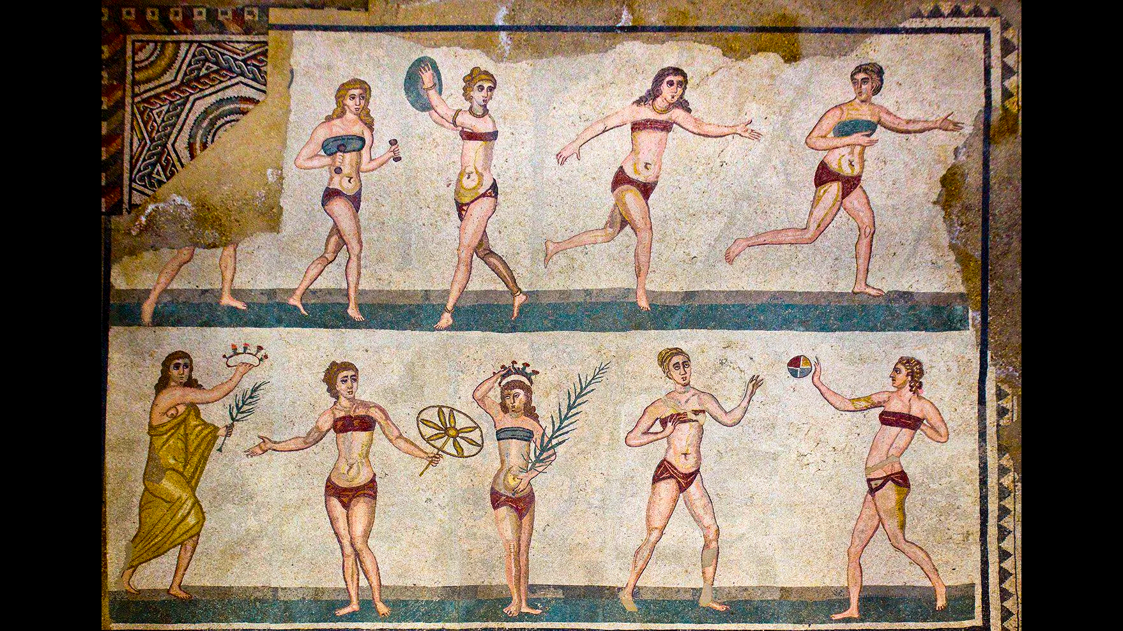
Imperial Greek Athletics and agōn
What Do We Learn?

Slide 2
Sala delle Palestrite, floor mosaic. Probably mid/late 4th cent CE.
Villa Romana del Casale, Piazza Armerina, Sicily
Notes:
“Roman Bikini-girls: Female Representation and Identity in Mosaics during Late Antiquity” https://nyavalor.se/wp-content/uploads/Roman_Bikini_Girls_Silvia_Lucantonio.pdf
Silvia Lucantonio. Nya Valör. 1.1. 2024 (Student-alumni journal, Uppsala)
This mosaic, often referred to in popular discourse as depicting “bikini-dressed women”, provides a unique visual narrative that, in many ways, might challenge modern interpretations of women during Late Antiquity.
“The women portrayed are, however, not wearing swimsuits, but strophium and subligaculum – garments associated with athletic, or intimate, contexts in Roman culture.
“While the mosaics from Villa Romana present a progressive view of women in athletic contexts, they also highlight the enduring tension between progressing social roles for women and the persistence of traditional gender expectations. The dual themes of physical excellence and fertility reinforce the complex ways in which Roman society viewed and represented women, as both capable of physical achievement and attraction, while simultaneously, as integral to reproductive and familial ideals.”
Pensabene, Gallocchio. “The Villa del Casale of Piazza Armerina.“ 53.2. Expedition 2011. “The sponsorship of female athletic contests would have been associated with only the highest levels of society and thus reflected upon the elevated status of the proprietor.”
owner possibly = “an urban prefect of Rome,” … “C. Ceionius Rufus Volusianus, urban prefect and consul under Maxentius and Constantine, and owner of great estates in Africa, and his son, M. Ceionius Rufus Albinus, consul in AD 355 and urban prefect, have been proposed as likely proprietors.”
[the villa clearly evokes the proprietor’s self-promotion as a sponsor of Roman-style chariot races in the Circus Maximus and staged hunts probably in the Colosseum, and of Greek paideia (literature, music) and athletics. the goddess (?), lower left, seems to wear something resembling the exōmis worn by girls competing in the Heraea]

Slide 3
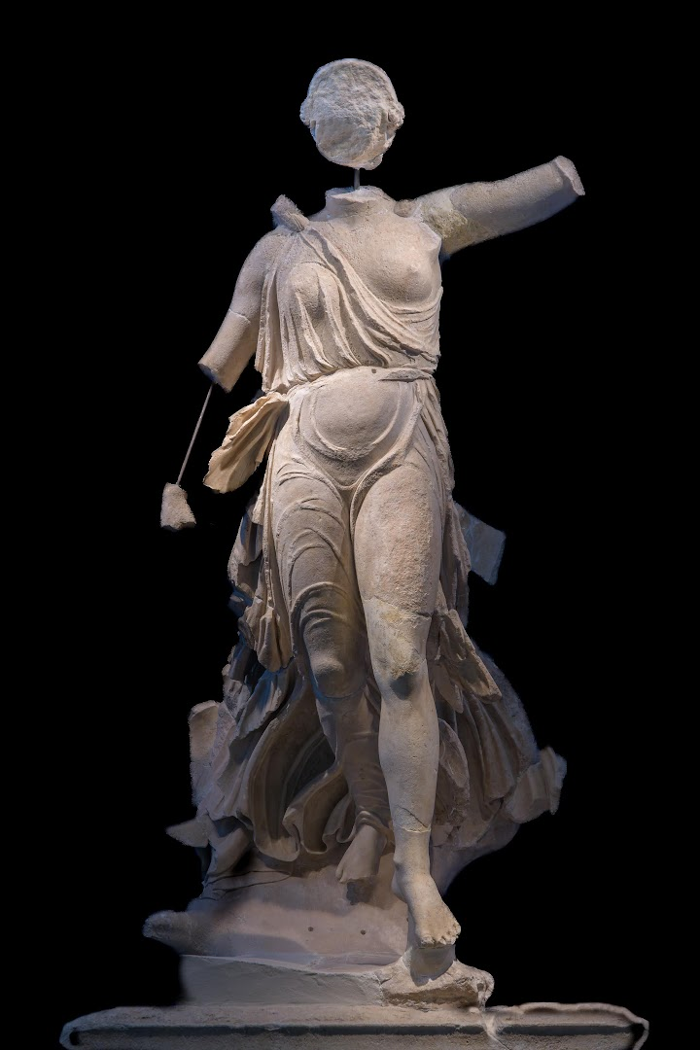
Agenda
Paper Pointers (due 15-Mar)
  Ongoing Writing Issues
Short Writing Assignment, Discussion
  What Is Winning?
Athletics and agōn
  Further Considerations
Images of agōn
  Ancient Olympia, Epidaurus Today
Nike (“Victory”) of Paionios, Olympia

Slide 4
Paper Pointers (due 15-Mar)
Ongoing Writing Issues

Slide 5
Writing Issues 1
Critical thinking, MLA, Titles, formatting
  Review Papers, CT bingdev pages.
Sentence fragments
  “Sentence fragments are to be Avoided. Seriously.”

Slide 6
Writing Issues 2
Commas
  “Review Purdue Owl for comma use, don’t make this mistake.” (“.... for comma use; don’t....”)
Usage
  “I don’t *except* avoidable mistakes in word choice.” (“accept”)

Slide 7
Short Writing Assignment, Discussion
What Is Winning?
Notes:
Ask them, “What is it to win? How do you know you’re a winner? How does it feel? Conversely, what’s it like to lose?”

Slide 8

Muhammad Ali On Being So Pretty (YouTube)

Slide 9
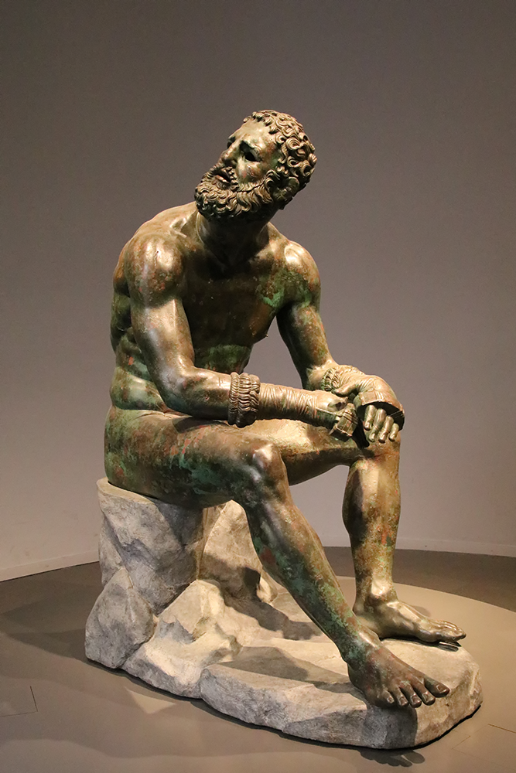
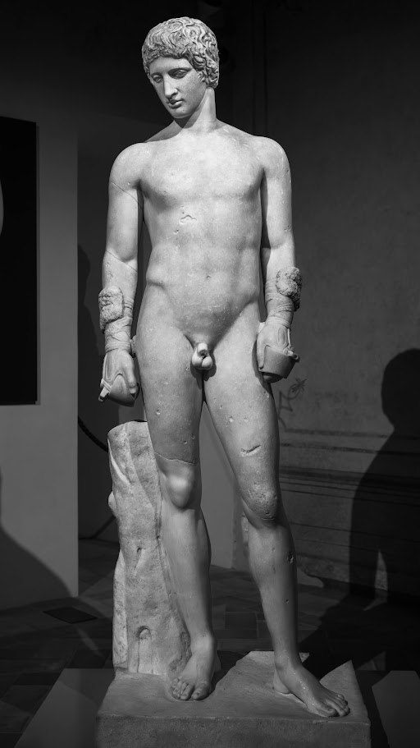
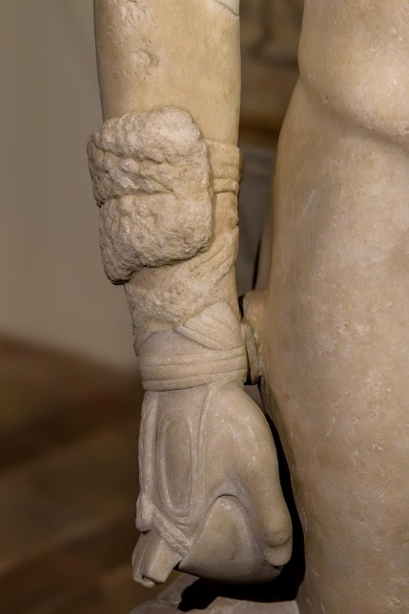
R to L: Kestos. Young boxer, Roman copy (1st CE) of a 4th cent BCE Greek original. “Boxer at Rest,” Greek original (?), 330-50 BCE

Slide 10
Dio Chrysostom Oration 29
“For often he would fight throughout the whole day, in the hottest season of the year, and although he could have more quickly won the contest by striking a blow, he refused to do it. . . . he held that it was the truest victory when he forced his opponent, although uninjured, to give up; for then the man was overcome, not by his injury, but by himself. . . .” (p. 385)
Notes:
“Furthermore, a person might have been amazed at this—that he won all his victories without being hit himself or hitting his opponent, so far superior was he in strength and in his power of endurance. For often he would fight throughout the whole day, in the hottest season of the year, and although he could have more quickly won the contest by striking a blow, he refused to do it, | thinking that it was possible at times for the least competent boxer to overcome by a blow the very best man, if the chance for making it were offered; but he held that it was the truest victory when he forced his opponent, although uninjured, to give up; for then the man was overcome, not by his injury, but by himself; and that for an adversary to give up because of the condition of his whole body and not simply of the part of his body that was struck, meant brilliant work on the part of the victor; whereas the man who rushed in to win as quickly as possible by striking and clinching was himself overcome by the heat and by the prolonged effort.” (pp. 383-385)

Slide 11
SWA Prompt: What is Winning?
In Dio’s Oration 29, how does Melancomas win? Is winning/losing for him the same as for…
  Girls competing in various festivals?
  Aurelius Helix? (Phoenician wrestler, pancratiast — Dio Cassius, Philostratus Dialogue on Heroes)
  Marcus Aurelius Asclepiades? (inscription, Rome — from Alexandria)
  Others?

Slide 12
Athletics and agōn
Further Considerations

Slide 13
Brief Timeline
776 BCE. First recorded Olympics
573 BCE. Periodos (“circuit”) in place
  Olympic, Pythian, Isthmian, Nemean games
  Panhellenic festivals
1st-3rd cent. CE. Proliferation of games
  86 CE. Capitoline Games est’d at Rome

Slide 14
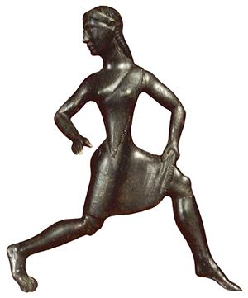
Women’s Sport
Training at Sparta (archaic, classical period)
Heraia (Argos, Olympia), Pythian, Isthmian, Nemean games
  Women’s events
Spartan girl runner wearing exōmis. Archaic statuette
Notes:
Athletics were not a male preserve. The young women of Sparta participated in athletic training, just like the young men, and together with them. Women were not allowed to attend the Olympic games, but they could still win victories there by sponsoring chariots. And they could attend as spectators at most other games. And even though women could not compete in person at the Olympics, they certainly did compete at the games of Hera (the "Heraea"), a sort of women's Olympics held at the same site. (The Olympics honored Zeus; the Heraea, Hera; both gods had temples at the site.) At the Heraea held at Argos, women also competed, as they did at the Pythian, Isthmian, Nemean, and other games during the Hellenistic period (323-30 BCE). Footraces for girls were, in fact, a wide-spread phenomenon. Note as well that women could compete in certain poetic competitions.
Did athletic victory for women differ from that for men ideologically? A young woman's victory in a footrace could bring honor to her family, though some felt that women's participation devalued sport. Under Rome, female victors in running and wrestling at the Antioch Olympics became priestesses. As for a woman's taking individual pride in a victory, that, notes Golden, seems to have been rare; our only evidence is the record left by Cynisca, Olympic chariot victor in the early fourth century BCE.

Slide 15
Marcus Aurelius Asclepiades
“I ... Marcus Aurelius Asclepiades, ..., senior temple warden of the great Sarapis, high priest of the entire guild of which I am president for life, in charge of the Imperial Baths (etc. etc. etc.), undefeated periodonikēs in the pancratium, (etc. etc. etc.), after competing for a total of six years, I retired from the ring at the age of twenty five because of the dangers and envies (phthonous) to which I had been exposed”
(ca. 200 CE, IG IVX 1102. IGR I 153. Moretti 79)

Slide 16
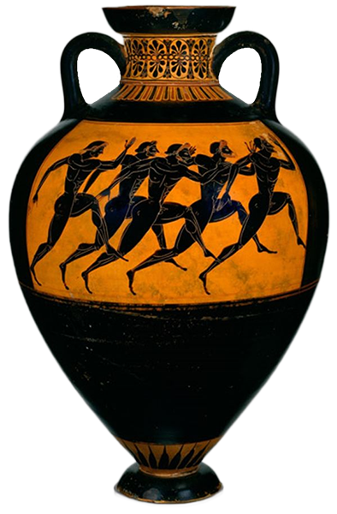
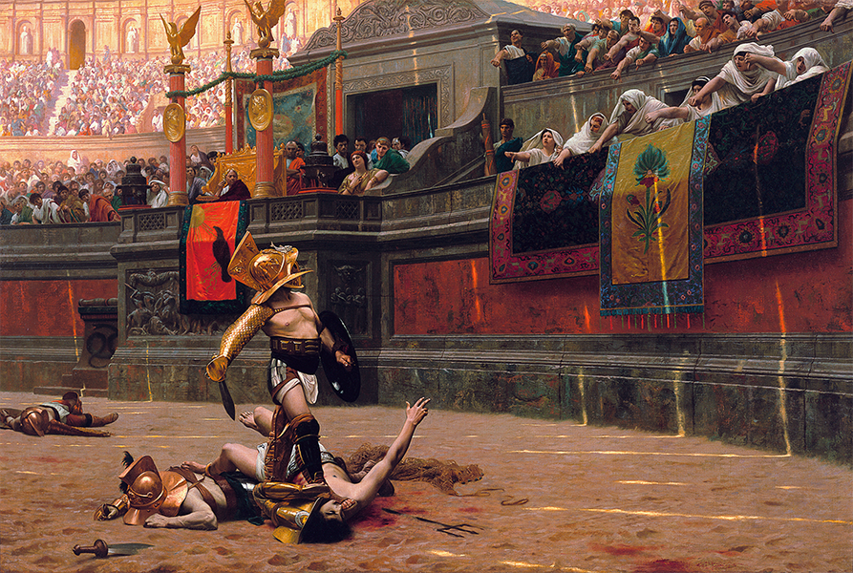
Greece and Rome
Pollice verso, Gérôme (gladiators)
Panathenaic prize amphora, c. 520 BCE

Slide 17
Images of agōn
Ancient Olympia, Epidaurus Today

Slide 18
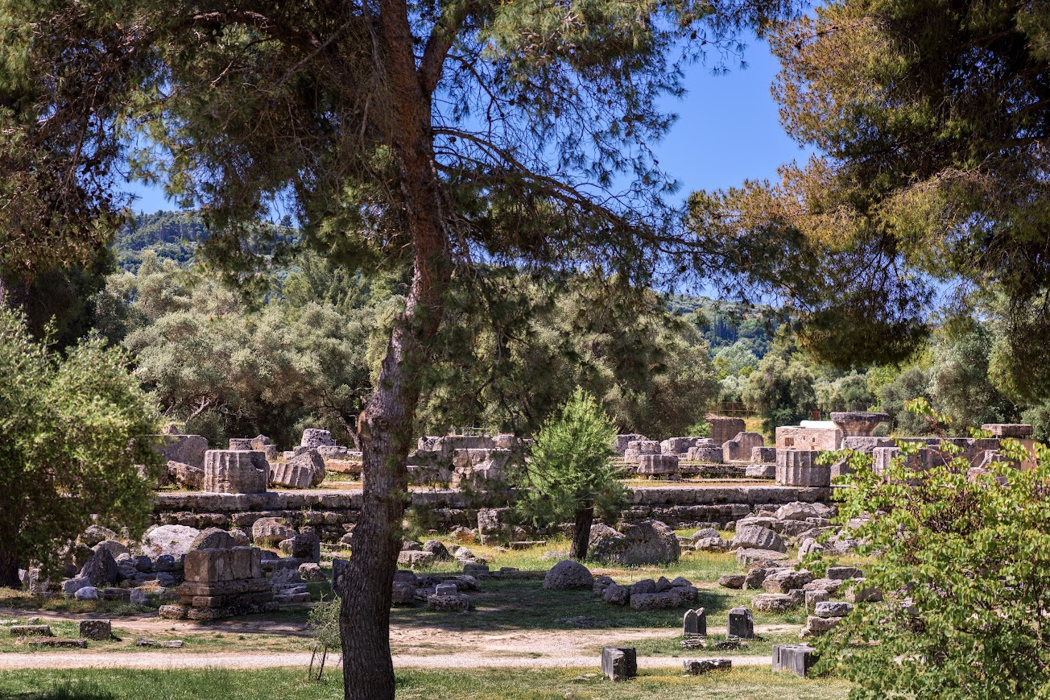
Temple of Olympian Zeus, Olympia

Slide 19
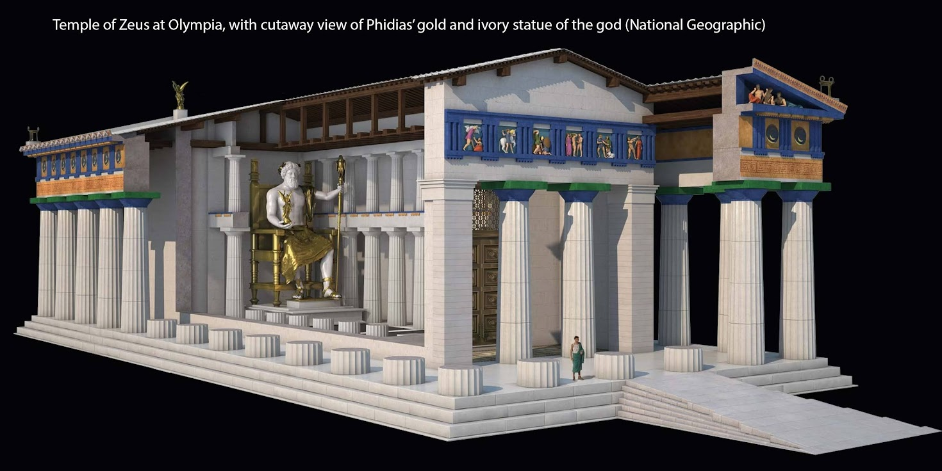
Temple of Olympian Zeus, reconstruction with cutaway view

Slide 20
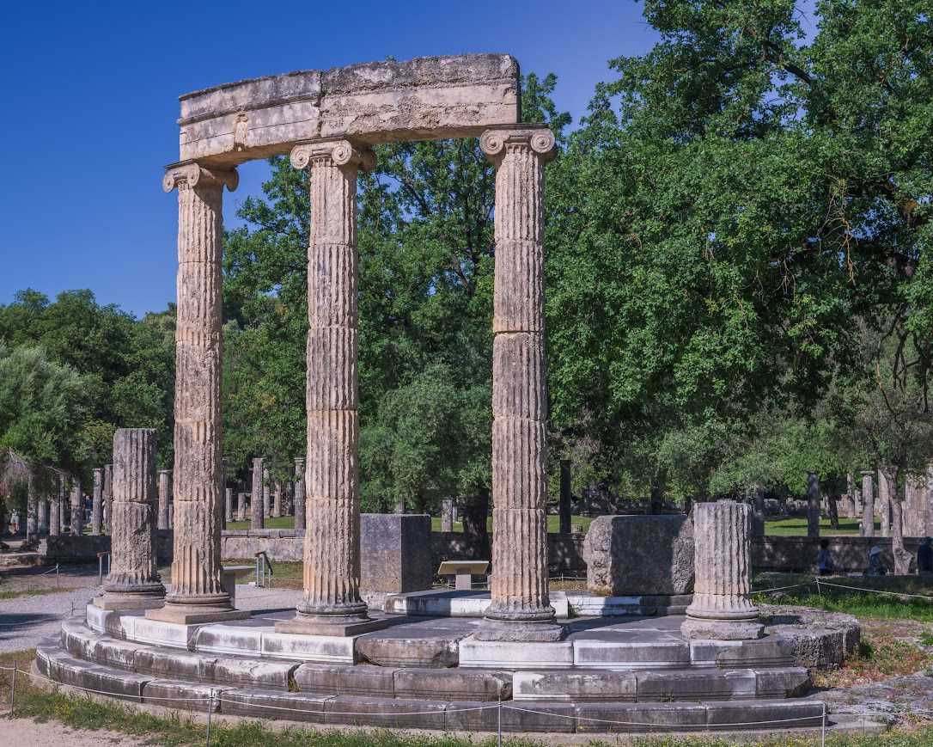
Philippeion, ca. 336 BCE, Olympia

Slide 21
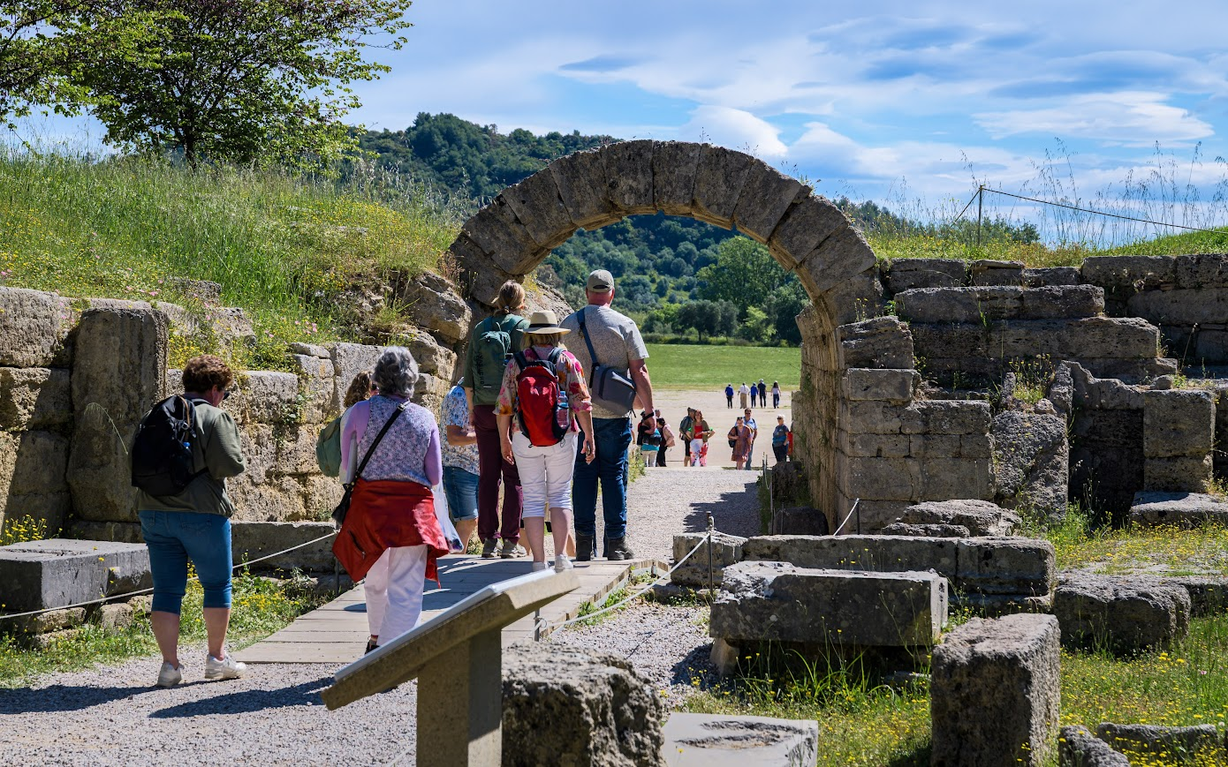
Entry, stadium, Olympia

Slide 22
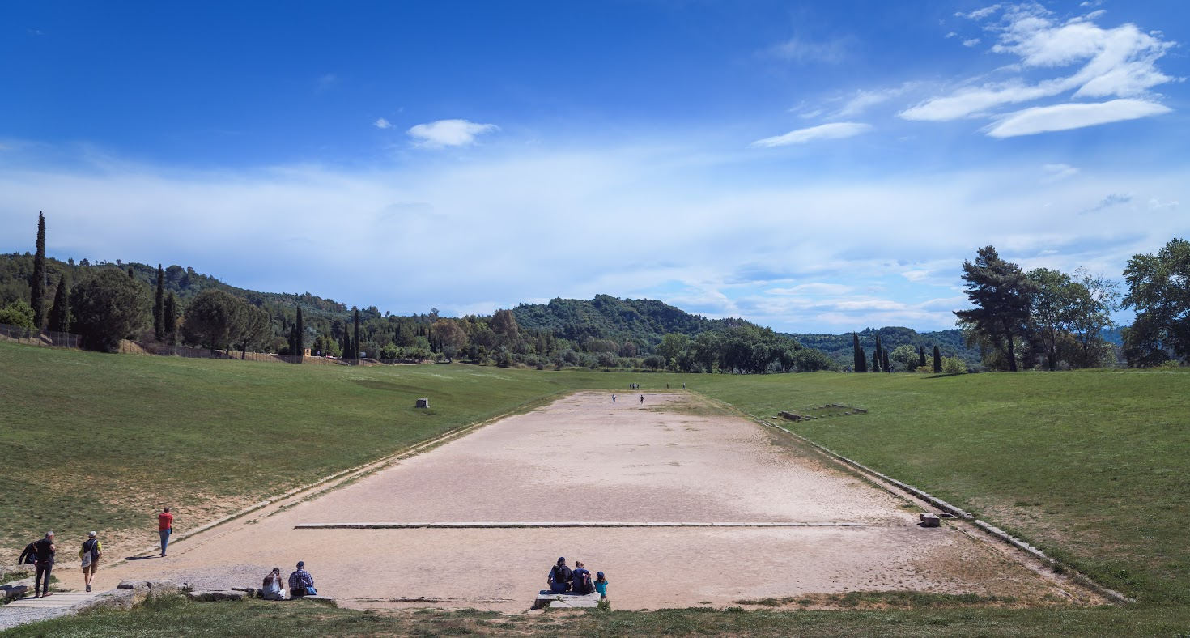
Stadium, Olympia
Notes:
to left, altar of Demeter Khamúnē, on which sat the priestess of the goddess to view the games ex officio

Slide 23
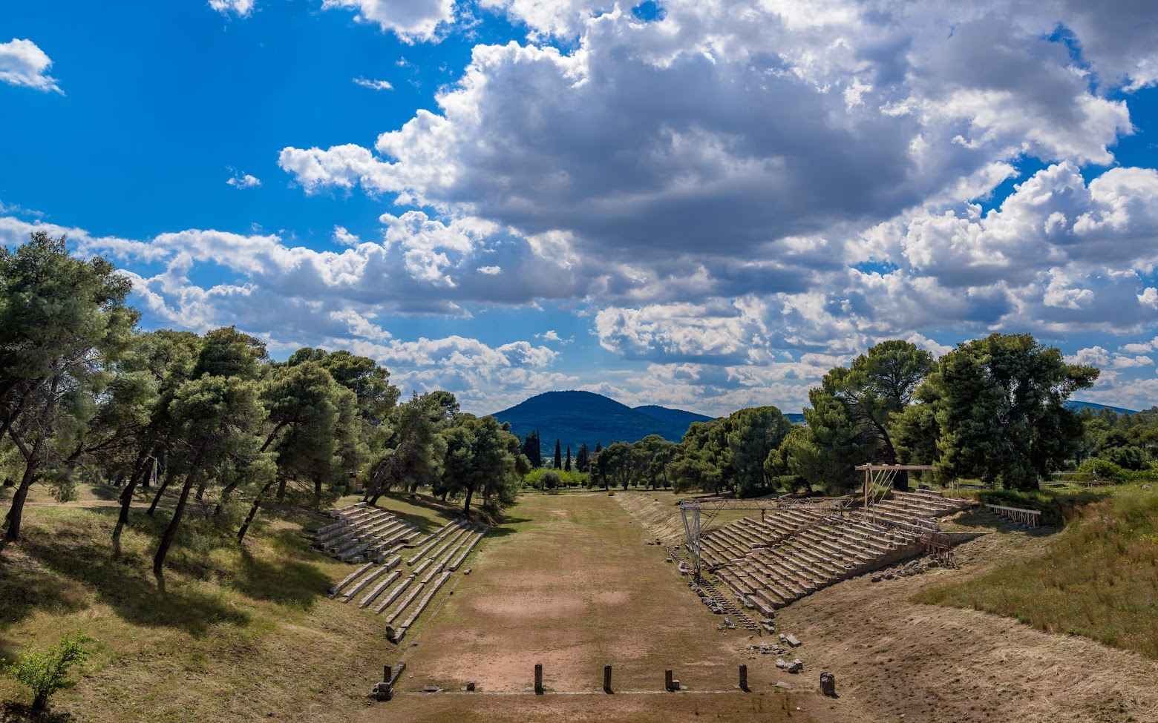
Stadium, Epidaurus

Slide 24
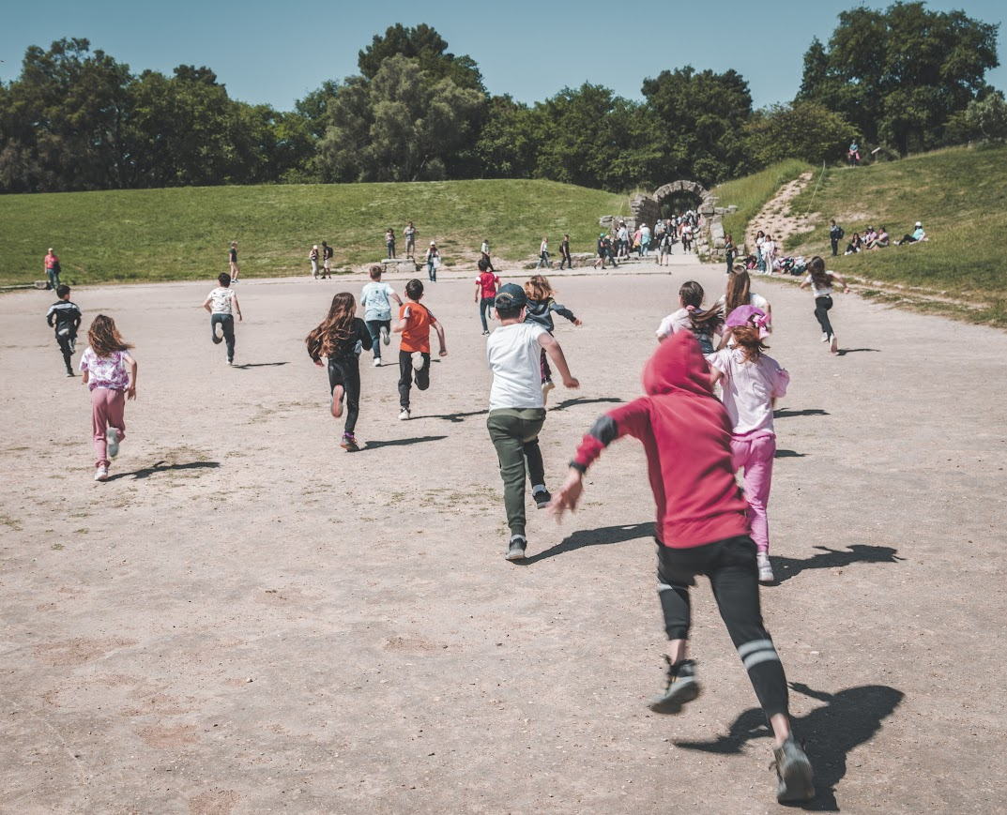
Olympic agōn

