Slide 1
Mind versus Body?
Van Nijf on Imperial Athletics and paideia

Slide 2
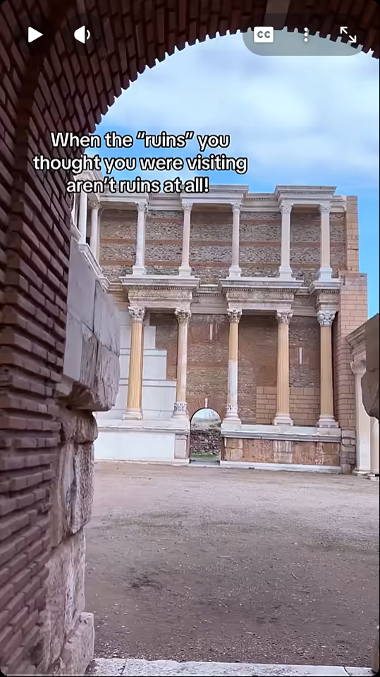
First, a video (YouTube)…

Slide 3
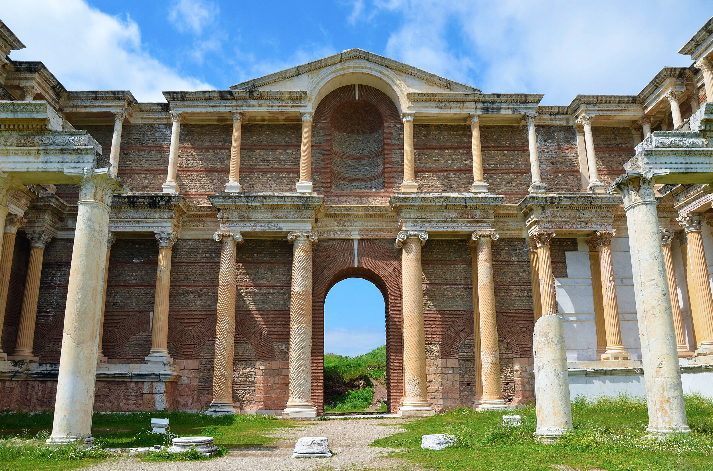
If she had words, what might she say?

Slide 4
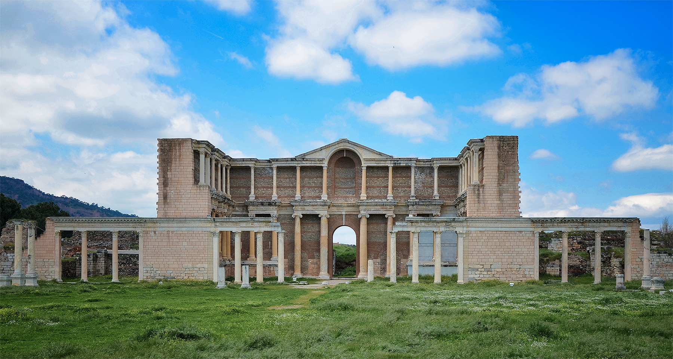
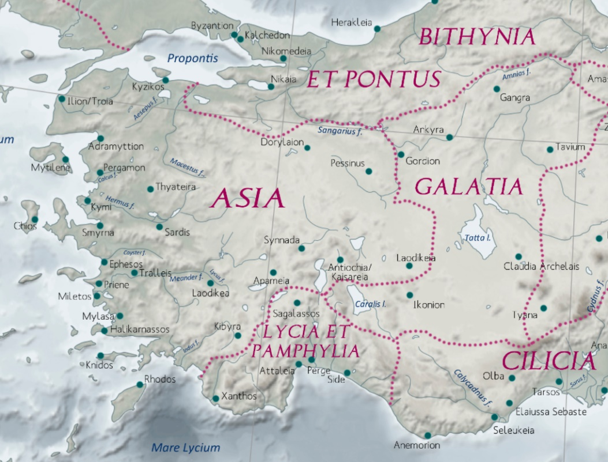
Gymnasium complex, Sardis, Asia Minor. Late 2nd/early 3rd CE
Sardis
Oinoanda
Gymnasium complex, Sardis, Asia Minor. Late 2nd/early 3rd CE
Notes:
gumnasion. Also spelled gymnasion, in Latin, gymnasium. The word derives from gumnos, "nude/naked." It was where Greek men and boys exercised in the nude. Originally, it would have simply been an open field outside the city. In the Roman East, gumnasia could be exercise-bathing establishments on a grand scale, and inside the city. Greco-Roman gymnasia were still a locus of physical training, but also offered a place for intellectual training. In addition to bathing facuilities, such establishments might boast of a roofed, indoor track (a xustos) and an auditorium.
you see here remains of the gymnasium in sardis, in the roman province of asia. but we’re more interested in another city to its south west, Oinoanda

Slide 5
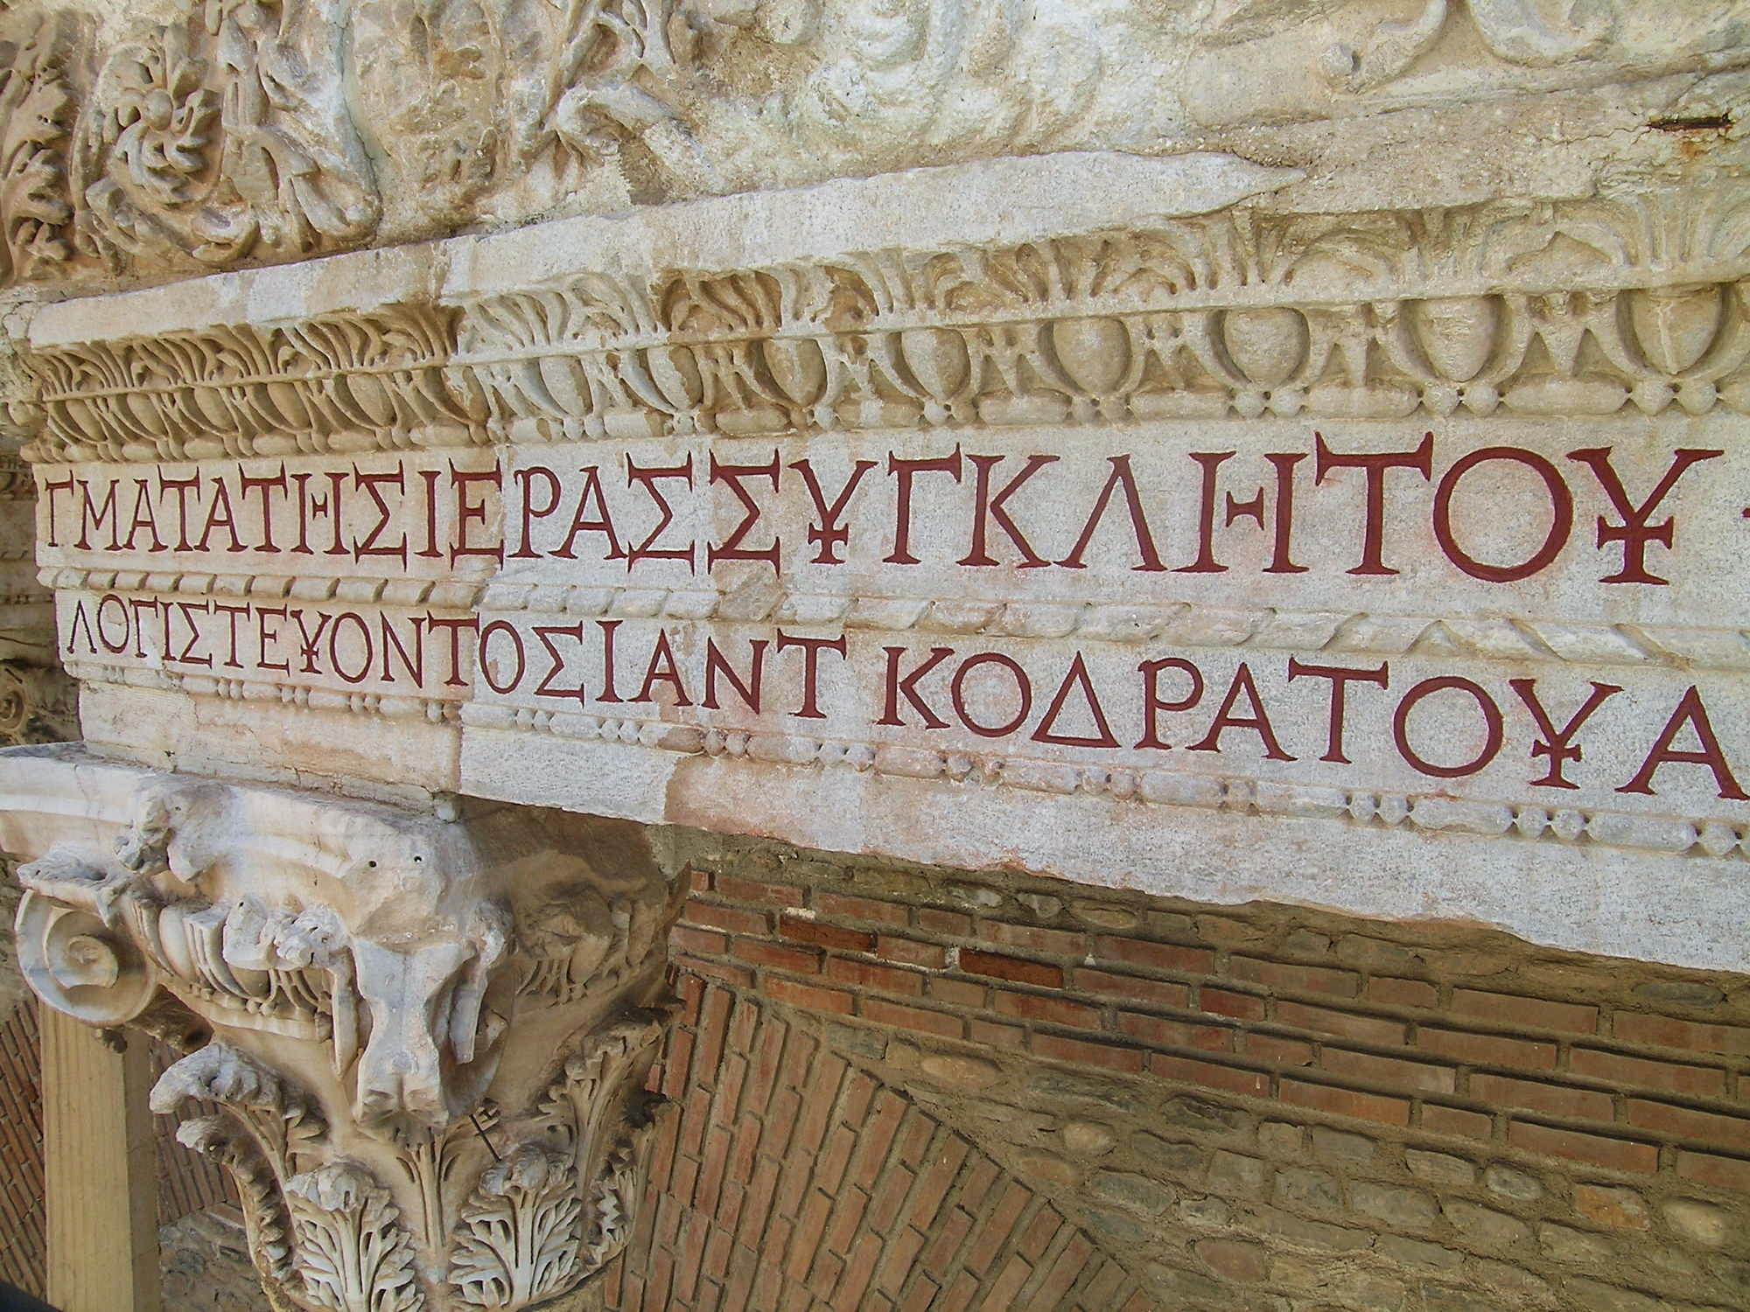
Part of inscription dedicating the Sardis Gymnasium to the Imperial family (among others), 211/12 CE
Notes:
Inscribed First Story Architrave of Marble Court: Building Inscription Dedicated to "the gods of our fathers," Caracalla, Geta, Julia Domna, the Imperial Family, the Senate, and people of Rome
Monograph 14: Sardis: Greek and Latin Inscriptions, Part II: Finds from 1958 to 2017 (2019) Cat. 419
Date 211–212 AD
Line 1: [Θεο]ῖς πατρίοις καὶ Αὐ[τοκ]ράτορι Καίσα|(2)ρι Μ. Αὐρ. Ἀντωνίνῳ Εὐσεβε[ῖ Σεβαστῷ καὶ] | Αὐτοκράτορι Καίσαρι Πο. Σε⟦[πτιμίῳ Γέτᾳ]⟧ |(4) Σεβαστῷ καὶ Ἰουλίᾳ Σεβαστῇ, μητρὶ κ[άστρων καὶ τῶν | αὐτο]κρατόρων καὶ παντὶ τῷ οἴκῳ τῶν Σεβαστῶν καὶ ἱε|(6)[ρ]ᾷ συγκλήτῳ καὶ δήμῳ Ῥωμαίων ἡ μητρόπολις τῆς | Ἀσίας καὶ δὶς νεωκόρος τῶν Σεβαστῶν κατὰ τὰ δό|(8)γματα τῆς ἱερᾶς συγκλήτου, v φίλη καὶ σύμμαχος |
Line 2: [Ῥωμαίων] καὶ οἰκεία τῶν κυρίων ἡμῶν αὐτοκ[ρατόρ]ων Σαρδιανῶν πό|(10)[λ]ις τὸ ἀλειπτήριον ἐκ θεμελίων σὺν παντὶ τῷ [ . . . . . κόσμῳ] | κατεσκεύασεν ἐπὶ ἀνθυπάτου Τ⟦ . . . . . . . . . . . . ⟧, ἐπιτροπεύοντος τῆς Ἀσ[ία]ς Δι|(12)ονυσίου τ[οῦ κρατί]στου, λογιστεύ[ο]ντος τῆς πόλεως [ . . . . . . . . . . . . . | . . . . το]ῦ κρατ[ίσ]του ἀνθυπάτου Ἑλλάδος. vac. |(14) Ἐχρυσώθη δὲ τὸ ἔργον ὑπό τε τῆς πόλεως καὶ Ἀντωνί|ας Σαβείνης ὑπατικῆς καὶ Φλαβίας Πωλλίττης ὑ[πατικῆς, |(16) λο]γιστεύοντος Ἰ. Ἀντ. Κοδράτου Ἀττάλου τοῦ κρατίστου. leaf
Inscription Translation
“To the gods of our fathers and to Imperator Caesar Marcus Aurelius Antoninus Pius Augustus and to Imperator Caesar Publius Se⟦ptimius Geta⟧ Augustus and to Iulia Augusta, Mother of the Camp and of the imperatores, and to the entire house of the Augusti and to the sacred Senate and to the People of the Romans the city of the Sardians, the metropolis of Asia and keeper of two Koinon temples of the Augusti by virtue of the decrees of the sacred Senate, friend and ally of the Romans and relative of our lords the imperatores, has built the aleipterion from the foundations, with the entire [ - - - decoration] under the proconsul T⟦ - - - ⟧, while the vir egregius Dionysios was procurator of Asia and the vir egregius [ - - - ], proconsul of Hellas, was curator of the city. The building was gilt by the city and by the woman of consular rank Antonia Sabina and by the woman of consular rank Flavia Politta while the vir egregius Iulius Antonius Quadratus Attalus was curator.”
https://www.sardisexpedition.org/en/artifacts/m14-419

Slide 6
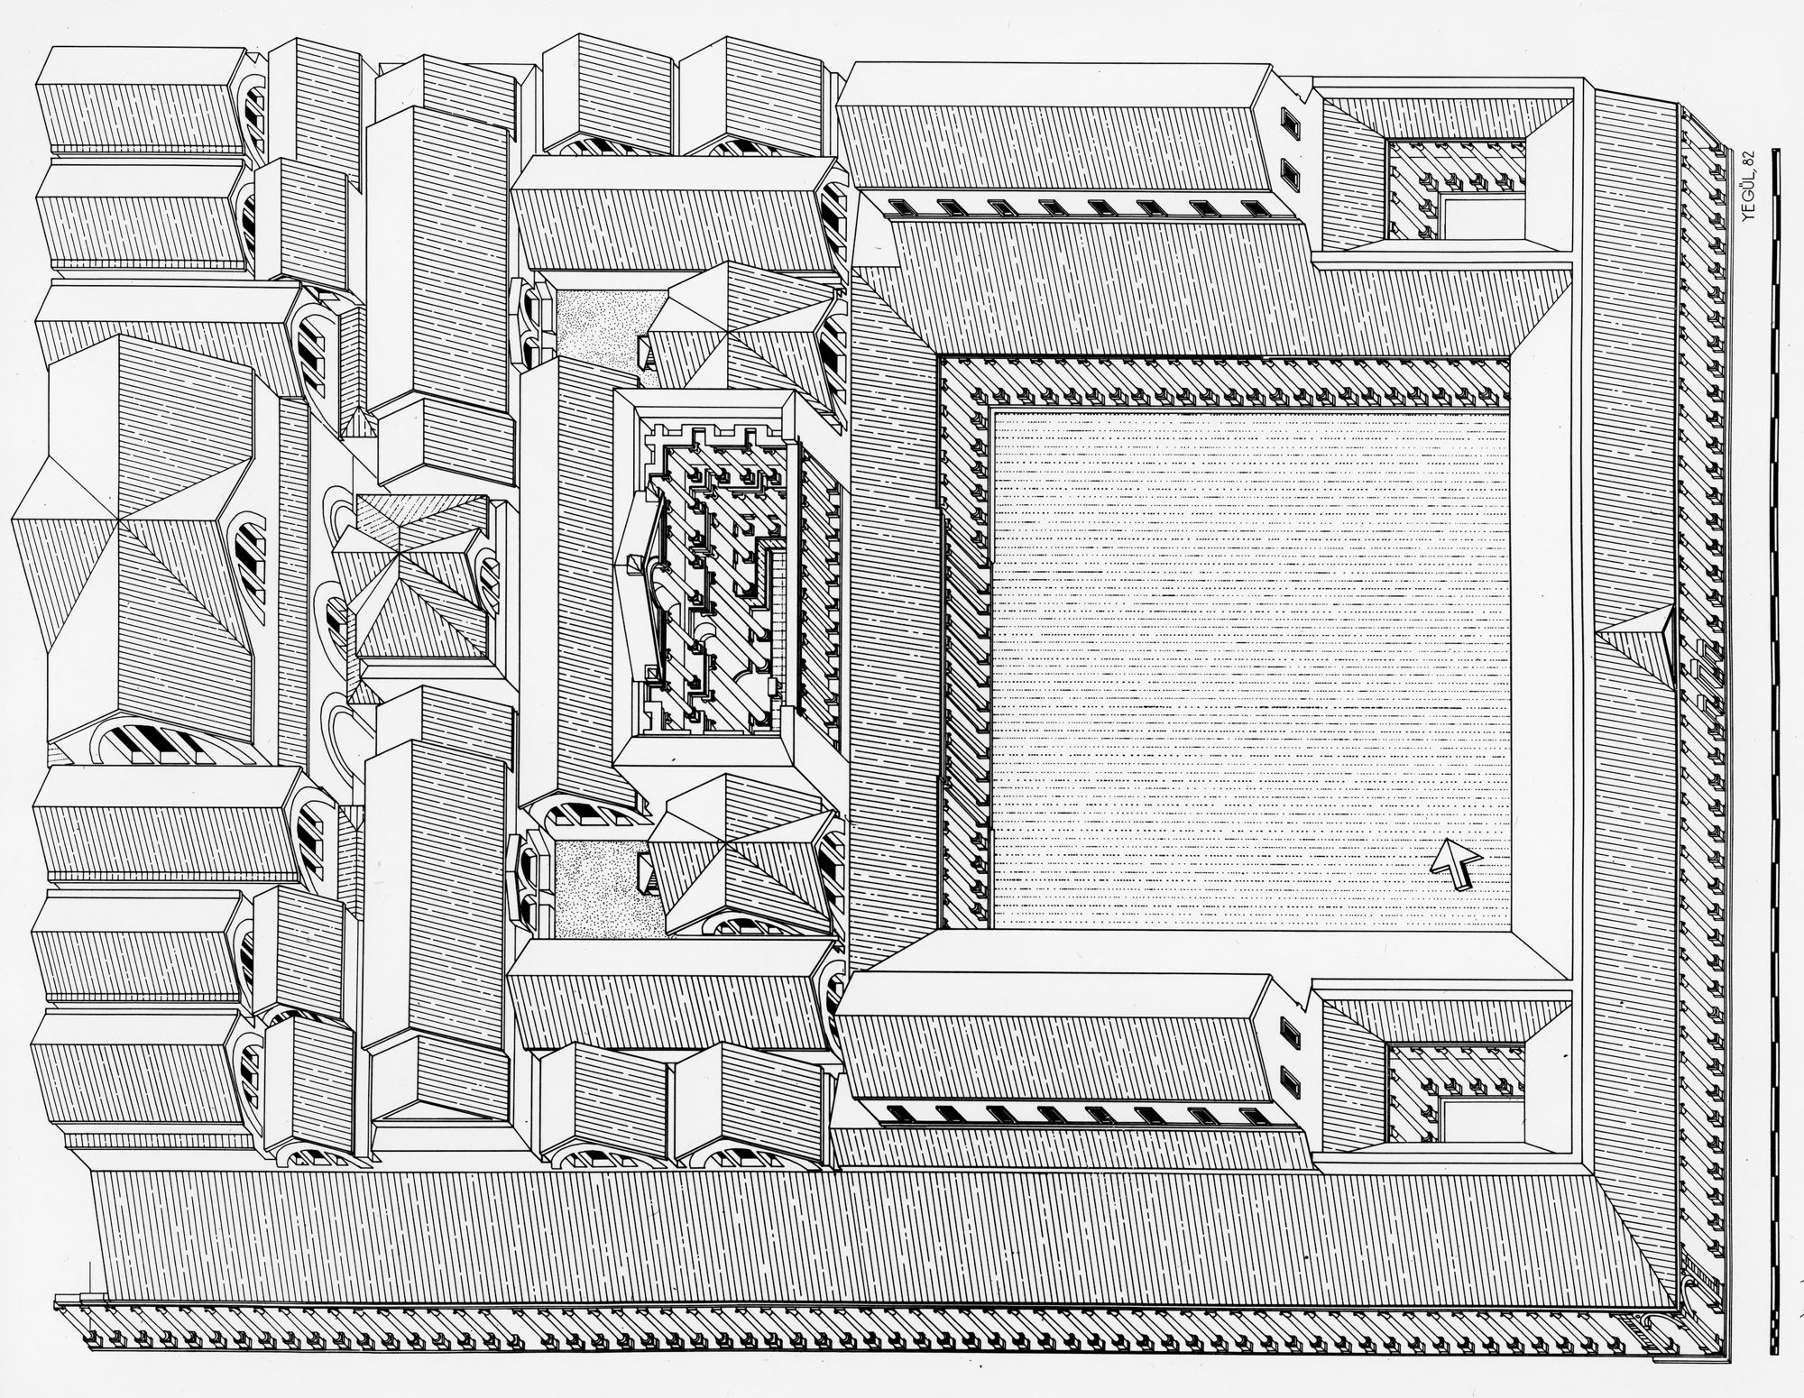
Gymnasium, Sardis. Axionometric reconstruction
The Archaeological Exploration of Sardis
Digital Resource Center
bath
complex
marble
court
palestra
(wrestling hall)
sardisexpedition.org
Notes:
paideia?
“It is highly probable that the palaestra was used as an athletic facility for the public even during the hours when the hot baths were closed. Whether or not it assumed the position of a formal center for athletic and intellectual education is more difficult to decide.”
Yegül, Fikret K., "The Bath-Gymnasium Complex at Sardis" (1986). Archive of Mesopotamian Archaeological Reports (AMAR). 220. p. 9 n. 35. https://commons.library.stonybrook.edu/amar/220

Slide 7
Agenda
Athletics Wrap-Up
  Lingering Issues
Daily Dilemma
  Was the Second Sophistic … Athletic?
“The World of the Gymnasium”
  Body and Mind, Leisure and Toil

Slide 8
Athletics Wrap-Up
Lingering Issues

Slide 9
Athletics Wrap-Up 1
Heavy athletics (boxing, wrestling, pancratium)
  Single bout ending in surrender/defeat
Intellectual resistance to athletics
  E.g., Dio Chrysostom, Galen: athletics as decadent
Athletics as exclusively elite?
  Mark Golden on the uncertainties

Slide 10
Athletics Wrap-Up 2
Melancomas (Dio Orations 28, 29): Real? Ideal?
    Dio Oration 21 On Beauty
    Poliakoff “Melancomas” AJP 1987
    König Athletics and Literature ch. 3
    Newby Greek Athletics in the Roman World (“The Athletic Body: Youth, Beauty, and Sexuality”) pp. 125–134

Slide 11
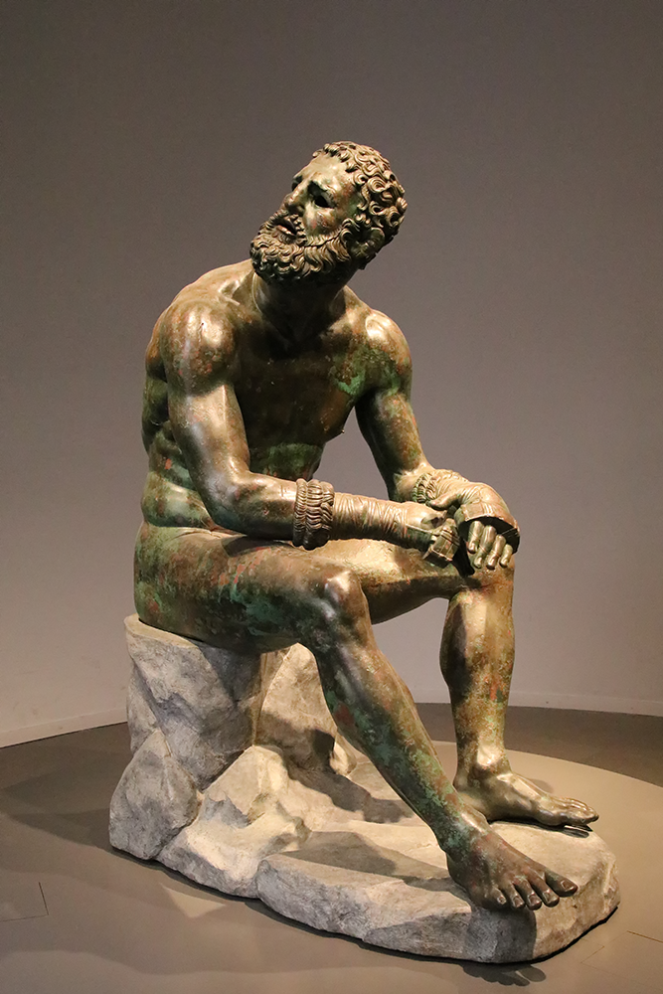
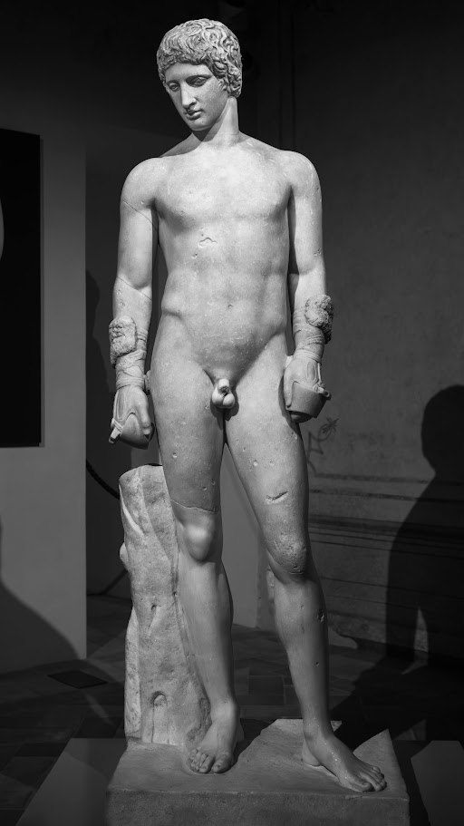
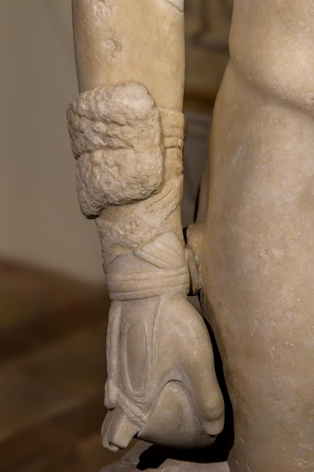
R to L: Kestos. Young boxer, Roman copy (1st CE) of a 4th cent BCE Greek original. “Boxer at Rest,” Greek original (?), 330-50 BCE

Slide 12
Daily Dilemma
Was the Second Sophistic … Athletic?

Slide 13
SWA Prompt
What is van Nijf’s (fahn NAYF) basic thesis? With which ideas previously encountered in this course does it engage? Do you have any feedback for the author?
Notes:
211 citing könig on phil. gym. on athletics as element of Greek ID under Rome:
“We probably have to place the Gymnasticus of the sophist Philostratus in this epideictic tradition. We do not quite understand the nature of this text, and interpretations have varied from a handbook for trainers to an elaborate pastiche. In a forthcoming study Jason Köning [Athletics and Literature ch7] has argued that we should take this text seriously as a sophisticated treatise on the value of traditional athletics for con-temporary Greek paideia in a world that was dominated by Rome. The text emphasises the educational value of athletic training and stresses the importance of a high morality of trainers and athletes alike. It refers to the glory that awaits the victorious athlete, warns against corruption, and of course appeals to the glorious Greek past, which was the stock in trade of the able sophist, using famous athletes as examples.”
Tim Whitmarsh makes the case in the same collection that exclusive focus on literary prose of the period privileges elites and obscures literary subelites, who were producing Greek poetry under Roman (including Imperial) patronage. Yet they’re just as invested in negotiating the position of Hellenic culture within a Roman-Imperial world.

Slide 14
“The World of the Gymnasium”
Body and Mind, Leisure and Toil

Slide 15
The World of the Gymnasium 1
gumnastikē alongside paideia, always!
Bathing alongside gymnasium, always!
  Roman-style baths, Imperial period

Slide 16
The World of the Gymnasium 2
Gym as educational institution
  paidotribēs, grammatikos
“Paideia was also a ‘spectators’ sport” (p.
  Intellectual, physical agōn

