Slide 1
What Are Heroes For?
Philostratus’ Dialogue on Heroes
Notes:
https://theshieldofachilles.net/disappearance/the-epic-death-of-achilles/deathofachilles_rumpf_chalkidischevasen_colorized-in-the-manner-of-the-inscriptions-painter/
Vail’s colorized rendition of a B&W drawing of a lost Chalcidian Black-Figure Amphora from 540-530 BCE by the Inscriptions Painter depicting the epic death of Achilles. Note the arrow in Achilles’ ankle. Above Achilles stands Aias fighting off Paris with his bow still drawn.
Source: Wikimedia Commons

Slide 2
Question…
What is it, to be a hero ?
Quickly write down something, anything, that says what you think

Slide 3

How does that differ from what you think? (YouTube: MARVEL | What is it, to be a hero ?)
Notes:
“What is it, to be a hero? Look into the mirror, and you’ll know.”
“This is your chance to become the hero that she (your daughter) already thinks you are. It’s not about saving our world. It’s about saving theirs.”
“Look into your own eyes and tell me, you’re not heroic. That you have not endured, or suffered, or lost the things you care about most. And we can always choose to do what’s right.”
“It’s the choices that make us who we are.”
“Because a hero isn’t someone living above us, keeping us safe. A hero is not a god or an idea. A hero is here, on the street, among us, with us, always here but rarely recognized. Look in the mirror and see yourself for what you truly are.”
Creator’s comment:
“This is definitely the biggest project I have made since my first video. I can't believe I finished it. It's not the longer one, I know, but the hardest one for sure. I wanted to make a MARVEL video since a long time and I finally made it! I wanted to send a message that being a hero isn't about having super-powers but it's about our choices. " It's the choices that make us who we are, and we can always choose to do what's right."

Slide 4

Agenda
Introduction
Philostratus’ Dialogue on Heroes
Discussion 1
What Are Heroes For?
Competition and Its Discontents
Emotion in Philostratus’ Dialogue
Discussion 2
Philostratus’ Dialogue as a Sophistic Text?

Slide 5
Introduction
Philostratus’ Dialogue on Heroes

Slide 6
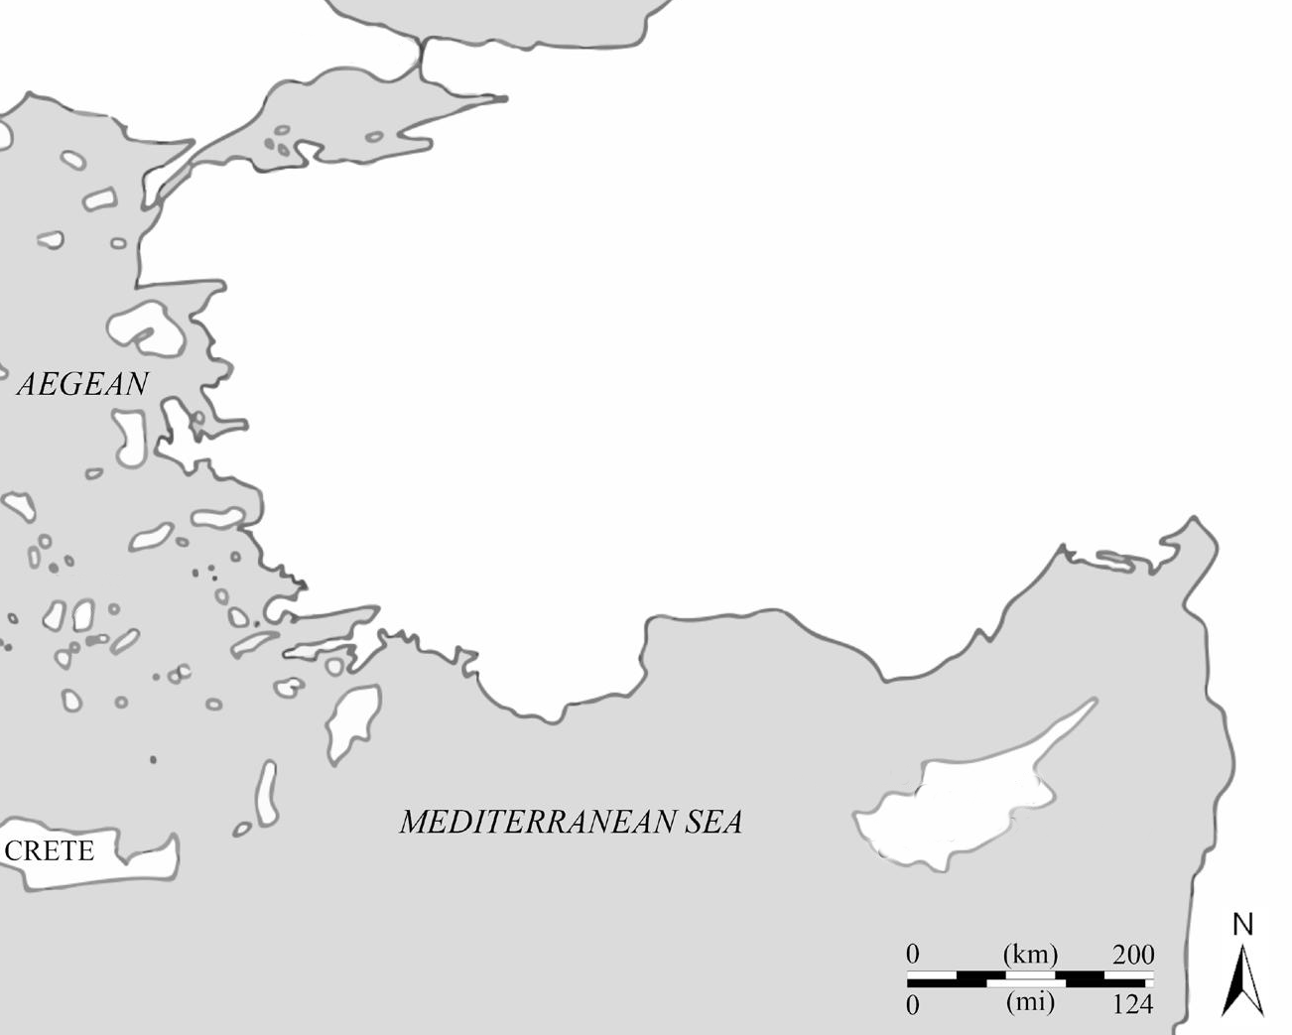
Philostratus’ Heroes, Intro 1
Author
Philostratus (again)
Date of composition
222–225 CE
Setting
Elaious
Author’s here and now
Elaious/Elaeus
Mysia
Troy
Anatolia
Phoenicia

Slide 7
Philostratus’ Heroes, Intro 2
Form
Dialogue
Speakers
(Greek) vinedresser
Phoenician merchant
Elaious/Elaeus
Mysia
Troy
Anatolia
Phoenicia

Slide 8
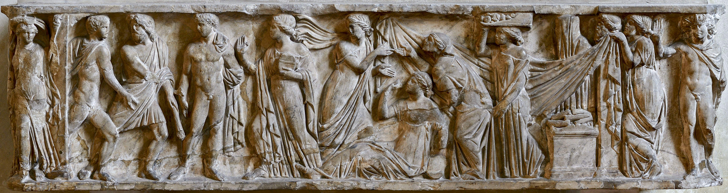
Philostratus’ Heroes, Intro 3 (situation)
Phoenician
Becalmed
Curious (about heroes)
Vinedresser
Well-informed (about heroes)
Eager to share
Protesilaus, Laodamia (sarcophagus, 2nd cent, Santa Chiara, Naples)

Slide 9
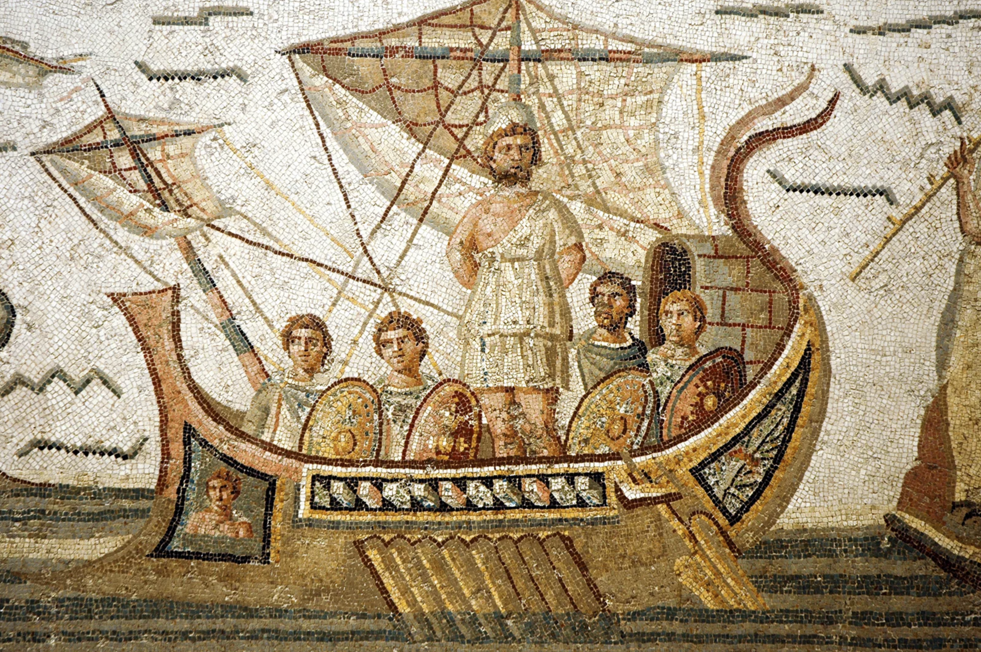
Philostratus’ Heroes, Intro 4 (issues)
Homeric correction
Suborned testimony
Contest, Exemplarity
Contest/rivalry
49+ times in Heroicus
aristeia (“meed of honor”)
E.g., Palamedes’ (Heroicus 33.19)
Odysseus, mosaic, ca. 260 CE, Thugga, Tunisia

Slide 10
Discussion 1
What Are Heroes For?

Slide 11
Quotations 1 (The Phoenician’s incertitude)
Vinedresser: [Protesilaus’] fellow soldiers at Troy here also still appear on the plain, looking very warlike and shaking their crests.
Phoenician: By Athena, vinedresser, that I cannot believe. (p. 109)
Phoenician: I desire to hear … whether the individual heroes were as handsome, brave and wise as the poems say. (p. 121)
Notes:
summarize the situation.

Slide 12
Quotations 2 (Achilles mourns Palamedes)
Vinedresser: [Achilles] composed a song for the lyre on Palamedes, and sang of him as of the heroes of old; and he prayed that he visit him in a dream, …. This hero appeared not only to Achilles, but to all those who loved (who had erōs for) strength and wisdom, to be worthy of song and admiration (zēlos)…. (pp. 237–239)
Notes:
what is Palamedes to achilles and the other Greek heroes at troy?

Slide 13
SWA Prompt
How do you think the dialogue would define heroism, that special something that makes heroes heroes? Is male gender a requirement? What are heroes good for in the here and now? And what do you think a hero is?
Notes:
He says that the women of Mysia also helped their husbands to fight on horseback, like Amazons, and the commander of this cavalry was Telephus’ wife Hiera. She is said to have been killed by Nireus—the youngest and least well-known part of the army had been assigned to oppose the women—and when she had fallen the Mysian women shouted in alarm, frightening their horses, and were carried away to the marshy ground around the Kaikos. This Hiera, claims Protesilaus, was the tallest woman he had ever seen, and the fairest of all who were famous for beauty. As for Menelaus’ wife Helen, he didn’t see her at Troy, but he sees her now and finds no fault with dying for her; but when he remembers Hiera, she seems to him to surpass Helen by as far as Helen did the women of Troy. Yet not even such a woman, stranger, received Homer’s praises, but in deference to Helen he did not introduce into his poems the godlike woman over whom the Achaeans are said to have been moved even when she had died, and the older soldiers commanded the younger ones not to strip the arms from Hiera, or even to touch her corpse.
HEROISM: not just extraordinary stature, beauty, prowess wisdom. benefit to humanity, example to imitate.
but also, because, extraordinary, object lessons: in self-control and its absence, in competition and its discontents.

Slide 14
Competition and Its Discontents
Emotion in Philostratus’ Dialogue

Slide 15
Arrow of Emulation
Notes:
Here, the urge to excel is sparked by the knowledge or thought of another’s excellence, which that “other” embodies for the emoting subject. In so doing, the “other” becomes the target of the emoting subject’s emulousness, in Greek, zēlos, though Philostratus seems to prefer to call it philotimia, usually translated as “ambition.” In any case, this “arrow of emulation” is bidirectional. Thus the emoting subject is also subject to emotion. For the image of another’s excellence leaves a certain sting, so Aristotle, in the affected person, who seeks relief by closing the perceived gap between self and other. Viewed thus, ancient Greek emulation is not so different from envy, phthonos. Each causes pain in the emoting subject. Each mediates what Latour would call a “momentary association,” a “network” impacting anyone or anything implicated in a given emotion event. And in so doing, emulation and envy, zēlos and phthonos, make themselves available as a way to make sense of why a given rivalry turned out as it did. (Think of your friend explaining a colleagues’s behavior by saying, “Oh, they’re just jealous!”) And it is principally in terms of the perceived results of a given rivalry, whether for good or for ill, that emotion attribution proves useful as what Edith Eidinow would term a “sense-making technique.”

Slide 16
Envy-Slander “Vicious Triangle” 1
powers that be C (audience for slander)
envy
rival A (source of slander)
rival B (target of slander)
Cf. Lucian Slander; see Scholtz AJP 147.1 2026
Notes:
The envy that Protesilaus attributes to Odysseus seems largely an inference from Odysseus’ actions, which don’t make much sense unless motivated by envy. For why else would a fellow Greek destroy so invaluable an asset to the Greek cause? When breaking down envy attribution as sense-making, we need, as in the case of emulation, to consider the relationality of actors — both persons and things — implicated in a given emotion event, and how, once emotion enters into the picture, it reconfigures those relationships. Consider how Lucian presents diabolē, the process of slandering someone, as a “drama” (drama) whose chief “characters” (prosōpōn, 6) include, notably, envy (Slander 10 et passim). Keeping with this drama metaphor, I suggest that we attend to the underlying script, and especially to the role played therein by envy. Think of it as a kind of vicious triangle. Rival A, envying rival B, slanders B to a person or persons C wielding power over both A and B. Carelessly susceptible to A’s suggestions, C is drawn into a dysfunctional bond with A, and to B’s detriment:

Slide 17
Envy-Slander “Vicious Triangle” 2
Agamemnon (audience for slander)
envy
Odysseus (source of slander)
Palamedes (target of slander)
Notes:
We see much the same vicious triangle play out in Odysseus’ rivalry with the individual whom the vinedresser clearly singles out as the greatest of the heroes at Troy: Palamedes. Thus Odysseus, the very embodiment of envy (34.1), resented the more junior and, arguably, bluntly undiplomatic Palamedes for a number of slights. That, combined with a series of wins for the younger man, induced Odysseus to embark on a whisper campaign with the result that a worthy competitor fell prey to the machinations of a resentful rival, and in no small measure due to the credulousness of a ruler’s — Agamemnon’s — failure to do due diligence (33.8–33). As in Lucian’s essay, so here, envy attribution makes sense of how rivalry can go all wrong. But Odysseus’ envy also helps Philostratus’ speakers evaluate the quality of the hero’s heroism, which, it is clear, lags behind that of Achilles, Ajax, and especially Palamedes, heroes earning approbation for the zēlos that they inspire or are inspired by.

Slide 18
Envy-Slander “Vicious Triangle” 3
Olympic judges (audience for slander)
envy
Olympic judges (source of slander)
Helix athlete (target of slander)
Notes:
Phoenician. You have made me weep, by Helios, for both their fates are indeed alike, and appropriate for mutual goodwill; shared good fortune sometimes produces envy, but those who share sorrows love each other and feel mutual sympathy. (p. 165)
Phoenician. [Helix] already had one victory wrestling in the men’s, though belonging to the boys, and in the Olympiad after that he entered both the wrestling and the pankration, which so angered the Eleans that they intended to bar him from both, charging him with infringement of the Olympic rules; they barely crowned him for the pankration. It was this envy that Protesilaus predicted he should guard against, since he knew it opposes men of achievement.
cf. Sardanapalus was conducting games and numerous spectacles in which Aurelius Helix, the athlete, won renown. This man so far surpassed his competitors, that he desired to contend in both wrestling and the pancratium at Olympia, and actually did win in both events at the Capitoline Games. But the Eleans were jealous of him [phthonēsantes autōi, "envying him"; compare phthonos, "envy"], fearing that he might prove to be "the eighth from Hercules," as the saying has it, and so would not call any wrestler into the stadium, even though they had announced this contest on the bulletin-board; in Rome, however, he won both events, a feat that no one else had accomplished. (Cassius Dio 79.10.3)
οἱ μὲν γὰρ Ἠλεῖοι φθονήσαντες αὐτῷ, μή (τὸ λεγόμενον δὴ τοῦτο) ἀφ’ Ἡρακλέους ὄγδοος γένηται, οὐδὲ ἐκάλεσαν ἐς τὸ στάδιον παλαιστὴν οὐδένα, καίπερ ἐν τῷ λευκώματι καὶ τοῦτο τὸ ἄθλημα προγράψαντες· ἐν δὲ δὴ τῇ Ῥώμῃ καὶ ἐνίκησεν ἑκάτερον, ὃ μηδεὶς ἄλλος ἐπεποιήκει.

Slide 19
Discussion 2
Philostratus’ Dialogue as a Sophistic Text?

