Slide 1

What Really Matters?
Artemidorus’ The Interpretation of Dreams

Slide 2
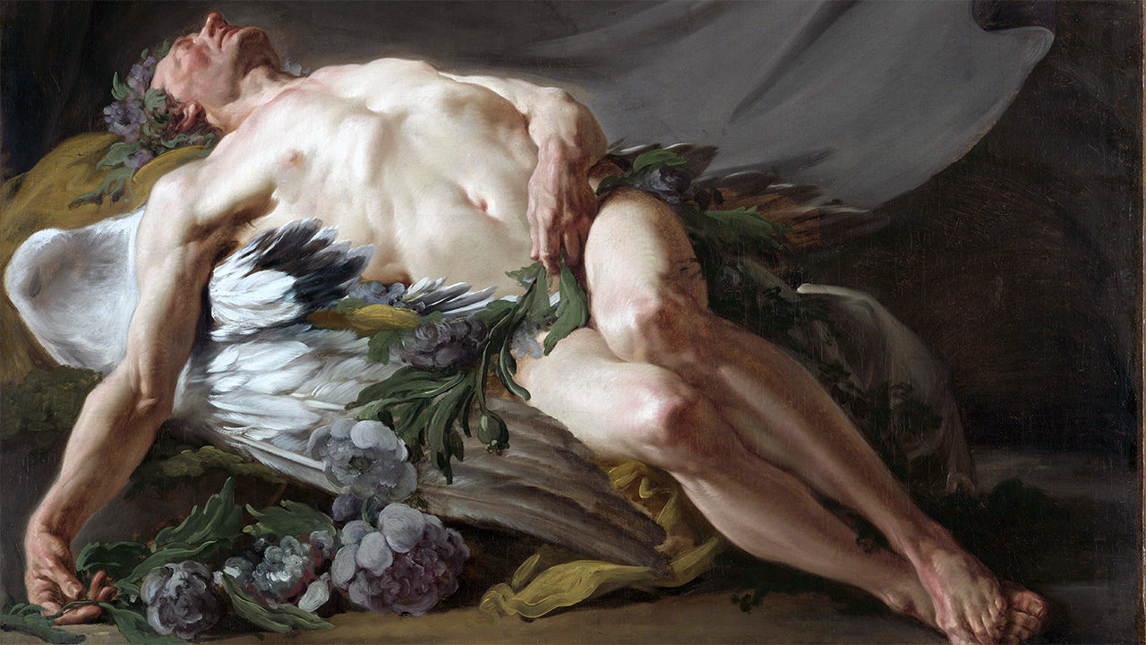
“For the Greeks, as for other ancient peoples, the fundamental distinction was that between significant and nonsignificant dreams….”
(E. R. Dodds The Greeks and the Irrational 1951 pp. 106–7)

Slide 3
Put differently, which dreams matter, and why?
Notes:
So, I have a question for you: Which dreams matter, and why? Write something quick….

Slide 4

Inception, 2010. Leonardo DiCaprio, Joseph Gordon-Levitt, Ellen Page. Directed by Christopher Nolan
Notes:
Which dreams matter, and why? In the film Inception, dreams fabricated by oneself or others, they really matter — they can threaten our “security,” as Leo puts it.
What about our dreams, yours and mine?
Take a some of the dreams I have. In them I find myself thinking about exactly the thing I’m thinking about when I wake up. It can be anything — the ending of Bruckner’s fourth symphony, for instance. (I don’t know why I think about that with a certain regularity, but I do.) Or maybe I wasn’t dreaming. But I know I was: my wife and dog are downstairs, and I didn’t notice them leave the bed.
One more dream — this one I’ll never forget. So, I’m on stage. In my hands is a guitar. Behind me, an orchestra. In front of me, an auditorium filled with people. The conductor lifts his baton, and I realize I’ve never played the guitar before.
So, do either of those dreams matter? Should I care? Why or why not?

Slide 5
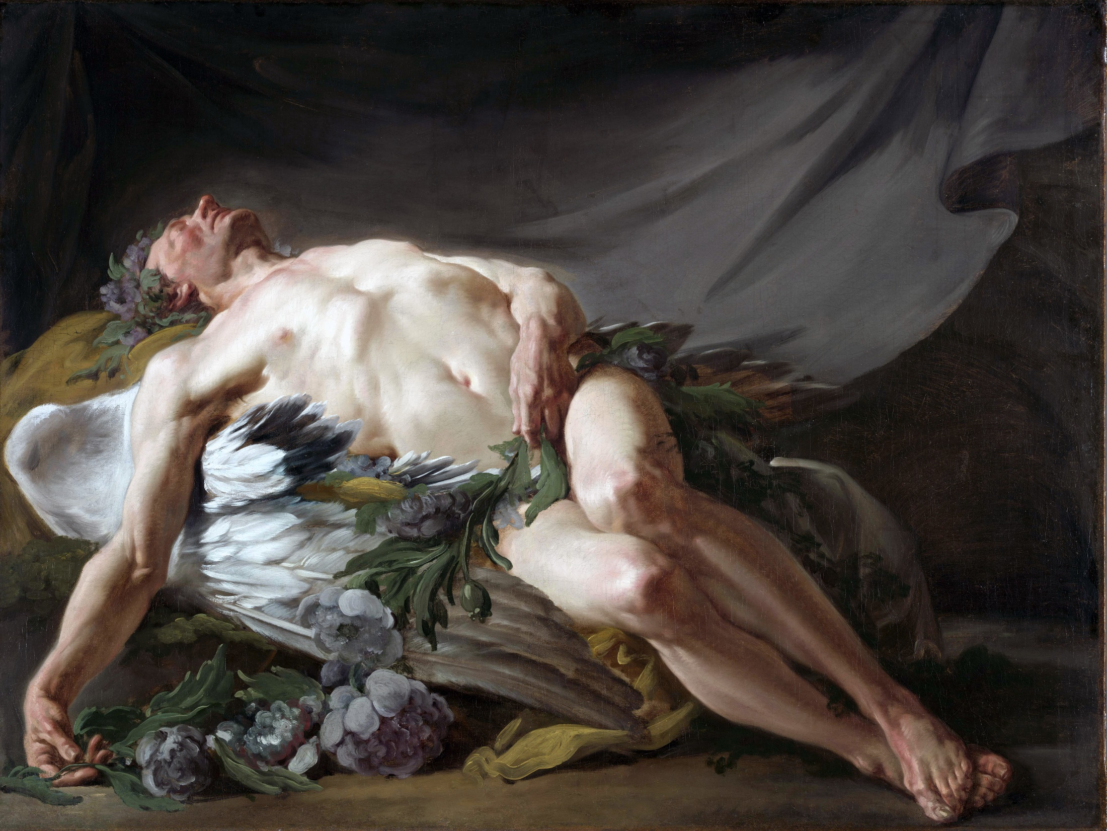
What matters to Artemidorus, and why should that matter to us?
Restout, “Morpheus” (god of dreams), ca. 1771

Slide 6
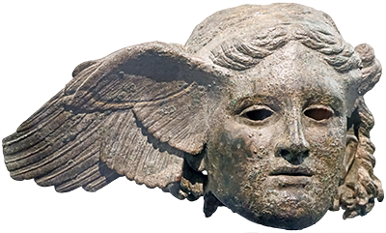
Agenda
Discussion 1
Daily Life as agōn?
Artemidorus’ Oneirocritica
A Quick and Dirty Introduction
Hands-On Learning
You Can “Artemidorus,” Too!
Hypnos, god of sleep. 1st/2nd cent CE Roman copy

Slide 7
Discussion 1
Daily Life as agōn?
Notes:
One way that what matters to Artemidorus could well matter to us is what his book can maybe tell us about his world. And because this course is, as you know, called “Race for Glory,” I’ve posed the question of whether his book can extend our understanding of agōn in the Roman Imperial East. So, …

Slide 8
SWA Prompt
How does this reading either reinforce or modify your view of the Imperial East during the period of the second sophistic? How might it add to your knowledge of that period?
Notes:
1.51.2. “To cultivate, sow, plant, or plough the land is auspicious for those intending to marry and for those without children. A field for ploughing can only mean a wife, and seeds and plants the children — wheat for boys, barley for girls, pulses for miscarriages. For everyone else a farming dream signifies hard labour and misery.”
3. “To dream of tanning hides is malign for everyone: tanners handle dead bodies and are prohibited from operating within the city.”
4. “To dream of being a goldsmith signifies devious designs on the dreamer, because of the materials involved in the work and the intricate weaving needed for necklaces.”
“Sculpting, painting on wood, chasing metal, or making statues are auspicious for adulterers, orators, counterfeiters, counterfeiters, and all fraudsters, as these arts present what is unreal as if it were real.”
1.53.1. “… pupils have a hard time and live in terror of their masters, but they learn to their ultimate advantage.”
3. “If a Roman learns to read Greek or a Greek learns to read Latin, the one will come to embrace Greek culture and the other Roman culture. … I know of someone who dreamt that he was learning to read Latin. He was condemned to slavery: such a sentence is never delivered in Greek.”
some interpretation is specifically for athletes. some interpretation of athletic dreams has broader, but varied, meaning.
1.56.7. “To ride a racehorse which responds nicely to the rein and the rider himself is auspicious for all alike, because a horse is analogous to a wife and a lover in that it prides itself on its beauty and supports a mount.”
ἵππον κέλητα ἐλαύνειν καλῶς πειθόμενον τῷ ῥυτῆρι καὶ αὐτῷ τῷ ἐλαύνοντι ἀγαθὸν ἐπίσης πᾶσιν· ἵππος γὰρ γυναικὶ μὲν καὶ ἐρωμένῃ τὸν αὐτὸν ἔχει λόγον, ὅτι καὶ ἐπὶ κάλλει μέγα φρονεῖ καὶ τὸν ἐλατῆρα βαστάζει.
9. “I also maintain that a dream of driving through the city in a chariot is auspicious for women and unmarried girls who are both freeborn and wealthy, as it wins them advantageous positions as priestesses. But for poor women, riding through the city foretells prostitution.”
1.57.1. “I have observed that in all cases a dream of competing in the pentathlon signifies firstly travel abroad or movement from place to place because of the foot-race; and then some sort of financial loss, untimely expense, or unexpected outlay because of the discus, which is made of bronze and flies out of the hands.”
1.59.1. “To dream of being selected for competition is auspicious for all. But for athletes the dream is either insignificant or irrelevant: insignificant for boy athletes, because they are within the age-limit for selection in their class, and irrelevant for grown men, because the vetting process only applies to boys. To dream of being disqualified is harmful for all, and also brings death to the sick. I know of someone who dreamt that he was disqualified at the Olympic games: he was condemned to the mines, as a result of this dream debarring him from the sacred games.”
Ok, Melancomas:
1.61.1. “To dream of boxing is harmful for everyone. It signifies financial damage as well as disgrace, as boxing disfigures the face and causes loss of blood, which has long been considered a symbol of money.”
1.69.1. “It is auspicious to dream of eating the type of bread to which one is accustomed — bran bread is suitable for the poor, and refined white bread for the rich. Swop these round, though, and the result is not only not auspicious, but positively bad: white bread signifies sickness for the poor, and bran bread deprivation for the rich — or at least it prevents achievement of their present hopes.”

Slide 9
Artemidorus’ Oneirocritica
A Quick and Dirty Introduction

Slide 10
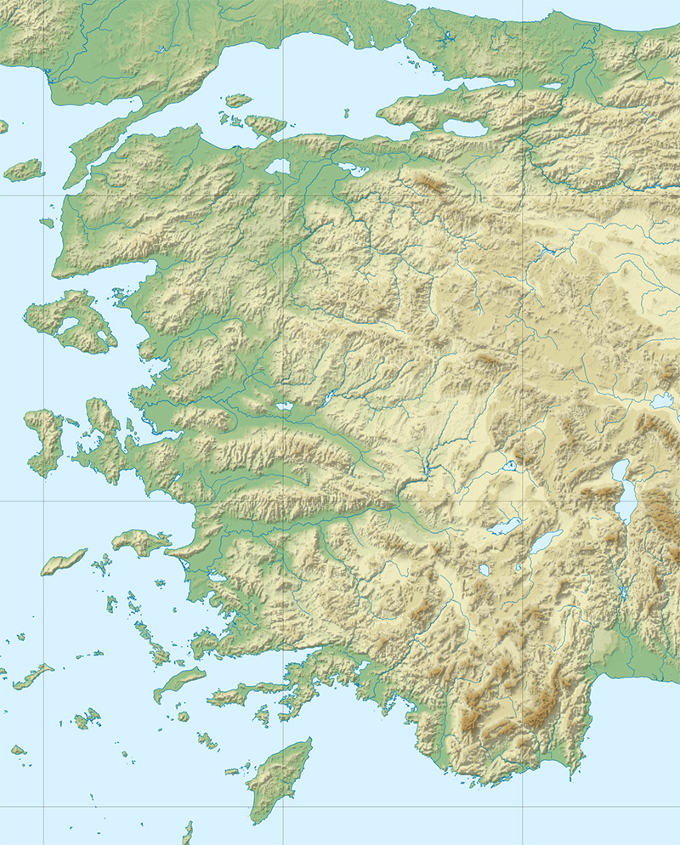
Basic Facts 1
Artemidorus’ bio
Later 2nd, early 3rd cent
Born Ephesus, citizen Daldis
His career
Travels in Asia, Greece, Italy
Active at agonistic festivals
Anatolia
Daldis (?)
Ephesus

Slide 11
Basic Facts 2 — Oneirocritica
Features
Practical
Technical
Non-sophistic
Dream typology
enupnion (enhypnion)
oneiroi
Oneiroi
Theorematic
Allegorical
Analogical analysis
Imagistic versus verbal
Natural versus unnatural

Slide 12
Contextual Focus (1.9)
It will be an advantage, and not only an advantage but a necessity, both for the dreamer and for the consultant, to have the dream-interpreter briefed as to the identity of the dreamer, his occupation, his birth, his financial situation, his state of health, and his age. And the nature of the dream itself must be examined in precise detail — any small addition or omission can skew the predicted outcome, as we go on to demonstrate.
Notes:
This especially is what makes Artemidorus useful to us in this class.
from the introduction:
“For Artemidorus, the meaning of a dream does not depend on an understanding of the dreamer as an individual, but rather on the correct ‘placement’ of the dreamer on a spectrum of social roles and public statuses. Artemidorus gives the example of a pregnant woman who dreams that she gives birth to a serpent (4.67). Seven different possible outcomes are listed, depending on the woman’s place in society: if she is wealthy, the child will become a famous orator, because both snakes and orators have forked tongues; if she is a slave, he will become a runaway slave, because snakes do not move in a straight line; if she is sick, the child will suffer from palsy, since snakes use their whole body to move.”
A cares not about the individual, but about that individual’s role, place in society

Slide 13
Hands-On Learning
You Can “Artemidorus,” Too!

Slide 14
Artemidorus on Cannibalism 1
But in my observation by far the greatest good results from a dream of eating human flesh, though not that of a friend or relative: anyone who dreams of eating a family member will bury whoever it was whose flesh he was eating and will not himself survive long after the person he consumed (the resort to such food is likely to be in some utterly desperate situation, as can happen in times of war or famine). (1.70.2)

Slide 15
Artemidorus on Cannibalism 2
Most ill-omened of all could well be a dream of eating the flesh of one’s own son. That prophesies sudden death — unless, that is, the dream is of eating from those parts of his body which earn the son his living: a runner’s feet, an artisan’s hands, a wrestler’s shoulders. In that case this dream foretells prosperity for the son, and a share in his good fortune for the father. (1.70.2)

Slide 16
Artemidorus on Cannibalism 3
But, this apart, dreams of eating other men’s flesh are auspicious: when men benefit from one another they are in a sense consuming one another. And it is always more auspicious to dream of eating the flesh of men rather than women, and of children rather than older people. (1.70.2)

Slide 17
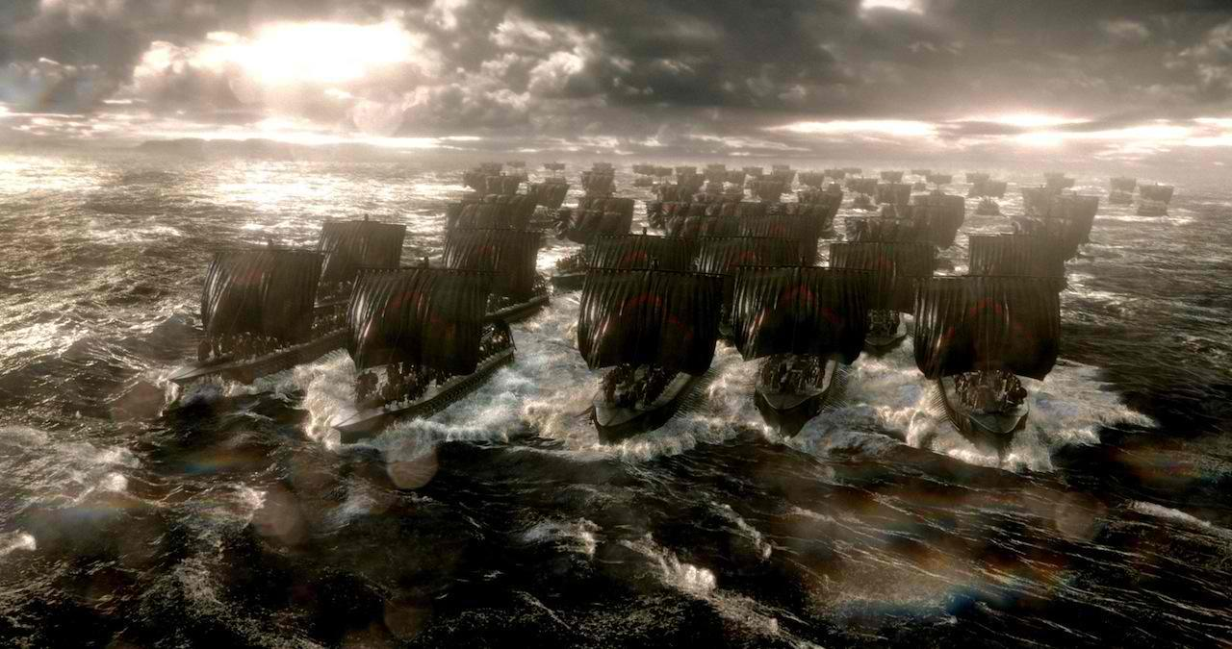
Battle of Salamis, 480 BCE (300: Rise of an Empire)

Slide 18
Hippias before Salamis
Hippias in the past night had seen a vision in his sleep, wherein he thought that he lay with his own mother; he interpreted this dream to signify that he should return to Athens and recover his power, and so die an old man in his own mother-country. Thus he interpreted the vision. (Herodotus 6.107 Loeb)
Notes:
why does he interpret the dream this way?
Aretmidorus:
1.79. Dreams of sex with one’s mother.
1. The subject of sexual intercourse with one’s mother has a multifaceted complexity allowing a degree of analysis which has escaped many of the dream-interpreters. The situation is this. The fact of intercourse is not of itself sufficient to reveal the significance of these dreams, but the outcomes they bring about vary with the various modes of contact and bodily positions adopted.
2. So if someone dreams of penetrating his mother face to face, which some call the position according with nature, and she is still alive when he dreams of this penetration and his father is still in good health, he will fall out with his father because of the jealousy (zēlotupia, often very close in meaning to phthonos) which arises between any men, and would be all the greater in this case. But if his father is ill, he will die, because the dreamer will preside over his mother as both son and husband.
3. 3. But this dream is auspicious for every artisan and labourer. A man’s trade is commonly called his ‘mother’, so coupling with this ‘mother’ can only mean keeping busy and earning a living from one’s trade. It is auspicious too for every politician and statesman, because a mother symbolizes one’s homeland. So just as anyone having sex in accordance with the law of Aphrodite, with a compliant and willing partner, is given authority over every part of her body, so a politician or statesman having this dream will preside over all the affairs of his city.
Freud Interpretation of Dreams
“To express the matter boldly, it is as though a sexual preference becomes active at an early period, as though the boy regards his father as a rival in love, and as though the girl takes the same attitude toward her mother—a rival by getting rid of whom he or she cannot but profit.”
cf. Sophocles Oedipus the King
Jocasta. It is best to live anyhow, as one may; do not be afraid of marriage with your mother! Many have lain with their mothers in dreams too. It is he to whom such things are nothing who puts up with life the best. (lines 979-983)

Slide 19
Hippias before Salamis, cont’d
Now while he dealt with these matters he fell to sneezing and coughing…; he was well stricken in years, and most of his teeth were loose; thus the violence of his cough made one of his teeth fall out. It fell into the sand, and Hippias used all diligence to find it; but the tooth being nowhere to be seen, he said…, “This land is none of ours, nor shall we avail to subdue it; my tooth has all the share of it that was for me.” (Herodotus 6.107 Loeb)

Slide 20
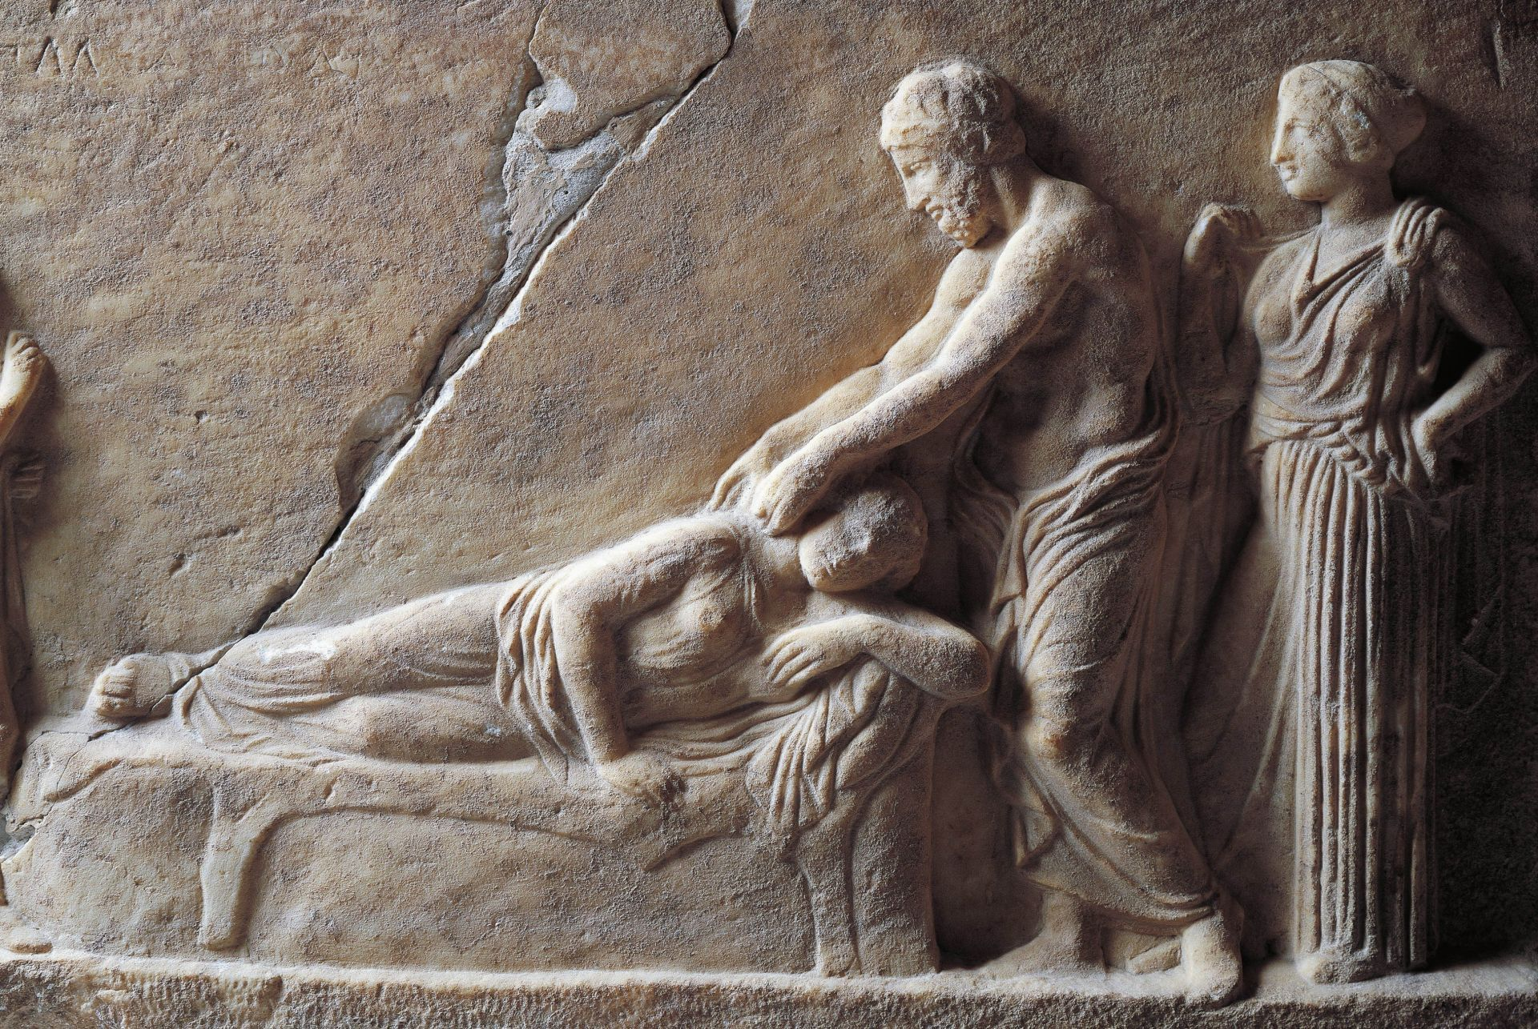
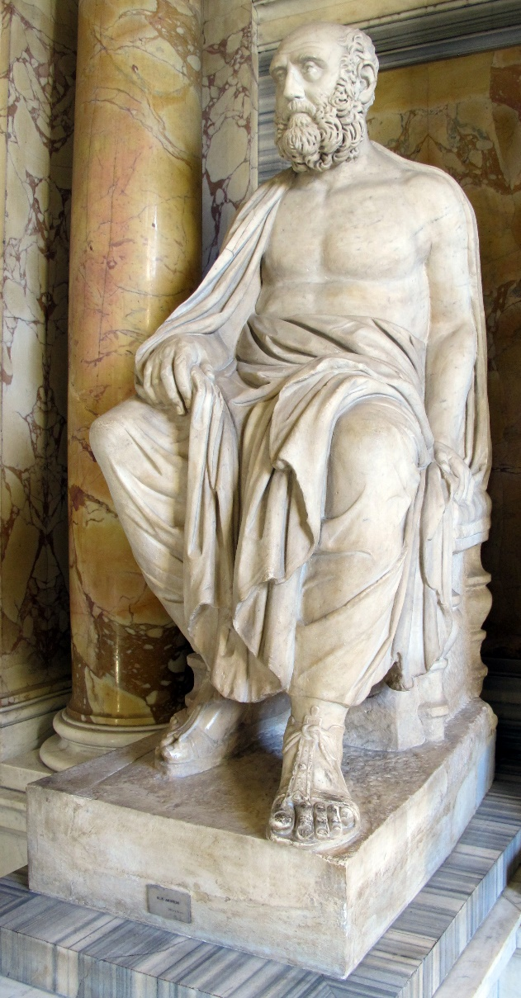
Aelius Aristides and Asclepius
Asclepius visits a patient in a dream (Epidaurus, 4th cent BCE)
Aelius Aristides, sophist (116–after 181 CE)

Slide 21
Writing a Speech 1
[While composing a speech honoring Asclepius], I had a dream…. I thought that I was giving an oratorical display and spoke among certain people, and in the midst of the speech with which I contended (ēgonizomēn, cf. agōn), I called on the god in this way: “Lord Asclepius, if in fact I excel in oratory and excel much, grant me health and cause the envious (baskanois) to burst.” (Aelius Aristides Sacred Tales 4.68–69 Behr. 171/1 CE)

Slide 22
Writing a Speech 2
I happened to have seen these things in the dream, and when it was day, I took up some book and read it. In it I found what I had said. In wonder, I said to Zosimus, “Behold, what I dreamed that I said, I find written in the book.” Thus even these new things have been added to the old. Whether we have understood the god’s intent, he himself would know best. (Aelius Aristides Sacred Tales 4.68–69 Behr. 171/1 CE)

