Slide 1
Sub-elite paideia Mesomedes and Alciphron

Slide 2
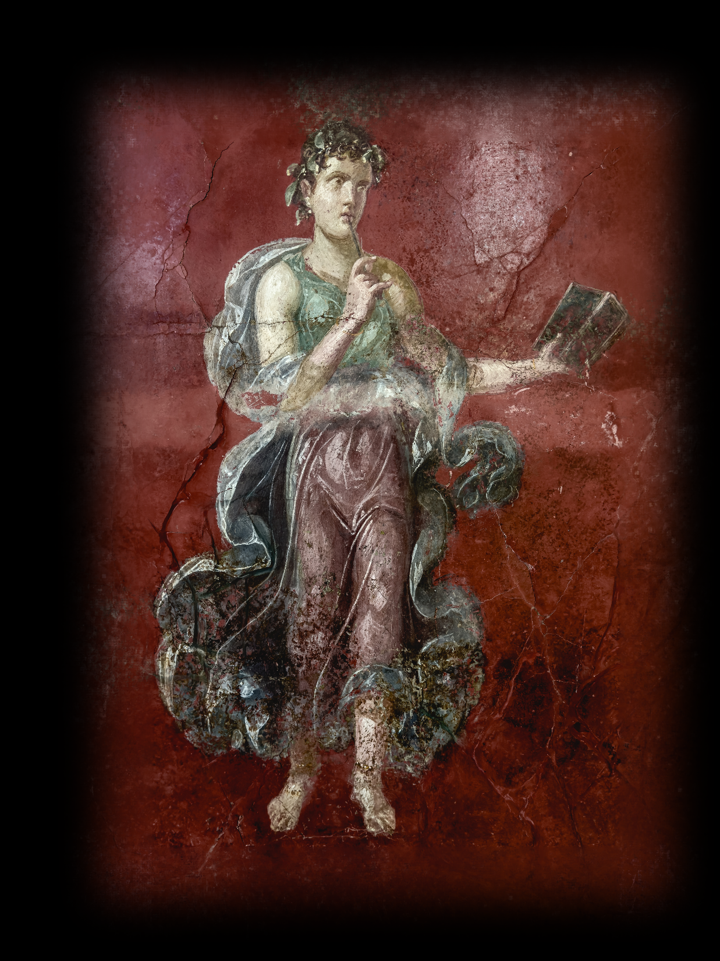
Mesomedes Hymn to the Muse (poem[s] 1)
Sing, Muse dear to me, be the leader of my song; may the breeze from your groves
stir my thoughts.
Wise Calliope, leader of the pleasant Muses, and wise mystery-giver, offspring of Leto, Delian Paean, stand both of you by me in kindness. (trans. Whitmarsh, from Borg Paideia)
Calliope, Muse of Poetry, Villa Moregine, 54–68 CE
Notes:
So, we’re going to listen to the poem, and then share our impressions. Remember, this is poetry; this is not, then, going to be, strictly speaking, an exercise in CT
let’s first read this aloud. then we’ll listen – you write down your impressions.
then we’ll share.

Slide 3
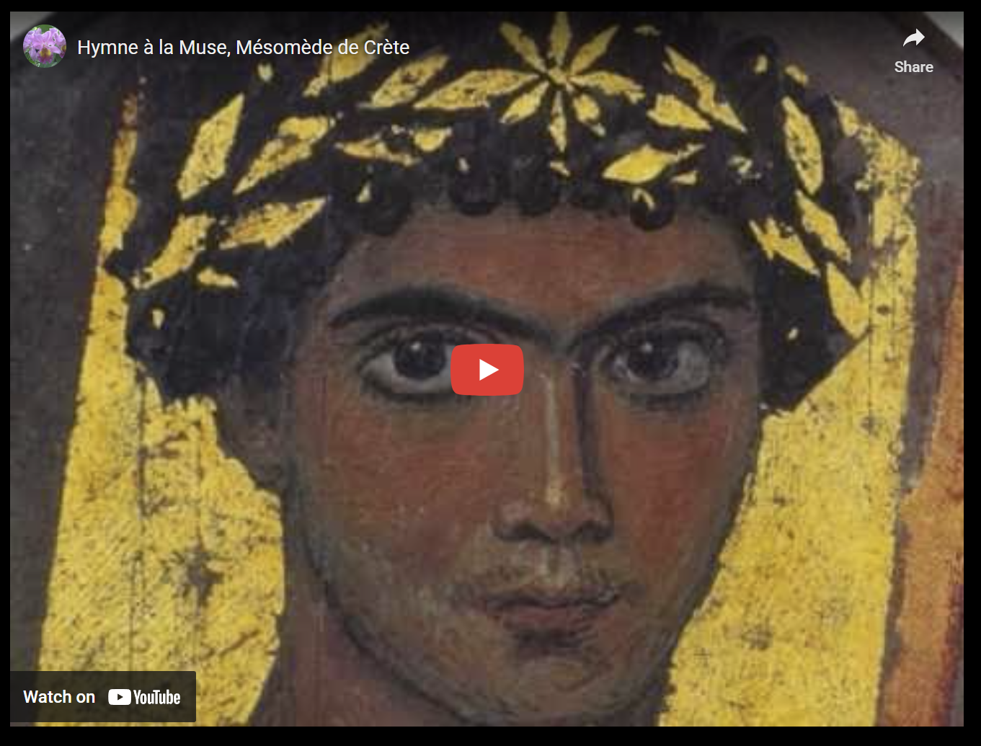
Mesomedes Hymn to the Muse (poem[s] 1). YouTube, Atrium Musicae de Madrid

Slide 4
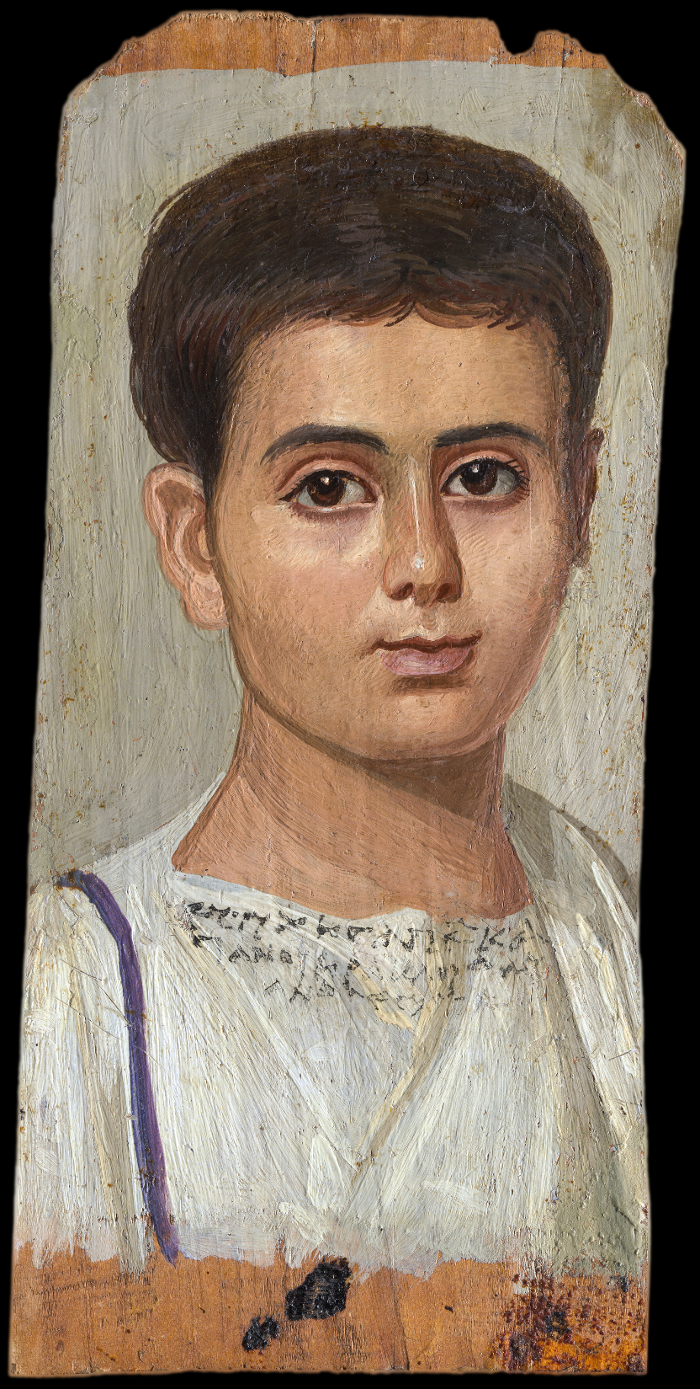
Mesomedes Hymn to the Muse (poem[s] 1), cont’d
Sing, Muse dear to me, be the leader of my song; may the breeze from your groves
stir my thoughts.
Wise Calliope, leader of the pleasant Muses, and wise mystery-giver, offspring of Leto, Delian Paean, stand both of you by me in kindness. (trans. Whitmarsh, from Borg Paideia)
Eutyches (mummy portrait) Worp, Bagnall on inscription
Notes:
(1) εἰς Μοῦσαν Ἄειδε μοῦσά μοι φίλη, (1) μολπῆς δ’ ἐμῆς κατάρχου, αὔρη δὲ σῶν ἀπ’ ἀλσέων ἐμὰς φρένας δονείτω.
Καλλιόπεια σοφά, (4) μουσῶν προκαθαγέτι τερπνῶν, (5) καὶ σοφὲ μυστοδότα, Λατοῦς γόνε, Δήλιε Παιάν, εὐμενεῖς πάρεστέ μοι.
Eutyches portrait (100-150 CE), from MET blurb:
“The boy's name ("Eutyches, freedman of Kasanios") seems indisputable; then follows either "son of Herakleides Evandros" or "Herakleides, son of Evandros." It is also unclear whether the "I signed" at the end of the inscription refers to the painter of the portrait or to the manumission (act of freeing a slave) that would have been witnessed by Herakleides or Evandros. An artist's signature would be unique in mummy portraits.”
“Paintings of this type, often called Faiyum portraits (though not all of them come from the Faiyum oasis), are typical products of the multicultural, multiethnic society of Roman Egypt. Most of them are painted in the elaborate encaustic technique, in which pigments were mixed with hot or cold beeswax and other ingredients, such as egg, resin, and linseed oil.”
εὐτύχης ἀπελ(εύθερος) κα- σιανοῦ ἡρακλείδ( ) εὐ- ανδ(ρο ) σεσημ(είωμαι)

Slide 5
Agenda
Discussion
Sub-elite paideia
Mesomedes
Patron, Client, paideia
Alciphron Letters
(Dys)functional, subelite competition

Slide 6
Discussion
Sub-elite paideia

Slide 7
SWA Prompt
How might these readings change/modify your view of the second sophistic? How is dramatizing members of the sub-elite (Alciphron's letter writers) as in possession of paideia absurd — or is it absurd? And what does it mean that a real-life member of the sub-elite (Mesomedes) plays much the same paideia game as a Polemon or Herodes Atticus?

Slide 8
Mesomedes
Patron, Client, paideia

Slide 9
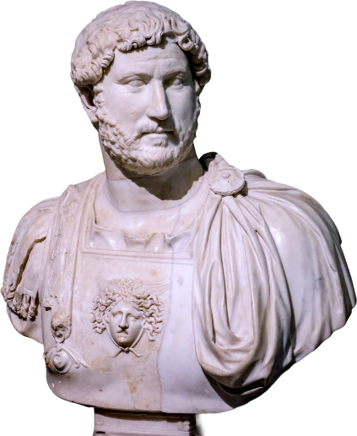
Mesomedes of Crete
Active 144 CE
Slave (servus/doulos) of
Hadrian (“master” = dominus/despotēs)
Freedman (libertus, apeleutheros). Thus…
cliens/pelatēs of
current patron (patronus/prostatēs) Hadrian
Hadrian, r. 117–138

Slide 10
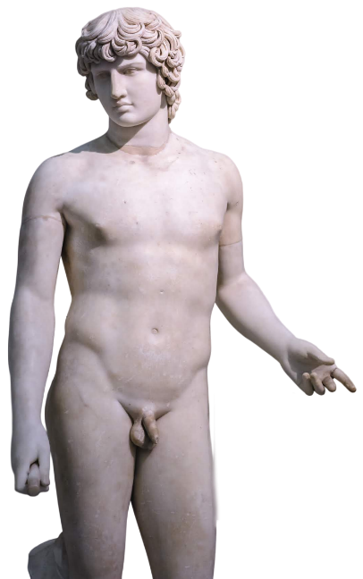
An Emperor and His Favorite
“Mesomedes, Cretan, lyric poet. Born during the reign of Hadrian, his freedman and a member of his circle of favorites (?). And so he composed an In Praise of Antinous.” (Suda)
Hadrian, r. 117–138
Antinous (ca. 111-130)

Slide 11
Mesomedes Hymn to the Muse
Sing, Muse dear to me, be the leader of my song; may the breeze from your groves stir my thoughts.
Wise Calliope, leader of the pleasant Muses, and wise mystery-giver, offspring of Leto, Delian Paean, stand both of you by me in kindness. (poem 1, trans. Whitmarsh)

Slide 12
Mesomedes To a Gnat
A gnat paused on an elephant’s ear, beating his wing that was no wing. His words were foolish: ‘I am flying away, for you are unable to bear my weight’. The other said, with a happy laugh, ‘I did not realise when you flew in, nor shall I realise when you fly away, gnat.’ (poem 8, trans. Whitmarsh)
Notes:
someone be Hadrian here. the other be mesomedes reading the poem to Hadrian. the rest of you be dinner guests listening to thepoem being read to Hadrian.
(11) εἰς κώνωπα
Ἐλέφαντος ἐπ’ οὔατι κώνωψ (1)
πτερὸν οὐ πτερὸν ἵστατο σείων,
φάτο δ’ ἄφρονα μῦθον· ἀφίπταμαι,
βάρος οὐ γὰρ ἐμὸν δύνασαι φέρειν.
ὃ δ’ ἔλεξε γέλωτος ὑφ’ ἁδονᾷ· (5)
ἀλλ’ οὔτ’ ἐδάην ὅτ’ ἐφιπτάθης
οὔθ’ ἡνίκ’ ἀφίπτασαι, κώνωψ.

Slide 13
Alciphron Letters
(Dys)functional, subelite competition

Slide 14
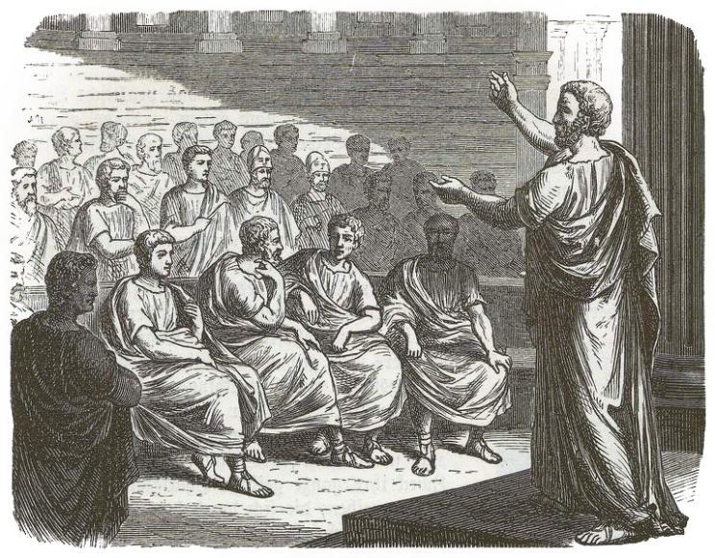
Alciphron and His Collection
Rhetorician
Ca. 200 ce?
Letters of
Fishermen
Farmers
Parasites
Professional spongers
Courtesans
Women sex workers
Notes:
About our author not much is known. We are told that he was a rhētōr, a teacher-practitioner of rhetoric, and one who cultivated the use of Attic Greek dialect. Those data, along with evidence internal to the letters that are his sole surviving work, tend to date the latter to about 200 ce or later, and to align our author with others likewise given to nostalgic classicizing; it’s a period we call the second sophistic.
As for the collection itself, it is divided into books organized by letter writers: fishermen, farmers, parasites (professional spongers), and women sex workers. Something that stands out about Alciphron’s collection is the fact that it, though prone to learned allusion and literary exhibitionism, nevertheless evinces considerable empathy for the trials and tribulations of its often struggling characters.

Slide 15
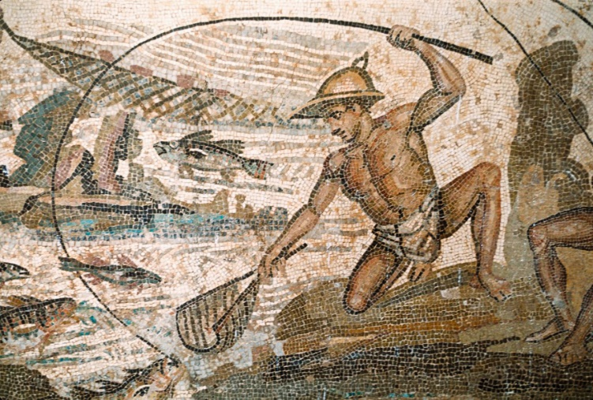
A Net and Two Fishermen
“I asked, when I saw on the beach at Sunium an old and badly worn fishing-net, whose it was and how it came to be lying there…. (1.17)
Detail, Mosaic, ca. 200 ce. Lepcis Magna, Libya
Notes:
I start with a tale of two fishermen. Once upon a time, one of them lost a net, which the other finds years later, rotting on a beach. Seeking to take possession, the net’s finder makes his case in a letter to the owner.

Slide 16
A Net and Two Fishermen (cont’d)
“And do you, since that which you have consigned to utter destruction is in no sense being taken away from you, be prompt to make a gift of it.” (1.17)
Detail, Mosaic, ca. 200 ce. Lepcis Magna, Libya

Slide 17
A Net and Two Fishermen (cont’d, 2)
“Ill-natured and envious is the eye of your neighbour, says the proverb. ... Restrain your hands, or rather your insatiate desires, and don’t let the itching for other people’s property drive you to request unfair favours” (1.18)
Detail, Mosaic, ca. 200 ce. Lepcis Magna, Libya
Notes:
How does the owner respond? With bile and vitriol. Thus the finder, driven by envy’s evil eye, by a “hunger for other people’s stuff,” by “insatiable lust,” asks for “unjust favors,” or so the owner claims — why? Why all this combative talk about envy and lust, and for what, a rotting net? What has the finder done to trigger this outburst?

Slide 18
A Net and Two Fishermen (cont’d, 3)
“I did not ask you for what you own, but for what you do not own. And since you are not willing that another should own what you do not own, keep what you do not own.” (1.19)
Detail, Mosaic, ca. 200 ce. Lepcis Magna, Libya
Notes:
How does the owner respond? With bile and vitriol. Thus the finder, driven by envy’s evil eye, by a “hunger for other people’s stuff,” by “insatiable lust,” asks for “unjust favors,” or so the owner claims — why? Why all this combative talk about envy and lust, and for what, a rotting net? What has the finder done to trigger this outburst?

Slide 19
A Widow’s Plight (2.35)
“I had plaited a harvest-wreath of flowers and was on my way to lay it on the cairn of Phaedrias…. Then all of a sudden there rose up before me a troop of high-spirited young fellows, … confederates of Moschion…. I didn’t know that, in refusing him, I was to bring upon myself a forced bridal…. So I have a husband won of outrage (hubris), against my will indeed, but yet I have him.”

Slide 20
Professional Rivalry (4.7)
A boy
Euthydemus
A courtesan
Thais
A sophist
[name?]
“Do you think a sophist is any better than a courtesan? So far, possibly, as the means by which they seek to persuade are different; but one end — gain — is the object of both.”
Notes:
“Ever since you took it into your head to study philosophy you have put on airs and have raised your eyebrows above your temples.”
“But since he is apparently turning you away from your intimacy with me, I’ll let him come; and, if you like, I’ll show you that your woman-hating schoolmaster is not content with the usual pleasures of a night. It’s stuff and nonsense and money-making off boys, that’s what it is, you ninny.”
“We do not say there are no gods; on the contrary, when our lovers take oath to their affection for us, we believe them; and we don’t approve of men’s having intercourse with their sisters or their mothers—or even with other men’s wives.”
“We teach young men just as well as they do.”

