Slide 1
Praise and Blame?
Encomium and Figured Rhetoric

Slide 2
How to speak truth to power? How to make it work?

Slide 3

Speak Truth to Power: Public Service Announcements 2 (YouTube)

Slide 4
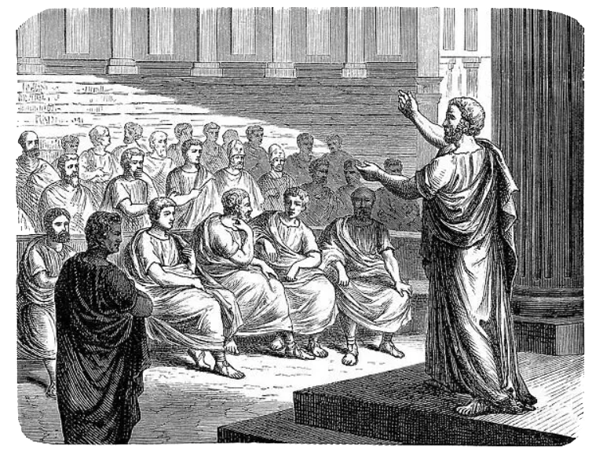
Agenda
The Writers’ Room
  Figured Rhetoric in Action
Encomium
  The Rhetoric of Praise
Take a Hint
  The Art of Figured Rhetoric

Slide 5
The Writers’ Room
Figured Rhetoric in Action

Slide 6
Classroom Exercise
Using your SWAs, work with your group to deploy praise as a vehicle for stealthy criticism of Lucian’s tyrant killer. For instance,
Suppose the tyrant killer is now the tyrant
How do you speak your truth to their power and get away with it?
Notes:
Use praise as a delivery system for stealthy criticism of Lucian’s tyrant killer.

Slide 7
Encomium
The Rhetoric of Praise

Slide 8
Aristotle on Rhetorical Genre
time | issue (topic) | audience | genre
past | guilt/innocence | judge | judicial
future | expedience/ inexpedience | judge | political
present | speaker’s ability (praise/blame) | spectator | epideictic (display)
Which genre is declamation?
Notes:
Menander Rhetor 1.2. “Epideictic speeches, then, have two aspects: blame and praise. For we consider the demonstrations (epideixeis) of public speeches composed by men called sophists to be an exercise (meletē) for real cases, not an actual epideictic speech (epideixis).” (yet sophists would regularly call any speech performance an epideixis)

Slide 9
Menander Rhetor on Epideictic 1
Two aspects: blame and praise. (pp. 21–23)
“The speech can acquire sweetness if we relate examples that get our point across.” (p. 197)
Simple style and argument (pp. 199–201)
Notes:
“Epideictic speeches, then, have two aspects: blame and praise.” (pp. 21–23)
“The speech can acquire sweetness if we relate examples that get our point across, while selecting the most pleasant stories for the listeners to learn.” (p. 197)
“Herodotus’ Histories are also full of sweet narratives, which add every kind of pleasure to the writing, not only because of the novel storytelling, but also because of the particular type of exposition — style we can employ that is neither rough nor full of periods and logical arguments (enthymēmata)5 but rather plainer and simpler….” (pp. 199–201)

Slide 10
… on Epideictic 2
Two aspects: blame and praise. (pp. 21–23)
Praise of emperors (p. 139)
  “… you must base your composition on qualities acknowledged to be good”
  “In it you should obviously derive your introduction … by noting how difficult it is to undertake and by claiming that you are engaged in a contest (agōn) by no means easy to win”
Notes:
“Epideictic speeches, then, have two aspects: blame and praise.” (pp. 21–23)

Slide 11
… on laliai (“talks”) 1
“The genre of the talk (lalia) is especially useful…. It naturally falls under two branches of rhetoric, the deliberative and the epideictic.” (p. 195)
Notes:
“The speech can acquire sweetness if we relate examples that get our point across, while selecting the most pleasant stories for the listeners to learn.” (p. 197)
“Herodotus’ Histories are also full of sweet narratives, which add every kind of pleasure to the writing, not only because of the novel storytelling, but also because of the particular type of exposition — style we can employ that is neither rough nor full of periods and logical arguments (enthymēmata)5 but rather plainer and simpler….” (pp. 199–201)

Slide 12
… on laliai (“talks”) 2
Dreams, mythical framing, etc. (pp. 199–201)
Criticism and censure
  Targeting anonymous persons (pp. 201–203)
Buttering up the audience (captatio benevolentiae)
  “… express your own pleasure … when you accept [your audience] as discerning listeners….” (p. 201)

Slide 13
… on laliai (“talks”) 3
“As a general rule, … we can say everything we wish to express without adhering to any systematic order, but as it occurs to us. Nonetheless, one must aim for the right moment to make each point and understand what is advantageous to put first and what second.” (p. 205)

Slide 14
Pseudo-Dionysius on Addresses
Affability (“greeting those whom you meet”)
  “by such means we may make [persons in authority] more friendly to us” (p. 407, cf. captatio benevolentiae)
Praise topics
  Birth, nature, upbringing
“… cite exemplary figures … showing that [the honoree] surpasses them (p. 411)

Slide 15
Take a Hint
The Art of Figured Rhetoric

Slide 16
Etymological Note
to eskhēmatismenon
  “the figured thing”
skhēma
  “figure,” “pose”

Slide 17
Apsines on Figured Rhetoric (3rd CE)
“Some figured themes operate by arguing the opposite of the intended message (misdirection, reverse psychology); some, by being oblique (indirectness); and some, through innuendo (hinting, verbal subliminal suggestion).”

Slide 18
Demetrius on Figured Rhetoric 1
“… in addressing a tyrant or any other violent individual, if we wish to be censorious, we often need to be oblique” (p. 511)
“… if we are advising [the powerful] against a fault, … we will either blame others who have acted in a similar way, … or we will praise people who have acted in the opposite way” (p. 513)

Slide 19
Demetrius on Figured Rhetoric 2
Flattery is shameful, open criticism is dangerous, and the best course lies in the middle, namely innuendo (to eskhēmatismenon, “the figured thing,” p. 515)

